Slide 1

VCS
Andrea Salicetti

Slide 2
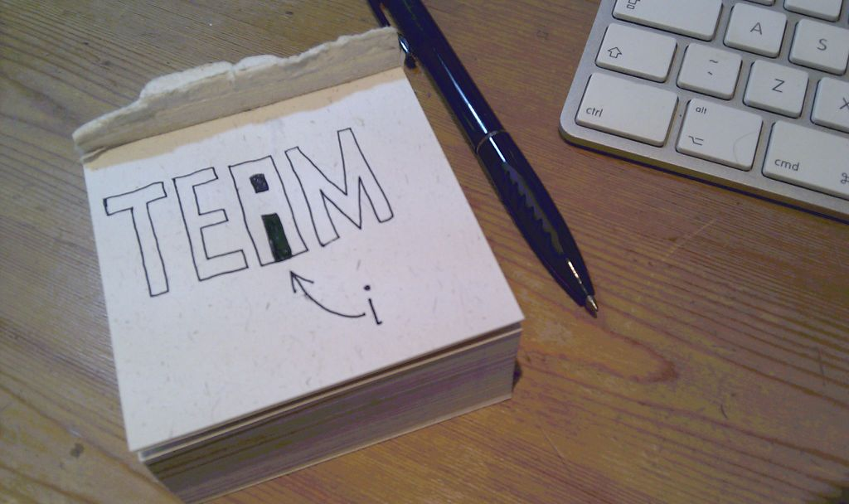
Today we'll talk about...

Slide 3
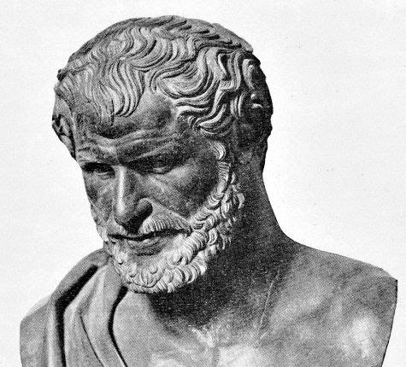
Ἡράκλειτος
“The only constant
is change”
Eraclito from Epheso, philosopher – 535 b.C. - 475 a.C.
VCS manage changes

Slide 4

How?
They allow teams to collaborate
Who cares?
I work alone!
(with my code)

Slide 5
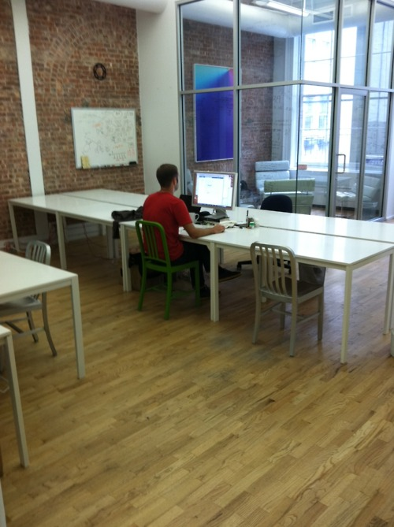


Slide 6
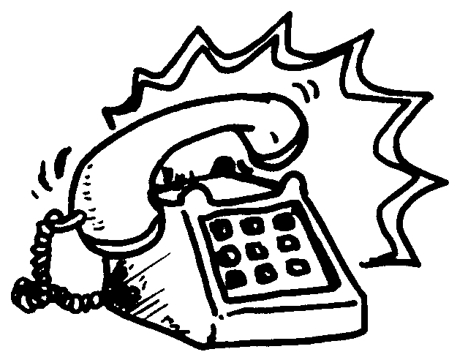
Case study “lonley developer”
“Lonley Dev already released version 1.0 of his “great App”, that now is in production.
He's working on the code of the next version (2.0) since a couple of weeks.
Lonley Dev is very happy, since he removed a lot of duplications from his code and – even if currently “Great App” doesn't work at all due to the refactoring of some parts – he plans to release the next greatest and stable version (2.0) within a couple of weeks.
Suddenly the phone rings... “

Slide 7
Case study “lonley developer”
“Hello?“
“Hi there, Here's Customer.
We hav found a critical bug on 1.0!“
WTF !
Developer
... sorry?
Nope ...
What's that?
Customer
Well, ... blah,
blah, blah,...
5 minutes later
OMG ...
... blah, blah, blah,
... really serious ... blah, blah ...
... I see... I can fix it for the next rel.
U will have it within 2 weeks, ok?
R U kidding? We need it NOW!
Of course ...
FUCK!
Have a nice day!

Slide 9
Case study “lonley developer”
Solutions
Experienced LD
He has a copy of 1.0
Noobie LD
Loose face
“Wait for 2.0”
Loose work
... but twice effort
to fix also in 2.0

Slide 10


Slide 11
How?
VCS allow teams to collaborate
( yes LD dude, even you with your brain...)
VCS manage change and allow for inspection
by tracking ownership
by tracking evolution of changes
by allowing for branching
by allowing for continuous integration

Slide 12
VCS Taxonomy
VCS
Local
Centralized
Distributed
SCCS
RCS
CVS
SVN
Git
Mercurial

Slide 13


Local VCS
Who cares?
Come on...
...neither you still use them!
Let’s draw a veil

Slide 14

VCS Taxonomy
VCS
Local
Centralized
Centralized
Distributed
SCCS
RCS
CVS
SVN
Git
Mercurial

Slide 15
Centralized VCS
Repository
Client / Server
commit
commit
commit
checkout
checkout
checkout
Ann
Developer's
local copy
Ben
Developer's
local copy
Your
local copy

Slide 16
Centralized VCS
Single server with revision information
Clients checkout a working copy locally
Most operations happen on the server
Linear revision history

Slide 17
Centralized VCS
Repository
Repository:
Keeps versions histories.
Holds official version of resources
Differences between versions as delta

Slide 18
checkout & commit
TIME
Repository
Workspace
Workspace
index.html (ver 1.2)
page1.html (ver 1.32)
style.css (ver 1.4)
checkout
*index.html (ver 1.2 - modified)
page1.html (ver 1.32)
*style.css (ver 1.4 – modified)
*page2.html(new)
index.html (ver 1.2)
page1.html (ver 1.32)
style.css (ver 1.4)
Repository
commit
index.html (ver 1.3)
page1.html (ver 1.32)
style.css (ver 1.5)
page2.html (ver 1.1)

Slide 19
checkout & commit
checkout: with this command, one can summon files or sets of files from the repository based on date, tag, branch, or any of a number of other criteria.
commit: with this command, one can summon files or sets of files from the repository based on date, tag, branch, or any of a number of other criteria.
update: will automatically bring your workspace up-to-date with the latest (or however you specify) files from the
repository, automatically merging non-exclusive
changes between files and initiating conflict resolution if necessary. Updates involving conflicts solicit information from the user how they wish to have a conflict resolve.

Slide 20
update
Workspace
TIME
index.html (ver 1.2)
page1.html (ver 1.32)
*style.css (ver 1.14 – modified)
*page2.html(ver 1.1 – modified)
*page3.html(new)
Repository
index.html (ver 1.4)
page1.html (ver 1.32)
style.css (ver 1.15)
page2.html (ver 1.2)
image.png (ver 1.3)
Workspace
update
index.html (ver 1.4 – updated)
page1.html (ver 1.32)
*style.css (ver 1.14 – conflict)
*page2.html(ver 1.2 – updated
& still modified)
*page3.html(new)
image.png (ver 1.1– updated)
Changed in the meanwhile
by other developers...

Slide 21
DEMO

Slide 22
VCS Taxonomy
VCS
Local
Centralized
Distributed
Distributed
SCCS
RCS
CVS
SVN
Git
Mercurial

Slide 23
Distributed VCS
commit
Ben
Developer's
node
Peer-to-Peer
push / pull
pull / push
push / pull
pull / push
commit
commit
Ann
Developer's
node
Your
node
push / pull
pull / push

Slide 24
Distributed VCS
Every client has a copy of the full repository locally
All repository operations are local (except sharing)
Intelligent network operations when sharing content
A very non linear revision history
Large online communities to share changes

Slide 25

Distributed VCS
Branch party!
Merge = weaving together two (or more) local branches into one.
Creating and destroying branches are simple operations so it's easy to experimen with new ideas.
Very easy to isolate changes.
Unlike CVCS, you don't have to specify anything about where you're merging from and to; the trees automatically know what their split point was in the past.

Slide 26
DVCS vs CVCS
Collaboration
  Developers can easily collaborate directly without needing a central authority or dealing with server administration costs

Slide 27
DVCS vs CVCS
Off-line operations
  Developers can still be productive and not worry about a central server going down...
  (remember the days of complaining that
  CVS was down and you couldn't work?)

Slide 28
Let's stop ...
... we won't use
Git by now ...
;__;

Slide 29
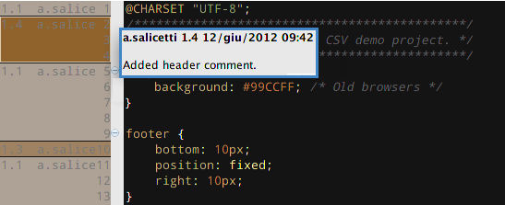
IDE Facilities
File annotations
Allows you to see who changed what when, line by line.
Useful for tracking bugs and responsability.
Can be used in combination with diff and history for even more info.

Slide 30
DEMO

Slide 31
Conclusion
VCS
- The future of version control.
- Lesson learned at Eclipse & Linux
- Version controller enables nice
code review workflow.
Local
Centralized
Distributed
SCCS
RCS
CVS
SVN
Git
Mercurial

Slide 32
Thanks!
(now you can wake up...)

