Slide 1
SVN BASIC TUTORIAL
Avoiding headaches ™
Notes:
04.09.2013

Slide 2
Direct deploy
Developer 1
Staging
Live
Developer 2
Staging
Live
Designer 1
Staging
Live
Designer 2
Staging
Live
Notes:
04.09.2013

Slide 3
Removal of direct deploy
Developer 1
Staging
Live
Developer 2
Staging
Live
Designer 1
Staging
Live
Designer 2
Staging
Live
Notes:
04.09.2013

Slide 4
Why not to directly deploy
Can’t check the status of the environment
Race conditions (DEV1 and DEV2 work on a same file => collisions)
Can’t easily update the environment (full replace of the entire working copy needed)
Notes:
04.09.2013

Slide 5
SVN
Subversion (SVN) is a SCM (Software Configuration Management) implementation
It allows to track changes in files and directories
It allows concurrent development on the same files
It is centralized (one server)
Notes:
04.09.2013

Slide 6
SVN Interaction
Designer 2
Designer 1
Staging Server
Developer 2
Issue Tracker
SVN Server
Developer 1
Production Server
Notes:
04.09.2013

Slide 7
SVN development cycle
Get last project status from SVN server
Send work to SVN server
Develop/Design
Test
Notes:
04.09.2013

Slide 8
SVN development (in SVN terms)
svn update
svn commit
edit files
Test
Notes:
04.09.2013

Slide 9
How it works
Will make some examples with TortoiseSVN and the command line to explain SVN
Notes:
04.09.2013

Slide 10
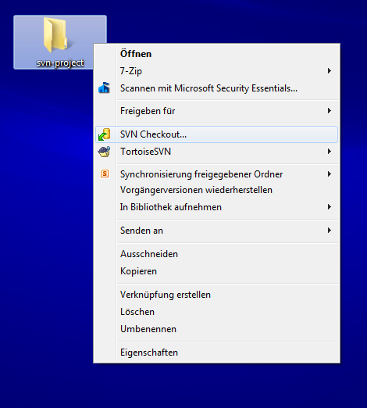
Fetching an existing project
Notes:
04.09.2013

Slide 11
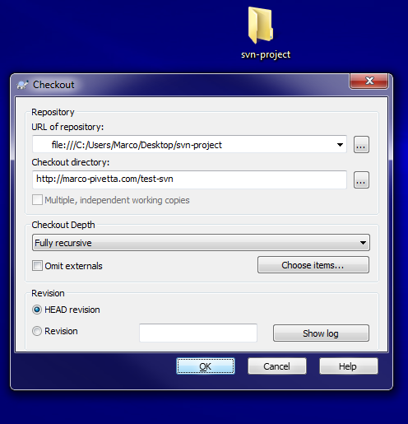
Fetching an existing project
Notes:
04.09.2013

Slide 12
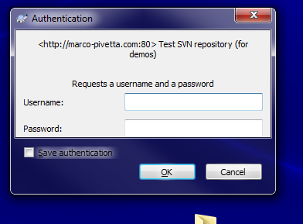
Fetching an existing project
Notes:
04.09.2013

Slide 13
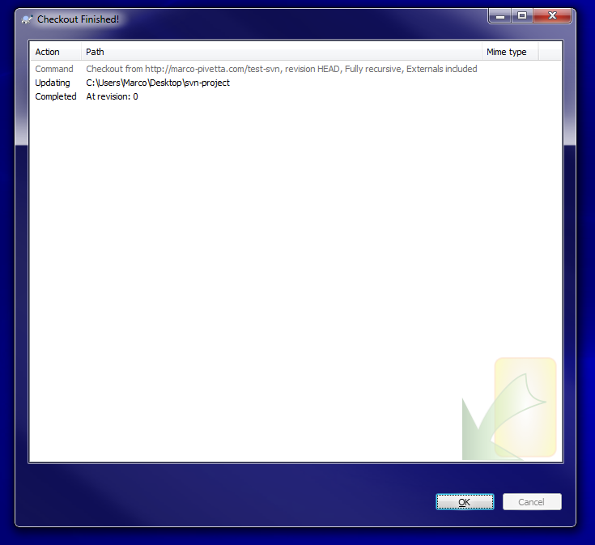
Fetching an existing project
Notes:
04.09.2013

Slide 14
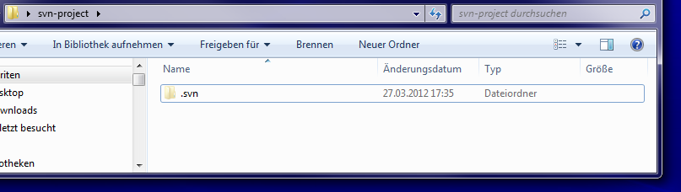
Fetching an existing project
The «.svn» directory is used by subversion to keep track of changes in the current directory tree.
Do not change it, copy it somewhere else or delete it!
Notes:
04.09.2013

Slide 15
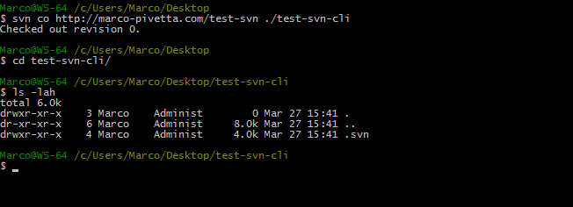
Fetching an existing project
Notes:
04.09.2013

Slide 16
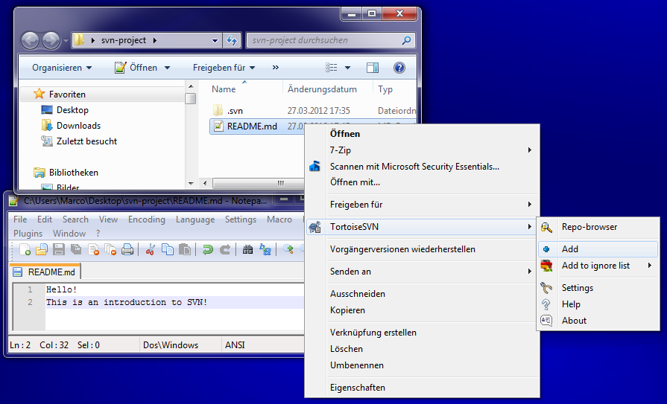
Adding some files to the project
Notes:
04.09.2013

Slide 17
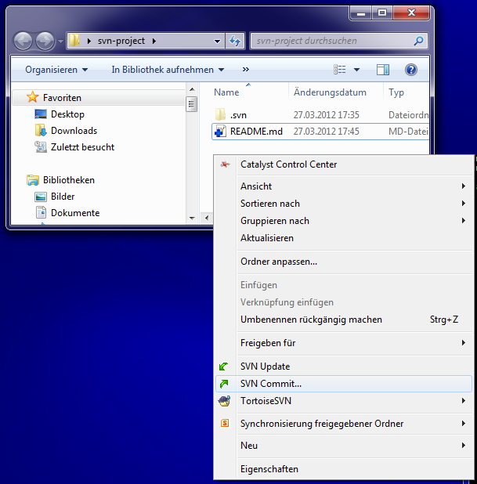
Adding some files to the project
Notes:
04.09.2013

Slide 18
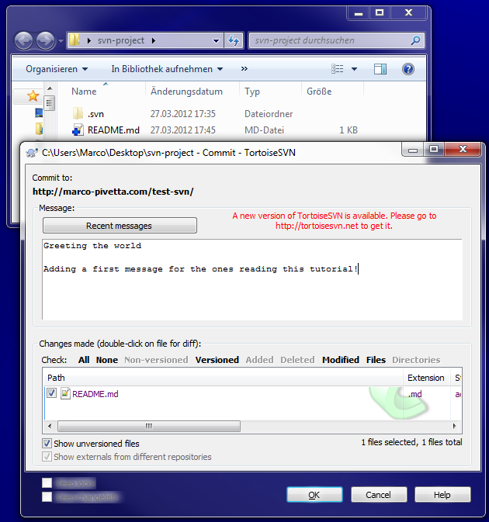
Adding some files to the project
Notes:
04.09.2013

Slide 19
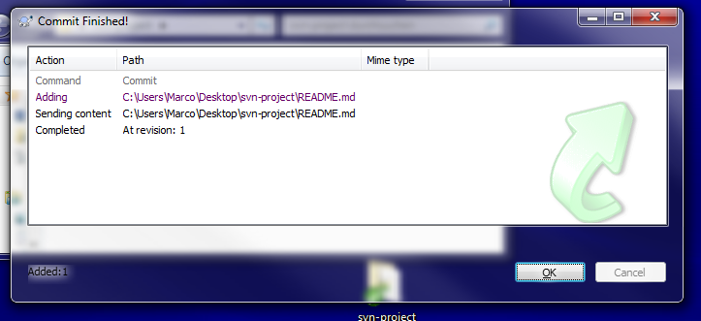
Adding some files to the project
Notes:
04.09.2013

Slide 20
Adding some files to the project
Notes:
04.09.2013

Slide 21
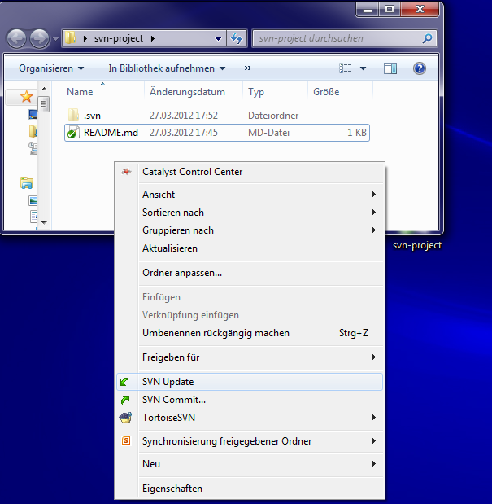
Updating working copy
Notes:
04.09.2013

Slide 22
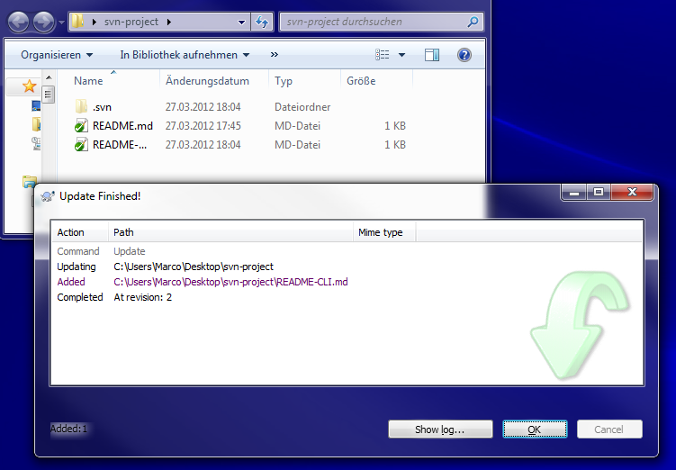
Updating working copy
Notes:
04.09.2013

Slide 23
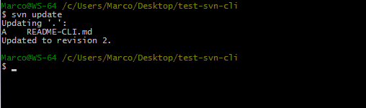
Updating working copy
Notes:
04.09.2013

Slide 24
Deploy with SVN
When having SSH access to a server, deploying and updating becomes as easy as:
$ ssh user@server.com
$ cd path/to/project
$ svn update
(Or "svn co" if the project is not yet deployed)
Notes:
04.09.2013

Slide 25
Merging and conflicts
In the following schema, two developers try to commit changes to a same file:
Developer 1
  echo ‘hello to’;
  echo $username;
Developer 2
  echo ‘hello world ’;
  echo $_GET[‘username’];
RED = changed by developer
Notes:
04.09.2013

Slide 26
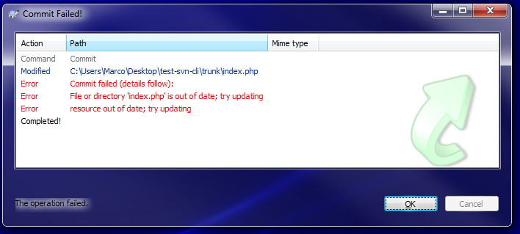
How merging works
When Developer 2 tries to commit, SVN will tell him that his copy is outdated, he will have to update it
Notes:
04.09.2013

Slide 27
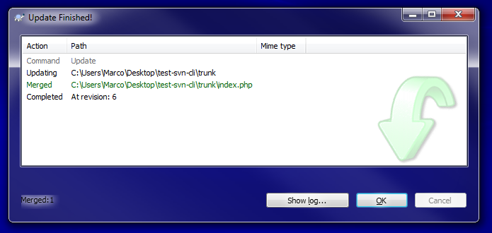
How merging works

Slide 28

How merging works
Merging won’t cause any changes on the server, you will first get all the changes locally, so that you can review them. Here’s the result of this merge case:
We can then
$ svn commit -m "Merged changes of marco’s commit"
Notes:
04.09.2013

Slide 29
Merging workflow
svn commit
Developer verifies merge
Can’t commit (outdated working copy)
svn tries to merge
svn update
Notes:
04.09.2013

Slide 30
What if SVN can’t merge?
svn commit
SVN couldn’t merge
????????
Can’t commit (outdated working copy)
svn tries to merge
svn update
Notes:
04.09.2013

Slide 31
SVN Conflicts
SVN conflicts happen when two developers act on a same file in the same line:
Developer 1
  echo ‘hello everybody’;
  echo $_GET[‘username’];
Developer 2
  echo ‘goodbye everybody’;
  echo $_GET[‘username’];
RED = changed by developer
Notes:
04.09.2013

Slide 32
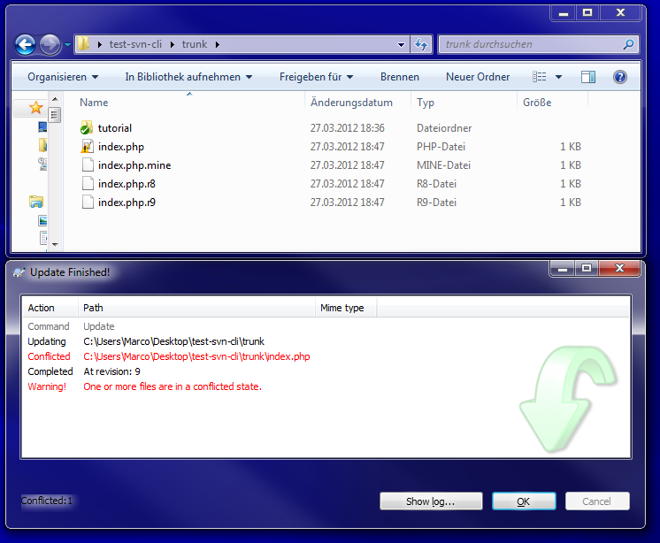
SVN Conflicts
Notes:
04.09.2013

Slide 33
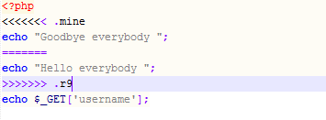
SVN Conflicts
index.php is a merged view of the conflict:
index.php.r8 is the version before the update
index.php.r9 is the version as in SVN server
index.php.mine is the version you had in your directory before committing
Notes:
04.09.2013

Slide 34
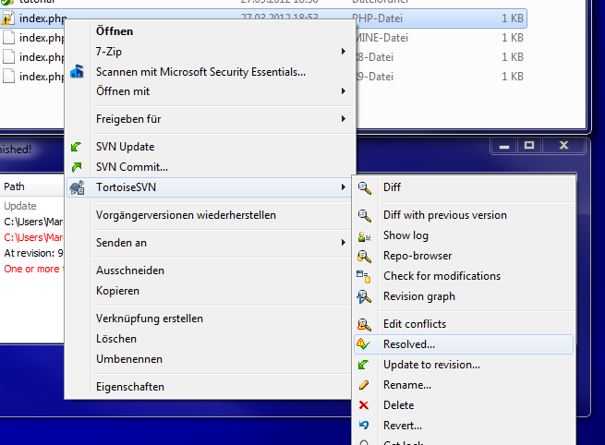
SVN Conflicts
We can edit the files until all conflicts are solved, then tell SVN it should accept our new working copy:
Notes:
04.09.2013

Slide 35
SVN Conflicts
svn commit
Mark conflicts as resolved
Can’t commit (outdated working copy)
Manually edit conflicts
svn update
SVN couldn’t merge
svn tries to merge
Notes:
04.09.2013

Slide 36

Parallel development
Notes:
04.09.2013

Slide 37
SVN branching
Main project
Next major version update
The main project and it’s features
Bugfix for a known bug
Keeps track of changes to be merged into the next major release of the software
New feature that has to be added
Work in progress to fix a known bug
Alternate version to show to the customer
A new feature that requires some work without being influenced by other bugfixes and changes
A slightly different version of the site that the customer has requested, but that isn’t ready yet, and could be discarded
Notes:
04.09.2013

Slide 38

This is actually how
git-flow by nvie.com handles development, but SVN could also use it!

Slide 39
What is a branch?
In SVN terms, a branch is just a copy of a current tree. Let’s create a branch to develop an alternate layout for the site:
  svn copy -m “creating green site dev branch”
  svn://path/to/repo/trunk
  svn://path/to/repo/branches/wide-layout
  (in TortoiseSVN it is under “branch/tag” in context menu)
Notes:
04.09.2013

Slide 40
Switching working copy
Given that you checked out:
  svn://project/path/trunk
You can now switch to a branch by doing
  svn switch svn://project/path/branches/red
and you will be working on that copy
Notes:
04.09.2013

Slide 41
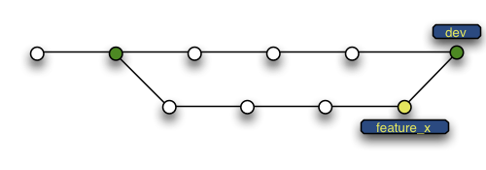
Merging branches
Once completed developing on a branch, you may want to merge changes back:
Notes:
04.09.2013

Slide 42
Merging branches
Like normal conflict merging!
Notes:
04.09.2013

Slide 43
First you switch to the branch you want changes to be merged to:
$ svn switch svn://path/to/target/branch

Slide 44
Then you merge a set of revision from the branch you developed on (here 25 to latest):
$ svn merge -r25:HEAD svn://path/to/merged/branch

Slide 45
Then SVN will merge any conflicts or set conflicted state and allow you to check what happened. After fixing conflicts:
$ svn ci -m “merging changes from new-layout branch”

Slide 46
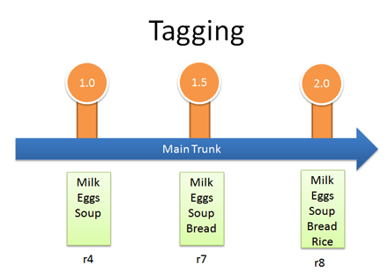
Tags
Tags are markers used for deployment, mainly for major release versions:
Notes:
04.09.2013

Slide 47
Tags
Tags are copies, exactly like branches:
  $ svn copy
  -m “tagging version 1.1 of the project”
  svn://path/to/project
  svn://path/to/tags/1.1
Except that you NEVER commit on tags!
Notes:
04.09.2013

Slide 48
svn:externals
Externals are “links” to other repositories:
$ svn propset svn:externals
“css/common svn://company/common/css/files”
./
Externals are not part of the repository, they are just fetched with the repository (useful for deploying applications!)
Notes:
04.09.2013

Slide 49
Best practices
Notes:
04.09.2013

Slide 50
Update your projects before working
Notes:
04.09.2013

Slide 51
Do not commit broken code/functionality!
(Test before committing if possible!)
Notes:
04.09.2013

Slide 52
Commit as soon as a piece of the functionality is completed
Notes:
04.09.2013

Slide 53
Branch life should not be too long
Long living branches increase merge conflicts!
This forces you to keep small units of work
Notes:
04.09.2013

Slide 54
Every commit should have a purpose. Commits with no purpose to be avoided!
If possible, avoid multiple commits on separate files being part of one functionality
Notes:
04.09.2013

Slide 55
Never commit generated code/data!
Generated code can produce dozens of useless commits, conflicts and generally, headaches!
Notes:
04.09.2013

Slide 56
EVERY
COMMIT
MUST
HAVE
DESCRIPTION
Notes:
04.09.2013

Slide 57
Examples of BAD commit messages:
“Fixed bug”
“Updated”
“Saved work”
“Updating”
“Merging changes”
“Saving work of 10/3/2010”
Notes:
04.09.2013

Slide 58
Examples of GOOD commit messages:
“Adding CSS definitions needed to create a lightbox overlay when focus is on the offers iframe”
“Fixed bug with session expiring after browser restart on IE7”
“Updated the logo with the new colors provided”
“Adding interfaces for the new blog feature
The interfaces are still quite lightweight, but should be refreshed in the next days”
(yes, multiline commits are allowed!)
Notes:
04.09.2013

Slide 59
If using an issue tracker (Jira, Trac, Bugzilla, Redmine, etc.), write the issue ID in the commit message:
«Fixed iframe width causing scrollbars to appear when not needed as of PRJ-123»

Slide 60
Optimal process
Notes:
04.09.2013

Slide 61
Update working copy
Build (test first)
If there’s errors, fix them first! (do not work on broken projects)
Develop
Test changes
Commit (with appropriate message)
Resolve conflicts immediately
Notes:
04.09.2013

Slide 62
Suggested Workflow

Slide 63
This is actually how
git-flow by nvie.com handles development, but SVN could also use it!

Slide 64
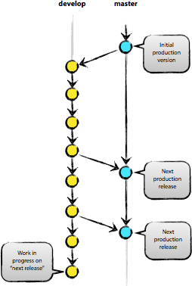

Slide 65

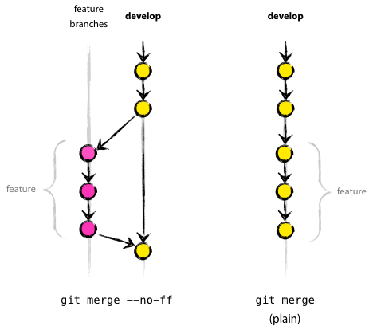

Slide 66
