Slide 1
IDE ECLIPSE SVN REPOSITORY

Slide 2
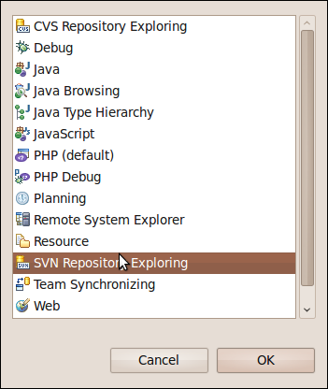
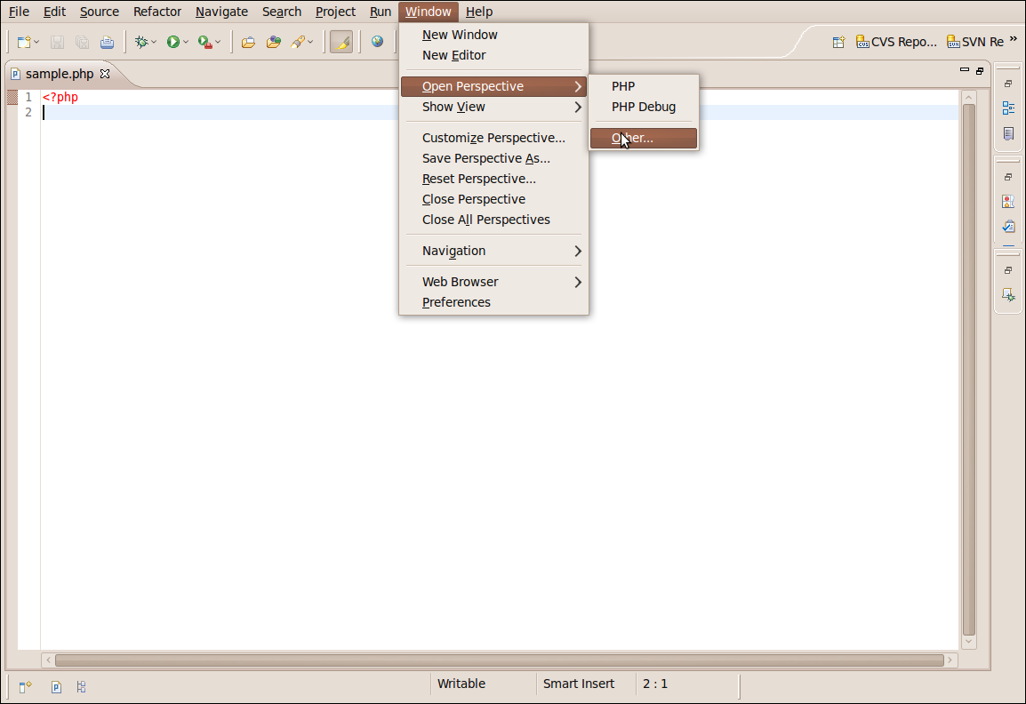
Intial step..
FIG 2
FIG 1

Slide 3
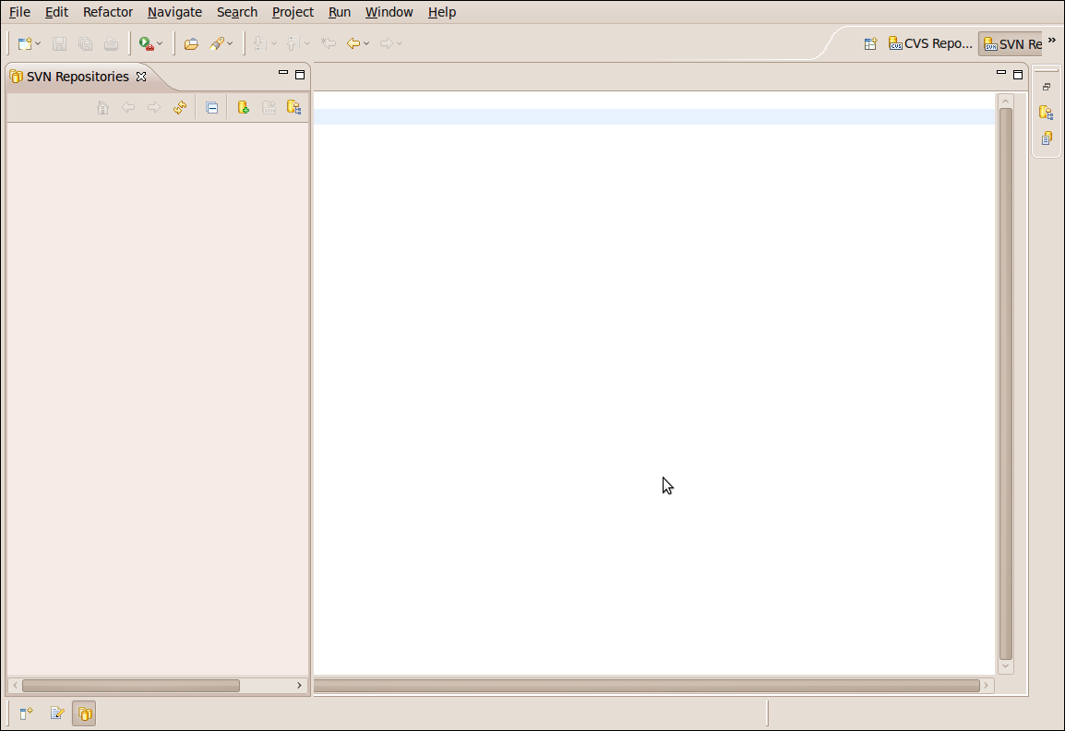
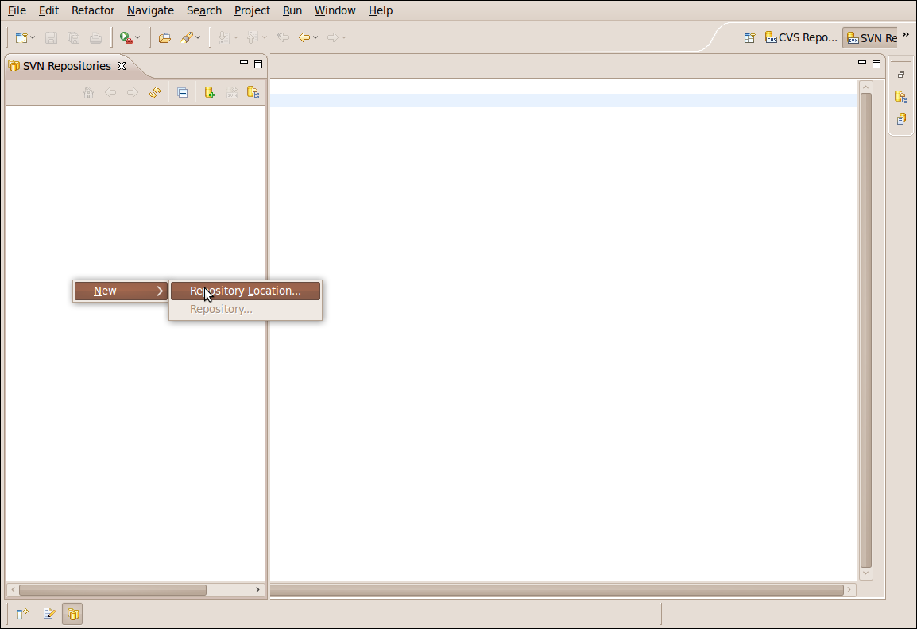
Step 1
Displays a empty svn repository workspace
Right click on the empty and select the following

Slide 4
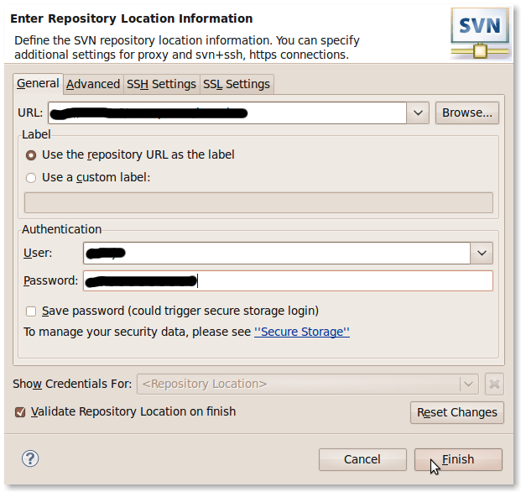
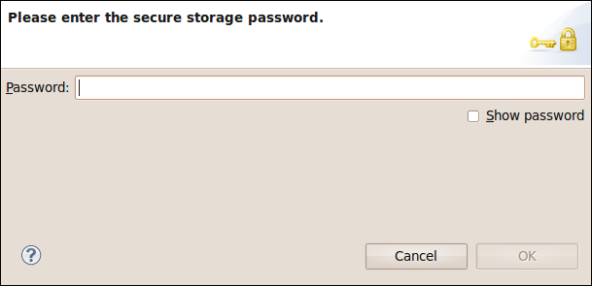
STEP 2
Fig 5.
Enter the url given by the admin
The user and password are entered here given by admin
Click cancel

Slide 5
In svn repository we can't edit any files or do any changes. We have to checkout the trunk source and send the source to the local computer. Here is the place we can add or delete anything. Then these changes are committed to the svn reprository.
The next step teaches how to chekout the source code.....

Slide 6
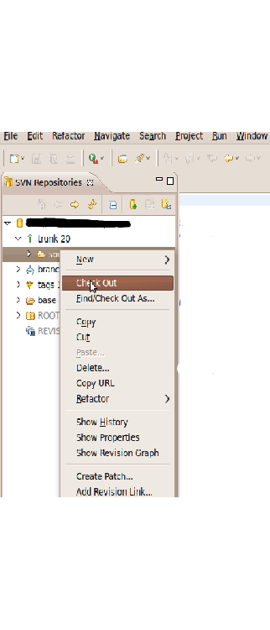
Step 4
Expand the svn url (in this case svn//xxx.xxx.xxx.xxx// example).
Expand the trunk and select the source given.
Right click on it and select Checkout as.
There two option checkout as and find/checkout as
Checkout will move the source from svn repository to local computer in which we can work with the same as given in the trunk.
Find/Checkout will do the same but we can specify a name to the project.

Slide 7
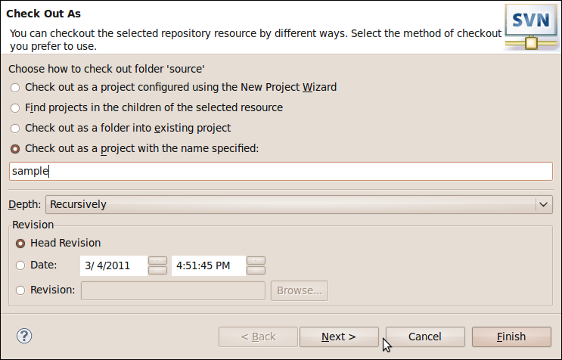
Step cont..
Click this
Type the name of the file
Eg:-sample

Slide 8
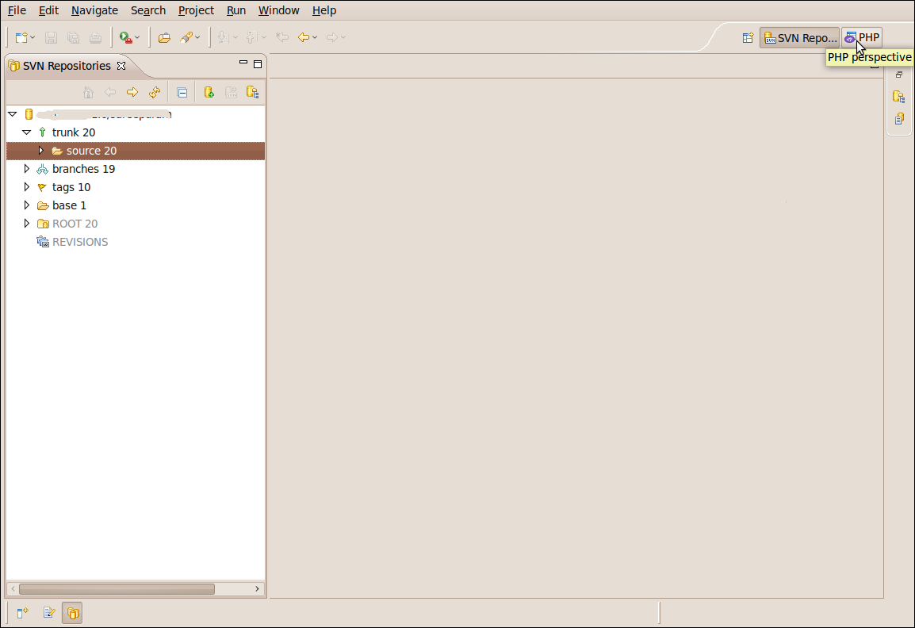
Step cont..
Click here

Slide 9
Description of trunk, branches, tags
Trunk :- The main development source code. “main line”
Branches :- Branches is a work area. Very time you release a major version, it gets a branch created Divergent copies of development lines.
Tags :-Tags is for read-only snapshots. stable snapshots of a particular line of development

Slide 10
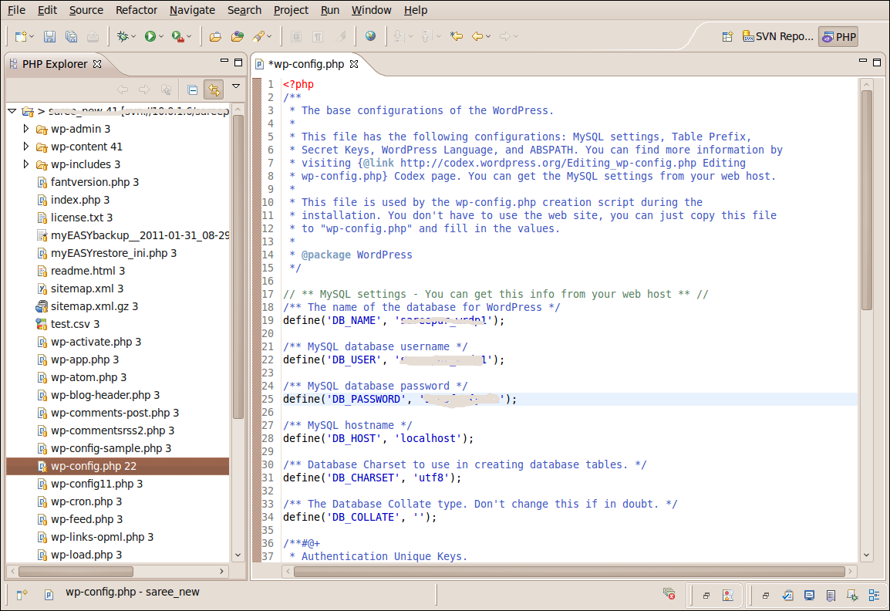
Step 5
Select the file to be changed. The changes should be done here
Click here

Slide 11
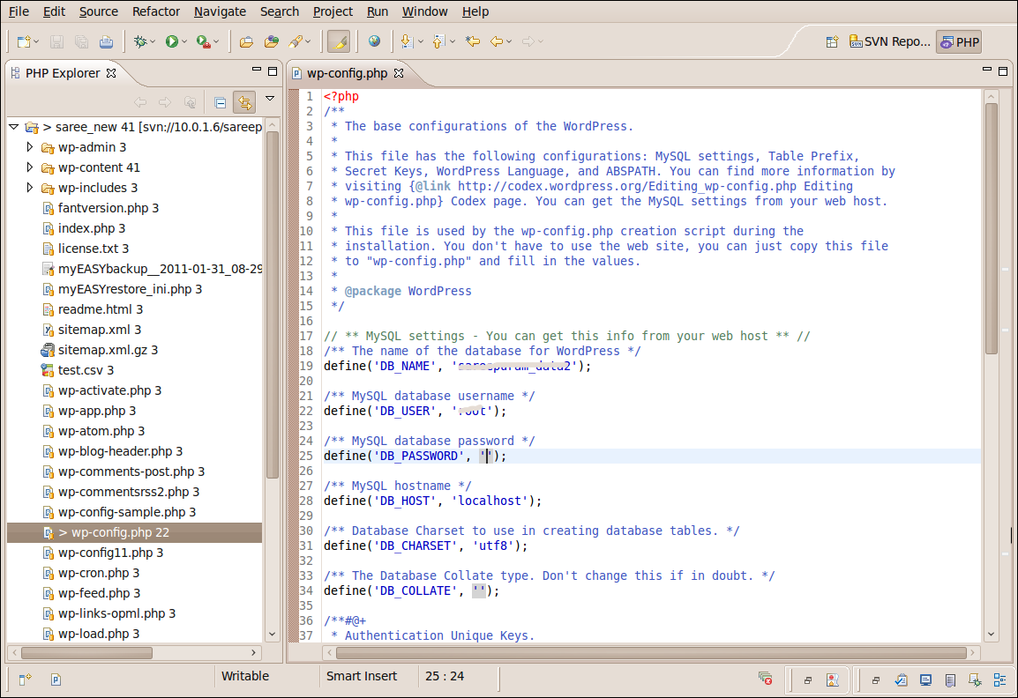
Step cont....
Here the database name , username and password is changed and saved.
An arrow mark is placed left to the filename to indicate that changes has done.

Slide 12
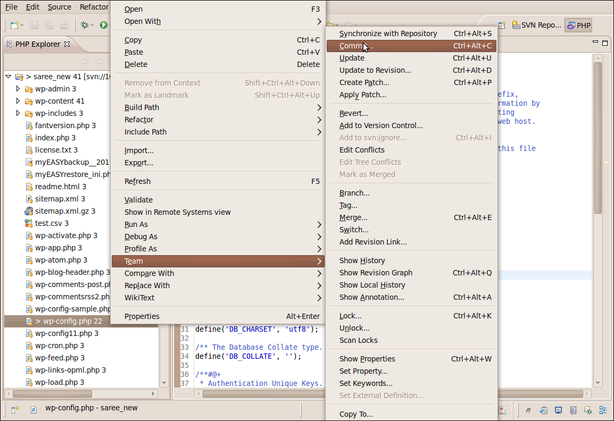
Step 6 Committing a file to svn

Slide 13
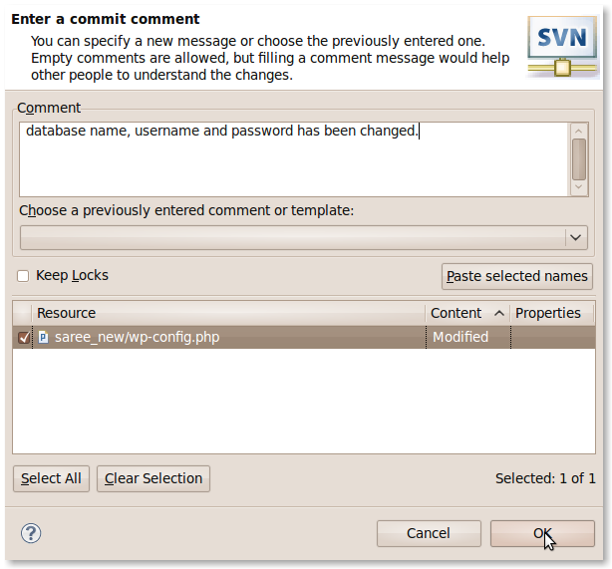
Step cont
Type the comment related to your changes

Slide 14
Step cont
A file is added the resource file content displays added.
A file is created then resource file content displays new.
A file is deleted then resource file content displays deleted.
A file is modified then resource file content displays modified.

Slide 15
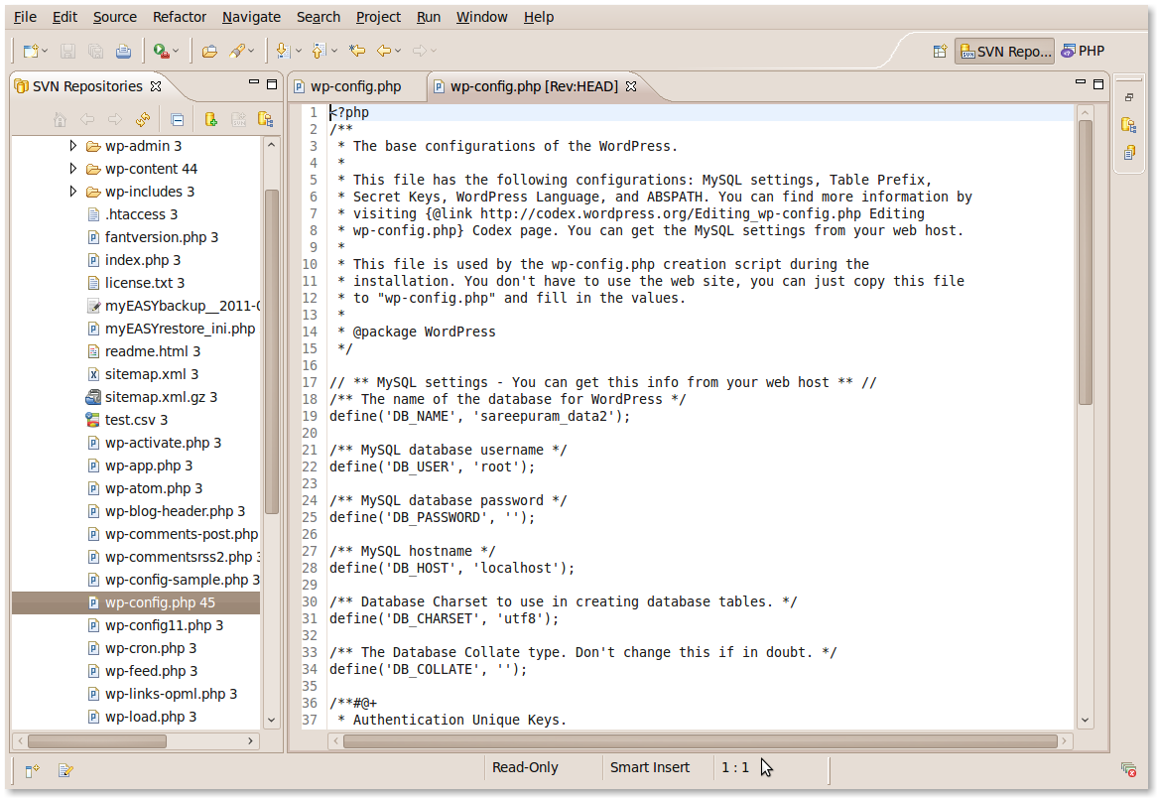
Click this icon to refresh the file wp-config.php
Notify svn repository is selected.

Slide 16
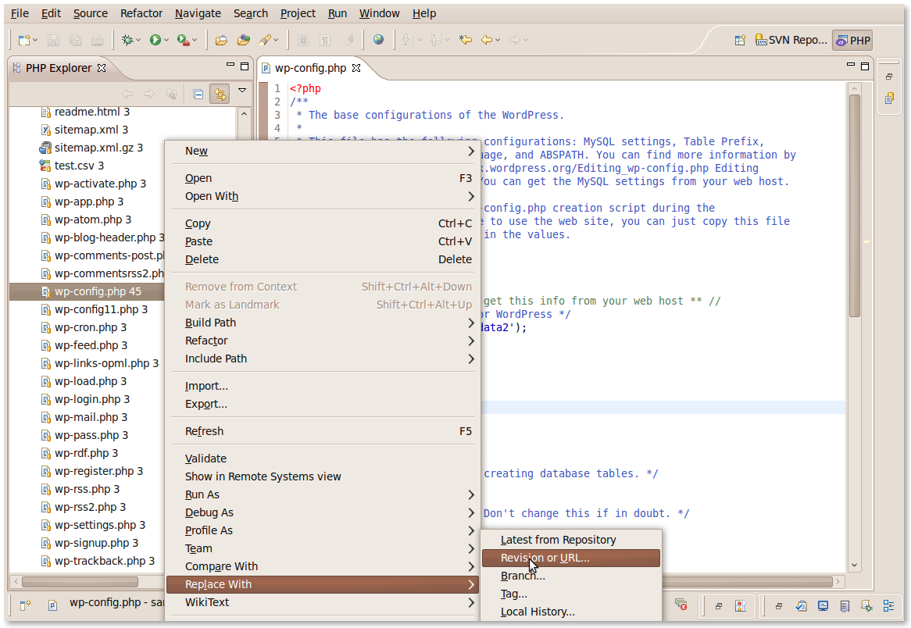
Step 7 Replacing a previous code.

Slide 17
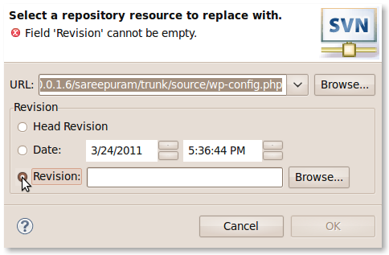
Step cont...
Click on revision
Radio button
Then click on browser button

Slide 18
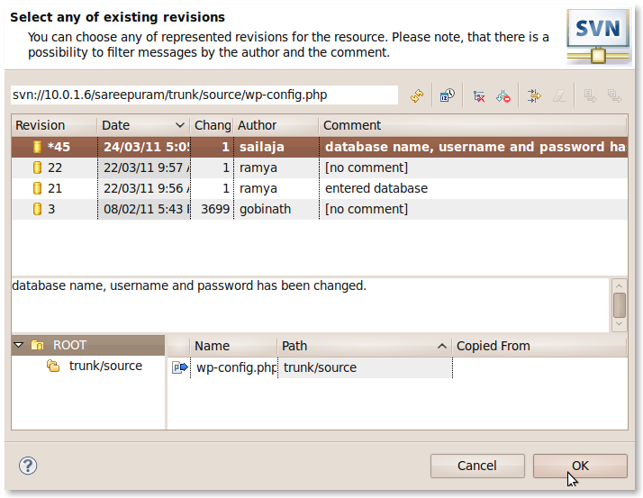
Step cont...
The revision, date,No.Of changes done ,author name and the comment is displayed.The replacement can be done and click on ok.

Slide 19
Step 8
After replacing the changes.
Again commit the changes done.
Follow the Step 6 to commit the changes.
These steps are just to do changes and commit them in svn.
The changes may be reflected in other team members who are in the same project. So while committing certain pemissions should be given.

Slide 20
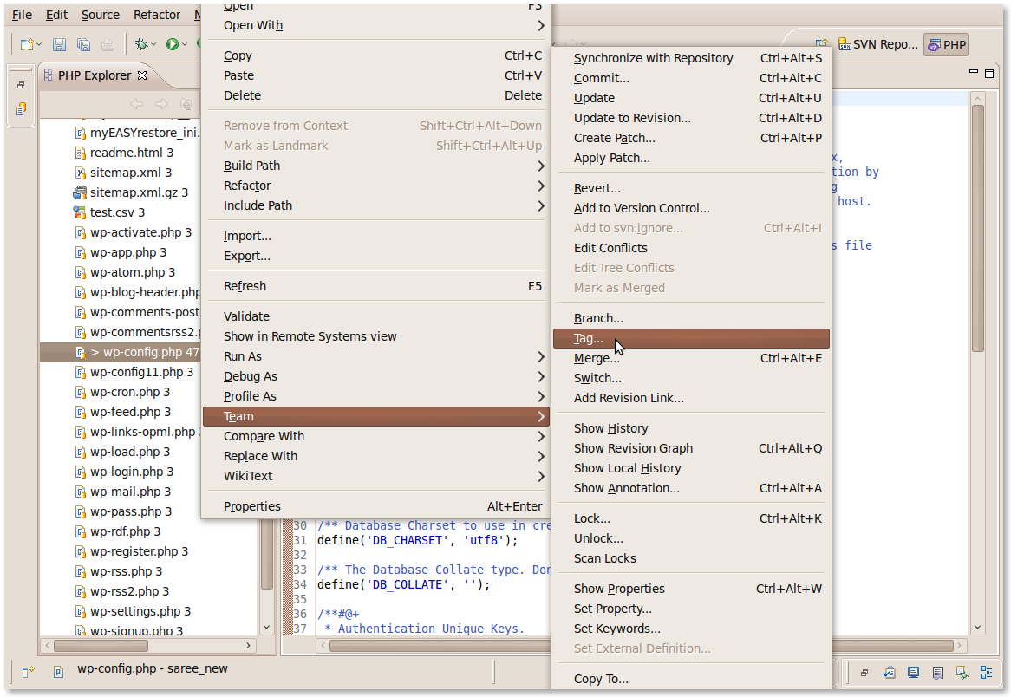
Step 9
Tagging

Slide 21
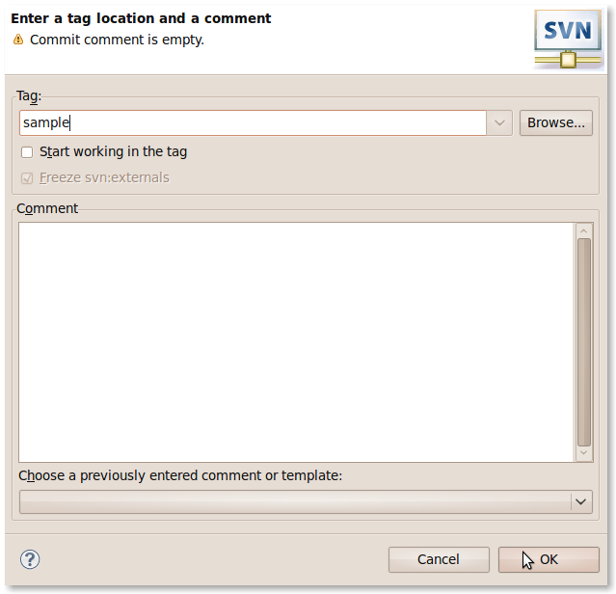
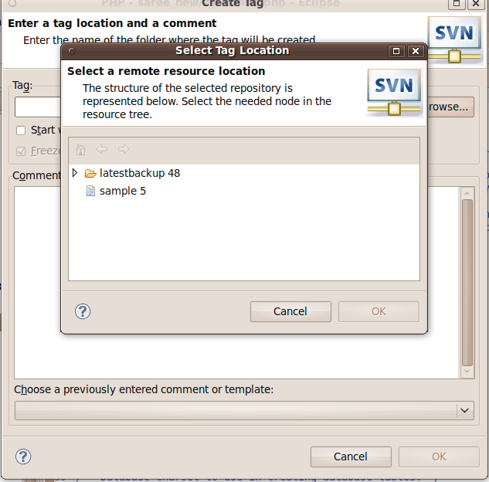
Click here
Select one file and click ok

Slide 22
Final step
Check with svn reprository tag.
Use it for time line development.
Similary branches are created.
cont......

Slide 23

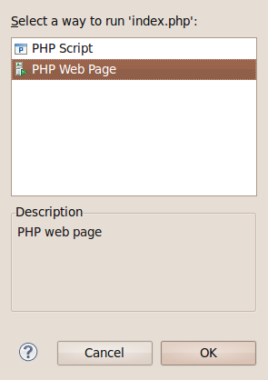
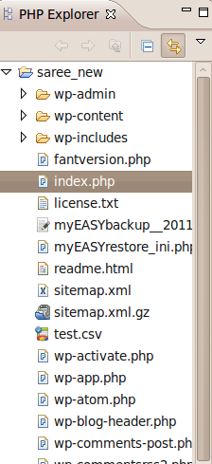
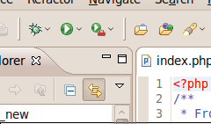
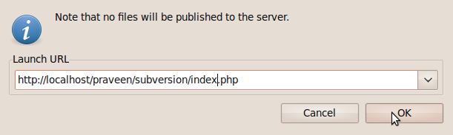
To Run the website
In the php explorer select index.php
Click on icon to run.
Then click here
Select this
Select the file index.php

Slide 24
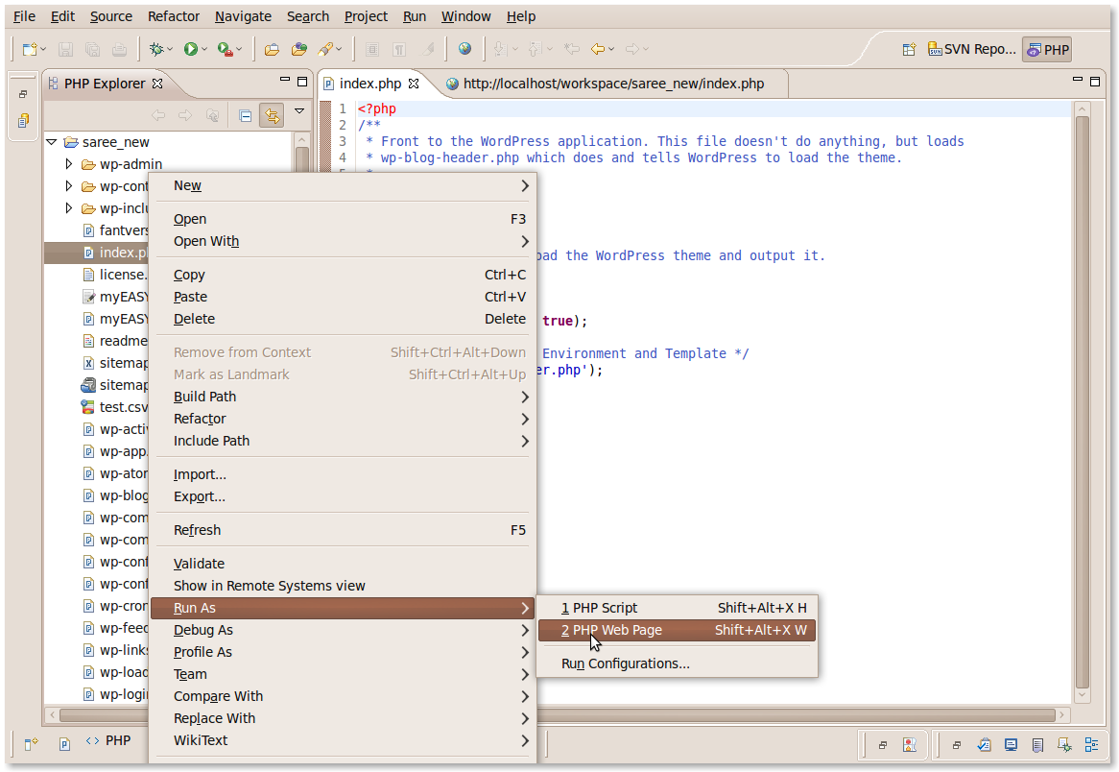
Alternate to run the website
Right click on index.php and select RunAs -> PHP web page

Slide 25
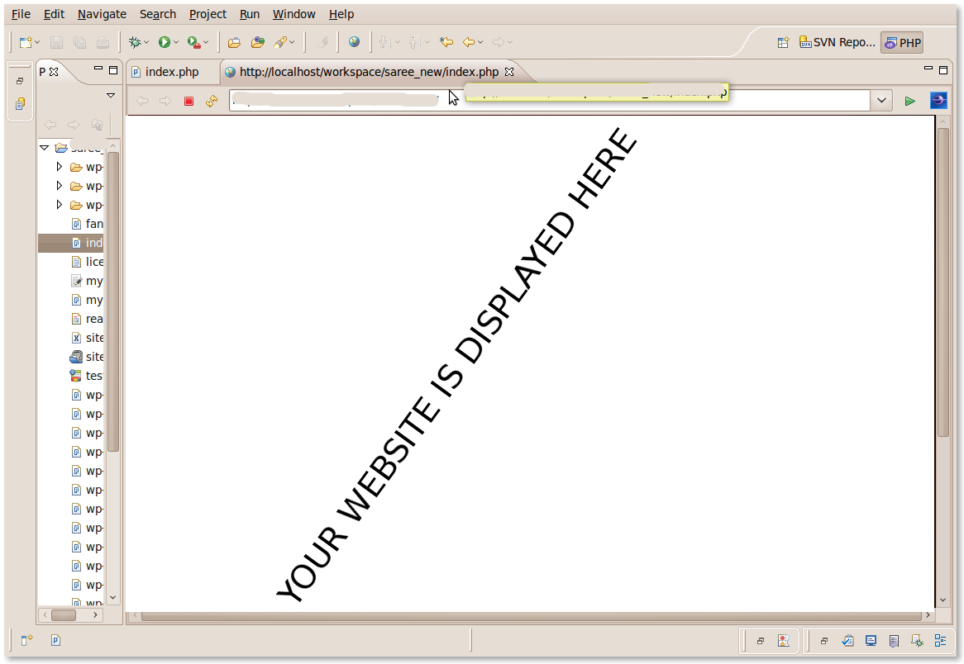
The website displayed

Slide 26
THANK YOU

