Slide 1
Version Control Basics
Nymgo team

Slide 2
Objectives
Understand basic elements and management of the version control, without entering in details of a specific Version Control System.

Slide 3
Agenda (1h)
Basic vocabulary
Parallel Worlds
Branching Patterns
Anti-Patterns

Slide 4
Main concepts
Basic Vocabulary

Slide 5
Environment
Repository
Where files’ current and historical data are stored.
Server
A machine serving the repository.
Client
The client machine connecting to the server.
Working copy
Local copy where the developer changes the code.

Slide 6


Environment
Client
Server
Working copy
Repository

Slide 7
Basic operations
Add
Mark a file or folder to be versioned
Change
Create any changes in the local copy
Commit
Send changes to the repository
Revert
Discard local changes and go back to the same last known revision from the repository

Slide 8


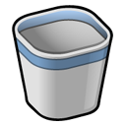



Basic operations
Revert
Add
Foobar.txt
Foobar.txt
Commit
Commit
Change
Delete
Commit
Revert
Foobar.txt
Foobar.txt

Slide 9
Basic artifacts
Revision
Set of changes, state of the code in a point of time
Changelog
Sequential view of the changes done to the code, stored in the repository

Slide 10
Artefatos Básicos
Last revision (head)
harry
1222
file1.txt
file2.txt
file4.txt
Refactoring of module C.
Changelog
dick
1221
file2.txt
file4.txt
Including BUG B.
tom
1220
file1.txt
file3.txt
Including feature A.
Revision number
fulano
1219
file1.txt
file2.txt
file3.txt
file4.txt
Revision author
First inclusion
Description message
Changed files
Timeline
Revision

Slide 11
Synchronization
Update
Synchronize changes from the repository to the local copy

Slide 12
Synchronization
Jerry
1219
1220
1221
1222
Commit
Server
1222
1219
1220
1221
Update
Tom
1219
1220
1221
1222

Slide 13
Labels
Tags
Comprehensive alias for existing revisions, marking an important snapshot in time

Slide 14
Labels
1.0.2
Tags
harry
1222
1222
file1.txt
file2.txt
file4.txt
Refactoring of module C.
1221
tom
1221
file2.txt
file4.txt
Including BUG B.
1220
dick
1220
file1.txt
file3.txt
Including feature A.
1.0.1
tom
1219
1219
file1.txt
file2.txt
file3.txt
file4.txt
First inclusion.

Slide 15
Changes
Diffs and Patches
The comparison between two text files is done by an application diff-like that feeds an application patch-like capable of redo the changes from the originating state to the destination state.
This operation of computing the differences is normally referred as diff, while the “file containing the differences”, that could be exchanged in e-mails and other eletronic media, is denominated patch.

Slide 16
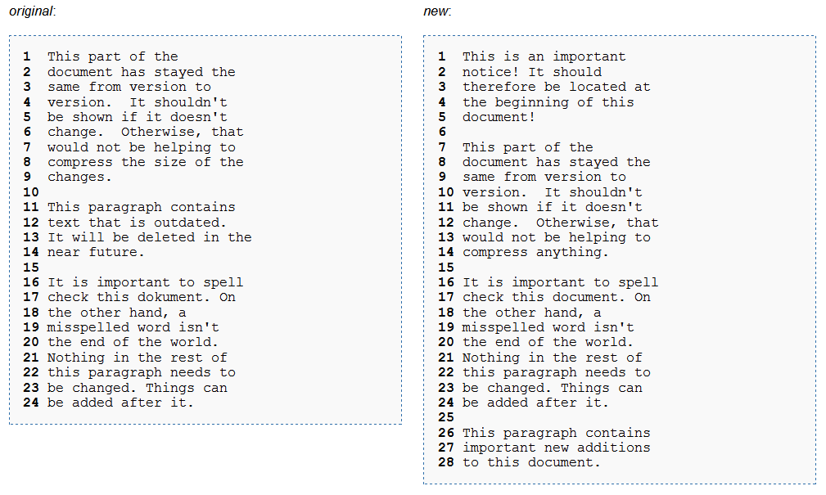
Changes – Example

Slide 17
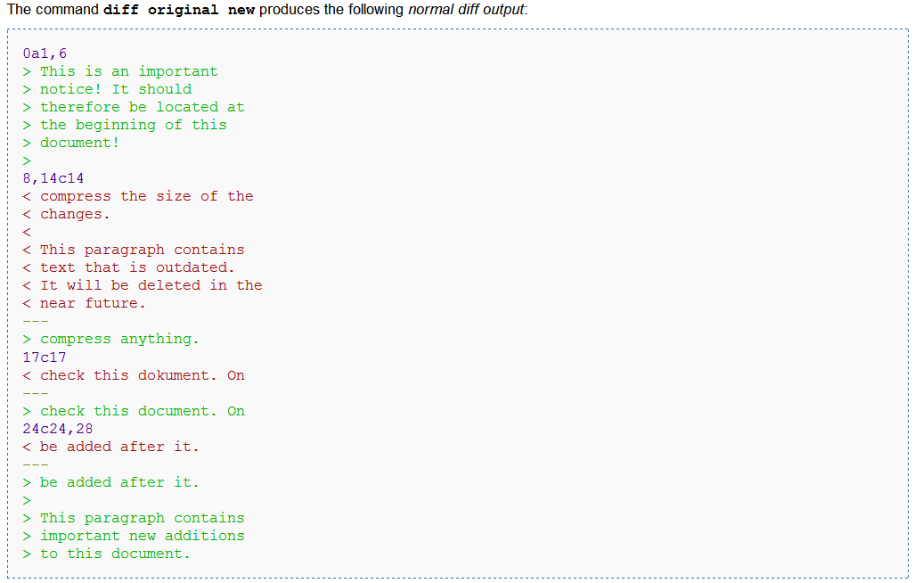
Diff file or patch

Slide 18
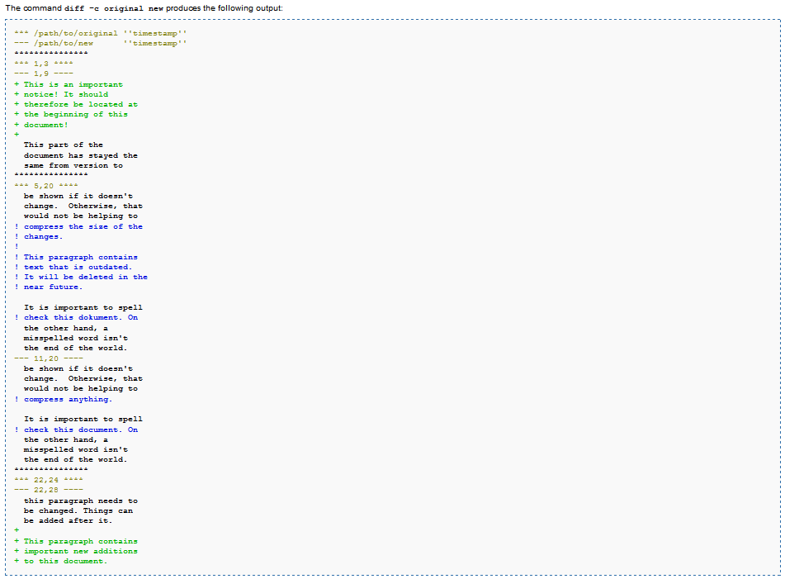
Diff file or patch

Slide 19
Changes
diff 1
diff 2
diff 3
diff 4
1218
1219
1220
1221
1222

Slide 20
Concepts of branching, merging and conflicts
Parallel Worlds

Slide 21



Parallel Worlds
Perhaps the most accessible way to think of branches is as parallel universes. They're places where, for whatever reason, history didn't go quite the same way as it did in your universe. From that point forward, that universe can be slightly different – or it can be radically and utterly transformed. Like the Marvel comic book series “What If?”, branching lets you answer some interesting and possibly even dangerous "what if" questions with your software development.

Slide 22
Parallel Worlds
Parallel universes offer unlimited possibilities.
They also allow you to stay safely ensconced in the particular universe of your choice, completely isolated from any events in other alternate universes.

Slide 23
Parallel Worlds
Branch is like a parallel world.
Changes done in one branch doesn’t have effect over the another.
Although branching offers the seductive appeal of multiple possibility with very little risk, it also brings along something far less desirable: increase of complexity.

Slide 24
Branches
Z
Create branch
X
Create branch
Y
Create branch
W

Slide 25
Merge
In some point of the development, the code must be merged.

Slide 26
Merge
X
Merge
Y

Slide 27
Conflicts
When the changes are done in the same source file lines, you can have conflicts.

Slide 28
How to solve conflicts?

Slide 29
How to solve conflicts?
Question:
Is it possible to solve these conflicts automatically?

Slide 30
How to solve conflicts?
Answer: No!!!
Even when don’t have changes in the same source line, you can still have semantic problems in the code. So, always double check before to commit.

Slide 31
How to solve conflicts?
A note before continuing:
It is always better to avoid unnecessary conflicts.
Communicate your development, always include a description in your committed revisions, ask for help if you don’t understand anything, etc.

Slide 32
How to solve conflicts?
Two way merge
A
A
working base
B
working copy
C = A + B
output
B
C

Slide 33
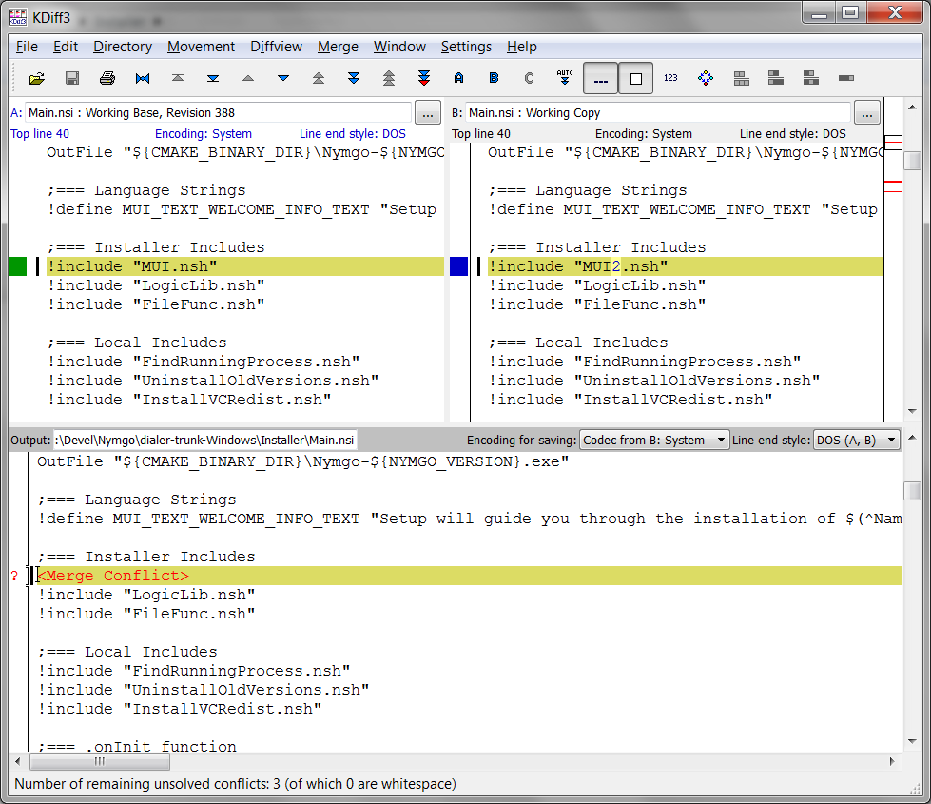
Tools: KDiff3

Slide 34
How to solve conflicts?
Three way merge
B
A
origin
B
branch #1
C
branch #2
Merge
D = A + B + C
Create branch
A
C
D

Slide 35
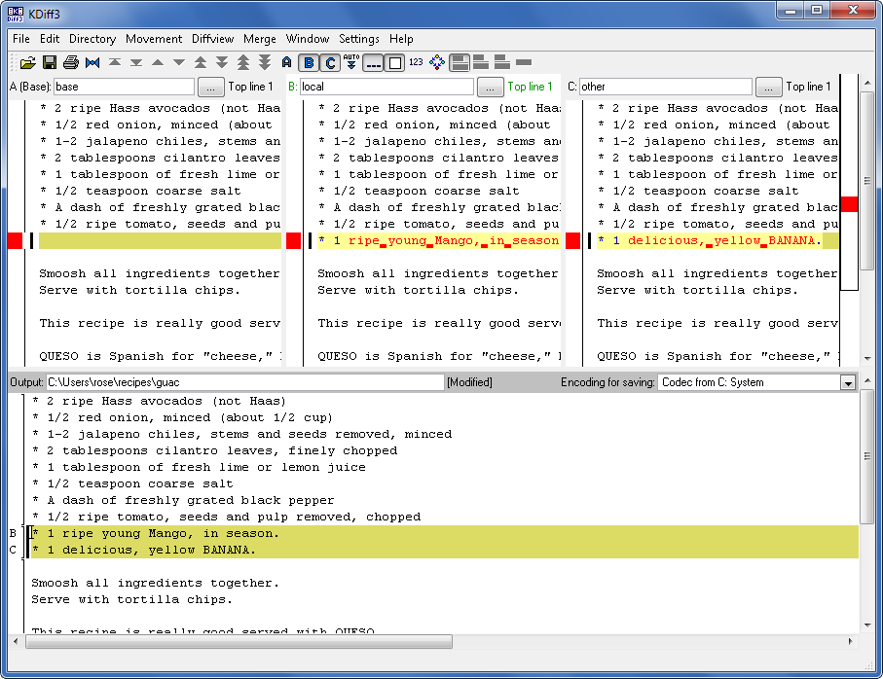
Tools: KDiff3

Slide 36
Tools: choose one…
Meld
Guiffy SureMerge
Ultracompare
DiffMerge
Notepad++
Apple Filemerge
Araxis
tkmerge
TFS diffmerge
xxdiff
...

Slide 37
Which one should I use?
Choose one that best fits your team!

Slide 38
How to manage the branches during the software lifecycle
Branching Patterns

Slide 39
Mainline
1.0
1.0.1
branch
merge
1.1
1.1.1
1.1.2
branch
merge
1.2
1.2.1
1.2.2
branch
merge
merge
2.0
2.0.1

Slide 40
Mainline
Bring a fix from branch n to branch m require m-n merges (linear complexity with the number of branches).

Slide 41
Mainline
Learned lesson:
Perform merges the early and frequently as possible.

Slide 42
Mainline / Variant
2.0
2.0.1
branch
1.2
1.2.1
1.2.2
merge
branch
merge
merge
mainline
branch
branch
merge
merge
1.1
3.0
1.1.1

Slide 43
Scenario:
You just developed a stable version of the software and you need to create a new version with new features and still provide small fixes for the last stable version.

Slide 44
Parallel Maintenance / Development Lines
Most used option
1.1
1.1.1
1.1.2
merge
merge
devel
1.0.0
branch
2.0.1

Slide 45
Parallel Maintenance / Development Lines
Note the internal branch
2.0
2.0.1
2.0.2
merge
merge
devel
1.0.0
branch
branch
merge
merge
1.1
1.1.1

Slide 46
Scenario:
You need to develop two different features in a short period of time.
(laughts)

Slide 47
Overlapping Release Lines
mainline
branch
func_1
merge
branch
merge
merge
func_2

Slide 48
Scenario:
You allocated a new developer to work in a too risky code base and you want to moderate his/her changes for a while.

Slide 49

Docking Line
devel
merge
merge
merge
moderador
sync
sync
sync
docking
line
change,
stabilize
change,
stabilize
change,
stabilize
desenvolvedor

Slide 50
Scenario:
Your development tasks need to progress in discrete levels of maturity: (1) change proposals, (2) analysis, (3) review, (4) unit tests, (5) integration tests, (6) system tests, etc.

Slide 51

Staged Integration Lines
devel
propostas
(1)
revisão
(2)
testes
(3)

Slide 52
Some most common patterns.
When to create a branch?

Slide 53
Branch per Delivery
1.0
1.1
1.2
1.3
Release 1
Create branch
Merge
Release 2
2.0
2.1
2.2
2.3

Slide 54
Branch per Task
Task 1
1.0
1.1
1.2
Devel
Task 2

Slide 55
Branch per Component
Component A
1.0
1.1
1.2
Devel
Components A + B
Component B

Slide 56
Branch per Technology
1.1
Android
1.1
1.2
Common
1.1
1.2
iOS

Slide 57
What can happen if you don’t manage branching
Anti-Patterns

Slide 58
Anti-Pattern | Description
Merge Paranoia | avoiding merging at all cost, usually because of a fear of the consequences.
Merge Mania | spending too much time merging software assets instead of developing them.
Big-Bang Merge | deferring branch merging to the end of the development effort and attempting to merge all branches simultaneously.
Nerver-Ending Merge | continuous merging activity because there is always more to merge.
Wrong-Way Merge | merging a software asset version with an earlier version.
Branch Mania | creating many branches for no apparent reason.
Cascading Branches | branching but never merging back to the main line.
Mysterious Branches | branching for no apparent reason.
Temporary Branches | branching for changing reasons, so the branch becomes a permanent temporary workspace.
Volatile Branches | branching with unstable software assets shared by other branches or merged into another branch. Note Branches are volatile most of the time while they exist as independent branches. That is the point of having them. The difference is that you should not share or merge branches while they are in an unstable state.
Development Freeze | stopping all development activities while branching, merging, and building new base lines.
Berlin Wall | using branches to divide the development team members, instead of dividing the work they are performing.

