Slide 1
BYU-SCUT EXCHANGING PROGRAME
Presented by: (in alphabet order)
Ada
Lucifer
Luke
Michelle
Ronnie*

Slide 2
CONTENTS
Introduction
Exchange Programs SCUT provides
  School of Architecture exchanging program
  School of Materials exchanging program
  SCUT environment
Exchange Program SCUT suggests
  School of Management exchanging program
Conclusion

Slide 3

INTRODUCTION
25,000 undergraduates and 18,000 postgraduates
Dedicated to educating engineers for 60 years
Ranked 138 worldwide by Leiden in 2013
China’s first-level university
Industry technology, Architecture, Materials Science…

Slide 4

INTRODUCTION
One of the largest private universities in U.S.
28,000 undergraduates and 2,000 full-time postgraduates
Ranked 62nd in the U.S. by U.S.News in 2013
Marriott School of Management received a No.5 ranking by Business Week in 2009
MBA program ranked 92nd among business schools worldwide.

Slide 5
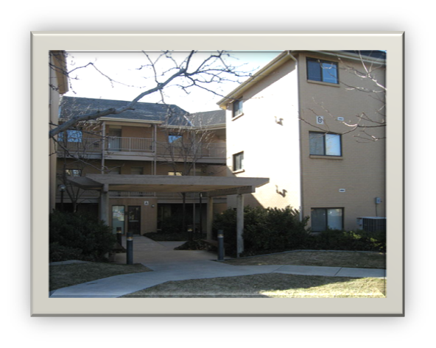
FOUNDATION OF COOPERATION?
Both are worldwide famous universities
For the BYU:
  Strong engineering background in SCUT
  A longer exchanging program in China
For the SCUT:
  A multi-language environment
  China needs more specialists
International Students Dormitory

Slide 6
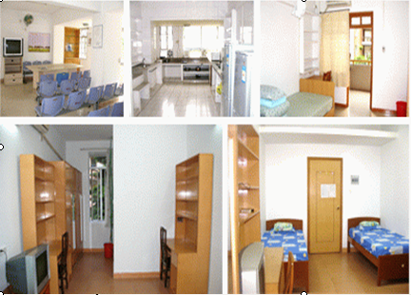
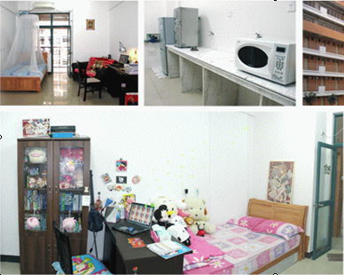
Accommodation
International Student Dorm
North Campus and South Campus -Building C15

Slide 7
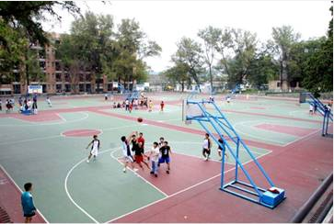
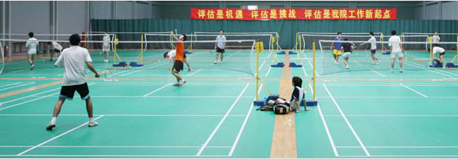

Sports & Recreation
Basketball, Football, Tennis, Badminton, Skating rink , Swimming pool and so on.

Slide 8



Interesting Guangzhou attractions
White Cloud Mountain
Canton Tower
Yue Cuisine

Slide 9
THANK YOU!

