Slide 1


Student Exchange Project

Slide 2
Hypothetical Scenario
Brigham Young University in Provo, Utah, is looking for a university in China to set up a student exchange program for two semesters. Since BYU already has exchange teachers at SCUT, they are considering SCUT as one of the options. BYU is considering other schools, and will choose only one school for this program.
The plan is to exchange students for two semesters. Therefore, students from SCUT will go to BYU, and BYU students will come to SCUT.

Slide 3



Slide 4
Task
Make a presentation about SCUT that you will present to BYU’s representatives.
Persuade the BYU representatives to choose SCUT for their exchange program.

Slide 5
Presentation must include:
Which department at BYU is most appropriate for sending students to SCUT?
Which students from SCUT are most appropriate to go to BYU, and what would they study there?

Slide 6
Presentation
What should BYU students expect at SCUT? (choose 3 or 4 to focus on)
Living conditions
Exercise facilities
Eating facilities and menus
Learning facilities
Study facilities
Other students at SCUT
Teachers at SCUT
Interesting Guangzhou attractions

Slide 7
Presentation
What should SCUT students expect at BYU? (choose 3 or 4 to focus on)
Living conditions
Exercise facilities
Eating facilities and menus
Learning facilities
Study facilities
Other students at BYU
Teachers at BYU
Interesting Provo attractions

Slide 8
PPT
Presentation should include pictures of the various facilities and students.
Present in PPT format to BYU representatives.
Presentations will be no more than 20 minutes.
All group members must participate.

Slide 9
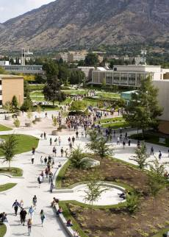


Slide 10
Brigham Young University
Research BYU so you can understand and decide:
-- What programs and degrees are offered. -- Which department should send their students from BYU and why.
-- Which students from SCUT should go to BYU.
http://home.byu.edu/home/

Slide 11
Project Schedule
Week 1 (Today) – Discuss PLAN in groups.
Week 2 – PPT guidelines and Public Speaking information in class.
Week 3- Research, take pictures, gather additional information and prepare/practice your presentation.
Week 4 – PRESENTATIONS May 5-8

Slide 12
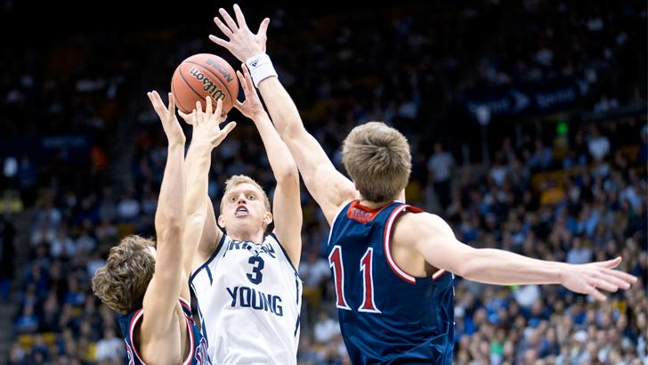

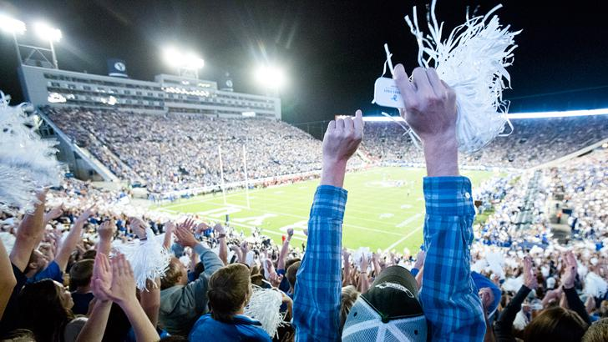

Slide 13
