Slide 1

GovHack
Data AnAlysis

Slide 2
The Plan
AU
QLD
MBRC
Start with Moreton Bay Regional Council data
Enhance that data with Queensland government data
Enhance that further with National data

Slide 3
Datasets looked at
The MBRC datasets https://datahub.moretonbay.qld.gov.au/
The QLD Government Data https://www.data.qld.gov.au/
Focussing on environmental datasets https://www.data.qld.gov.au/organization/environment-science-and-innovation
The Australian Faunal Directory https://biodiversity.org.au/afd/home
The Atlas of Living Australia https://www.ala.org.au/sites-and-services/
The National Vegetation Information System https://fed.dcceew.gov.au/search?q=nvis

Slide 4
Our Limitations
In the time that we had to do any data analysis, it was decided to focus on textual not geospatial analysis
So MS Access was used to import the various datasets to analyse and combine them

Slide 5
Issues Found
Unfortunately, a lot of the data was found to be spatial without textual fields that would allow textual linking and analysis
Datasets with textual data had data quality issues:
MBRC_Planning_Scheme_-_Heritage_Landscape_Significant_Trees had issues with a number of tree types misspelt and both proper and common names mixed in the one field.
The MBRC Shorebird_Roosts datasets were supposed to have “shorebird count data for each roost site over the period 1991 to February 2021 inclusive.”, but this data wasn’t present

Slide 6
Data Used
In the end the “Koala_Monitoring_The_Mill” dataset was used for some analysis (following)
There wasn’t enough time to find other datasets to enhance the MBRC data.

Slide 7
Koala Data Analysis
Measure
Number of Koalas spotted in 2018 but not 2022 | 34
Number of Koalas spotted in 2022 but not 2018 | 74
Number of Koalas spotted in both 2018 and 2022 | 45

Slide 8
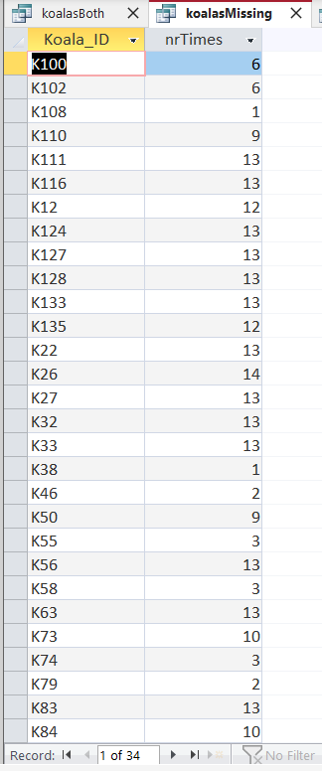
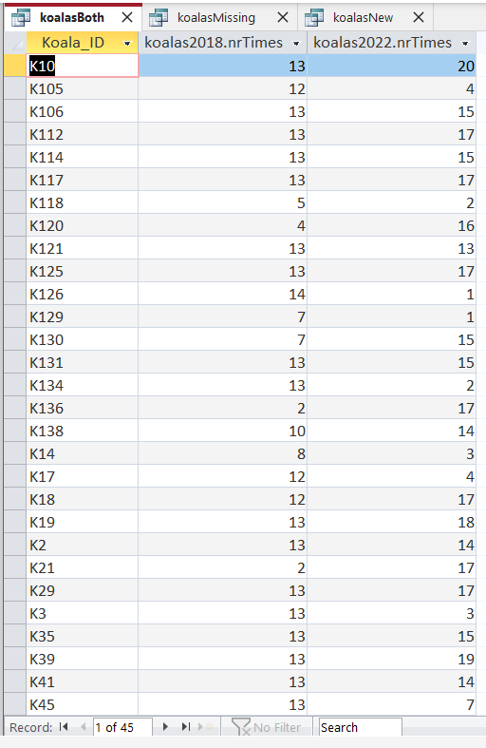
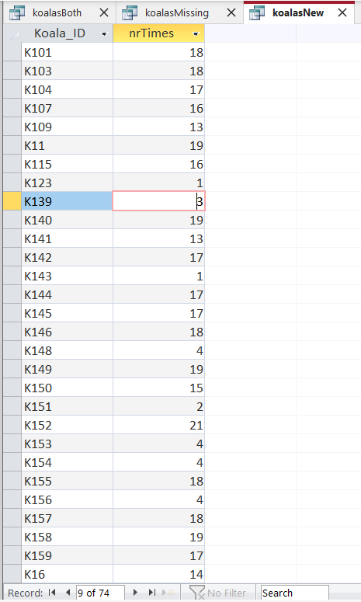
Koala Detail

Slide 9
Koala Sighting Summary
2018 | 2019 | 2020 | 2021
79 | 92 | 115 | 126

Slide 10
Future Learnings
If we participate in another GovHack challenge, use the guidance at https://govhack.org/handbook/geographic-data/ to set up a geospatial engine and load in key national datasets to give us a prepared spatial framework

