Slide 1
UV-vis and fluorescence spectroscopy
PHAY0002 – Tutorial problems
Dr Chris Waudby (c.waudby@ucl.ac.uk)

Slide 2
The BP gives the specific absorbance A(1%,1cm) for riboflavin (M_{r} = 376.4) as 328 at 444 nm.
Calculate the value of the molar absorption coefficient for riboflavin at 444 nm.

Slide 3
Use the data below to calculate the aluminium content of the water sample. The determination is based on the fact that aluminium forms a complex with quinoline-8-ol which fluoresces in a chloroform medium.
500 mL of the water sample plus 10 mL of acetate buffer and 100 mL of purified water was extracted several times with a 0.5% m/v solution of quinoline-8-ol in chloroform. The total volume of the combined extracts was 50 mL. The chloroform extract gave a fluorescence intensity reading of 82. When the procedure was repeated using 4.0 mL of a 0.56 µg/mL aluminium standard solution in place of the water sample a reading of 67 was obtained. In the absence of any sample a fluorescence intensity reading of 23 was obtained.

Slide 4
A batch of co-codamol tablets is being analysed. Three tablets are crushed and dissolved in 0.1 M HCl and made up to 250 mL in a volumetric flask. A 1 mL portion is diluted to 250 mL and the absorbance measured in a 1 cm cell. If the absorbance at 248 nm is 0.8477 and at 275 nm is 0.2267, calculate the content of paracetamol and codeine in the original tablet. The label claim is 500 mg paracetamol and 30 mg codeine phosphate per tablet. Verify if the amount of paracetamol and codeine are within 5% of this.
The A(1%, 1cm) of paracetamol is 360.7 at 248 nm and 87.0 at 275 nm. The A(1%, 1cm) of codeine is 22.6 at 248 nm and 115.3 at 275 nm.

Slide 5
Separation and chromatography
PHAY0002 – Tutorial problems
Prof Zoe Waller (z.waller@ucl.ac.uk)

Slide 6
You have finished a reaction and worked it up. You performed normal phase column chromatography to separate the components. Below is a normal phase TLC of your fractions:
Explain what is meant by the “crude” spot?
How many different components are in the reaction mixture? 3 which have been visualised
Which fractions are pure? 2, 3, 5, 6, 8-13
Which fractions are not pure? 7
Which fractions do not contain any compound? 1, 4, 14
Which fractions contain the most non-polar compound? 2, 3
Which fractions contain the most polar compound? 7-13

Slide 7
Compare and contrast column chromatography and SPE.

Slide 8
Given below are the R_{f} values for a mixture of two compounds (A and B), analysed by TLC under three different elution conditions.
What are column volumes (CV) used to measure. What is the relationship between R_{f} and CV?
By column chromatography, compound retention is measured in column volumes (CV)
This is the number of column volumes of solvent required to elute the compound off the stationary phase
Elution methods developed by TLC are usually transferable to column chromatography.
The relationship between Rf and CV is reciprocal CV = 1 / Rf
Eluent | R_{f}
 | DCM | Ether | Hexane/Ether (1:1)
A | 0.8 | 0.5 | 0.2
B | 0.5 | 0.3 | 0.15

Slide 9
Given below are the R_{f} values for a mixture of two compounds (A and B), analysed by TLC under three different elution conditions.
Calculate which of solvent systems would be best suited for separation of compounds A & B by column chromatography.
Hexane/ether (1:1) will give greatest difference in CV between A and B hence will give the best compound resolution by chromatography.
Note: it is the difference in CV not Rf that is the main determinant of resolution by column chromatography
Eluent | R_{f}
 | DCM | Ether | Hexane/Ether (1:1)
A | 0.8 | 0.5 | 0.2
B | 0.5 | 0.3 | 0.15

Slide 10
Compounds C-G are analogues of morphine which you are using in a study as a receptor agonist. Order compounds C-G in terms of highest to lowest R_{f} values that would be expected if they were analysed by normal phase TLC under neutral pH conditions. Explain your answer.

Slide 11
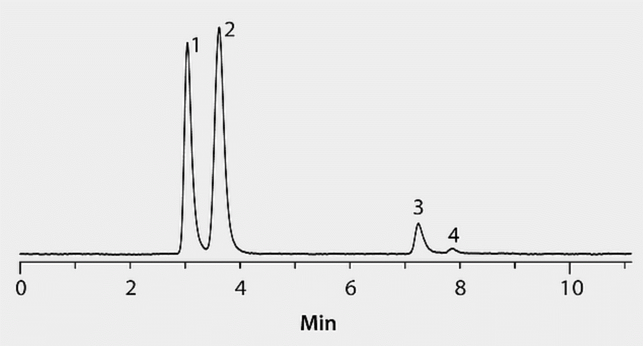
Below is a HPLC trace of an unknown mixture of compounds monitored at 254 nm. Which compound 1-4 has the highest concentration in the solution that was injected?

Slide 12
A mass of 2.398 g of a newly synthesised compound (Compound 1), was completely dissolved in 150 mL of water. The pH of the resulting solution was 4.6. This aqueous solution was then extracted with 100 mL of n-octanol. To find out the concentration of compound 1 in the organic phase, a sample of 10 mL was diluted to 100 mL with mobile phase and 20 µL injected in a HPLC (normal phase). The peak area (AUC) obtained was 179,142 units. A previous injection of 20 µL of a standard solution of 1 mg/ml of compound 1 gave a peak area of 132,698 units. Calculate the P(octanol/water) of compound 1.

Slide 13
How can you modify the aqueous phase to prevent compound 1 being extracted into the organic phase?

