Slide 1
PHAY0002
Stoichiometry
Dr Chris Waudby
c.waudby@ucl.ac.uk
Room 439

Slide 2
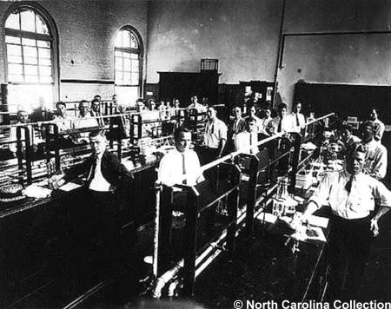
Historical motivation

Slide 3
Introduction and learning objectives
Being able to confidently and correctly calculate chemical quantities is an essential skill for the pharmacist!
Understanding:
the ways in which compounds react with each other
the ratios in which they react
the efficiency of the reactions
is crucial to a number of areas of pharmacy and pharmaceutical analysis.
These include:
calculating the yields and efficiency of chemical reactions and processes
analytical methods (titration procedures, gravimetric analysis) to determine the drug or impurity content of medicines
equilibrium processes involving e.g. acid-base reactions and buffering systems

Slide 4
Recommended reading and reference books
Pharmaceutical Analysis. D G Watson. Elsevier Churchill Livingstone, 2nd edition, 2005
Essentials of Pharmaceutical Chemistry. D Cairns. Pharmaceutical Press, London, 2nd edition, 2003.
Some Khan Academy worked examples – search for ‘stoichiometry’

Slide 5
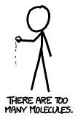
Moles and Avogadro’s constant
A mole is a unit. It’s not a typical unit, though. It’s really just a number—like “dozen” or “billion.”
If you have a mole of something, it means you have 602,214,129,000,000,000,000,000 of them (usually written 6.022 x 10²³).
This is Avogadro’s number.
It’s such a big number because it’s used for counting numbers of molecules, which there are a lot of.
One mole is equal to the number of atoms in 12 grams of carbon-12.
N_{A} is Avogadro’s constant.
Note the units:
N_{A} = 6.022 x 10²³ mol⁻¹
xkcd.com

Slide 6
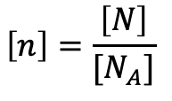
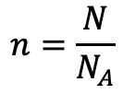
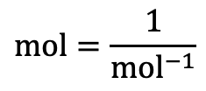
Calculation of amount of substance
The amount of a substance, n, can be calculated if
the number of entities, N, is known:
Check units:
$$n=\frac{N}{N_{A}}$$
$$\left[n\right]=\frac{\left[N\right]}{{[N}_{A}]}$$
$$\text{mol}=\frac{1}{{\text{mol}}^{−1}}$$

Slide 7
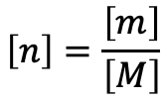

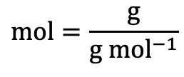
Calculation of amount of substance
The amount of a substance, n, can be calculated if its mass, m,
and molar mass, M, are known:
If the mass is measured in grams, then the molar mass must be in g mol⁻¹
The molar mass is numerically equivalent to the relative molecular mass, M_{r}.
Beware: The relative molecular mass (M_{r}) is a dimensionless number calculated from atomic masses. The molar mass (M) has units of g mol⁻¹ and is used in stoichiometric calculations. The numbers are the same but serve different purposes, so don’t confuse M_{r} = 180.157 with M = 180.157 g mol⁻¹ in your calculations.
Check units:
$$n=\frac{m}{M}$$
$$\left[n\right]=\frac{\left[m\right]}{\left[M\right]}$$
$$\text{mol}=\frac{\text{g}}{{\text{g mol}}^{−1}}$$

Slide 8



Calculations involving liquids
The mass of a substance, m, can be calculated if its volume, V,
and density, ρ, are known (ρ is the Greek letter rho):
Density typically has units of g mL⁻¹ or g cm⁻³
  N.B. these are the same because 1 mL = 1 cm³
Useful to remember: the density of water is 1 g mL⁻¹ (at 4ºC)
Check units:
$$m=ρV$$
$$\left[m\right]=\left[ρ\right]\left[V\right]$$
$$\text{g}=\frac{\text{g}}{\text{mL}} × \text{mL}$$

Slide 9
Mentimeter
Test your intuition…

Slide 10
Mentimeter: test your intuition…
How many moles are in these common items?
  20 mL water
  Ethanol in one shot of vodka
  Aspirin in a 300 mg tablet
How many molecules of aspirin will be found in a ‘typical’ cell after taking one tablet?
What is the molar concentration of water?
Volume of contraction of ethanol?

Slide 11
How to problem solve
Read & Identify
  What’s being asked?
  What data is given?
Estimate
  What would a reasonable answer look like?
Plan
  What approach or equation(s) do I need?
Execute
  Show the calculation with units
Check
  Does my answer make sense? Have I the right number of significant figures?
The problems you’ll face will not involve particularly complicated maths!
BUT – calculations may have many steps and require you to synthesise a lot of information (some of which may not be relevant)!

Slide 12
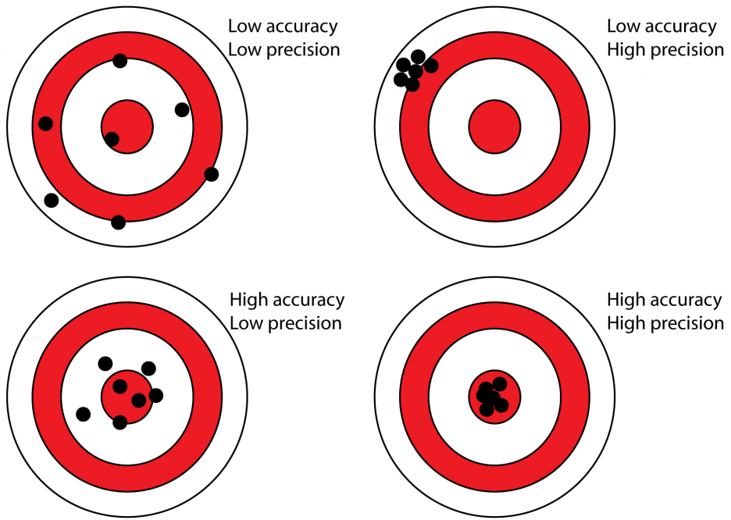
Precision, accuracy and significant figures
Accuracy = how close to the true value
Precision = how reproducible/consistent you are
You can be precise but inaccurate!
Significant figures reflect precision.
2.1 g suggests ±0.1 g uncertainty
2.10 g suggests ±0.01 g uncertainty
Your answer can’t be more precise than your data!
If you measure 2.1 g, don't report 0.152174 mol
Use the least precise measurement to guide your final answer

Slide 13
Example: aspirin
Calculate the amount of aspirin (in mol) in a tablet containing 300 mg aspirin.
1. Read & Identify
  What’s being asked? Number of moles
  What data is given? Mass of aspirin, structure of aspirin
2. Estimate
  What would a reasonable answer look like? There’s roughly 0.1 g, and looking at the size of the structure, the molecular weight is probably around a hundred units – so expect something like 0.1 / 100 = 0.001 mol.
3. Plan
  What approach or equation(s) do I need?

Slide 14
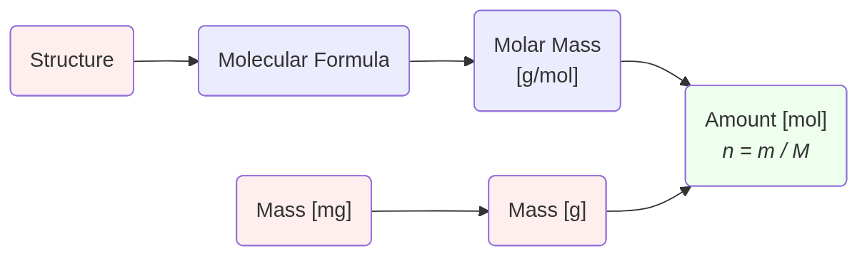
How do you create a plan?
Start at the beginning – what information have you been given?
  Convert all quantities to standard units at the beginning of your calculation (e.g. mg to g)
Start at the end – where do you want to get to?
  Convert any answers from standard units into the units requested (e.g. mol to mmol)
Think about the process in between – apply your chemistry knowledge to work forwards/backwards
Notes:
https://mermaid.live/
flowchart LR
A(Structure) --> B(Molecular Formula)
B --> C("Molar Mass
[g/mol]")
D("Mass [mg]") --> E("Mass [g]")
C --> F("Amount [mol]
*n = m / M*")
E --> F

Slide 15
Example: aspirin
Calculate the amount of aspirin (in mol) in a tablet containing 300 mg aspirin.
4. Execute
  Show the calculation with units
(12.0107 x 9) + (1.00794 x 8) + (15.9994 x 4)
C₉H₈O₄
180.157 g/mol
1.665 x 10⁻³ mol
300 mg
0.3 g

Slide 16
Example: aspirin
Calculate the amount of aspirin (in mol) in a tablet containing 300 mg aspirin.
5. Check
  Does my answer make sense? Have I the right number of significant figures?
C₉H₈O₄
180.157 g/mol
1.67 x 10⁻³ mol
300 mg
0.3 g

Slide 17
Example: water
Calculate the amount of water (in mol) in 20 mL.
1. Read & Identify
  What’s being asked? Number of moles
  What data is given? Volume
  Knowledge: Density of water
2. Estimate
  Water has a density of 1 g/mL, so 20 mL of water has a mass of 20 g.
  H₂O has a molar mass of 18 g/mol, so there must be just over 1 mole present in 20 mL.
3. Plan
  What approach or equation(s) do I need?

Slide 18
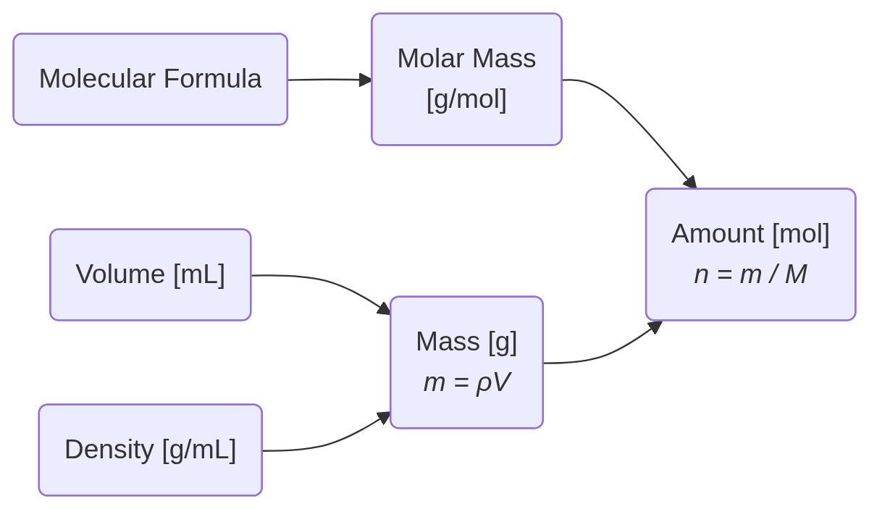
Example: water
Calculate the amount of water (in mol) in 20 mL.
3. Plan
4. Execute
5. Check
H₂O
18 g/mol
20 mL
20 / 18
= 1.11 mol
20 x 1
= 20 g
1 g/mL

Slide 19
Concentration of solutions
Concentration measures the quantity of substance per unit volume (or mass).
Quantity can be specified in different ways – as an amount (moles), mass, or volume. This gives different measures/units of concentration.
Some typical units for concentration are: g L⁻¹, g dm⁻³, mg mL⁻¹, mg cm⁻³, mol dm⁻³, nmol cm⁻³, % m/v, etc.
A note on volumes:
  1 cm³ ≡ 1 mL
  1000 cm³ ≡ 1 dm³ ≡ 1 L

Slide 20
Example
102.3 mg of lead nitrate (Pb(NO₃)₂) was dissolved in dilute nitric acid and made up to 250.0 mL with water. What is the concentration (g L⁻¹) of the lead nitrate solution?
Read and identify:
  What’s being asked? Concentration of lead nitrate in g/L
  What information do we have? Mass of lead nitrate, volume of final solution, molecular formula
Estimate:
  We have about 100 mg in a quarter of a litre. So we’ll have about 400 mg in one litre. Therefore the concentration should be close to 0.4 g/L.

Slide 21
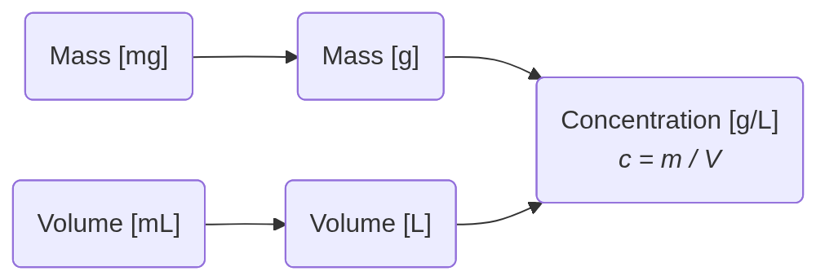
Example
102.3 mg of lead nitrate (Pb(NO₃)₂) was dissolved in dilute nitric acid and made up to 250.0 mL with water. What is the concentration (g L⁻¹) of the lead nitrate solution?
3. Plan
4. Execute
5. Check
102.3 mg
0.1023 g
0.1023 / 0.25
= 0.4092 g/L
250.0 mL
0.2500 L

Slide 22
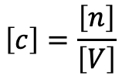

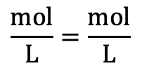
Molar concentrations and molarity
When the quantity of a substance is measured in moles, the concentration is called
the amount concentration, or molar concentration, or molarity.
Nomenclature:
  There are two common ways to denote molar concentrations
  A lower case italic c is the standard symbol for the molar concentration.
  The substance or entity may be specified as a subscript or in brackets, e.g. c_{B}, c(B), c_{NaOH}, etc.
  Square brackets can also used for the molar concentrations of specified species, e.g. [B], [OH⁻], etc.
Check units:
$$c=\frac{n}{V}$$
$$\left[c\right]=\frac{\left[n\right]}{\left[V\right]}$$
$$\frac{\text{mol}}{\text{L}}=\frac{\text{mol}}{\text{L}}$$

Slide 23
Molar concentrations and molarity
A solution of 1 mol L⁻¹ (or mol dm⁻³) is commonly called a 1 molar solution,
denoted 1 M solution. Thus M is treated as a symbol for mol L⁻¹.
If you’re dealing with smaller concentrations, you might also use units like:
  mM – millimolar (10⁻³ M)
  μM – micromolar (10⁻⁶ M)
  nM – nanomolar (10⁻⁹ M)
More rarely, you might also come across extremely small concentrations:
  pM – picomolar (10⁻¹² M)
  fM – femtomolar (10⁻¹⁵ M)

Slide 24
Example
1.7753 g of a pure (> 99.99% m/m) sample of potassium iodate (KIO₃) was dissolved in water and made up to 500.0 mL with water. Calculate the molarity of the solution.
Read and Identify
  What’s being asked? Molarity (molar concentration) of potassium iodate in final solution
  What information are we given? Mass, purity, chemical formula, volume of final solution
  The purity is extremely high – we don’t need to worry about the effect of impurities
Estimate
  Potassium iodate is a simple formula but the atoms are quite heavy – the molar mass might be round about 100 or 200 g/mol.
  If we have roughly 1.5 g in half a litre, we’ll have 3 g per litre. 3 / 100 = 0.03 M, so we should expect the concentration to be in the tens of millimolar

Slide 25
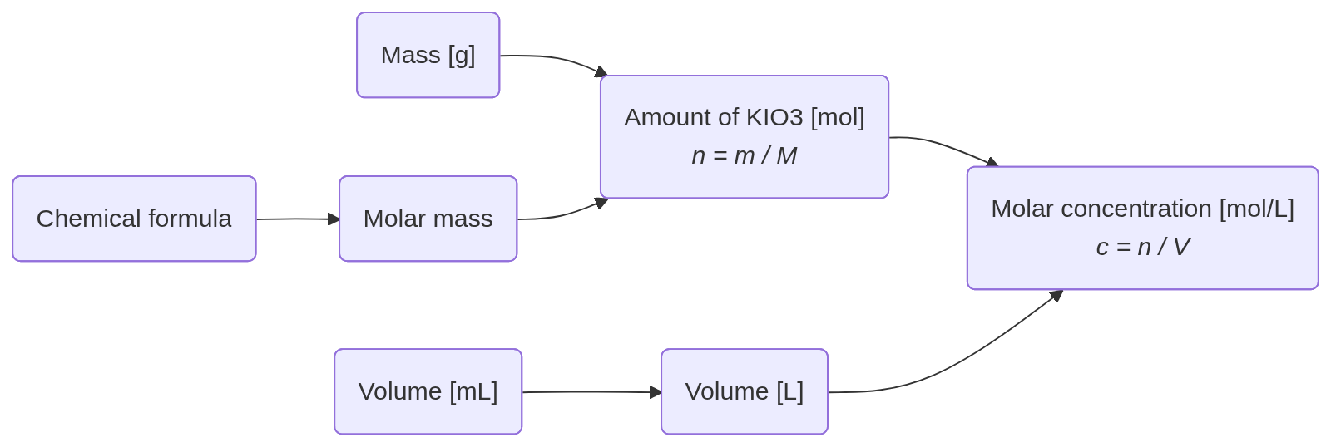
Example
1.7753 g of a pure (> 99.99% m/m) sample of potassium iodate (KIO₃) was dissolved in water and made up to 500.0 mL with water. Calculate the molarity of the solution.
3. Plan
4. Execute
5. Check
1.7753 g
1.7753 / 214.001
= 8.29576 x 10⁻³ mol
KIO₃
214.001 g/L
8.29576 x 10⁻³ / 0.5
= 0.01659 M
500.0 mL
0.5000 L

Slide 26
Intensive and extensive quantities
The amount of substance is an extensive quantity – doubling the sample doubles the amount of moles
Concentrations are intensive quantities – they don't change if you have more solution of the same composition
Extensive quantities depend on how much material you have
  Exampes: mass, volume, amount of substance
Intensive quantities are properties of the material itself, independent of sample size
  Examples: density, temperature, molarity
Extensive quantities add up when you combine samples – two 5 g samples give you 10 g total
Intensive quantities don’t add up – combining two solutions at 20°C doesn't give you 40°C

Slide 27
Example: concentrations and amounts
Calculate the amount of sodium in 10 mL of a 0.1 M sodium sulphate (Na₂SO₄) solution.
Read & identify
  What’s being asked? Number of moles of sodium – not sodium sulphate! There are two sodium ions for each formula unit!
  What data is given? Chemical formula, volume and molar concentration
Estimate
  This is an easy one! A 0.1 M solution has 0.1 mol per litre, so in 0.01 litres (one hundredth the volume) we’ll have 0.001 mol sodium sulphate. Therefore we’ll have twice as many sodium ions, 2 mmol.

Slide 28
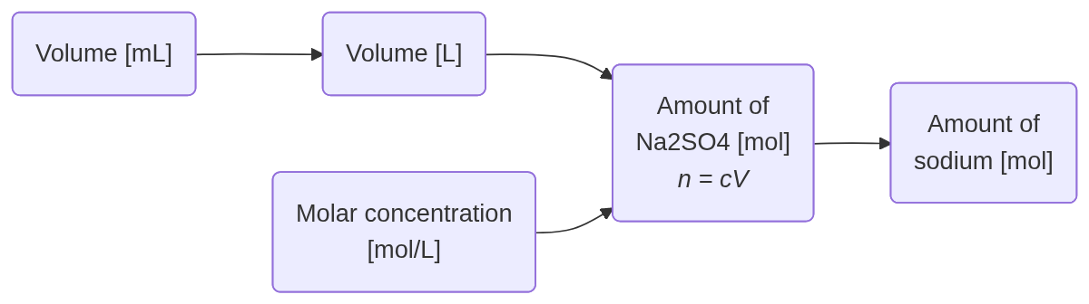
Example: concentrations and amounts
Calculate the amount of sodium in 10 mL of a 0.1 M sodium sulphate (Na₂SO₄) solution.
3. Plan
4. Execute
5. Check
10 mL
0.01 L
0.001 x 2
= 0.002 mol
0.01 x 0.1
= 0.001 mol
0.1 mol/L

Slide 29
Example: concentrations and mixtures
25 mL of a 0.30 M sodium chloride solution, plus 50 mL of a 0.15 M sodium chloride solution are mixed together. Calculate the total amount of sodium chloride and the concentration of the final solution.
Read & identify
  What’s being asked? Total amount of sodium chloride AND concentration of final mixture
  What data is given? Volume and molar concentration of starting solutions
Estimate
  The final concentration must be somewhere between the two original solutions
  There’s more of the second solution so the final concentration should be closer to that than the first
  So we expect something between 0.15 and 0.225 M

Slide 30
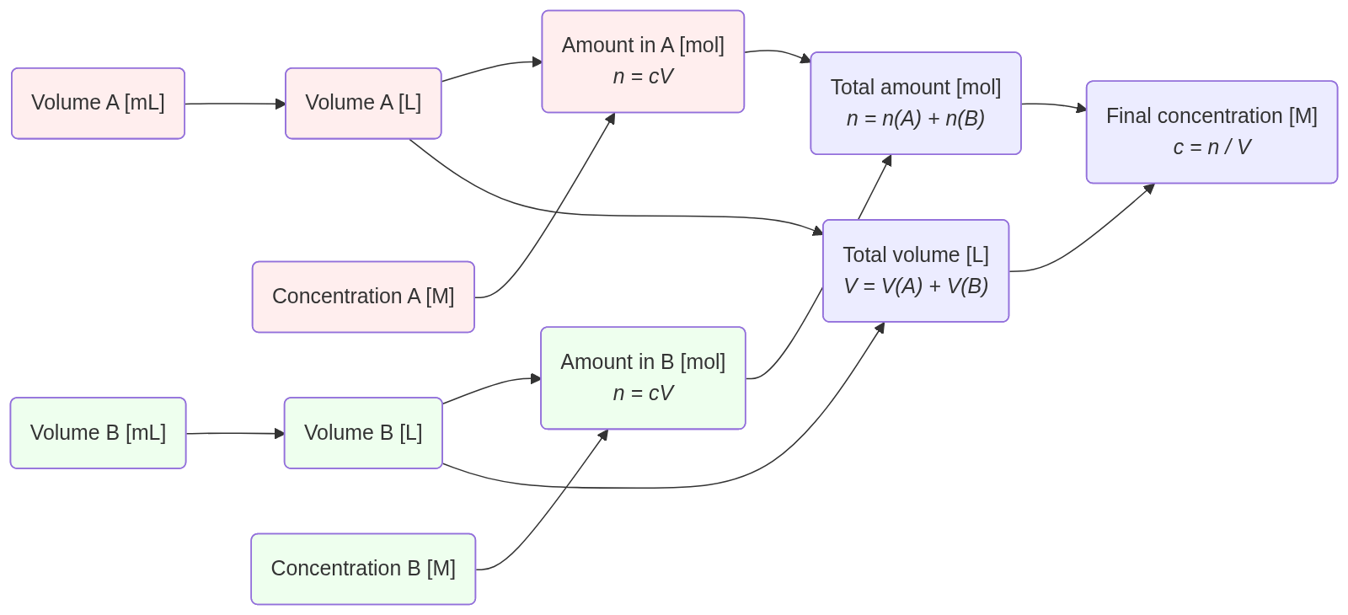
Example: concentrations and mixtures
25 mL of a 0.30 M sodium chloride solution, plus 50 mL of a 0.15 M sodium chloride solution are mixed together. Calculate the total amount of sodium chloride and the concentration of the final solution.
3. Plan
4. Execute
5. Check
0.015 mol
25 mL
0.0075 mol
0.025 L
0.015 / 0.075
= 0.20 M
0.30 M
75 mL
= 0.075 L
0.0075 mol
50 mL
0.05 L
0.15 M
Notes:
flowchart LR
X1("Volume A [mL]"):::foo --> A1("Volume A [L]"):::foo --> C1
B1("Concentration A [M]"):::foo --> C1
C1("Amount in A [mol]
*n = cV*"):::foo
X2("Volume B [mL]"):::bar --> A2("Volume B [L]"):::bar --> C2
B2("Concentration B [M]"):::bar --> C2
C2("Amount in B [mol]
*n = cV*"):::bar
C1 --> X("Total amount [mol]
*n = n(A) + n(B)*")
C2 --> X
C1 ~~~ Y
A1 --> Y("Total volume [L]
*V = V(A) + V(B)*")
A2 --> Y
X --> Z("Final concentration [M]
*c = n / V*")
Y --> Z
classDef foo fill:#fee
classDef bar fill:#efe

Slide 31
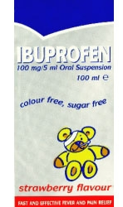
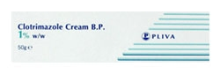
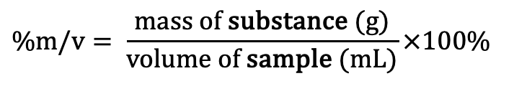
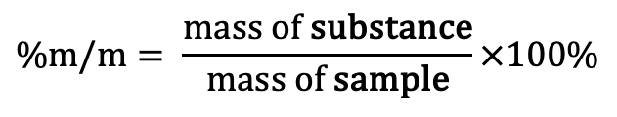
Percentage concentrations
The composition and purity of materials are commonly expressed as a percentage.
There are calculations and extra details in the notes.
Percentage mass in mass (% m/m) = number of grams per 100 g
Unless indicated otherwise percentage compositions (including
liquids and solutions) are always given on a mass in mass basis.
Percentage mass in volume (% m/v) = number of grams per 100 mL
Widely used in pharmacy.
Always assumed that the mass is in grams and the volume in mL.
The British Pharmacopoeia defines it as grams of solute per 100 mL of solution.
$$\text{\%}\text{m/m}= \frac{\text{mass of }\text{substance}}{\text{mass of }\text{sample}}×100\%$$
$$\text{\%}\text{m/v}= \frac{\text{mass of }\text{substance}\text{ (g)}}{\text{volume}\text{ of }\text{sample}\text{ (mL)}}×100\%$$

Slide 32
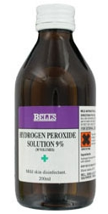
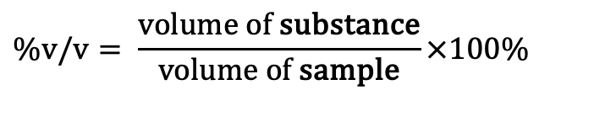
Percentage concentrations
The composition and purity of materials are commonly expressed as a percentage.
There are calculations and extra details in the notes.
Percentage volume in volume (% v/v) = mL per 100 mL
Mixtures of liquids or gases are sometimes expressed
on a percentage volume in volume basis.
$$\text{\%}\text{v/v}= \frac{\text{v}\text{olume}\text{ of }\text{substance}}{\text{volume}\text{ of }\text{sample}}×100\%$$

Slide 33
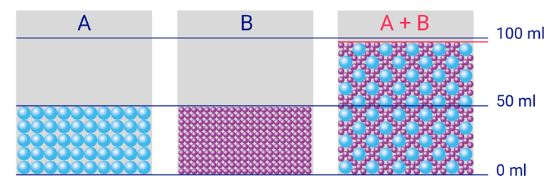
Percentage concentrations
The composition and purity of materials are commonly expressed as a percentage.
There are calculations and extra details in the notes.
Percentage volume in volume (% v/v) = mL per 100 mL
Mixtures of liquids or gases are sometimes expressed
on a percentage volume in volume basis.
Beware: When liquids are mixed, the final volume is rarely equal to the sum of the individual volumes – it can expand or contract. This is because molecules of different liquids can pack together more or less efficiently than they do in their pure states.
To prepare %v/v solutions accurately, take the specified volume of the solute and make it up to the required final volume with the solvent.

Slide 34
Preparing solutions by parts
A more accurate way to specify mixtures of liquids is by parts, giving a ratio of the original components:
Take care to avoid confusion between
ratios of components (e.g. 1:4 parts)
and ratios of composition (e.g. 1 part in 5)
Equivalent descriptions:
4 parts
1:4 ratio of components
1 part in 5
Approx. 20% v/v
1 part

Slide 35
Example: ethanol
Calculate the amount of ethanol (in mol) in one shot of vodka. The density of ethanol is 0.79 g/mL.
Read & identify
  What’s being asked? Number of moles of ethanol
  What data is given? Density, total volume of solution
  Knowledge: Chemical structure of ethanol
  Knowledge: One shot = 25 mL
  Knowledge: Vodka is 40% alcohol (v/v)
Estimate
  We already worked out there’s roughly one mole of water in 20 mL – about the same volume. However, ethanol only makes up about half the solution, and it’s a bigger molecule – about 3x the size of H₂O. So we estimate there’ll be a bit over 0.1 mole.

Slide 36
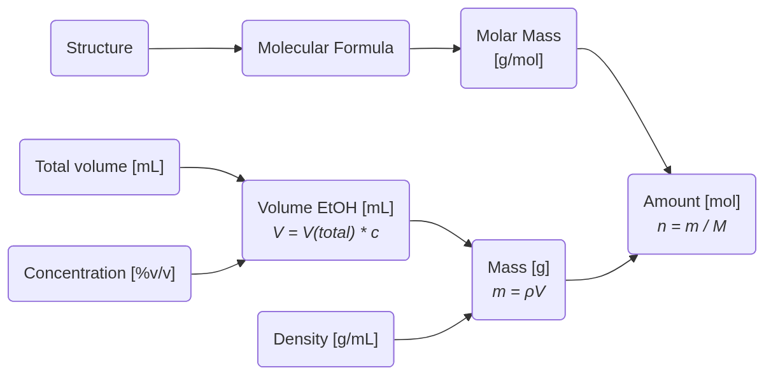
Example: ethanol
Calculate the amount of ethanol (in mol) in one shot of vodka. The density of ethanol is 0.79 g/mL.
3. Plan
4. Execute
5. Check
C₂H₆O
2x12 + 6 + 16
= 46 g/mol
25 mL
25 x 40 / 100 = 10 mL
7.9 / 46
= 0.17 mol
40% v/v
0.79 x 10
= 7.9 g
0.79 g/mL

Slide 37
Example: molar concentration of water
Calculate the molar concentration of water.
Read & identify
  What’s being asked? Molar concentration of water.
  What data is given? No data directly, so we need to rely on our knowledge…
  Knowledge: Chemical structure of water
  Knowledge: Density of water is 1 g / mL
Estimate
  This seems like an odd concept – perhaps you’re not sure where to even begin
  But concentrated solutions that you may have seen before are a few mol/L, so it seems likely that it must be higher than this – after all, there’s lots of water in a sample of water!

Slide 38
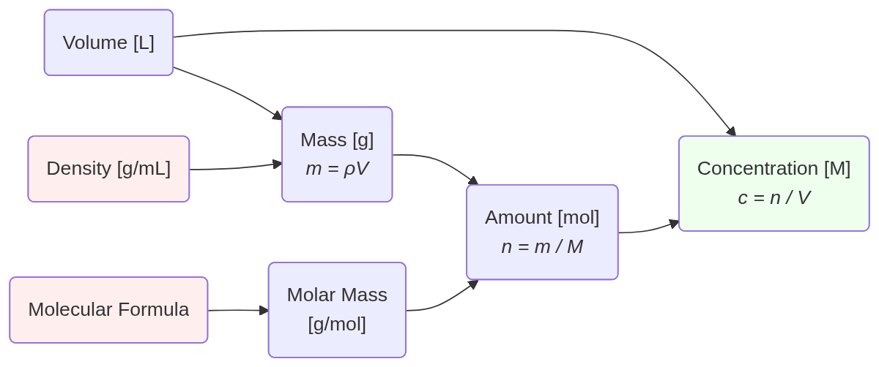
Example: molar concentration of water
Calculate the molar concentration of water.
3. Plan
4. Execute
5. Check
1 L
1 g/mL
1000 g
55.6 / 1
= 55.6 M
1000 / 18
= 55.6 mol
H₂O
18 g/mol

Slide 39
Example: aspirin
We already calculated that a 300 mg aspirin tablet contains 1.67 mmol of aspirin.
Estimate the number of molecules of aspirin present in a typical cell after taking this tablet.
1. Read and Identify:
What do we want? Number of molecules of aspirin
What information are we given? Total amount of aspirin in body
Knowledge: Body is roughly 60% water, adults weigh around 65 kg
Knowledge: ‘Typical’ eukaryotic cells are about 15 μm in diameter
Assumptions: Molecules distribute equally across body
2. Estimate:
If we’ve got about 1 mmol distributed across tens of litres, we expect a concentration roughly 10–100 μΜ
Avogadro’s constant is huge but cells are small! We should expect a large but not astronomical number…

Slide 40
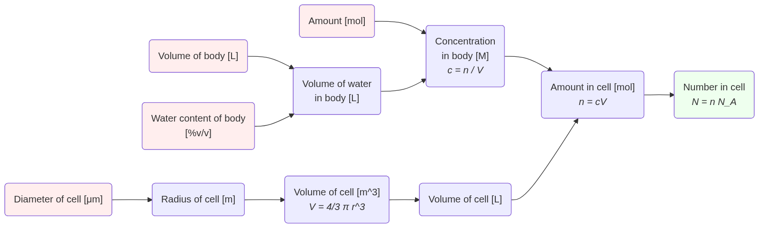
Example: aspirin
We already calculated that a 300 mg aspirin tablet contains 1.67 mmol of aspirin.
Estimate the number of molecules of aspirin present in a typical cell after taking this tablet.
4.3 x 10⁻⁵
x 1.8 x 10⁻¹²
7.7 x 10⁻¹⁸ mol
x 6.022 x 10²³ mol⁻¹
0.00167 mol
65 L
0.00167 / 39
= 4.3 x 10⁻⁵ M
65 x 60/100
= 39 L
7.7 x 10⁻¹⁸ mol
46 million
60% v/v
15 μm
7.5 x 10⁻⁶ m
1.8 x 10⁻¹⁵ m³
1.8 x 10⁻¹² L

Slide 41
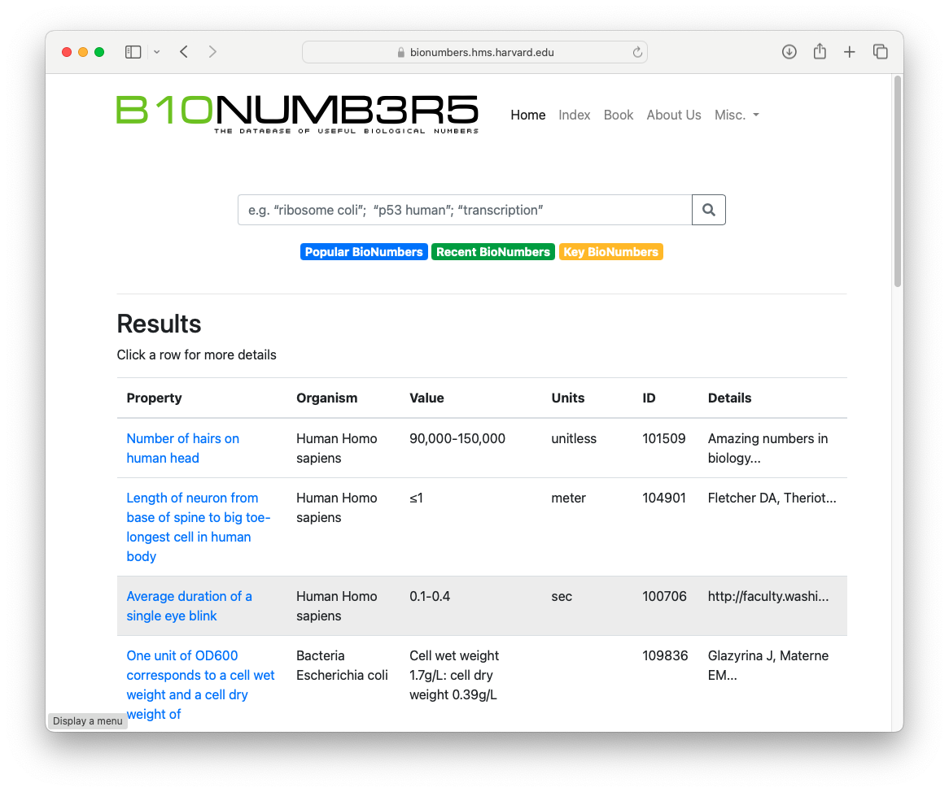

Slide 42
Chemical reactions

Slide 43
Stoichiometry of chemical reactions
Determining the stoichiometry (ratio) in which two or more compounds react is straightforward:
Every component on each side of the equations needs to balance.
For example, acid base reactions:
__ HCl + __ NaOH → __ NaCl + __ H₂O
__ H₃PO₄ + __ Na₂CO₃ → __ Na₃PO₄ + __ CO₂ + __ H₂O

Slide 44
Product formation and chemical yield
How efficient are chemical reactions?
We cannot always assume that all chemical reactions work perfectly
i.e. that all of the reactant is converted to product…
Some reactions work well…
  e.g. the reaction between sodium hydroxide and hydrochloric acid
and some work poorly or not at all…

Slide 45
Product formation and chemical yield
The success of a chemical reaction depends on a number of factors:
  the reaction conditions (temperature, pressure, time, solvent)
  choice of reactants and reagents
  properties of the starting material
  activation energy of the chemical reaction
  stability of the starting materials and products
  side reactions
  ease and efficiency of product isolation
  operator related factors – loses due to handling etc.

Slide 46
Calculating chemical yields
The stoichiometry tells us how much product we should expect based on a given amount of starting material.
If we know the amount of product we obtained, then we can calculate the yield of the reaction
(i.e. how efficient the reaction has been), based on the amount of product formed relative to the amount of starting material.
But first, we need to determine which reagent is limiting
Analogy: If we’re making sandwiches, and have 5 slices of cheese and 6 pieces of bread, what’s the limiting reagent? How many sandwiches would we expect for “100% yield”?
$$\text{yield}=\frac{\text{amount of }\text{product (}\text{mol)}}{\text{amount of limiting reagent (mol)}}×\text{ relative stoichiometry} ×100\%$$

Slide 47
Example: calculating yields
Calculate the yield of this reaction:
1. Read and Identify:
What do we want? Reaction yield (in %)
What information are we given? Chemical structures, masses of reagents and products
2. Estimate:
We have equal masses of two reagents, so expect that the heavier molecule – salicylic acid – will be limiting
We have equal masses of starting material and product, but the product is a bit heavier. So we expect the yield will be less than 100%. It doesn’t look like the product has doubled in size though so the yield will be greater than 50%. Maybe something around 75%…
1.0 g
1.0 g
1.0 g

Slide 48
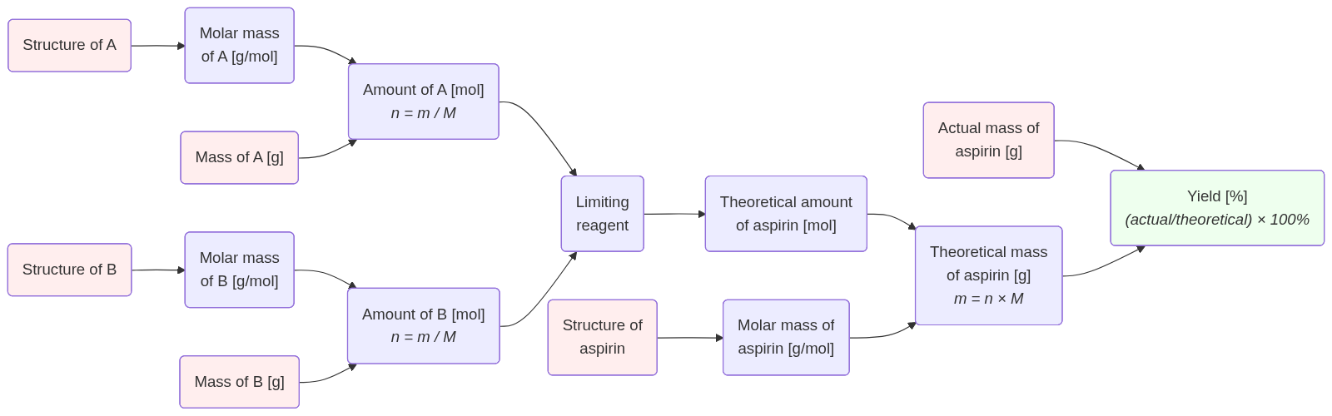
Example: calculating yields
A
B
Calculate the yield of this reaction:
3. Plan
1.0 g
1.0 g
1.0 g
C₇H₆O₃
138 g/mol
0.00725 mol
1.0 g
1.0 g
A
0.00725 mol
76.7 %
C₄H₆O₃
102 g/mol
1.304 g
0.00980 mol
C₉H₈O₄
180 g/mol
1.0 g

Slide 49
Product formation and chemical yield
The yield is typically less than 100% due to the factors outlined earlier.
Conservation of matter means that the yield should not exceed 100%!
A yield of greater than 100% may indicate:
  Contamination of the product
  The product is not dry
  Weighing error

Slide 50
Multistep procedures
Most drug syntheses are multistep processes with several different chemical procedures being required to make the final drug molecule.
Synthetic procedures can be linear in nature:
or convergent:

Slide 51
Chemical yield in multistep procedures
What’s the cumulative yield of a multistep process?
To calculate the cumulative yield, take the product of all the individual steps:
i.e. 0.9 x 0.9 x 0.9 x 0.9 x 0.9 x 100% = 59%
Remember, you still need to work out the limiting reagent for each step when calculating individual yields.
90%
90%
90%
90%
90%

Slide 52
Chemical yield in multistep procedures
What’s the cumulative yield of a multistep process?
To calculate the cumulative yield, take the product of all the individual steps:
i.e. 0.5 x 0.9 x 0.9 x 0.9 x 0.9 x 100% = 33%
If the yield of the first step is 50% and the other steps is 90% then the overall yield is 33%.
50%
90%
90%
90%
90%

Slide 53
Chemical yield in multistep procedures
What’s the cumulative yield of a multistep process?
To calculate the cumulative yield, take the product of all the individual steps:
i.e. 0.5 x 0.5 x 0.5 x 0.5 x 0.5 x 100% = 3%
If the yields of all steps are 50% then the overall yield drops to just 3%! This can have a big impact on the cost of manufacturing pharmaceutical products.
Convergent syntheses are favourable because they have fewer steps and therefore higher yields.
50%
50%
50%
50%
50%

Slide 54
Atom economy and sustainability in chemistry
Atom economy is a concept that measures the efficiency of a chemical reaction in terms of how well atoms are utilised.
It is calculated from the ratio of the molecular weight of the desired product to the total molecular weight of all reactants:
A higher atom economy indicates a more efficient reaction, where fewer atoms are wasted as by-products.
This concept is crucial in green chemistry – we try to reduce waste at the molecular level.
$$\text{atom}\text{ economy}=\frac{\text{molecular weight of product}}{\text{total molecular weight of starting materials}}×100\%$$

Slide 55
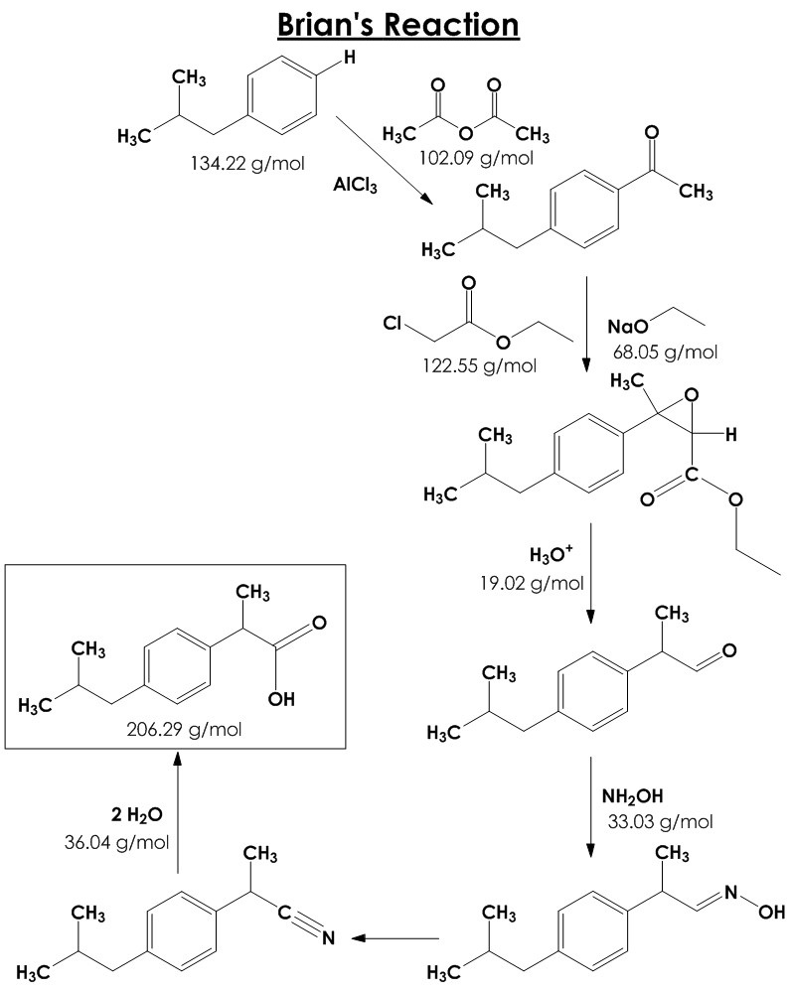
Example: synthesis of ibuprofen
Ibuprofen can be synthesised industrially by a six-step process.
You don’t need to understand the details of individual steps!
Molecular weight of reactants = 134.22 + 102.09 + 122.55 + 68.05 + 19.02 + 33.03 + 36.04 = 515.00
Molecular weight of product = 206.29
Atom efficiency = 206.29 / 515.00 x 100% = 40%
60% of atoms using in the synthesis are wasted!

Slide 56
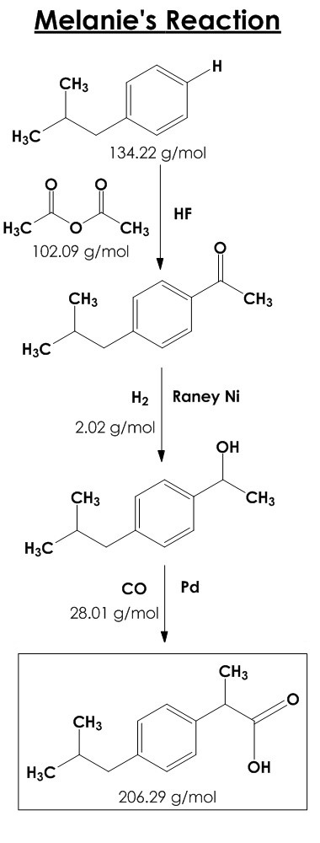
Example: synthesis of ibuprofen
Modern synthetic routes are often designed to have greater atom economy.
This reduces waste on the molecular level!
On an industrial scale, this can have a large impact on waste.
Exercise: calculate the atom efficiency of this more modern synthesis of ibuprofen and compare with the last slide.

Slide 57
PHAY0002
Pharmaceutical Analysis
Dr Chris Waudby
c.waudby@ucl.ac.uk
Room 439

Slide 58
Introduction and learning objectives
Pharmaceutical analysis ensures medicines are safe, effective, and contain the correct amount of active ingredient. Without reliable analytical methods, we cannot guarantee drug quality or patient safety.
You should understand:
How chemical reactivity enables quantitative analysis of pharmaceuticals
When and why different titration methods and indicators are used
The role of analytical standards in ensuring measurement accuracy
Why some analyses require back titration procedures
You should be able to:
Calculate drug purity and content from titration data
Analyse gravimetric and loss-on-drying results to determine substance quality

Slide 59
Chemistry in pharmaceutical analysis
Compounds can be assayed for amount or purity by chemical analysis:
A + B → C + D
Chemical processes used in analysis should be:
Specific for the substance being analysed
React quantitatively
React at a rate that is fast compared to the rate of addition
Have a suitable indicator to show when the reaction is complete
Be referenced to a suitable standard

Slide 60
Outline
Volumetric analysis – titrations
  How to calculate
BP and standards
  Primary standards
  Secondary standards
Volumetric analysis – indirect ‘back’ titrations
  Motivation – why are these necessary?
  Calculation example
Volumetric analysis – blank titrations
  Motivation – when you don’t know the exact concentration of your titrant
  Calculation example

Slide 61
Outline
Acidometric and alkalimetric titrations
  Indicators
  Non-aqueous titrations
Other types of titration reaction
  Redox
  Complexation
  Precipitation
Gravimetric analysis (brief)
Loss on drying
Conversion factors

Slide 62
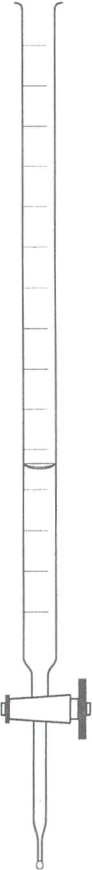
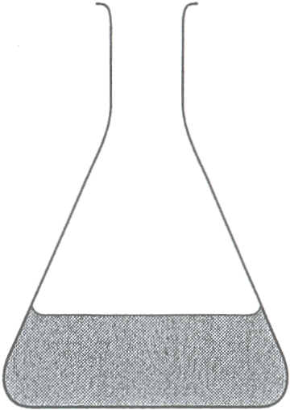
Volumetric analysis – practical aspects
A titration involves measuring, by volume, the amount of a reagent of known concentration (the titrant) which will react with the substance being determined (the titrand or analyte).
If the reaction proceeds according to a definite chemical equation, then from the volume of titrant used the amount of substance originally present may be calculated.
A typical titration involves the following steps:
  A known mass or volume of the analyte is measured into a conical flask, then dissolved in water (or other suitable reagent)
  An indicator is added
  The titrant is added from a burette until the indicator changes colour – the end-point
  From the volume of titrant added the amount of substance of interest is calculated

Slide 63
Volumetric analysis – indicators
Indicators show visibly when a reaction is complete, by giving a colour reaction with the reagent being added, or substance being determined, so that a small excess of either may be detected.
Ideally, an indicator should change colour when the amount of reagent added equals that required by the stoichiometry of the reaction.
  This is the stoichiometric point or equivalence point of the titration.
The point in the titration when the colour change actually occurs is known as the end-point of the titration.
The indicator used should be chosen so that the difference between the equivalence point and the end­point is as small as possible.
This difference is known as the titration error.

Slide 64
Volumetric analysis – calculation principles
A titration determines the amount of one substance by measuring how much of another substance is needed to react with it completely
The key principle is reaching the equivalence point – where the number of moles of titrant added exactly matches the number of moles of analyte present (accounting for the reaction stoichiometry)
For example, in a 1:1 reaction like HCl + NaOH → NaCl + H₂O
equivalence occurs when number of moles of HCl = number of moles of NaOH added

Slide 65
Volumetric analysis – calculation principles
A titration determines the amount of one substance by measuring how much of another substance is needed to react with it completely
The key principle is reaching the equivalence point – where the number of moles of titrant added exactly matches the number of moles of analyte present (accounting for the reaction stoichiometry)
In reactions with different stoichiometries (e.g. 2HCl + Na₂CO₃ → 2NaCl + CO₂ + H₂O),
equivalence occurs when the ratio of amounts matches the balanced equation
(here, 2 moles HCl for every 1 mole Na₂CO₃)

Slide 66
Example: acid-base titration
50.0 mL of a hydrochloric acid solution was titrated with a 0.0847 M sodium carbonate solution. If 30.31 mL of sodium carbonate solution was required to reach the end-point, what is the molarity of the hydrochloric acid solution?
Read and Identify:
  What’s being asked? Concentration of HCl solution
  What data is given? Concentration of sodium carbonate, volumes of HCl and sodium carbonate solutions

Slide 67
Example: acid-base titration
50.0 mL of a hydrochloric acid solution was titrated with a 0.0847 M sodium carbonate solution. If 30.31 mL of sodium carbonate solution was required to reach the end-point, what is the molarity of the hydrochloric acid solution?
Read and Identify:
  What’s being asked? Concentration of HCl solution
  What data is given? Concentration of sodium carbonate, volumes of HCl and sodium carbonate solutions
  Knowledge: Write a balanced equation for the chemical reaction that’s taking place
2HCl + Na₂CO₃ → 2NaCl + CO₂ + H₂O

Slide 68
Example: acid-base titration
50.0 mL of a hydrochloric acid solution was titrated with a 0.0847 M sodium carbonate solution. If 30.31 mL of sodium carbonate solution was required to reach the end-point, what is the molarity of the hydrochloric acid solution?
Read and Identify:
  What’s being asked? Concentration of HCl solution
  What data is given? Concentration of sodium carbonate, volumes of HCl and sodium carbonate solutions
  Knowledge: Write a balanced equation for the chemical reaction that’s taking place
Estimate:
  Only roughly half the volume of base solution was needed compared to the acid solution, so the base must have about twice the neutralising ability per mL
  But – each carbonate ion can neutralise two HCl molecules, which doubles its neutralising power!
  So we estimate the acid concentration is actually about the same as the base, roughly 0.09 M
2HCl + Na₂CO₃ → 2NaCl + CO₂ + H₂O

Slide 69
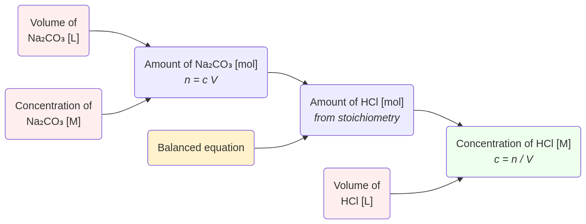
Example: acid-base titration
50.0 mL of a hydrochloric acid solution was titrated with a 0.0847 M sodium carbonate solution. If 30.31 mL of sodium carbonate solution was required to reach the end-point, what is the molarity of the hydrochloric acid solution?
3. Plan
4. Execute
5. Check
2HCl + Na₂CO₃ → 2NaCl + CO₂ + H₂O
0.03031 L
0.002567 mol
2 x 0.002567
= 0.0051345 mol
0.0847 M
0.0051345 / 0.050
= 0.1027 M
0.0500 L

Slide 70
Volumetric analysis – limitations
Volumetric calculations have two important things to bear in mind:
they require a knowledge of the exact chemical reactions taking place, and
in most practical assays it is the absolute amount of material and not the concentration that is of interest.

Slide 71

The British Pharmacopoeia
The British Pharmacopoeia (BP) is a reference book that documents standards for:
pharmaceutical substances (raw materials)
medicinal products

Slide 72
Standard solutions
Standard solutions are solutions of accurately and precisely known concentration
In the British Pharmacopeia standard solutions for use in titrations are always denoted by VS
  VS stands for ‘Volumetric Standard’
Examples:
  0.0166 M potassium iodate VS
  0.1 M sodium hydroxide VS
  1 M hydrochloric acid VS
Primary standard solutions are prepared by dissolving an exact mass of a pure substance in a known volume using a volumetric flask

Slide 73
Primary standards
Primary standards are chemicals with properties making them suitable for creating primary standard solutions.
Obtainable in very high purity (> 99.99% m/m).
Stable to heat so they may be dried. Allows moisture absorbed on storage to be removed.
Do not absorb/react with water, CO₂ or anything else from the air.
Have a high molecular mass so that weighing errors are small.
Readily soluble in solvent for titration.
Easily tested for impurities.
Few substances meets all these requirements.
Hydrated substances are rarely suitable – can easily lose their water of hydration – exact composition is uncertain.

Slide 74
Examples of primary standards in the BP
Benzoic acid – a standard acid. But, low solubility in water.
Potassium hydrogen phthalate (KHP) – a standard acid.
Potassium iodate - good redox standard.
Anhydrous sodium carbonate – used as a standard base. Storage difficult as readily absorbs water and carbon dioxide from the atmosphere.
Sodium chloride – used for standardising silver nitrate solutions.
Zinc – used for standardising EDTA solutions.

Slide 75
Secondary standards
The concentration of standard solutions of substances which can not be prepared directly must be determined by titration against suitable primary standards.
For example, solutions of hydrochloric acid are standardised by titration with sodium carbonate.
Sodium hydroxide solutions standardised by:
  titration with a standardised hydrochloric acid solution
  or titration with a primary standard such as benzoic acid.
Standards that are determined relative to a primary standard are called secondary standards.

Slide 76
Volumetric analysis – indirect ‘back’ titrations
Many substances cannot be titrated directly.
  There may be no suitable reaction, or the reaction may be too slow to allow direct titration.
A procedure known as a back titration can be used in such cases.
  A known quantity of a standard solution is added (in excess) to the sample and allowed to react.
  The amount of unreacted solution is then determined by titration with some other suitable standard titrimetric solution.
  The difference between the amount of reagent taken and the amount in excess gives the amount used by the sample.

Slide 77
Volumetric analysis – indirect ‘back’ titrations
React remainder
with titrant
known volume &
concentration
React with analyte
unknown amount
Starting solution
of titrand
known volume &
concentration
Some titrand
remains unreacted
Equivalence point
All titrand has reacted
starting amount = amount reacted + amount titrated

Slide 78
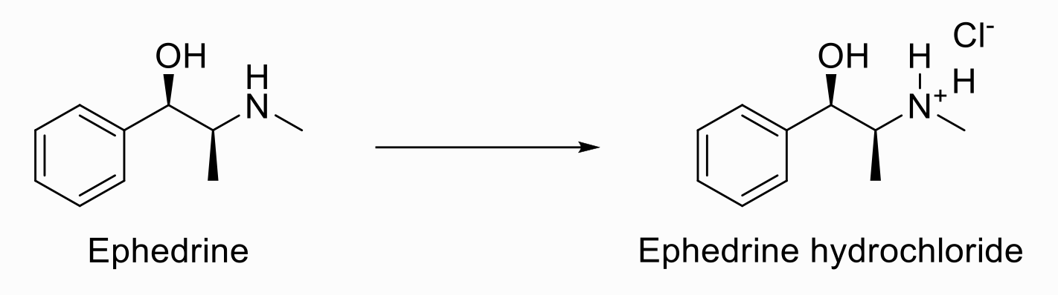
Example: Determination of ephedrine
A 0.198 g sample of ephedrine in 5 mL of ethanol
was treated with 20.0 mL of 0.098 M hydrochloric
acid. The excess acid was titrated with 0.110 M
sodium hydroxide solution and 7.15 mL was required. Calculate the percentage C₁₀H₁₅NO in the sample.
Ephedrine (C₁₀H₁₅NO) M = 165.2 g/mol
1. Read and Identify
  What’s being asked? Percentage content of ephedrine in original sample (assume %m/m)
  What data is given? Mass of ephedrine, molar mass of ephedrine, concentrations of acid and base, volumes of acid and base
  Knowledge: Balanced equations
  There’s a lot of information here – draw a simple diagram to see what’s going on
HCl

Slide 79
Example: Determination of ephedrine
A 0.198 g sample of ephedrine in 5 mL of ethanol
was treated with 20.0 mL of 0.098 M hydrochloric
acid. The excess acid was titrated with 0.110 M
sodium hydroxide solution and 7.15 mL was required. Calculate the percentage C₁₀H₁₅NO in the sample.
Ephedrine (C₁₀H₁₅NO) M = 165.2 g/mol
HCl
React with
ephedrine sample
unknown amount
Titrate with NaOH
7.15 mL, 0.110 M
Acid (HCl)
20 mL, 0.098 M
Some acid
remains unreacted
Equivalence point
All the acid has reacted

Slide 80
Example: Determination of ephedrine
HCl
A 0.198 g sample of ephedrine in 5 mL of ethanol
was treated with 20.0 mL of 0.098 M hydrochloric
acid. The excess acid was titrated with 0.110 M
sodium hydroxide solution and 7.15 mL was required. Calculate the percentage C₁₀H₁₅NO in the sample.
Ephedrine (C₁₀H₁₅NO) M = 165.2 g/mol
2. Estimate
  Estimation gets harder as problems get more complex – but if we’re dealing with a pharmaceutical analysis we’re probably expecting purities close to 100%
  Acid and base concentrations are similar, indicating roughly 20 - 7 = 13 mL acid reacted with the drug
  An acid concentration about 0.1 M corresponds to 1.3 mmol
  MW around 150 would give a mass of roughly 200 mg – close to 100% purity

Slide 81
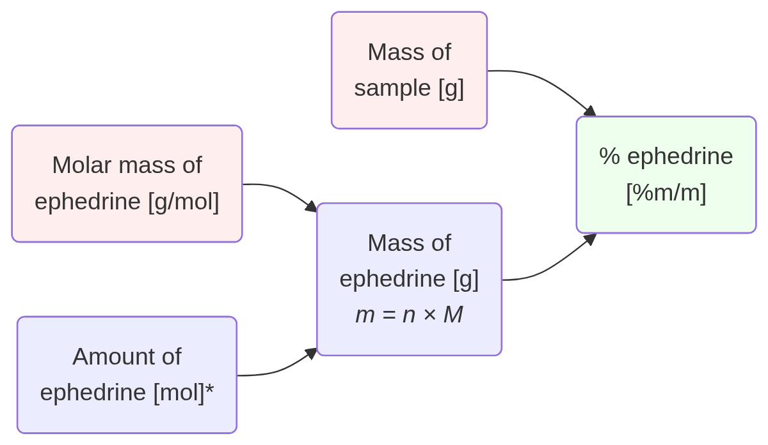
Example: Determination of ephedrine
3. Plan
Start by working backwards…

Slide 82
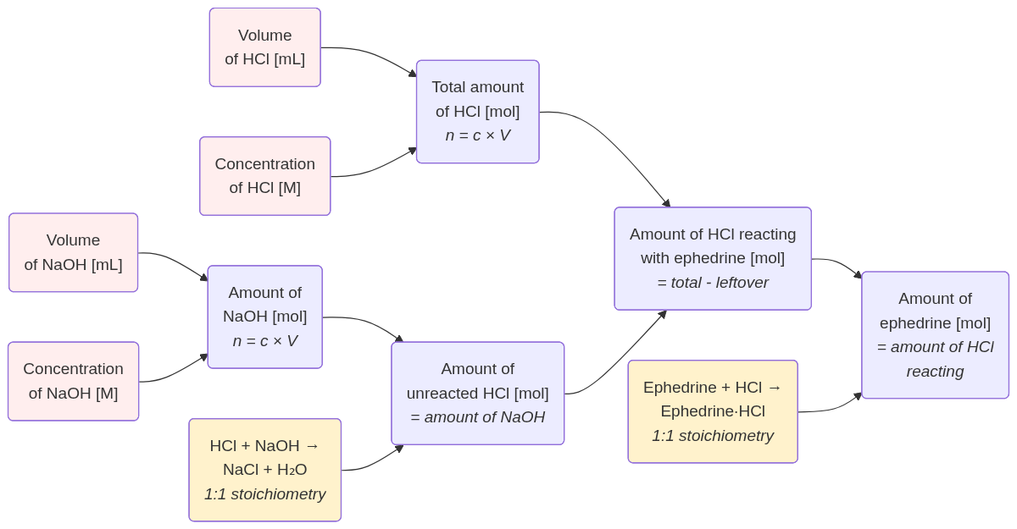
Example: Determination of ephedrine
3. Plan
Break up calculation into two stages:
(i) amount of ephedrine
(ii) purity of sample
4. Execute
5. Check
20.0 mL
1.96 mmol
0.098 M
7.15 mL
1.1735 mmol
0.7865 mmol
1.1735 mmol
0.110 M
0.7865 mmol

Slide 83
Example: Determination of ephedrine
3. Plan
Break up calculation into two stages:
(i) amount of ephedrine
(ii) purity of sample
4. Execute
5. Check
0.198 g
165.2 g/mol
97.9%
0.1939 g
1.1735 mmol

Slide 84
Volumetric analysis – indirect ‘back’ titrations
React remainder
with titrant
known volume &
concentration
React with analyte
unknown amount
Starting solution
of titrand
known volume &
known concentration
Some titrand
remains unreacted
Equivalence point
All titrand has reacted
starting amount = amount reacted + amount titrated

Slide 85
What if one concentration is unknown?
React remainder
with titrant
known volume &
UNKNOWN
concentration
React with analyte
unknown amount
Starting solution
of titrand
known volume &
known concentration
Some titrand
remains unreacted
Equivalence point
All titrand has reacted
starting amount = amount reacted + ???

Slide 86
Volumetric analysis – blank titrations
React
with titrant
known volume &
UNKNOWN
concentration
Starting solution
of titrand
known volume &
known concentration
Equivalence point
All titrand has reacted
starting amount = amount of titrant

Slide 87

Volumetric analysis – blank titrations
If the concentration of titrant is unknown, its concentration can be determined using a blank titration
  A known quantity of a standard solution is prepared
  The concentration of the titrant is then determined by titration
  The calculated concentration can then be used for further analysis

Slide 88
Example: ephedrine again
A 0.3400 g sample of pseudoephedrine was dissolved in ethanol and 12.5 mL of 0.108 M sulphuric acid was added. The excess acid was back titrated with approximately 0.1 M sodium hydroxide solution and 5.67 mL was required. A blank titration was performed and 23.48 mL of sodium hydroxide solution was required.
The BP requires pseudoephedrine to contain not less than 99.0 per cent and not more than the equivalent of 101.0 per cent C₁₀H₁₅NO. (Molar mass = 165.2 g/mol)
Determine whether the sample complies with the requirements of the assay.

Slide 89
Example: ephedrine again
A 0.3400 g sample of pseudoephedrine was dissolved in ethanol and 12.5 mL of 0.108 M sulphuric acid was added. The excess acid was back titrated with approximately 0.1 M sodium hydroxide solution and 5.67 mL was required. A blank titration was performed and 23.48 mL of sodium hydroxide solution was required.
The BP requires pseudoephedrine to contain not less than 99.0 per cent and not more than the equivalent of 101.0 per cent C₁₀H₁₅NO. (Molar mass = 165.2 g/mol)
Determine whether the sample complies with the requirements of the assay
1. Read and identify
What’s being asked? Percentage content of ephedrine vs BP limits (assume %m/m)
What data is given? BP specifications, mass of ephedrine, molar mass of ephedrine, concentration of acid, volumes of acid and base, volume for blank titration
Knowledge: Balanced equations

Slide 90
Example: ephedrine again
A 0.3400 g sample of pseudoephedrine was dissolved in ethanol and 12.5 mL of 0.108 M sulphuric acid was added. The excess acid was back titrated with approximately 0.1 M sodium hydroxide solution and 5.67 mL was required. A blank titration was performed and 23.48 mL of sodium hydroxide solution was required.
The BP requires pseudoephedrine to contain not less than 99.0 per cent and not more than the equivalent of 101.0 per cent C₁₀H₁₅NO. (Molar mass = 165.2 g/mol)
Determine whether the sample complies with the requirements of the assay
2. Estimate
Estimation gets harder as problems get more complex – but if we’re dealing with a pharmaceutical analysis we’re probably expecting purities close to 100%
We’re already told to expect a concentration of sodium hydroxide around 0.1 M

Slide 91
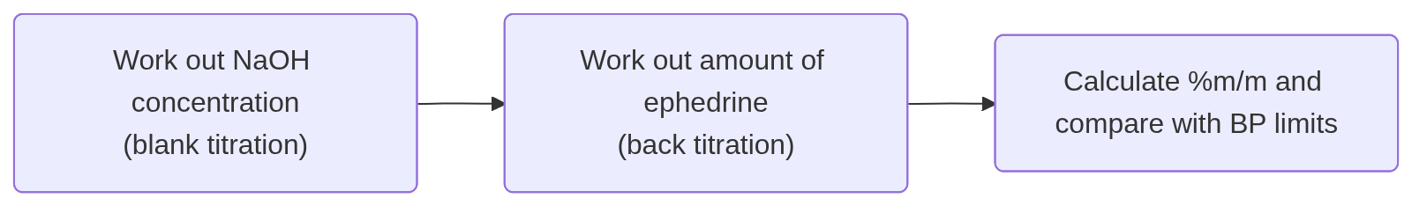
Example: ephedrine again
A 0.3400 g sample of pseudoephedrine was dissolved in ethanol and 12.5 mL of 0.108 M sulphuric acid was added. The excess acid was back titrated with approximately 0.1 M sodium hydroxide solution and 5.67 mL was required. A blank titration was performed and 23.48 mL of sodium hydroxide solution was required.
The BP requires pseudoephedrine to contain not less than 99.0 per cent and not more than the equivalent of 101.0 per cent C₁₀H₁₅NO. (Molar mass = 165.2 g/mol)
Determine whether the sample complies with the requirements of the assay
3. Plan

Slide 92
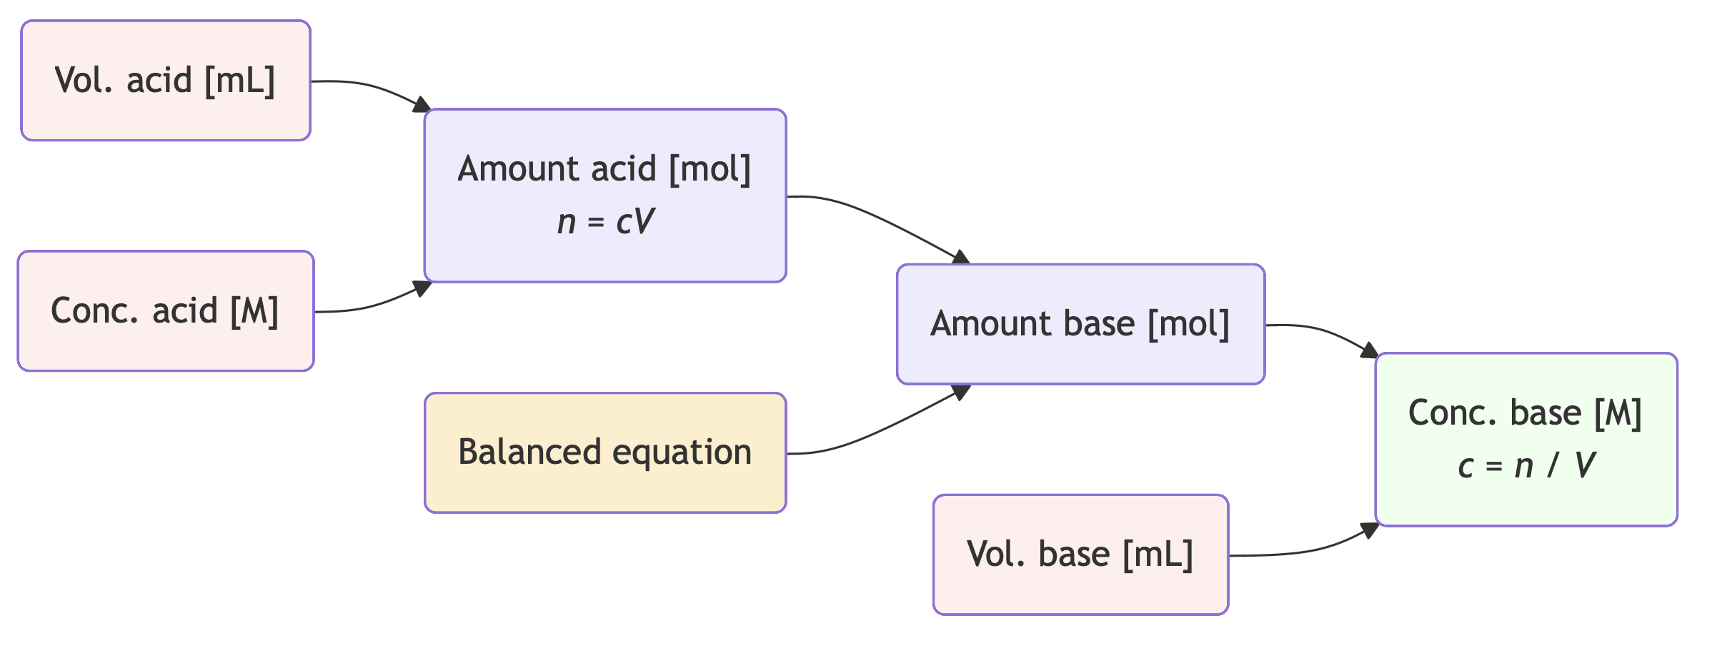
Step 1: Blank titration
acid
+ NaOH
A 0.3400 g sample of pseudoephedrine was dissolved in ethanol and 12.5 mL of 0.108 M sulphuric acid was added. The excess acid was back titrated with approximately 0.1 M sodium hydroxide solution and 5.67 mL was required. A blank titration was performed and 23.48 mL of sodium hydroxide solution was required.
12.5 mL
0.00135 mol
0.108 M
0.0027 mol
H₂SO₄ + 2 NaOH → Na₂SO₄ + 2 H₂O
0.1145 M
23.48 mL
Notes:
flowchart LR
vA("Vol. acid [mL]"):::R --> nA
cA("Conc. acid [M]"):::R --> nA
nA("Amount acid [mol]
*n = cV*") --> nB
eq("Balanced equation"):::Y --> nB
nB("Amount base [mol]") --> cB
vB("Vol. base [mL]"):::R --> cB
cB("Conc. base [M]
*c = n / V*"):::G
classDef R fill:#fee
classDef G fill:#efe
classDef Y fill:#fec

Slide 93
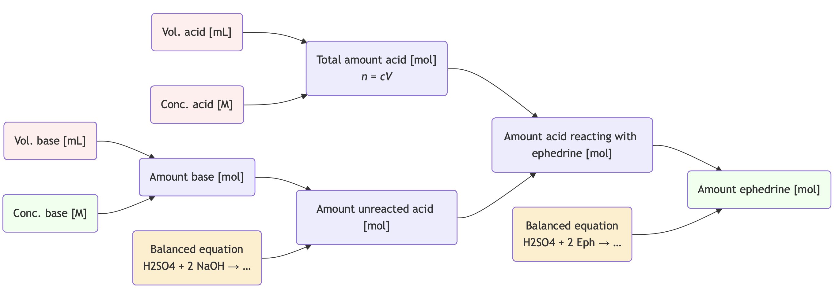
Step 2: Back titration
acid
+ ephedrine
+ base
A 0.3400 g sample of pseudoephedrine was dissolved in ethanol and 12.5 mL of 0.108 M sulphuric acid was added. The excess acid was back titrated with approximately 0.1 M sodium hydroxide solution and 5.67 mL was required. A blank titration was performed and 23.48 mL of sodium hydroxide solution was required.
0.3388 g
12.5 mL
0.00135 mol
0.108 M
5.67 mL
0.001025 mol
0.0006492 mol
0.002051 mol
0.1145 M
0.0003246 mol
Notes:
flowchart LR
vA("Vol. acid [mL]"):::R --> nA
cA("Conc. acid [M]"):::R --> nA
nA("Total amount acid [mol]
*n = cV*") --> x
vB("Vol. base [mL]"):::R --> nB
cB("Conc. base [M]"):::G --> nB
nB("Amount base [mol]") --> unreacted
eq("Balanced equation
H2SO4 + 2 NaOH → …"):::Y --> unreacted
unreacted("Amount unreacted acid [mol]") --> x
x("Amount acid reacting with ephedrine [mol]") --> nE
eq2("Balanced equation
H2SO4 + 2 Eph → …"):::Y --> nE
nE("Amount ephedrine [mol]"):::G
classDef R fill:#fee
classDef G fill:#efe
classDef Y fill:#fec

Slide 94
Step 3: Complete the calculation
The BP requires pseudoephedrine to contain not less than 99.0 per cent and not more than the equivalent of 101.0 per cent C₁₀H₁₅NO. (Molar mass = 165.2 g/mol)
Determine whether the sample complies with the requirements of the assay.
0.3400 g
165.2 g/mol
99.6%
0.3388 g
0.002051 mol
Conclusion: Sample complies with BP specification

Slide 95
Acidometric and alkalimetric titrations
Many types of chemical reaction can be used for volumetric titrations.
So far, we have looked at acid–base titrations:
  Acid + Base → Salt
  For example, the analysis of ephedrine
The titration of free bases with a standard acid (acidimetry), and the titration of free acids with a standard base (alkalimetry) are common tests in the BP.
Benzoic acid and potassium hydrogen phthalate are
widely used as primary standard acids.
Anhydrous sodium carbonate is used as a primary
standard base.

Slide 96
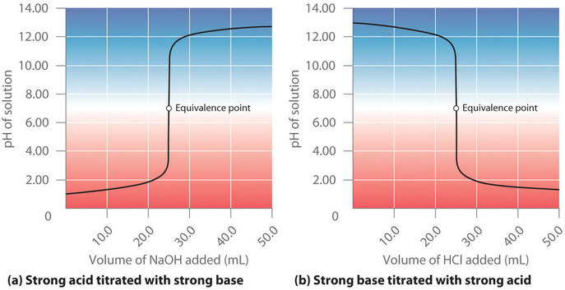
Acidometric and alkalimetric titrations
As a titration proceeds, we expect a sharp change in the pH of the solution at the equivalence point, when the acid or base being titrated is fully neutralised.
We will see later in the term how to calculate these curves.

Slide 97
Indicators for acid–base titrations
Chemical indicators are typically used for end-point detection in acid-base titrations.
An indicator is simply a weak organic acid in which the various ionised states differ in colour.
There is a rapid change in pH when the reaction is complete.
The indicator is chosen so that the colour change occurs as close to the equivalence point as possible.
  e.g. methyl orange

Slide 98
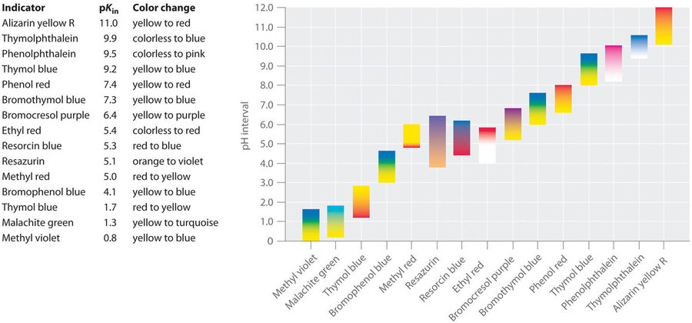
Indicators for acid–base titrations
A variety of indicators are available depending on the expected pH change at the equivalence point (you do not need to know these names!)

Slide 99
Non-aqueous titrations
The strongest possible acid in water is the H₃O⁺ ion, which in the presence of excess water, is not sufficiently acidic to give a sharp end-point with weak bases such as amines.
OH– is the strongest base in water, but is not strong enough for the accurate determination of weak acids such as phenols.
These limitations at both ends of the scale are so serious that many classes of compounds cannot be determined by titration in aqueous solution.
Many organic compounds have very limited solubility in water and this also makes titration in aqueous media difficult.
By using solvents other than water the range of acids and bases which can be determined may be extended.

Slide 100
Non-aqueous titrations – example
An amine (R–NH₂) dissolved in water is titrated with a strong acid (H⁺).
The added H⁺ can react with the nitrogen lone pair forming R–NH₃⁺.
But H⁺ could also react with an oxygen lone pair in water forming H₃O⁺.
Competition for H⁺ between a weak base and solvent water during a titration means that there will not be a sharp change in pH and it may be difficult to detect the end-point of the titration.

Slide 101
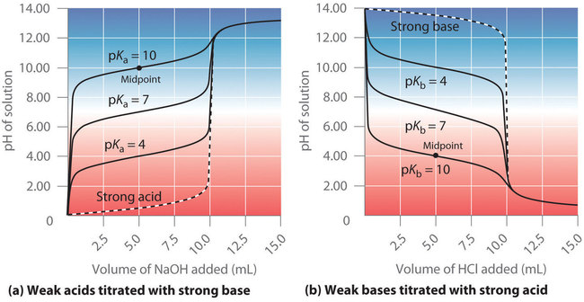
Non-aqueous titrations
pK_{a} is a measurement of the strength of an acid or base. We will explore this later in the term.
High pK_{a} values indicate a weak acid, and low pK_{a} values indicate a weak base.

Slide 102
Other types of reaction – redox titrations
In redox reactions, one component of the reaction is reduced and the other component is oxidised.
There is a transfer of electrons.
(Whether a reaction actually occurs depends on the redox potentials of the corresponding half reactions.)
Full reaction equations can be generated by matching the number of electrons on each side of the relevant half reactions.
Mnemonic to help distinguish reduction and oxidation: OIL RIG
O Oxidation
I Is
L Loss (of electrons)
R Reduction
I Is
G Gain (of electrons)

Slide 103
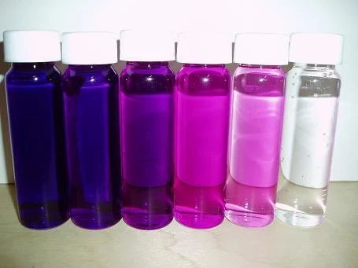
Redox – potassium permanganate (KMnO₄)
Potassium permanganate is a cheap, widely used oxidising agent.
Half reaction:
  MnO₄– + 8H⁺ + 5e– → Mn²⁺ + 4H₂O
  Ensure the charge is balanced when writing half reactions!
Most permanganate titrations are performed using 0.02 M KMnO₄.
Titrations are self-indicating – first drop of excess permanganate gives a pink colouration to the solution (Mn2+ salts are colourless, where as the MnO4- ions are a deep purple colour in solution).

Slide 104
Example – potassium permanganate (KMnO₄)
Determination of iron(II) by oxidation to iron(III) using KMnO₄
Half reactions:
  Fe²⁺ → Fe³⁺ + e–
  MnO₄– + 8H⁺ + 5e– → Mn²⁺ + 4H₂O
Full reaction:
  MnO₄– + 5Fe²⁺ + 8H⁺ → Mn²⁺ + 5Fe³⁺ + 4H₂O
  Match the number of electrons for both half reactions

Slide 105
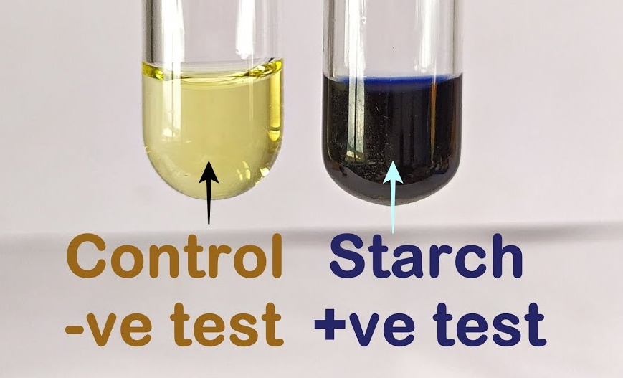
Example – sodium thiosulphate (Na₂S₂O₃)
Sodium thiosulphate (Na₂S₂O₃.5H₂O) is a reducing agent used for the titration of iodine.
Half reactions:
  2S₂O₃^{2–} → S₄O₆^{2–} + 2e–
  I₂ + 2e– → 2I–
Full reaction:
  2S₂O₃^{2–} + I₂ → S₄O₆^{2–} + 2I–
The colour of iodine clearly indicates its first appearance or disappearance from a solution.
For added sensitivity starch is usually added as an indicator to give the blue starch-iodine colour.

Slide 106
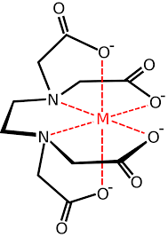
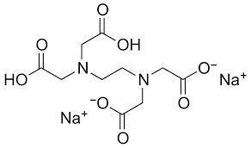
Complexometric titrations
These reactions usually involve a complex forming reaction between a metal ion and a chelating agent.
The most important titrant in this class is ethylenediamine-tetraacetic acid (EDTA) which is widely used for the determination of metal ions.
  The free acid is not very soluble in water and solutions of the disodium salt are used in titrimetry. The BP refers to the disodium salt as disodium edetate.
EDTA is a polydentate ligand and forms chelate complexes.
EDTA always reacts to form 1:1 complexes with metal ions irrespective of the valency of the metal ion.

Slide 107
Precipitation titrations
Not used very often in analysis.
The most important titrations are those between silver nitrate and halide ions.
  e.g. Ag⁺ + Cl– → AgCl(s)
Volumetric methods in which silver nitrate is used are often called argentimetric methods.
  These methods are commonly used for the determination of chloride and bromide.
  The equivalence point occurs when no further precipitation is observed.
  Silver may be determined by using the procedure in reverse.

Slide 108
Volumetric analysis – conversion factors
A volumetric conversion factor simply gives the mass of the substance being determined equivalent to each mL of titrant.
Official analytical procedures such as those in the British Pharmacopoeia rarely require you to know the details of the chemistry involved. Instead, the methods provide conversion factors for performing the calculations.
Example:
Dissolve 0.120 g in 30 mL of ethanol and add 20 mL of water. Titrate with 0.1 M sodium hydroxide. 1 mL of 0.1 M sodium hydroxide is equivalent to 13.81 mg of C₇H₆O₃.

Slide 109
Example: salicylic acid
Dissolve 0.120 g in 30 mL of ethanol and add 20 mL of water. Titrate with 0.1 M sodium hydroxide. 1 mL of 0.1 M sodium hydroxide is equivalent to 13.81 mg of C₇H₆O₃.
A 0.132 g sample of material was analysed according to the procedure above. A 0.107 M NaOH solution was used and 8.2 mL was required to reach the end-point. Calculate the percentage salicylic acid in the sample.
1. Read and identify:
  What’s being asked? Percentage salicylic acid (assume %m/m)
  What data is given? Conversion factor, concentrations quoted and used, mass of sample, volume of titrant
2. Estimate
  Our NaOH is a little stronger, but it’s roughly 10 mL at 0.1 M
  This would correspond to 138 mg, so our answer should be fairly close to 100% m/m

Slide 110
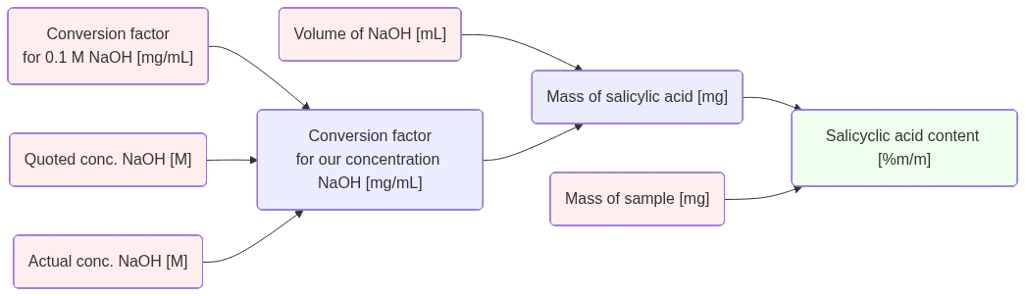
Example: salicylic acid
Dissolve 0.120 g in 30 mL of ethanol and add 20 mL of water. Titrate with 0.1 M sodium hydroxide. 1 mL of 0.1 M sodium hydroxide is equivalent to 13.81 mg of C₇H₆O₃.
A 0.132 g sample of material was analysed according to the procedure above. A 0.107 M NaOH solution was used and 8.2 mL was required to reach the end-point. Calculate the percentage salicylic acid in the sample.
3. Plan
4. Execute
5. Check
8.2 mL
13.81 mg/mL
14.78 x 8.2 = 121.2 mg
0.1 M
91.8% m/m
(0.107 / 0.100) x 13.81
= 14.78 mg/mL
132 mg
0.107 M
Notes:
flowchart LR
v("Volume of NaOH [mL]"):::R --> ms
cf("Conversion factor
for 0.1 M NaOH [mg/mL]"):::R --> rc
qc("Quoted conc. NaOH [M]"):::R --> rc
c("Actual conc. NaOH [M]"):::R --> rc
rc("Conversion factor
for our concentration NaOH [mg/mL]") --> ms
ms("Mass of salicylic acid [mg]") --> z
x("Mass of sample [mg]"):::R --> z
z("Salicyclic acid content [%m/m]"):::G
classDef R fill:#fee
classDef G fill:#efe
classDef Y fill:#fec

Slide 111
Gravimetric analysis
An alternative to volumetric analysis.
The desired constituent of the test material is isolated and weighed.
Generally, the desired constituent is converted into a pure stable compound that can easily be isolated and weighed.
The compound that is weighed is called the ‘weighing form’. Simple calculation gives the amount of the constituent under consideration.
For example, sulphate (SO₄²⁻) can be precipitated as barium sulphate (BaSO₄). The barium sulphate is filtered off, dried and weighed.
Gravimetric procedures are time consuming and are not widely used.
The British Pharmacopoeia contains few examples.

Slide 112
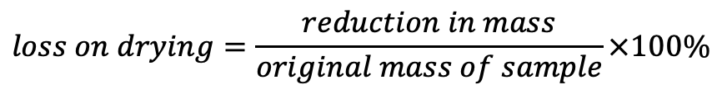
Gravimetric analysis: loss on drying
Many substances absorb moisture on storage.
The British Pharmacopoeia sets limits for such deterioration.
Gravimetric procedures are widely used for determining the moisture content.
A known mass of sample is dried at a specified temperature until a constant mass is obtained and the percentage loss in mass calculated.
Most BP specifications for content are with respect to the dried substance.
Assays may be carried out on a dried sample of the substance or an allowance for the loss on drying taken into account in the calculation.
$$loss on drying=\frac{reduction in mass}{original mass of sample}×100\%$$

Slide 113
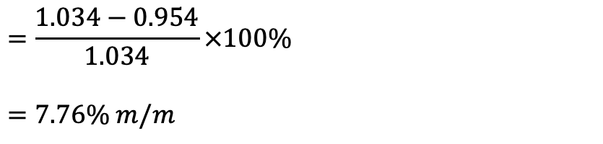
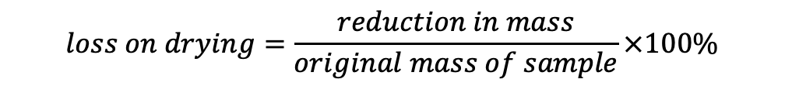
Example
1.034 g of a Fluorescein Sodium sample decreased in mass to 0.954 g on drying at 105°C. Calculate the loss on drying.
$$loss on drying=\frac{reduction in mass}{original mass of sample}×100\%$$
$$=\frac{1.034−0.954}{1.034}×100\%$$
$$=7.76\% m/m$$

Slide 114
Example
The BP(2008) requires Fluorescein Sodium to contain not less than 95.0 and not more than 103.0 per cent C₂₀H₁₀Na₂O₅ with respect to the dried substance. A sample was found to contain the equivalent of 91.8% m/m C₂₀H₁₀Na₂O₅. If the loss on drying was 7.76%, does the sample comply with the BP assay requirement?
1. Read and identify
  What’s being asked? Percentage content of (dried) fluorescein vs BP limits
  What data is given? BP specifications, loss on drying, %m/m of original (wet) sample
2. Estimate
  The %m/m should be higher once we correct for moisture content
  If I started with 100 mg, I’d have just over 92 mg after drying
  Both wet and dry samples will contain 91.8 mg fluorescein – so the purity will be just slightly under 100%

Slide 115

Example
The BP(2008) requires Fluorescein Sodium to contain not less than 95.0 and not more than 103.0 per cent C₂₀H₁₀Na₂O₅ with respect to the dried substance. A sample was found to contain the equivalent of 91.8% m/m C₂₀H₁₀Na₂O₅. If the loss on drying was 7.76%, does the sample comply with the BP assay requirement?
3. Plan
4. Execute
5. Check
91.8% m/m
91.8 mg
100 mg
91.8 / 92.24 x 100%
= 99.5% m/m
7.76%
100 x 7.76/100
= 7.76 mg
100 - 7.76
= 92.24 mg
Conclusion: Sample complies with BP specification
Notes:
flowchart LR
x("Fluorescein content of wet sample [%m/m]"):::R --> mfluor
wet("Wet mass [mg]") --> mfluor
mfluor("Mass of fluorescein [mg]") --> z
lod("Loss on drying [%]"):::R --> change
wet --> change("Change in mass [mg]") --> dry
dry("Dry mass [mg]") --> z
z("Fluorescein content of dried sample [%m/m]"):::G
classDef R fill:#fee
classDef G fill:#efe
classDef Y fill:#fec

Slide 116
Summary: ‘Classical’ analytical chemistry
When do we use classical analytical techniques?
Used for some drug substances and excipients
Used for some drugs in medicines – tablets, capsules, suspensions, etc
Used especially when instrumental methods may be unsuitable (e.g. lack of UV absorbance)
Used for standardising raw materials

Slide 117
Summary: ‘Classical’ analytical chemistry
Advantages
Robust methods that can be carried out very precisely
Automation is possible (e.g. automatic titrators etc.)
Fairly cheap, little specialist equipment is required
The methods do not depend on instrument calibration (but they do require pure substances for standards…)
Disadvantages
Require relatively large amounts of sample
Procedures are time consuming and depend upon the skill of the analyst
Methods can be relatively non-selective and are often unsuitable for complex mixtures of ingredients in formulated medicines
Chemical reactions that are exploited for these procedures need to be proceed rapidly to completion

