Slide 1
PHAY0002: Chemistry of Medicines
Tutorial 1
Structure &
Stoichiometry
Dr John Malkinson
Dr Chris Waudby

Slide 2
Structure and Bonding
Which of the following ions have closed-shell configurations? (a) H– (b) O– (c) Mg²⁺

Slide 3
Structure and Bonding
How many covalent bonds does phosphorous form to complete its valence shell in phosphine, PH_{x}? Similarly, complete the molecular formula CH₃NH_{x}.

Slide 4
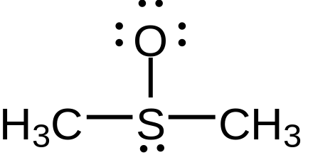
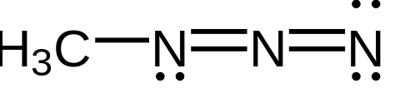
Structure and Bonding
Calculate the formal charges on the appropriate atoms in the following:

Slide 5
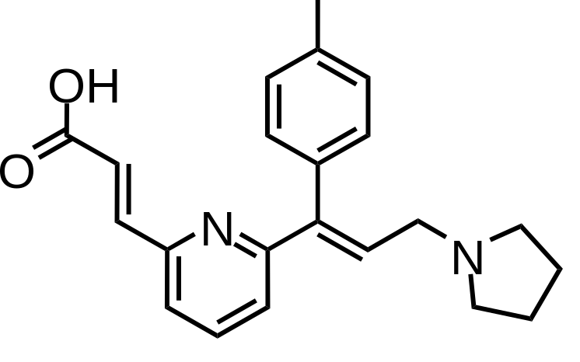
Structure and Bonding
Acrivastine is an anti-histamine. Hybridisation state of each C, N and O atom. Lone pairs. H-bond donors and acceptors?

Slide 6
Structure and Bonding
Molecular formula of acrivastine. How many moles of drug would be required to prepare 100 tablets if each tablet contains 8 mg of acrivastine.

Slide 7
Stoichiometry and Analysis
A buffer solution is made up with 0.0074 mol of potassium dihydrogen phosphate and 0.0175 mol of dipotassium hydrogen phosphate hexahydrate. Calculate the total mass of potassium in the final solution.

Slide 8
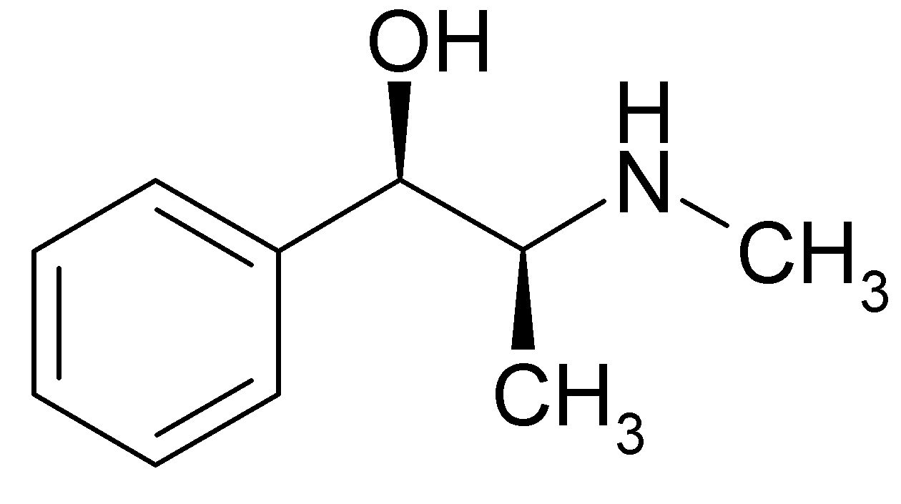
Stoichiometry and Analysis
If you mix 50 mL of a 2% w/v solution of ephedrine hydrochloride with 24 mL of a 5% w/v solution of ephedrine hydrochloride, what will the final % strength be? Calculate the molarity of the final mixture.
ephedrine

Slide 9
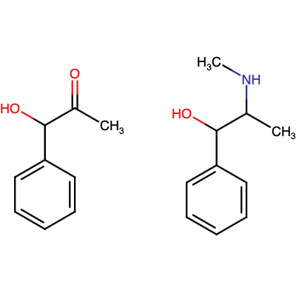
Stoichiometry and Analysis
Ephedrine is synthesised by the catalytic reduction of phenylacetylcarbinol by hydrogen gas in the presence of methylamine.
MeNH₂
H₂ (Pt catalyst)
phenylacetylcarbinol
ephedrine

Slide 10
Stoichiometry and Analysis
(a) 2.7 g of phenylacetylcarbinol were reacted with 0.7 g methylamine in the presence of excess hydrogen gas, and 2.77 g of ephedrine was obtained. Calculate the yield.
MeNH₂
H₂ (Pt catalyst)
phenylacetylcarbinol
ephedrine

Slide 11
Stoichiometry and Analysis
(b) Calculate the atom economy of the reaction.
MeNH₂
H₂ (Pt catalyst)
phenylacetylcarbinol
ephedrine

Slide 12
Stoichiometry and Analysis
A 150 mg vial of acetylcholine chloride (molecular formula C₇H₁₆ClNO₂) is specified with a purity of >98%. Acetylcholine chloride is a strong base and is determined by back-titration with hydrochloric acid. A primary standard of 0.02 M sodium carbonate solution is provided, together with a solution of approximately 0.03 M hydrochloric acid.

Slide 13
Stoichiometry and Analysis
A 150 mg vial of acetylcholine chloride (molecular formula C₇H₁₆ClNO₂) is specified with a purity of >98%. Acetylcholine chloride is a strong base and is determined by back-titration with hydrochloric acid. A primary standard of 0.02 M sodium carbonate solution is provided, together with a solution of approximately 0.03 M hydrochloric acid.
(a) 50.0 mL of acid was titrated with the sodium carbonate solution, and 36.0 mL was required to reach the equivalence point. Calculate the precise concentration of the acid.

Slide 14
Stoichiometry and Analysis
36.0 mL of primary standard: 0.02 M sodium carbonate
50.0 mL of ~0.03 M hydrochloric acid
Calculate precise concentration of HCl
___ Na₂CO₃ + ___ HCl → ___ NaCl + ___ CO₂ + ___ H₂O

Slide 15
Stoichiometry and Analysis
A 150 mg vial of acetylcholine chloride (molecular formula C₇H₁₆ClNO₂) is specified with a purity of >98%. Acetylcholine chloride is a strong base and is determined by back-titration with hydrochloric acid. A primary standard of 0.02 M sodium carbonate solution is provided, together with a solution of approximately 0.03 M hydrochloric acid.
(b) The contents of the vial were then dissolved in 50 mL of acid, and the titration was repeated. 16.0 mL were required to reach the equivalence point. Calculate the amount of acetylcholine in the vial.

Slide 16
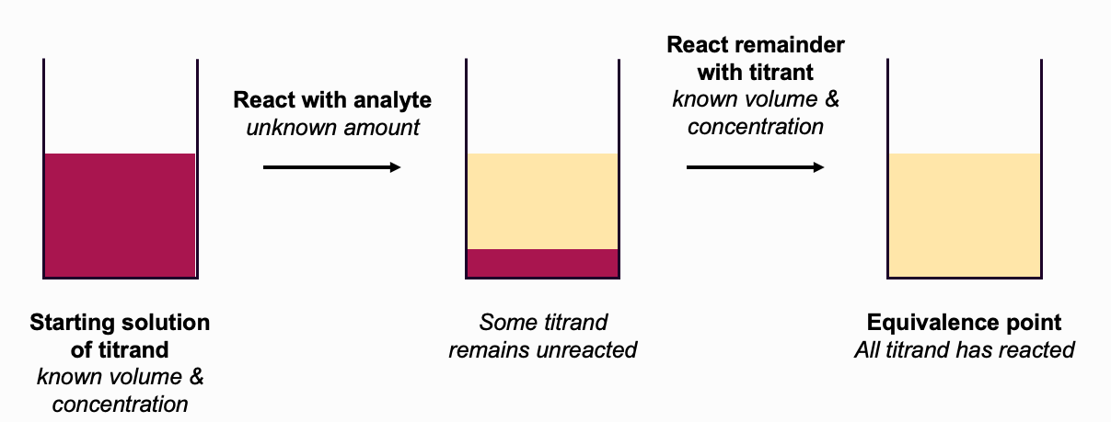
Stoichiometry and Analysis
150 mg vial of AChCl
– dissolved in 0.0288 M hydrochloric acid (50.0 mL)
– reacts 1:1 with HCl
– remaining HCl titrated with 0.02 M Na₂CO₃ (16.0 mL)
Calculate the amount of acetylcholine in the vial.

Slide 17
Stoichiometry and Analysis
A 150 mg vial of acetylcholine chloride (molecular formula C₇H₁₆ClNO₂) is specified with a purity of >98%. Acetylcholine chloride is a strong base and is determined by back-titration with hydrochloric acid. A primary standard of 0.02 M sodium carbonate solution is provided, together with a solution of approximately 0.03 M hydrochloric acid.
(c) Does it meet the specified purity?

Slide 18
Stoichiometry and Analysis
150 mg vial of AChCl (C₇H₁₆ClNO₂)
– specified with a purity of >98% (m/m)
– by titration, amount in vial = 0.00080 mol
Does it meet the specified purity?

