Slide 1
Final Capstone
Seattle/Bellevue/Redmond vs Nearby Cities

Slide 2
Introduction
Seattle/Bellevue/Redmond (Popular Cities)
“Eastside”
Tech companies: Amazon, Microsoft, Facebook
Raising housing price
Higher cost of living
Nearby Cities
Not as expensive
Further away from necessities
Bigger land
Lower cost of living

Slide 3
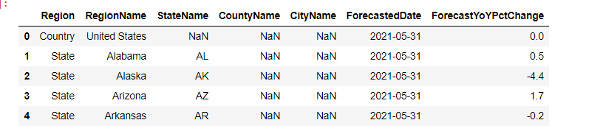
Finding nearby cities to explore
Zillow Housing Data
Home value forecast data can be downloaded from the Zillow research website. By using this data, I will find five nearby cities from the popular cities (Seattle, Bellevue and Redmond) with the highest forecast percentage increase in home value.

Slide 4
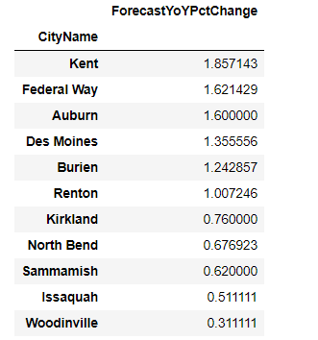
Finding nearby cities to explore cont.
Zillow Housing Data
The method that is used to find the nearby cities is by finding the top five cities from the same county as the popular cities (King County) with ForecastYoYPctChange > 0.5 in Zillow Housing data.
The top five cities are Kent, Federal Way, Auburn, Des Moines and Burien.

Slide 5
Get neighborhoods
Seattle/Bellevue/Redmond
129 neighborhoods from Zillow Housing Data
Explore only the top 44 neighbors (sorted by ForecastYoYPctChange)
Kent, Federal Way, Auburn, Des Moines and Burien
45 neighborhoods

Slide 6
Get location data
Latitude and longitude for every neighborhoods
Foursquare API
Seattle/Bellevue/Redmond
645 venues from 44 neighborhoods
201 unique venues
Too many venues to explore, group the common venues
Final number of unique venues: 89
Kent, Federal Way, Auburn, Des Moines and Burien
527 venues from 45 neighborhoods
151 unique venues
Too many venues to explore, group the common venues
Final number of unique venues: 74

Slide 7
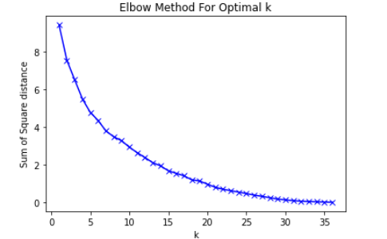
K-means clustering
Elbow method not useful
For both the popular cities and nearby cities, the elbow method results can’t provide an optimal k-value that we can use for k-means model. So for the purpose of this presentation, let’s pick k=5 to explore.

Slide 8
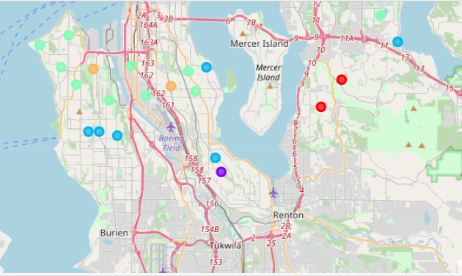
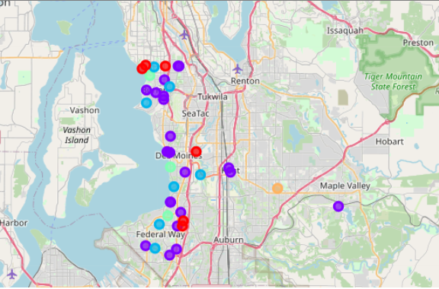
K-means clustering cont.
Seattle/Bellevue/Redmond Kent, Federal Way, Auburn, Des Moines and Burien

Slide 9
Results (clusters)
Seattle/Bellevue/Redmond
parks and fields
workout and exercise studios or gyms
parks and playground
restaurants
transportation services
Kent, Federal Way, Auburn, Des Moines and Burien
parks and fields
restaurants
transportation services
home services
lake

Slide 10
Final
Both the popular and nearby cities have a lot of restaurants. An extended analysis that can be done is to explore the differences in the restaurants. The popular cities have more workout places while the nearby cities might have more bigger lands to build services such as Home Depot, Lowes, Ikea, or other stores for home improvement resources.
Because Seattle, Bellevue and Redmond have more tech companies and people tend to live closer to shopping, restaurants and even a variety of personal enhancement services such as yoga studios, cycling studios, etc.
The elbow method doesn’t seem to work very well in the two models we explored. So the k value that is used in k-means models might not be the optimal value.
This assignment is a good start for exploring two distinct areas due to their professional differences. We can further clean up the data and perhaps look at other data that is not venue related. Other data that can be considered could be housing value, store or service locations, traffic data, crime data, etc. This assignment is a good start for exploring two distinct areas due to their professional differences.

