Slide 1
An Online Platform for Conducting Studies in Software Engineering
By: Dr. Thomas LaToza, Dr. Josh Sunshine and Avelino Inguane

Slide 2
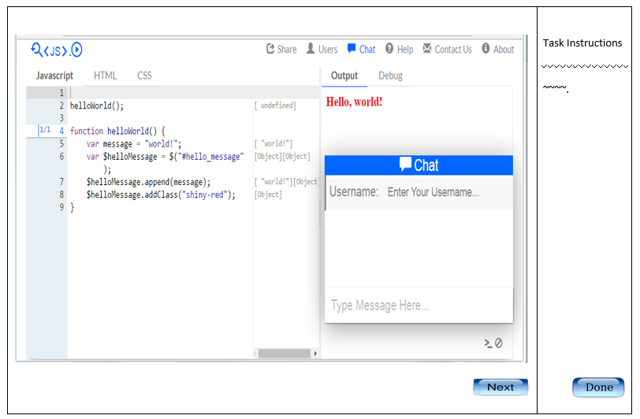
Overview and Goals
Project
In microtask crowdsourcing, transient contributors are given a short, well-defined task and an interface purpose-built for completing it.
Research
Can software be built through self-contained ten-minute contributions? {crowdsourcing}
https://seecode.run/#-KdUCcUf37Q18dg8WtyX

Slide 3
Problems to be Solved
Microtasking software development may help reduce barriers that software developers face today in contributing to open source projects e.g. https://github.com/tlatoza
Rather than understand an entire codebase, developers view and edit a single function.
Bring opportunity for parallel codding that may dramatically decrease the time to bring software to market.
Notes:
decomposing a large task into many microtasks brings opportunities for parallelism that may dramatically decrease the time to bring software projects to market.

Slide 4
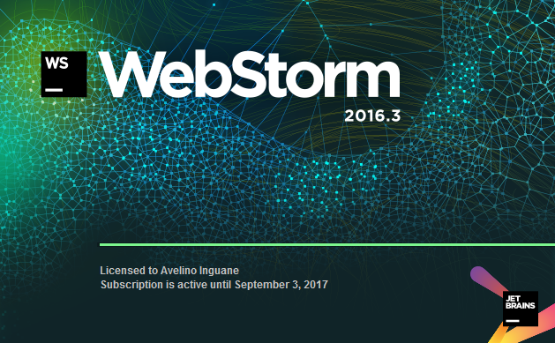
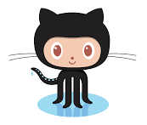

Technology
NodeJS ,JSON, AJAX, HTTP, and RESTful API
back-end development
HTML, CSS, JavaScript, and jQuery
front-end development
Firebase
Persist data
GitHub
Version control
WebStorm
IDE
Zotero
citation

Slide 5
Team Member Role
Dr. Thomas LaToza: Project/Research Originator, Manager, and Mentor.
Dr. Josh Sunshine (Carnegie Mellon University): Responsible for assisting in the design and development of the overall programming study as well as study materials.
Avelino {Wave} Inguane: Responsible for Platform Implementation conducting and evaluating the $(‘.crowdcoding’) research

Slide 6
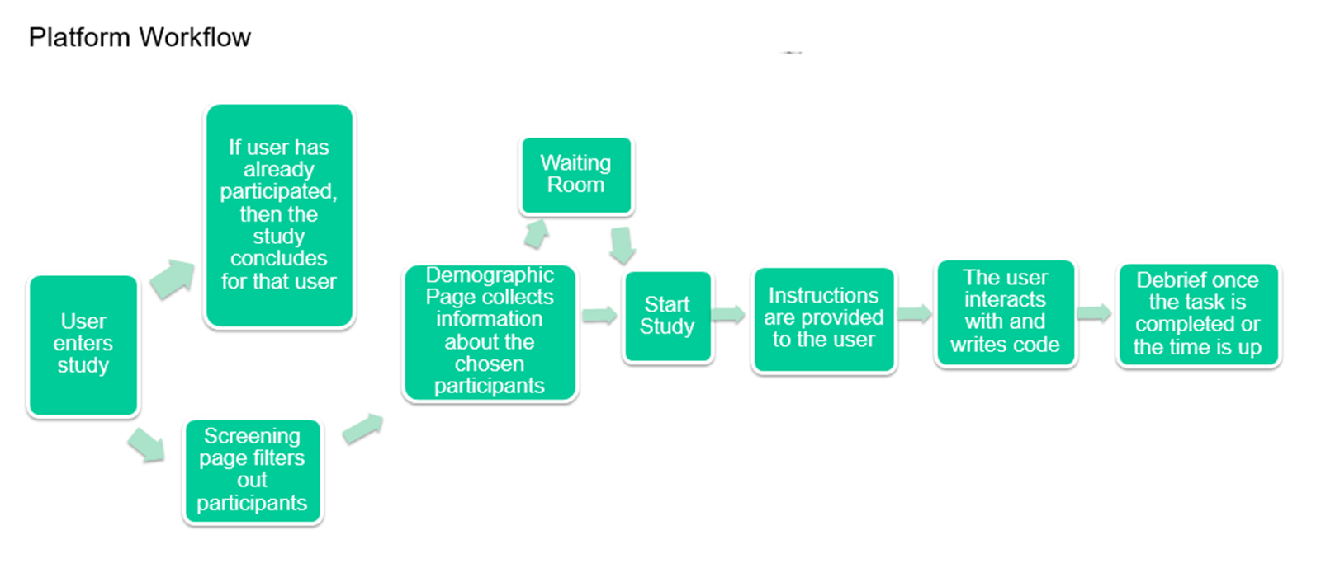
Anticipated Challenges
The basic sequence of events for the participant in the platform

Slide 7
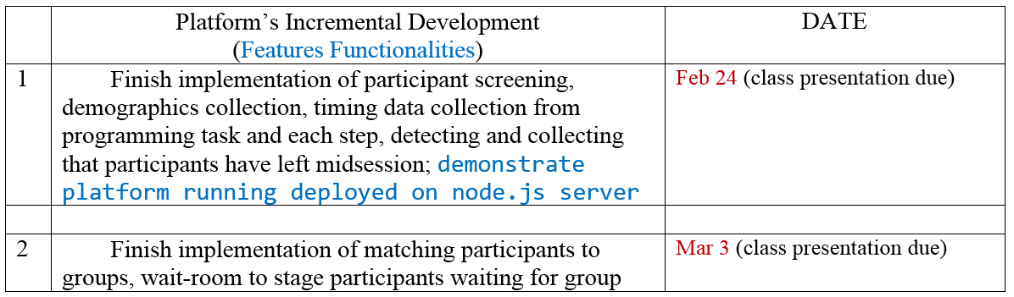

Milestones and Deliverables

Slide 8
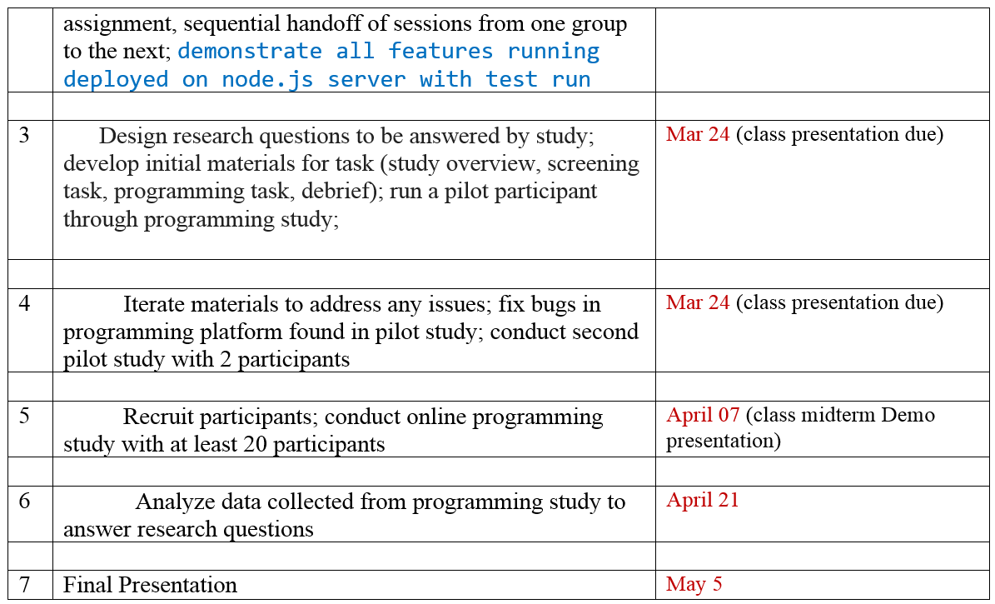
Milestones and Deliverables cont.

Slide 9
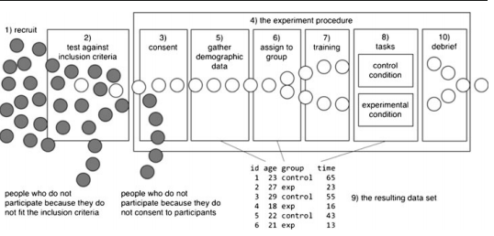
Conducting the Research
Figure adapted from Ko et al 2013

Slide 10
Assessment/Evaluation Criteria
The final product must be able to handle all aspects of a study involving human participants testing a software engineering tool.
For group sessions check if the code is being updated correctly
in the database.
The researcher should have the flexibility to create screening tasks for filtering participants, and add more sessions to the workflow.
From {seecode.run} the researcher should have an abundance of data to analyze and draw experiment conclusions.

Slide 11
Bibliography
[1] G. Fraser, T. D. LaToza, and L. Mariani, “2nd International Workshop on Crowd Sourcing in Software Engineering (CSI-SE 2015),” in 2015 IEEE/ACM 37th IEEE International Conference on Software Engineering, 2015, vol. 2, pp. 975–976.
[2] T. D. LaToza and A. v d Hoek, “A Vision of Crowd Development,” in 2015 IEEE/ACM 37th IEEE International Conference on Software Engineering, 2015, vol. 2, pp. 563–566.
[3] T. D. LaToza, W. B. Towne, A. van der Hoek, and J. D. Herbsleb, “Crowd development,” in 2013 6th International Workshop on Cooperative and Human Aspects of Software Engineering (CHASE), 2013, pp. 85–88.
[4] T. D. LaToza and A. van der Hoek, “Crowdsourcing in Software Engineering: Models, Motivations, and Challenges,” IEEE Softw., vol. 33, no. 1, pp. 74–80, Jan. 2016.

Slide 12


Run Demo
Access the application
Application host:
Public access: BETA https://pure-wave-34590.herokuapp.com/
Access firebase
Firebase host: google
Private access.

Slide 13
Q&A
This work is part of a joint project with researchers at UC Irvine and is supported by a $1.4M grant from the National Science Foundation on Crowd Programming.

