Slide 1

„Like an employee, but without the hassle.“

Slide 2
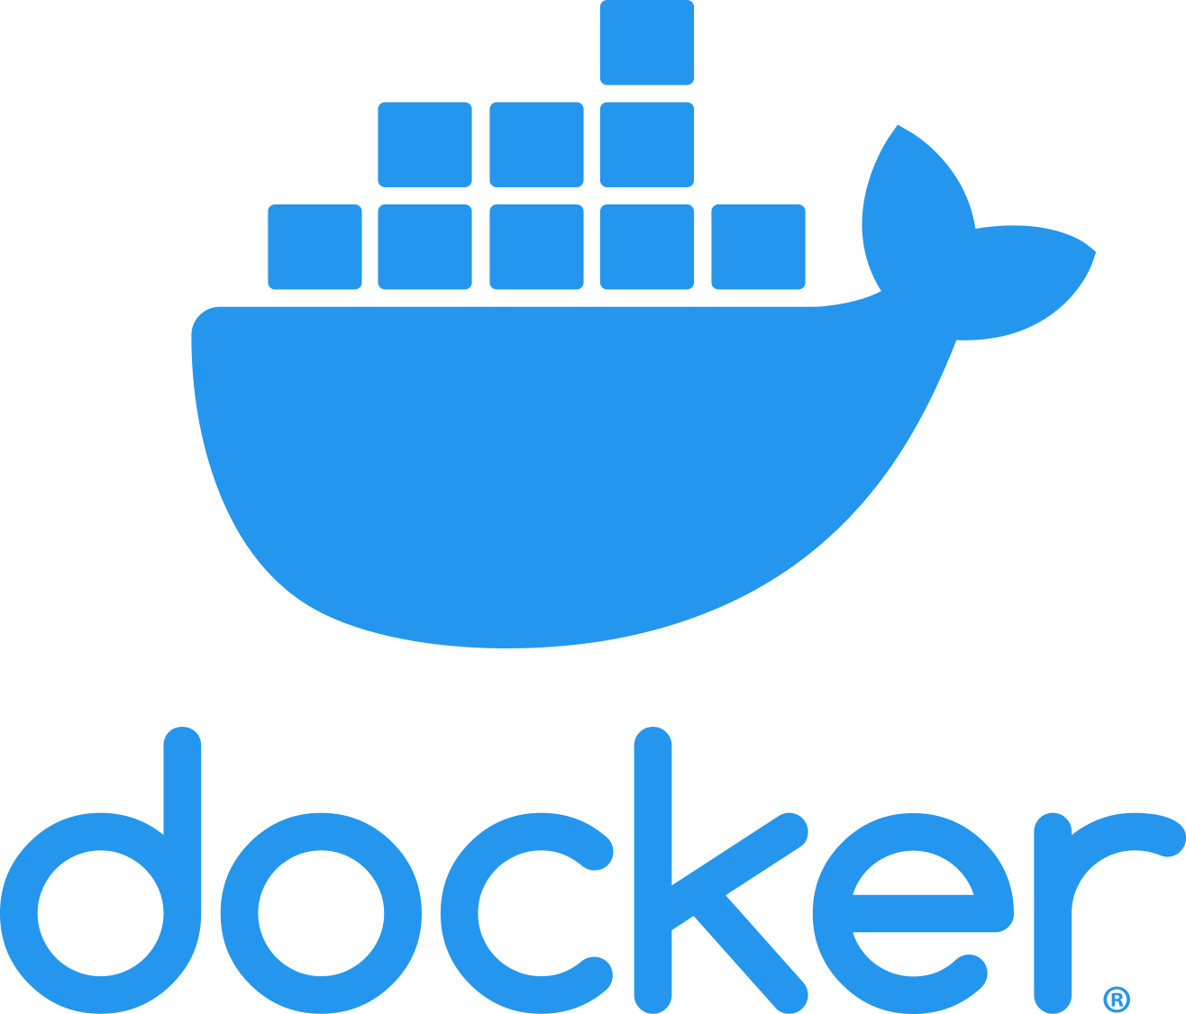
Book a workshop for your employees: www.wavect.io/#contact
Notes:
Short theoretical intro before we are going practical.
What is Docker? Assuming that most in here already know a bit about Docker, but just to ensure that everyone knows enough to follow the webinar.

Slide 3
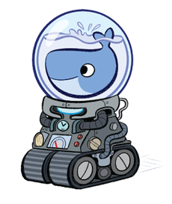
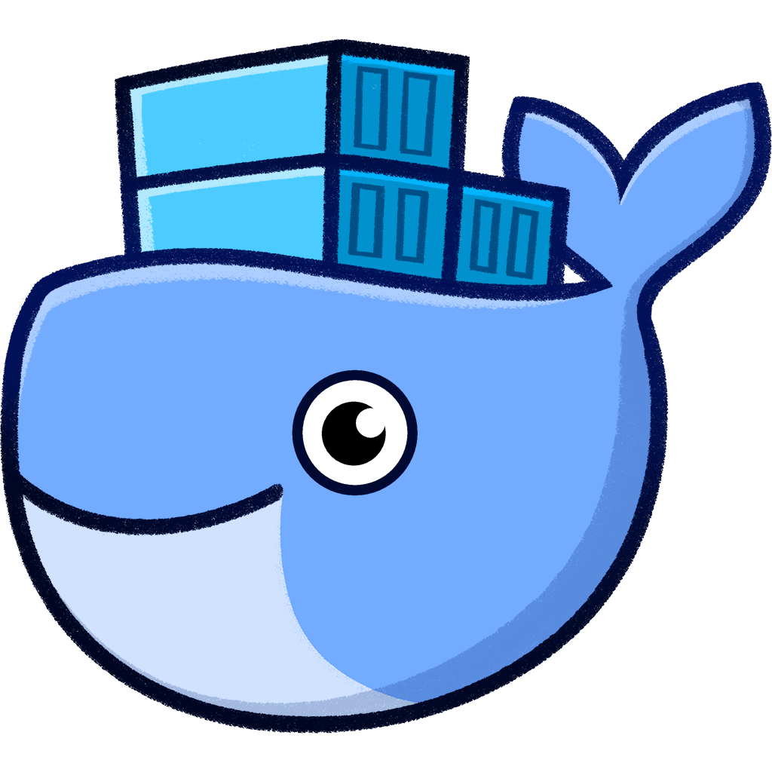
Install Docker
Book a workshop for your employees: www.wavect.io/#contact

Slide 4
Why Docker?
More efficient use of system resources
Faster software delivery cycles
Application portability
Shines for microservices architecture
NOT:
Replacement for VMs
Book a workshop for your employees: www.wavect.io/#contact
Notes:
System resources (less memory, faster to start/stop than VMs, etc.)
VMs not replacement, different use case (more isolation -> regulatory requirements, etc.)

Slide 5
Virtual Machines vs. Docker
Deploying within VMs
Deploying with Docker
App 1
App 2
bins/libs
bins/libs
Guest OS
Guest OS
App 1
App 2
bins/libs
App 3
bins/libs
Hypervisor
Container Engine
Host Operating System
Host Operating System
Infrastructure
Infrastructure
Notes:
Bins/libs sharing via Docker layers, …

Slide 6
Limitations
GUIs within containers
RDP, but pot. security risk
Additional configuration overhead
Avoid Windows Containers
Huge image size
Linux containers not avoidable.
Limited supports on Clouds as quite new.
Additional complexity for mixed environments
Kubernetes, Swarm, Compose, Clouds
Additional overhead for some applications (sensors, ..)
Book a workshop for your employees: www.wavect.io/#contact
Notes:
* Home assistant, etc.

Slide 7
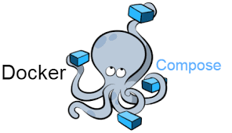
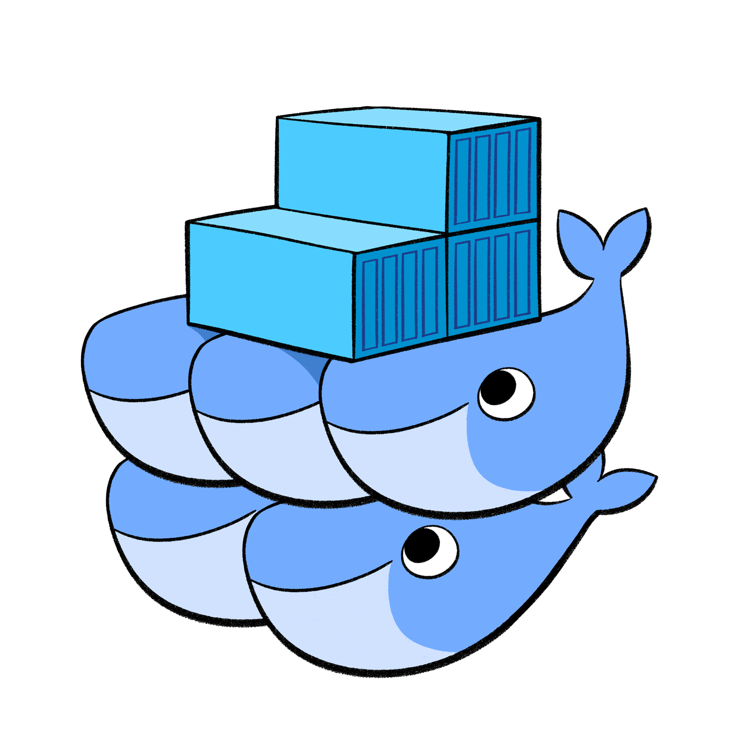

Notes:
Briefly explain others. Let me know if you want a course about Kubernetes, Compose or Swarm too.

Slide 8
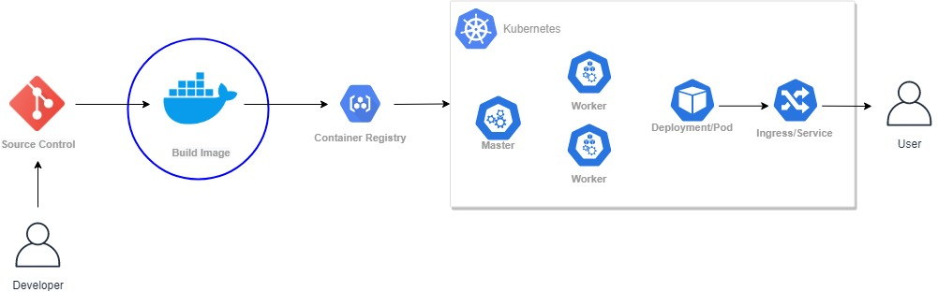
How does it usually work?
Book a workshop for your employees: www.wavect.io/#contact

Slide 9
How to create a Docker Image?
Only one single file needed: Dockerfile
FROM node:latest as builder
WORKDIR /app
COPY package.json /app/package.json
RUN npm install && npm install react-scripts -g
COPY . /app
RUN npm run build
FROM nginx:latest
COPY --from=builder /app/build /usr/share/nginx/html
RUN rm /etc/nginx/conf.d/default.conf
COPY nginx/nginx.conf /etc/nginx/conf.d
EXPOSE 80
CMD ["nginx", "-g", "daemon off;"]
Book a workshop for your employees: www.wavect.io/#contact
Notes:
We‘ll go over these commands in practice.

Slide 10
FROM
Base Image
Scratch
Platform Image
Node
Application
Image
My Web-Application
Alpine
…
Nginx
…
…
Book a workshop for your employees: www.wavect.io/#contact
Notes:
* Scratch: not even a console
* Deep Hierarchy

Slide 11
Some Best-Practices
Use the smallest image possible, ideally alpine or even scratch
Mostly higher order images are used (inspect Dockerfile).
Use multi-stage builds if possible.
Configure your application with Environment Variables.
Split up your monoliths.
Concatenate RUN commands to avoid additional layers.
Have a .dockerignore and a small Docker-Context
Value your Layer caches (see COPY).
Book a workshop for your employees: www.wavect.io/#contact

Slide 12
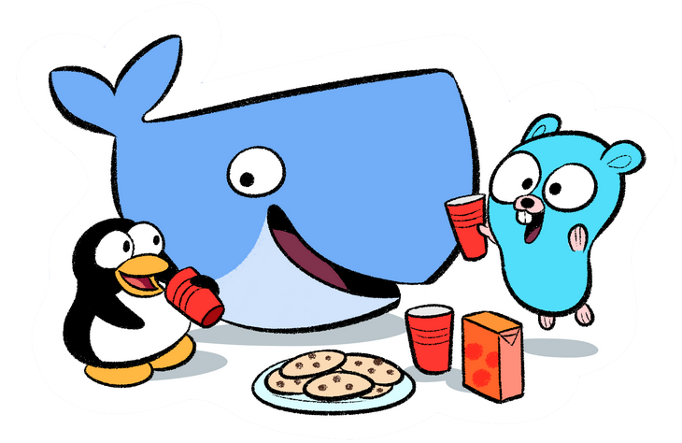
Let‘s Docker
Book a workshop for your employees: www.wavect.io/#contact

