Slide 1

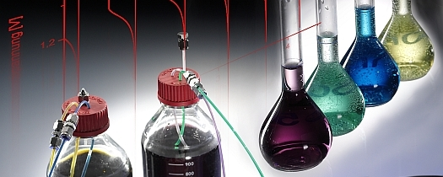

Chapter 17
IMPEDANCE METHODS
阻抗技术
李硕琦 lishuoqi@sdust.edu.cn
College of Materials Science and Engineering, SDUST

Slide 2
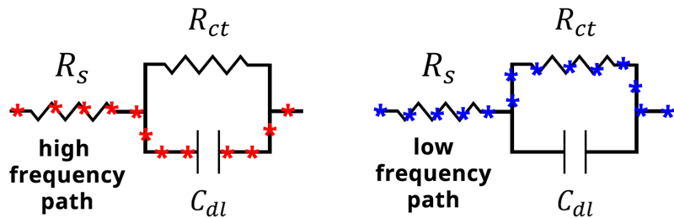
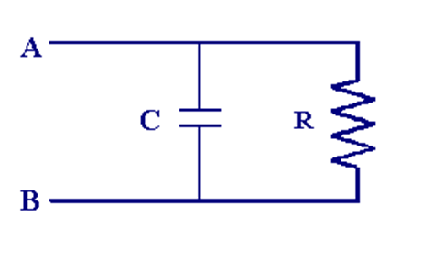
复习
Resistors and Capacitors in Parallel电阻和电容并联电路（实际双电层的状态）
低频电流主要经过电阻，高频主要经过电容
https://pineresearch.com/shop/kb/theory/eis-theory/eis-basics/
Notes:
BEA Confidential

Slide 3
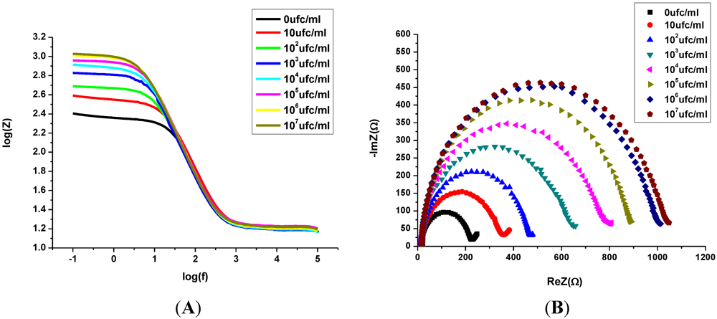
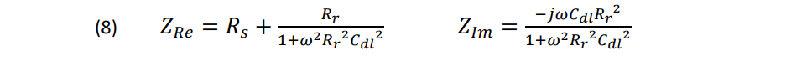
复习
Randles Cell
(Simplified)
Notes:
BEA Confidential

Slide 4
11.3 Equivalent circuit of an electrochemical cell 等效电路图
Any electrochemical cell（电化学电池） can be represented in terms of （照着）an equivalent electrical circuit（等效电路图） that comprises a combination of resistances and capacitances（电阻和电容的组合）：
capacitance [kəˈpæsɪtəns]电容
Notes:
BEA Confidential

Slide 5
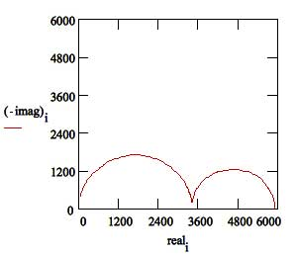
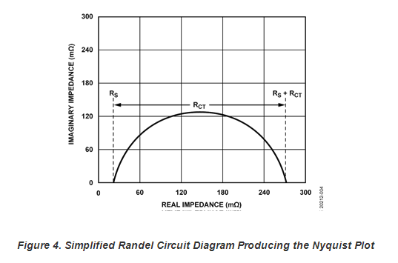
常见的说法“Time constant”
The semicircle is characteristic of a single "time constant". Electrochemical impedance plots often contain several semicircles.
半圆是“时间常数”的特征。电化学阻抗通常可以有多个半圆。
Notes:
BEA Confidential

Slide 6
常见的说法“Time constant”
时间常数表示过渡反应的时间过程的常数。指该物理量从最大值衰减到最大值的1/e所需要的时间。对于某一按指数规律衰变的量，其幅值衰变为1/e倍时所需的时间称为时间常数。
RC的时间常数：表示过渡反应的时间过程的常数。在电阻、电容的电路中，它是电阻和电容的乘积。若C的单位是μF（微法），R的单位是MΩ（兆欧），时间常数的单位就是秒。在这样的电路中当恒定电流I流过时，电容的端电压达到最大值（等于IR）的1-1/e时即约0.63倍所需要的时间即是时间常数 ，而在电路断开时，时间常数是电容的端电压达到最大值的1/e，即约0.37倍时所需要的时间。
RLC暂态电路时间常数是在RC电路中，电容电压Uc总是由初始值Uc（0）按指数规律单调的衰减到零，其时间常数 τ =RC。
https://blog.csdn.net/peiweixjtu1/article/details/88746308
Notes:
BEA Confidential

Slide 7
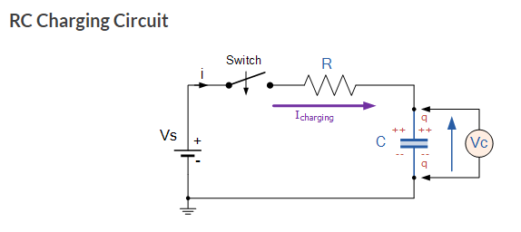
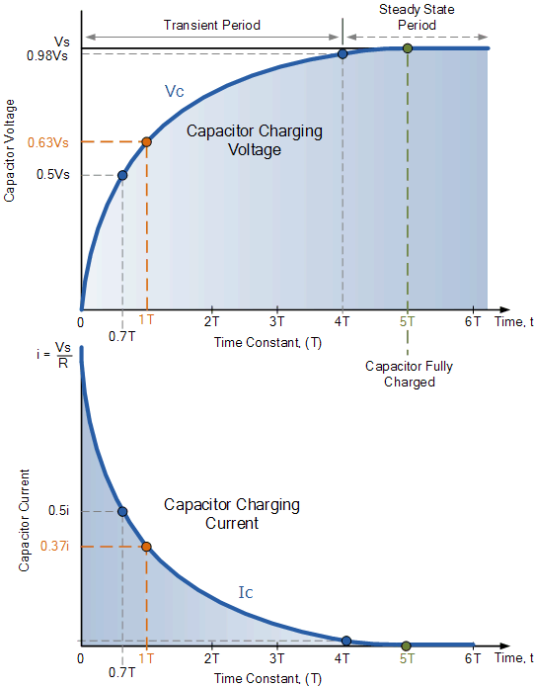
常见的说法“Time constant”
This charging (storage) and discharging (release) of a capacitors energy is never instant but takes a certain amount of time to occur with the time taken for the capacitor to charge or discharge to within a certain percentage of its maximum supply value being known as its Time Constant ( τ ).
https://www.electronics-tutorials.ws/rc/rc_1.html
Notes:
BEA Confidential

Slide 8
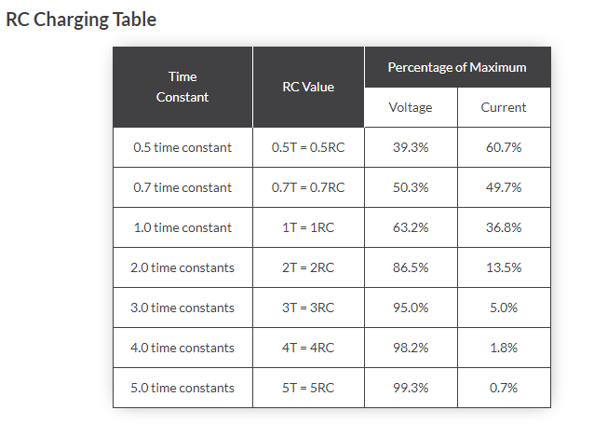
常见的说法“Time constant”
Notes:
BEA Confidential

Slide 9
常见的说法“Time constant”
The capacitor (C), charges up at a rate shown by the graph. The rise in the RC charging curve is much steeper at the beginning because the charging rate is fastest at the start of charge but soon tapers off exponentially as the capacitor takes on additional charge at a slower rate.
As the capacitor charges up, the potential difference across its plates begins to increase with the actual time taken for the charge on the capacitor to reach 63% of its maximum possible fully charged voltage, in our curve 0.63Vs, being known as one full Time Constant, ( T ).
Notes:
BEA Confidential

Slide 10
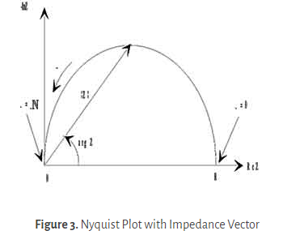
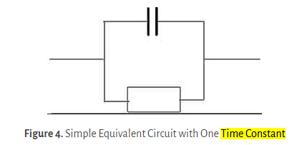
常见的说法“Time constant”
The Nyquist Plot in Figure 3 results from the electrical circuit of Figure 4. The semicircle is characteristic of a single "time constant". Electrochemical impedance plots often contain several semicircles. Often only a portion of a semicircle is seen.
Notes:
BEA Confidential

