Slide 1
Minesweeper
Jorge Hoyos, Jose Ortegas, James Harstad

Slide 2
Agenda
Introduction
UML Designs
Results
Future Features
Conclusion

Slide 3
Introduction
Video games have come a long ways in recent years. Today, we have 4k, ultra-realistic graphics coupled with remote controllers that feature ergonomic hand designs and vibrating motors… all for our gaming enjoyment!
In an effort to pay homage to how far video games have come since their beginnings, we decided to recreate one of the first video games to come out on the personal computer, Minesweeper. We hope you enjoy.

Slide 4
UML Design

Slide 5
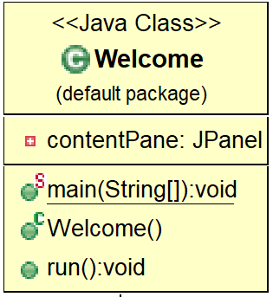
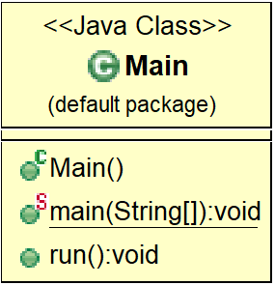
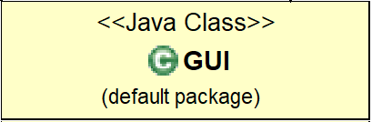
3 Main Classes

Slide 6
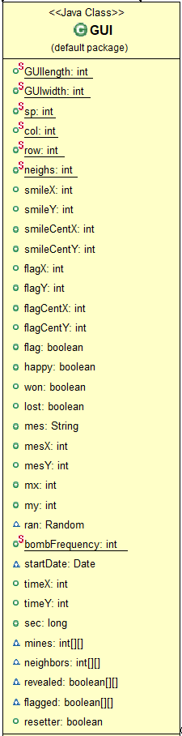
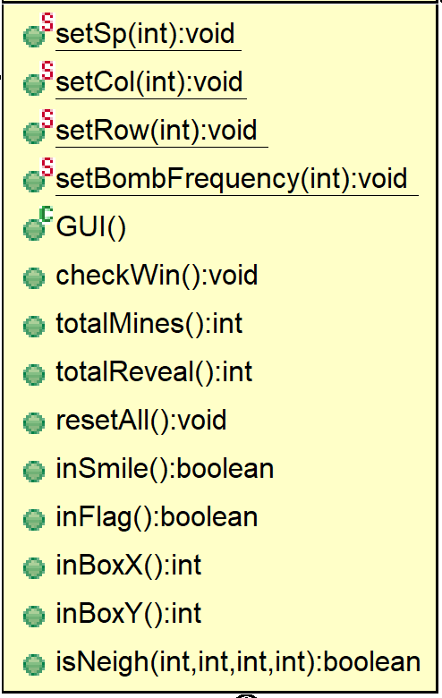

Slide 7
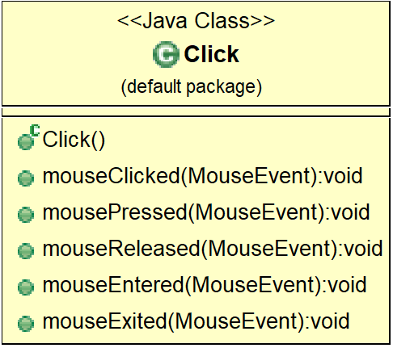
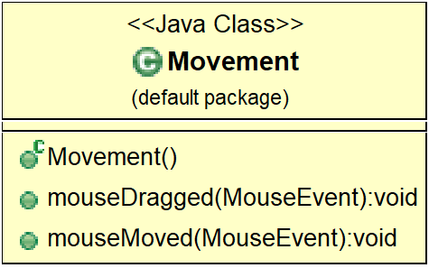
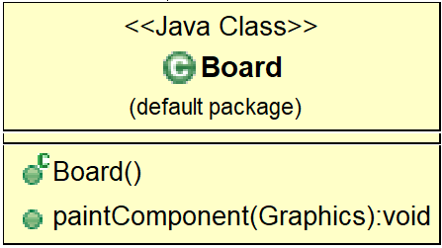
3 Secondary Classes

Slide 8
6 Classes Total

Slide 9
Implementation

Slide 10
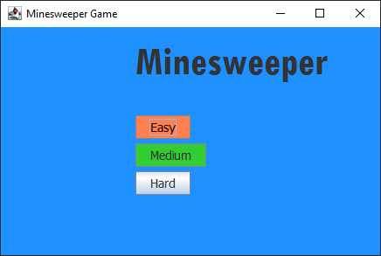
Welcome Window
3 levels of difficulty

Slide 11
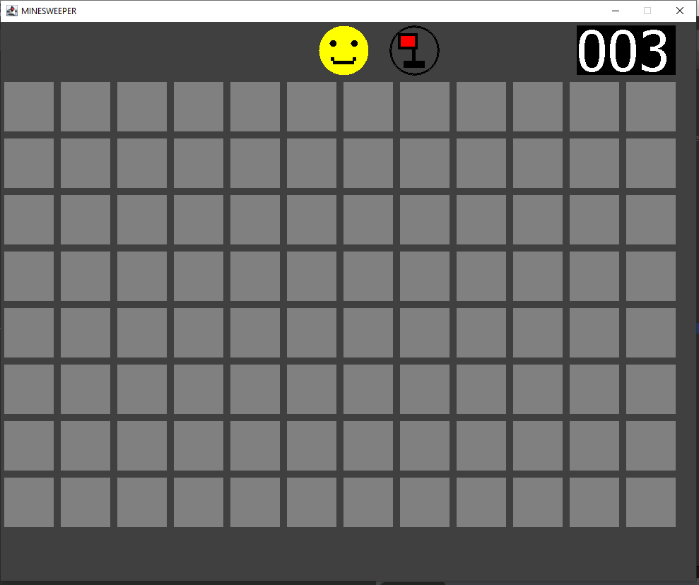
Starting Screen
Win/Lose Face
Flag Selector
Timer

Slide 12
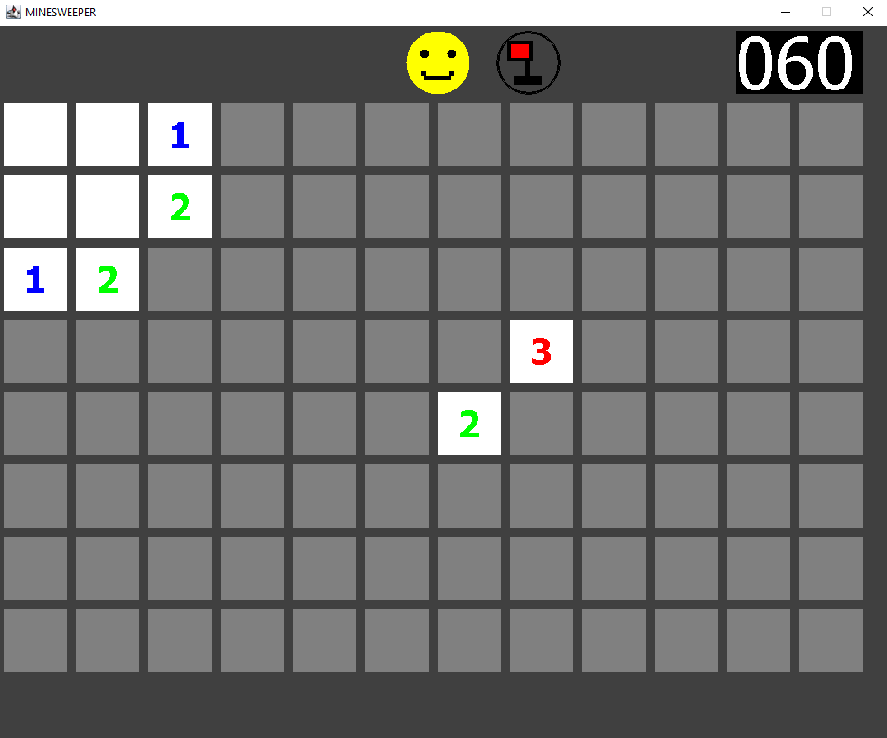
Gameplay
Numbers inside of the squares indicate how many bombs there are in adjacent squares.
“1” means that square is touching one bomb, “2” means two bombs, etc.

Slide 13
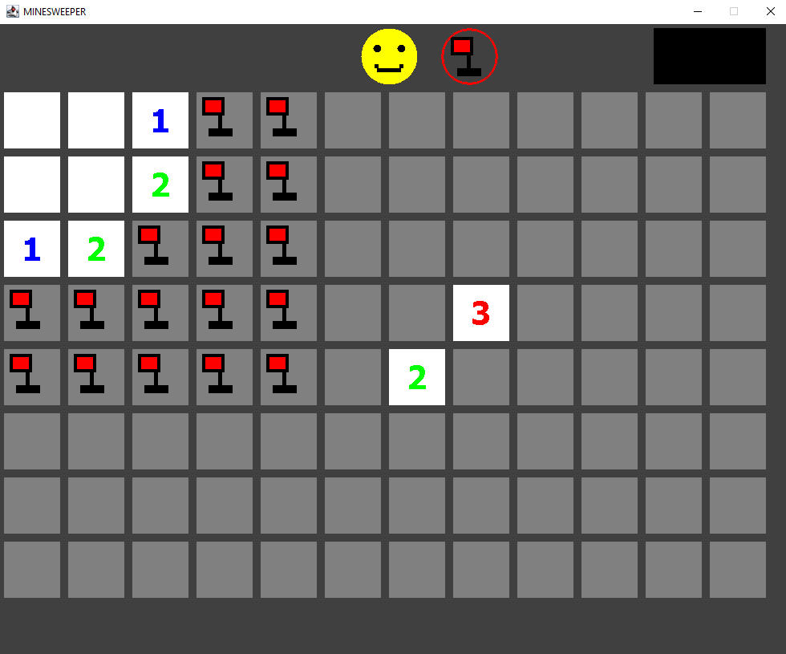
Gameplay
Bombs can be easily marked with red flags.

Slide 14
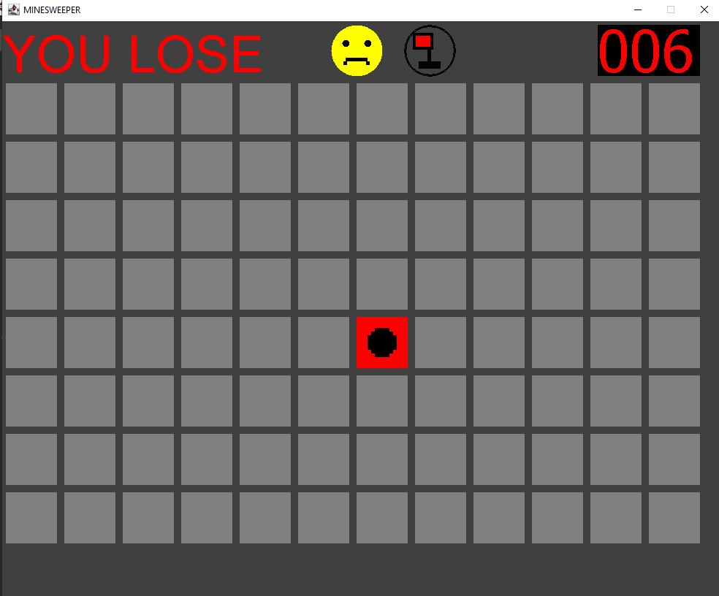
Gameplay
Player loses if they click a bomb by accident

Slide 15
Demostration

Slide 16
Future Features
Scoreboard and leaderboard
Different items in the board than solely bombs (good, bad, neutral)
Customizable images

Slide 17
Questions?

