Slide 1
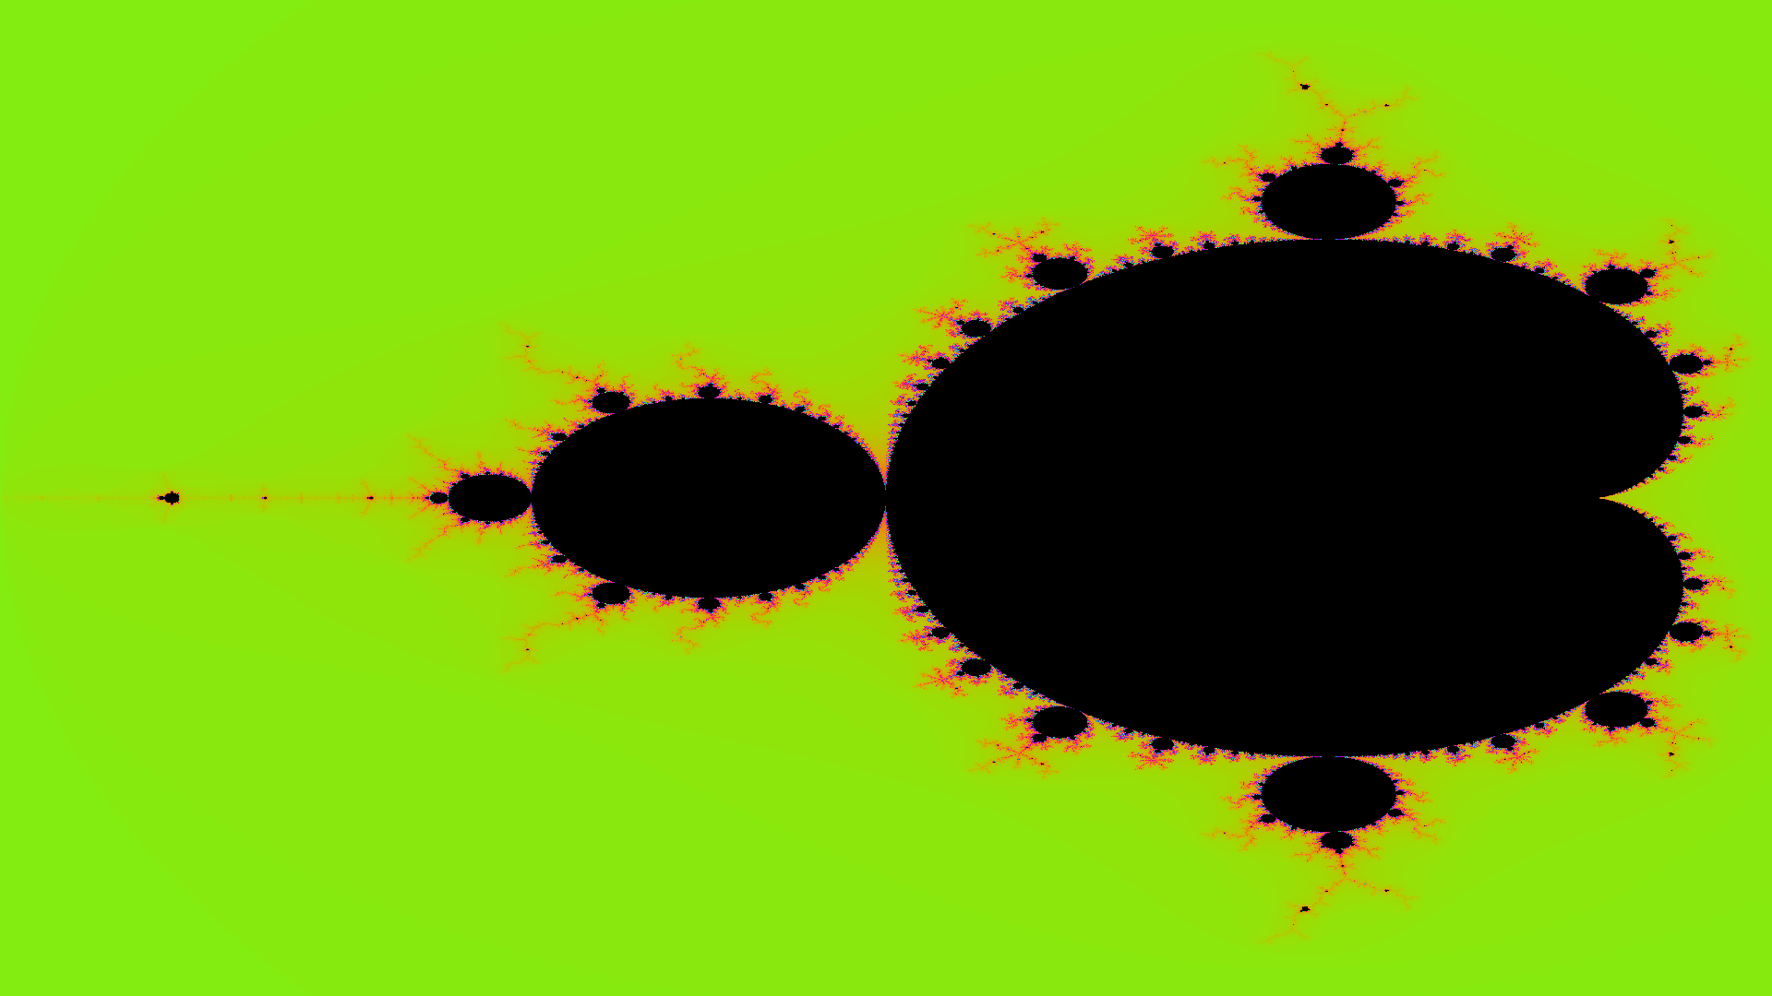
Parallel Mandelbrot Set
with OpenMP
Static scheduling vs. dynamic load balancing,
benchmarked by self-relative speedup.
Parallel Computing | Project Presentation

Slide 2
Introduction: the task and the tool
📌 The Task
• Compute the Mandelbrot set using the escape-time algorithm, then render it as an image.
• Pixel computational cost is highly non-uniform: boundary points escape in 1–5 iterations, while interior points require all 1000 iterations.
• Compare static block scheduling with dynamic chunk load balancing across multiple CPU cores.
• Measure and analyze self-relative speedup and parallel efficiency.
⚙️ The Tool: OpenMP
• Industry-standard compiler-directed API for shared-memory parallel programming in C, C++, and Fortran.
• Parallelism is introduced declaratively via pragmas (e.g. #pragma omp parallel for) and compiled with -fopenmp.
• Provides runtime scheduling clauses (schedule(static) vs schedule(dynamic, chunk)) without rewriting algorithm logic.
• Includes standard runtime routines: omp_set_num_threads() and omp_get_wtime().

Slide 3
Parallel computing environment
Intel Core i5-13420H (SMP, 12 Hardware Threads)
• 4 Performance Cores (P-cores): 8 threads via Hyper-Threading (up to 4.6 GHz)
• 4 Efficient Cores (E-cores): 4 single-threaded cores for background throughput
• Total Hardware Execution Units: 8 physical cores, 12 logical threads
• L1 Cache: 320 KB Data / 384 KB Instruction
• L2 Cache: 7 MB dedicated cache
• L3 Cache: 12 MB shared unified cache across all cores
• Memory Architecture: Unified Main Memory (UMA) in a single physical address space
8 Cores, 12 Hardware Threads
Thread counts of 1, 2, 4, 8, and 12 map cleanly onto physical P-cores, E-cores, and Hyper-Threads.
Uniform Shared Memory (UMA)
All OpenMP worker threads see a unified 64-bit address space, writing directly into the output image buffer.
Cache-Friendly Row Layout
Each row is stored contiguously in memory, maximizing L1 and L2 spatial cache line hit rates.
Disjoint Lock-Free Writes
Each thread computes independent rows, completely eliminating mutex contention and false sharing.

Slide 4
OpenMP: main capabilities
Worksharing [Used here]
#pragma omp parallel for partitions loop iterations across a team of worker threads. Supports sections, single, and reduction operations.
Loop Scheduling [Used here]
Controls iteration dispatching: schedule(static), schedule(dynamic, chunk), guided, and auto allow flexible trade-offs between overhead and load balance.
Tasks & Dependencies
omp task with depend clauses constructs dynamic task graphs for irregular parallelism; taskloop divides irregular nested iterations into tasks.
SIMD & Heterogeneous Offloading
omp simd enforces data vectorization; target directives offload compute kernels to GPUs, DSPs, and attached accelerators.

Slide 5
Where OpenMP is used in practice
🌐 Weather & Climate Modeling
ECMWF's Integrated Forecasting System (IFS) and the Weather Research and Forecasting (WRF) model combine OpenMP on multicore nodes with MPI across cluster nodes.
🔬 Molecular Dynamics
GROMACS, LAMMPS, and NAMD distribute inter-atomic particle force calculations across threads on shared-memory nodes.
📊 High-Performance Numerical Libraries
OpenBLAS, Intel oneMKL, and LAPACK leverage OpenMP to parallelize dense linear algebra operations (GEMM, matrix inversions).
⚙️ Engineering Simulation & CFD
OpenFOAM and ANSYS Fluent employ hybrid MPI + OpenMP models for aerodynamic and fluid dynamic simulations.

Slide 6
The task: escape-time Mandelbrot
Mathematical Definition
• Map each screen pixel (x, y) to a complex number c = cr + i*ci in the region x in [-2.0, 0.5], y in [-1.25, 1.25].
• Iterate the quadratic recurrence: z_{n+1} = z_n^2 + c with z_0 = 0.
• Escape condition: if |z|^2 = zr^2 + zi^2 > 4.0, sequence diverges.
• Stop at escape or when max_iter (1000) is reached. Iteration count is the escape time.
• Resolution: 1920 x 1080 Full HD (2,073,600 individual pixels).
• Coloring: Escaped pixels colored via standard sine palette; interior set points remain obsidian black.

Slide 7
How the task is parallelized
No Task Dependencies
Embarrassingly Parallel
A pixel's value depends exclusively on its own complex coordinate c. No thread ever needs to read data written by another thread.
No Locks on Data Buffer
Disjoint Memory Writes
Each thread computes independent scanlines and writes directly into its assigned slice of the shared 1D buffer: index = y * width + x.
Distribution is the Problem
Spatial Load Imbalance
Computing cost varies from 1 to 1000 iterations per pixel. Equal row division creates severe bottlenecks, requiring dynamic scheduling.

Slide 8
Static vs. dynamic scheduling
schedule(static)
Equal Contiguous Blocks, Fixed at Start
#pragma omp parallel for schedule(static)
for (int y = 0; y < H; ++y) {
compute_row(y);
}
• Deterministic block division: Thread i gets rows [i*H/P, (i+1)*H/P).
• Near-zero scheduling overhead at runtime.
• Critical Flaw: Threads 1 & 2 handle the dense central cardioid, while Threads 0 & 3 finish outer rows early and sit idle at the barrier.
schedule(dynamic, 4)
Idle Threads Request Next 4 Rows at Runtime
#pragma omp parallel for schedule(dynamic, 4)
for (int y = 0; y < H; ++y) {
compute_row(y);
}
• Shared work queue dispatches chunks of 4 rows on demand.
• Small synchronization overhead per chunk fetch.
• Major Advantage: Threads finishing fast exterior rows immediately pull more work, dynamically distributing the cardioid load across all cores.

Slide 9
Why the workload is uneven
Spatial Workload Imbalance Analysis
Mandelbrot has extreme spatial irregularity:
• Middle 25% of rows contain 59% of all computational work (main cardioid and period bulbs).
• Outer 50% of rows contain only 6% of total work (quick escape outside the set).
• In a 4-thread static run, middle threads receive ~47% of total work each, while outer threads receive only ~3%.
• Result: Middle threads become severe stragglers. The parallel runtime is determined by the slowest thread!
59%
of all computation sits in the middle 25% of rows
6%
of all computation sits in the outer 50% of rows
47% vs 3%
work given to middle vs outer threads under 4-way static chunking

Slide 10
OpenMP features that enabled it
OpenMP Directive / Feature | How It is Used in Project
#pragma omp parallel for | Splits the outer row loop (y) across the thread team
schedule(static) | Divides rows into equal contiguous blocks fixed at loop start
schedule(dynamic, 4) | Assigns 4-row chunks on-demand via shared runtime queue
omp_set_num_threads(t) | Configures worker thread count for 1, 2, 4, 8, 12 benchmark runs
Implicit barrier | Guarantees all threads finish before stopping the timer
std::chrono | High-precision wall-clock timing in milliseconds for benchmarks
Why Dynamic Wins
schedule(dynamic, 4)
• The OpenMP runtime maintains an atomic shared queue of 4-row chunks.
• When an exterior thread finishes early, it immediately pulls another chunk.
• Faster threads shoulder more total rows, balancing total execution time.
• Eliminates the straggler problem completely!

Slide 11
Benchmark: method and measured times
Speedup Method
S(p) = T(1) / T(p)
• Self-Relative Speedup: Each parallel strategy is compared against single-thread baseline.
• Efficiency: E(p) = S(p) / p * 100%.
• Thread Counts: 1, 2, 4, 8, 12 threads tested on Intel Core i5-13420H.
• Same C++ code executed across all configurations.
Threads | Static (ms) | Dynamic (ms) | Static Spd | Dynamic Spd | Dynamic Eff
1 | 1345.43 | 1338.51 | 1.00x | 1.00x | 100.0%
2 | 679.81 | 670.41 | 1.98x | 2.00x | 99.8%
4 | 638.49 | 338.92 | 2.11x | 3.95x | 98.7%
8 | 416.64 | 207.43 | 3.23x | 6.45x | 80.7%
12 | 339.12 | 157.33 | 3.97x | 8.51x | 70.9%

Slide 12
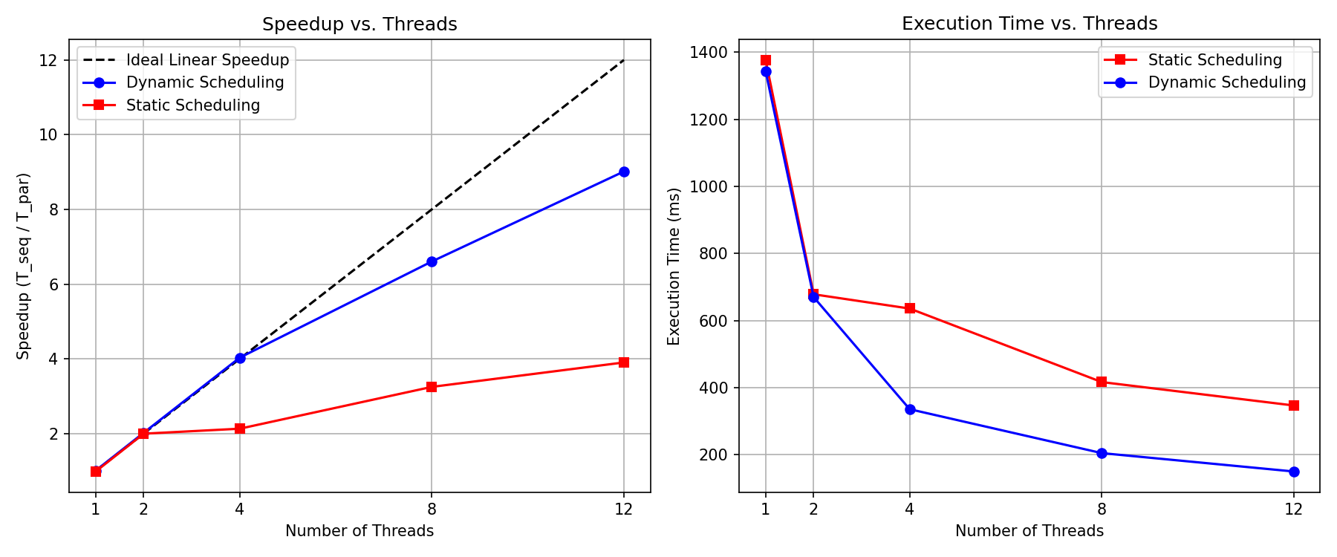
Self-relative speedup results
3.95x vs. 2.11x (at 4 threads)
Dynamic scheduling achieves 98.7% parallel efficiency. Static scheduling hits a ceiling of 2.11x due to cardioid stragglers.
8.51x vs. 3.97x (at 12 threads)
Dynamic scheduling delivers more than double the speedup of static scheduling (71% vs. 33% efficiency).
Why efficiency drops after 8 threads
Threads 9–12 run on Intel's Efficient cores (E-cores) and Hyper-Threading shares execution pipelines on P-cores.

Slide 13
Live visualizer: watching calculations in real time
🧵 Core Allocation Map
Color-codes every row by the thread that calculated it. Visually confirms how static chunks form rigid bands while dynamic chunks interleave dynamically.
⚡ Flexible Core Scaling
Interactive toggle for 1, 2, 4, 8, 12, or 16 cores with live CPU load meters showing iteration balance.
🎨 Multiple Color Themes
Royal Amethyst, Quanta Cyan, Classic Electric, Sunset, and Cyber Emerald palettes.
🔍 Real-Time Pixel Telemetry
Inspects HEX/RGB codes, iteration counts, complex plane coordinates, and thread owners on mouse hover.

Slide 14
Key takeaways
3.95x vs. 2.11x
Dynamic vs. Static Speedup at 4 Threads
Eliminates the cardioid bottleneck, maintaining near-100% CPU utilization.
8.51x
Peak Dynamic Speedup at 12 Threads
Static scheduling caps at 3.97x (less than half the performance).
59%
of All Work Sits in Middle 25% of Rows
Why static block partitioning fundamentally fails on fractal algorithms.
• Uneven computational cost causes static scheduling to stall. Dynamic scheduling cures load imbalance with a one-clause change.
• Efficiency scales near-linearly up to physical P-cores, then tapers off as E-cores and Hyper-Threads are utilized.

Slide 15
References & resources
Academic & Technical Literature
1. OpenMP Architecture Review Board, 'OpenMP Application Programming Interface Specification', Version 5.2, November 2021. Available: https://www.openmp.org/
2. R. Chandra, L. Dagum, D. Kohr, D. Maydan, J. McDonald, and R. Menon, 'Parallel Programming in OpenMP', Morgan Kaufmann Publishers, 2001.
3. P. Pacheco, 'An Introduction to Parallel Programming', Morgan Kaufmann / Elsevier, 2011.
4. B. B. Mandelbrot, 'The Fractal Geometry of Nature', W. H. Freeman and Company, New York, 1982.
5. Intel Corporation, '13th Gen Intel Core Processor Datasheet, Volume 1: Architecture and Hybrid Multiprocessing', 2023.

