Slide 1
MIS 637 : Data Analytics and Machine Learning
School of Business
Stevens Institute of Technology
First Case Study: Recommender Systems, Netflix
M. Daneshmand, PhD
Mahmoud.Daneshmand@stevens.edu
Spring 2022
MD-MIS 637-Spring 2022

Slide 2
Big Data Value Creation:
Netflix
Netflix recommendation engine takes dozens of algorithms into account and compares you with similar users in the more than 190 countries where Netflix's service is available.
And Netflix thinks it’s worth a lot of money: $1 billion per year. In an academic paper penned by Gomez-Uribe and Netflix’s Chief Product Officer Neil Hunt, they assert that “the combined effect of personalization and recommendations save us more than $1B per year."
MD-MIS 637-Spring 2022

Slide 3
Big Data Value Creation:
Netflix
“Consumer research suggests that a typical Netflix member loses interest after perhaps 60 to 90 seconds of choosing, having reviewed 10 to 20 titles (perhaps 3 in detail) on one or two screens,” they write. “The user either finds something of interest or the risk of the user abandoning our service increases substantially.”
Thus, Netflix only has 90 seconds to grab a subscriber’s attention, it needs to find a good show or movie fast. If people were just typing in what they wanted to see into the search bar, this would be relatively easy. But Netflix estimates that only 20% of its subscriber video choices come from search, with the other 80% coming from recommendations. So it’s essential that Netflix gets this right, fast.
MD-MIS 637-Spring 2022

Slide 4
Big Data Value Creation:
Netflix
Netflix believes it could lose $1 billion or more every year from subscribers quitting its service if it weren't for its personalized recommendation engine.
Nathan McAlone, “Why Netflix thinks its personalized recommendation engine is worth $1 billion per year”, Business Insider, June 14, 2016
The Nature of Analytics Has Changed:
Real –Time Big Data Streams Analytics
MD-MIS 637-Spring 2022

Slide 5
Recommender Systems
There are two classes of entities: Users, and Items
The data is represented as a Utility Matrix,
giving a value for each user-item pair
Which users like which items
    Purchase history
    Viewing history
    Rating information
Goal: recommend new items for users
MD-MIS 637-Spring 2022

Slide 6
Data: Utility Matrix
users
 | 1 | 2 | 3 | 4 | 5 | 6 | 7 | 8 | 9 | 10 | 11 | 12
1 | 1 |  | 3 |  |  | 5 |  |  | 5 |  | 4
2 |  |  | 5 | 4 |  |  | 4 |  |  | 2 | 1 | 3
3 | 2 | 4 |  | 1 | 2 |  | 3 |  | 4 | 3 | 5
4 |  | 2 | 4 |  | 5 |  |  | 4 |  |  | 2
5 |  |  | 4 | 3 | 4 | 2 |  |  |  |  | 2 | 5
6 | 1 |  | 3 |  | 3 |  |  | 2 |  |  | 4
movies
- unknown rating
- rating between 1 to 5
MD-MIS 637-Spring 2022

Slide 7
Recommender System Technologies
Two Broad Camps
Content-Based
  Focuses on properties of items. Similarity of items are determined by measuring the similarity in their properties
Collaborative-Filtering
Based on similarity measures between users and
/or items
MD-MIS 637-Spring 2022

Slide 8
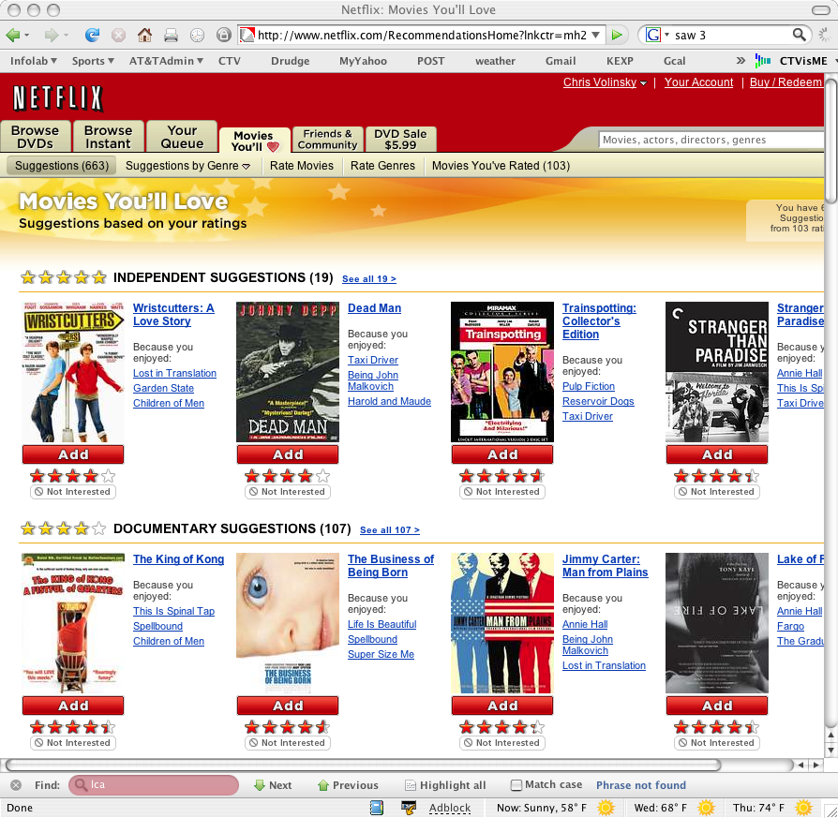
Netflix
A US-based DVD rental-by mail company
8.2M customers, 100K titles, ships 1.9M DVDs per day
Good recommendations = happy customers
MD-MIS 637-Spring 2022

Slide 9
BellKor solution…
Our solution is a mixture of many different models.
Mostly variants of two main classes of collaborative filtering models
    Nearest Neighbors
    Latent Factor (SVD: Singular Value Decomposition) )
MD-MIS 637-Spring 2022

Slide 10
Nearest Neighbors
users
 | 1 | 2 | 3 | 4 | 5 | 6 | 7 | 8 | 9 | 10 | 11 | 12
1 | 1 |  | 3 |  |  | 5 |  |  | 5 |  | 4
2 |  |  | 5 | 4 |  |  | 4 |  |  | 2 | 1 | 3
3 | 2 | 4 |  | 1 | 2 |  | 3 |  | 4 | 3 | 5
4 |  | 2 | 4 |  | 5 |  |  | 4 |  |  | 2
5 |  |  | 4 | 3 | 4 | 2 |  |  |  |  | 2 | 5
6 | 1 |  | 3 |  | 3 |  |  | 2 |  |  | 4
movies
- unknown rating
- rating between 1 to 5
MD-MIS 637-Spring 2022

Slide 11
Nearest Neighbors
users
 | 1 | 2 | 3 | 4 | 5 | 6 | 7 | 8 | 9 | 10 | 11 | 12
1 | 1 |  | 3 |  | ? | 5 |  |  | 5 |  | 4
2 |  |  | 5 | 4 |  |  | 4 |  |  | 2 | 1 | 3
3 | 2 | 4 |  | 1 | 2 |  | 3 |  | 4 | 3 | 5
4 |  | 2 | 4 |  | 5 |  |  | 4 |  |  | 2
5 |  |  | 4 | 3 | 4 | 2 |  |  |  |  | 2 | 5
6 | 1 |  | 3 |  | 3 |  |  | 2 |  |  | 4
movies
- estimate rating of movie 1 by user 5
MD-MIS 637-Spring 2022

Slide 12
Nearest Neighbors
users
 | 1 | 2 | 3 | 4 | 5 | 6 | 7 | 8 | 9 | 10 | 11 | 12
1 | 1 |  | 3 |  | ? | 5 |  |  | 5 |  | 4
2 |  |  | 5 | 4 |  |  | 4 |  |  | 2 | 1 | 3
3 | 2 | 4 |  | 1 | 2 |  | 3 |  | 4 | 3 | 5
4 |  | 2 | 4 |  | 5 |  |  | 4 |  |  | 2
5 |  |  | 4 | 3 | 4 | 2 |  |  |  |  | 2 | 5
6 | 1 |  | 3 |  | 3 |  |  | 2 |  |  | 4
movies
Neighbor selection:
Identify movies similar to 1, rated by user 5
MD-MIS 637-Spring 2022

Slide 13
Nearest Neighbors
users
 | 1 | 2 | 3 | 4 | 5 | 6 | 7 | 8 | 9 | 10 | 11 | 12
1 | 1 |  | 3 |  | ? | 5 |  |  | 5 |  | 4
2 |  |  | 5 | 4 |  |  | 4 |  |  | 2 | 1 | 3
3 | 2 | 4 |  | 1 | 2 |  | 3 |  | 4 | 3 | 5
4 |  | 2 | 4 |  | 5 |  |  | 4 |  |  | 2
5 |  |  | 4 | 3 | 4 | 2 |  |  |  |  | 2 | 5
6 | 1 |  | 3 |  | 3 |  |  | 2 |  |  | 4
movies
Compute similarity weights:
s₁₃=0.2, s₁₆=0.3
MD-MIS 637-Spring 2022

Slide 14
Nearest Neighbors
users
 | 1 | 2 | 3 | 4 | 5 | 6 | 7 | 8 | 9 | 10 | 11 | 12
1 | 1 |  | 3 |  | 2.6 | 5 |  |  | 5 |  | 4
2 |  |  | 5 | 4 |  |  | 4 |  |  | 2 | 1 | 3
3 | 2 | 4 |  | 1 | 2 |  | 3 |  | 4 | 3 | 5
4 |  | 2 | 4 |  | 5 |  |  | 4 |  |  | 2
5 |  |  | 4 | 3 | 4 | 2 |  |  |  |  | 2 | 5
6 | 1 |  | 3 |  | 3 |  |  | 2 |  |  | 4
movies
Predict by taking weighted average:
(0.2*2+0.3*3)/(0.2+0.3)=2.6
MD-MIS 637-Spring 2022

Slide 15
Latent Factors - SVD
Latent factors are determined through optimization and might not be interpretable!
users
1 |  | 3 |  |  | 5 |  |  | 5 |  | 4
 |  | 5 | 4 |  |  | 4 |  |  | 2 | 1 | 3
2 | 4 |  | 1 | 2 |  | 3 |  | 4 | 3 | 5
 | 2 | 4 |  | 5 |  |  | 4 |  |  | 2
 |  | 4 | 3 | 4 | 2 |  |  |  |  | 2 | 5
1 |  | 3 |  | 3 |  |  | 2 |  |  | 4
?
items
~
users
.1 | -.4 | .2
-.5 | .6 | .5
-.2 | .3 | .5
1.1 | 2.1 | .3
-.7 | 2.1 | -2
-1 | .7 | .3
1.1 | -.2 | .3 | .5 | -2 | -.5 | .8 | -.4 | .3 | 1.4 | 2.4 | -.9
-.8 | .7 | .5 | 1.4 | .3 | -1 | 1.4 | 2.9 | -.7 | 1.2 | -.1 | 1.3
2.1 | -.4 | .6 | 1.7 | 2.4 | .9 | -.3 | .4 | .8 | .7 | -.6 | .1
~
items
MD-MIS 637-Spring 2022

Slide 16
Why we won
Lots of people used variants of these two models
We did a few things differently
New approach to Nearest Neighbors
  Estimated similarity weights specific to each prediction
  Accounts for interactions/correlations between similar movies
Localized SVD
    User factors p_{u} could differ depending on the movie being rated
    Accounts for movies rated by Mom vs. Dad vs. the Kids
    Each p_{u} is a weighted ridge regressions with higher weights for movies similar to the target movie
MD-MIS 637-Spring 2022

Slide 17
Why we won
Lots of people used variants of these two models – so why did we win?
We did a few things differently:
New approach to Nearest Neighbors
Localized SVD (Singular Value Decomposition)
Changed perspective on data
Heavy Regularization
References: ICDM and KDD Papers: Google “BellKor”
MD-MIS 637-Spring 2022

Slide 18
Big Data Value Creation:
Netflix
Netflix recommendation engine takes dozens of algorithms into account and compares you with similar users in the more than 190 countries where Netflix's service is available.
And Netflix thinks it’s worth a lot of money: $1 billion per year. In an academic paper penned by Gomez-Uribe and Netflix’s Chief Product Officer Neil Hunt, they assert that “the combined effect of personalization and recommendations save us more than $1B per year."
MD-MIS 637-Spring 2022

Slide 19
Big Data Value Creation:
Netflix
“Consumer research suggests that a typical Netflix member loses interest after perhaps 60 to 90 seconds of choosing, having reviewed 10 to 20 titles (perhaps 3 in detail) on one or two screens,” they write. “The user either finds something of interest or the risk of the user abandoning our service increases substantially.”
Thus, Netflix only has 90 seconds to grab a subscriber’s attention, it needs to find a good show or movie fast. If people were just typing in what they wanted to see into the search bar, this would be relatively easy. But Netflix estimates that only 20% of its subscriber video choices come from search, with the other 80% coming from recommendations. So it’s essential that Netflix gets this right, fast.
MD-MIS 637-Spring 2022

Slide 20
Big Data Value Creation:
Netflix
Netflix believes it could lose $1 billion or more every year from subscribers quitting its service if it weren't for its personalized recommendation engine.
Nathan McAlone, “Why Netflix thinks its personalized recommendation engine is worth $1 billion per year”, Business Insider, June 14, 2016
The Nature of Analytics Has Changed:
Real –Time Big Data Streams Analytics
MD-MIS 637-Spring 2022

