Slide 1
Analisis Trafik
Muhammad Ikhwan Perwira (09011282025077)

Slide 2
Pokok Bahasan
Analisa Packet Flow
Analisa QoS

Slide 3
Wireshark
Wireshark adalah penganalisis paket bebas. Perangkat ini digunakan untuk pemecahan masalah jaringan, analisis, perangkat lunak dan pengembangan protokol komunikasi, dan pendidikan.

Slide 4
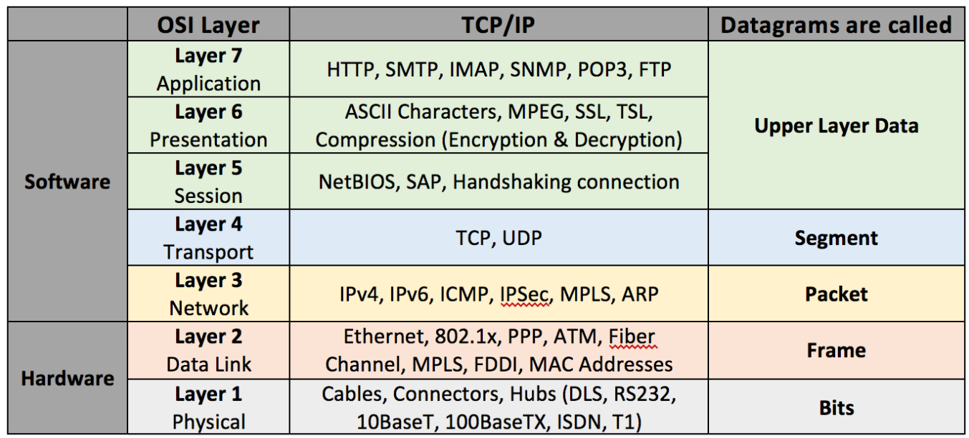
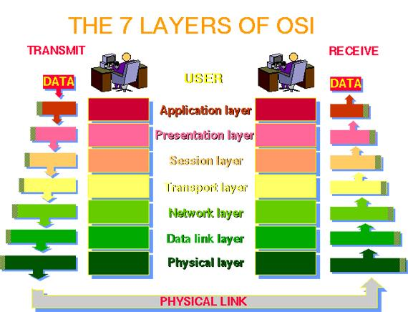
Layer OSI

Slide 5

UDP vs TCP
UDP lebih bersifat ke broadcasting (menyebarkan) daripada bersifat berkomunikasi meskipun bisa digunakan sebagai berkomunikasi.
TCP lebih bersifat saling berkoneksi layaknya dua manusia yang saling ngobrol dengan saling mengonfirmasi apa yang dibicarakan.

Slide 6
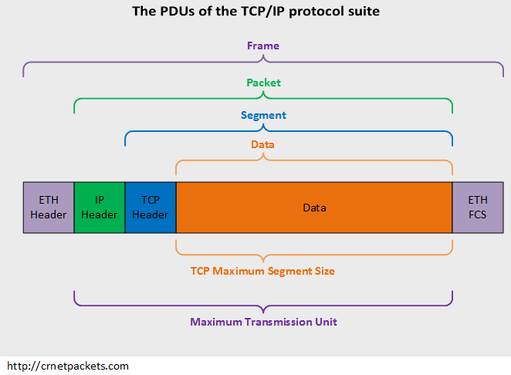
Protokol Data Unit

Slide 7
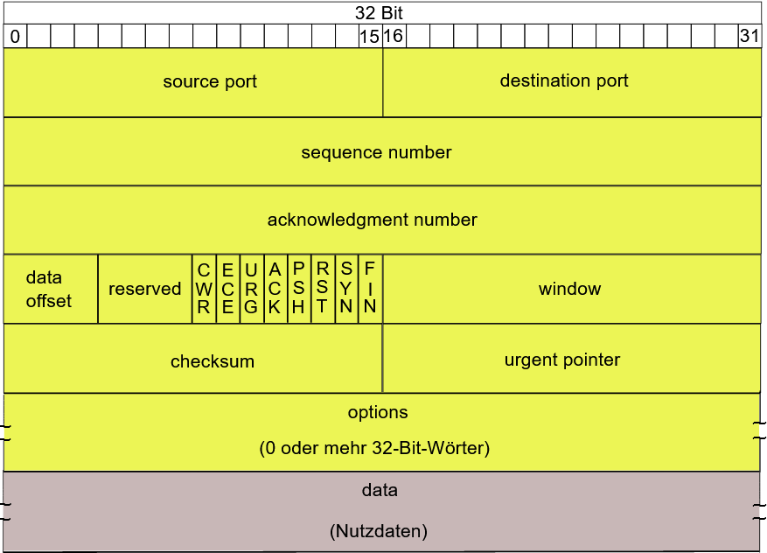
TCP Header

Slide 8
Source port: this is a 16 bit field that specifies the port number of the sender.
Destination port: this is a 16 bit field that specifies the port number of the receiver.
Sequence number: the sequence number is a 32 bit field that indicates how much data is sent during the TCP session. When you establish a new TCP connection (3 way handshake) then the initial sequence number is a random 32 bit value. The receiver will use this sequence number and sends back an acknowledgment. Protocol analyzers like wireshark will often use a relative sequence number of 0 since it’s easier to read than some high random number.
Acknowledgment number: this 32 bit field is used by the receiver to request the next TCP segment. This value will be the sequence number incremented by 1.
DO: this is the 4 bit data offset field, also known as the header length. It indicates the length of the TCP header so that we know where the actual data begins.
RSV: these are 3 bits for the reserved field. They are unused and are always set to 0.
Flags: there are 9 bits for flags, we also call them control bits. We use them to establish connections, send data and terminate connections:
URG: urgent pointer. When this bit is set, the data should be treated as priority over other data.
ACK: used for the acknowledgment.
PSH: this is the push function. This tells an application that the data should be transmitted immediately and that we don’t want to wait to fill the entire TCP segment.
RST: this resets the connection, when you receive this you have to terminate the connection right away. This is only used when there are unrecoverable errors and it’s not a normal way to finish the TCP connection.
SYN: we use this for the initial three way handshake and it’s used to set the initial sequence number.
FIN: this finish bit is used to end the TCP connection. TCP is full duplex so both parties will have to use the FIN bit to end the connection. This is the normal method how we end an connection.
Window: the 16 bit window field specifies how many bytes the receiver is willing to receive. It is used so the receiver can tell the sender that it would like to receive more data than what it is currently receiving. It does so by specifying the number of bytes beyond the sequence number in the acknowledgment field.
Checksum: 16 bits are used for a checksum to check if the TCP header is OK or not.
Urgent pointer: these 16 bits are used when the URG bit has been set, the urgent pointer is used to indicate where the urgent data ends.
Options: this field is optional and can be anywhere between 0 and 320 bits.

Slide 9
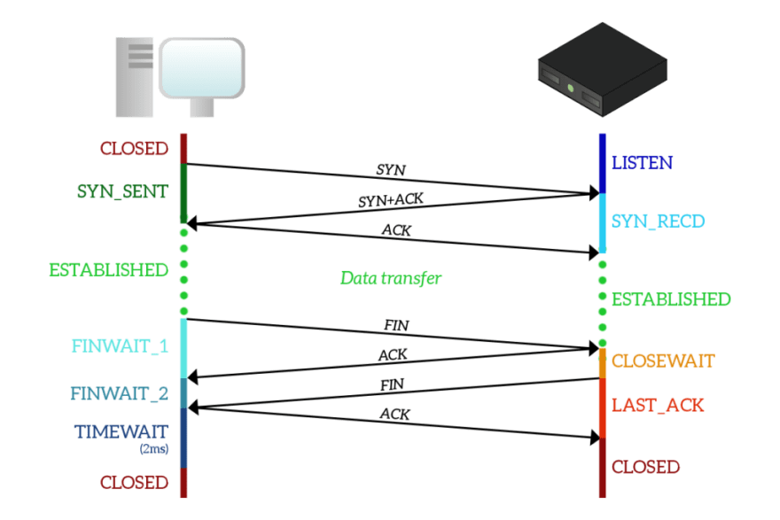
Establishing TCP

Slide 10
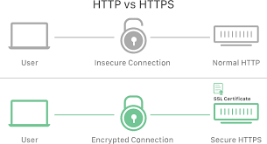
Encryped Packet vs Non-Encrypted Packet

Slide 11
QoS
Quality of Service (QoS) atau Kualitas layanan adalah metode pengukuran yang digunakan untuk menentukan kemampuan sebuah jaringan seperti; aplikasi jaringan, host atau router dengan tujuan memberikan network service yang lebih baik dan terencana sehingga dapat memenuhi kebutuhan suatu layanan.
Parameter kualitas yang dinilai meliputi throughput, latency, jitter, packet loss.
Tahap untuk melakukan penilaian QoS adalah Capturing, Filtering, Analysis.

Slide 12
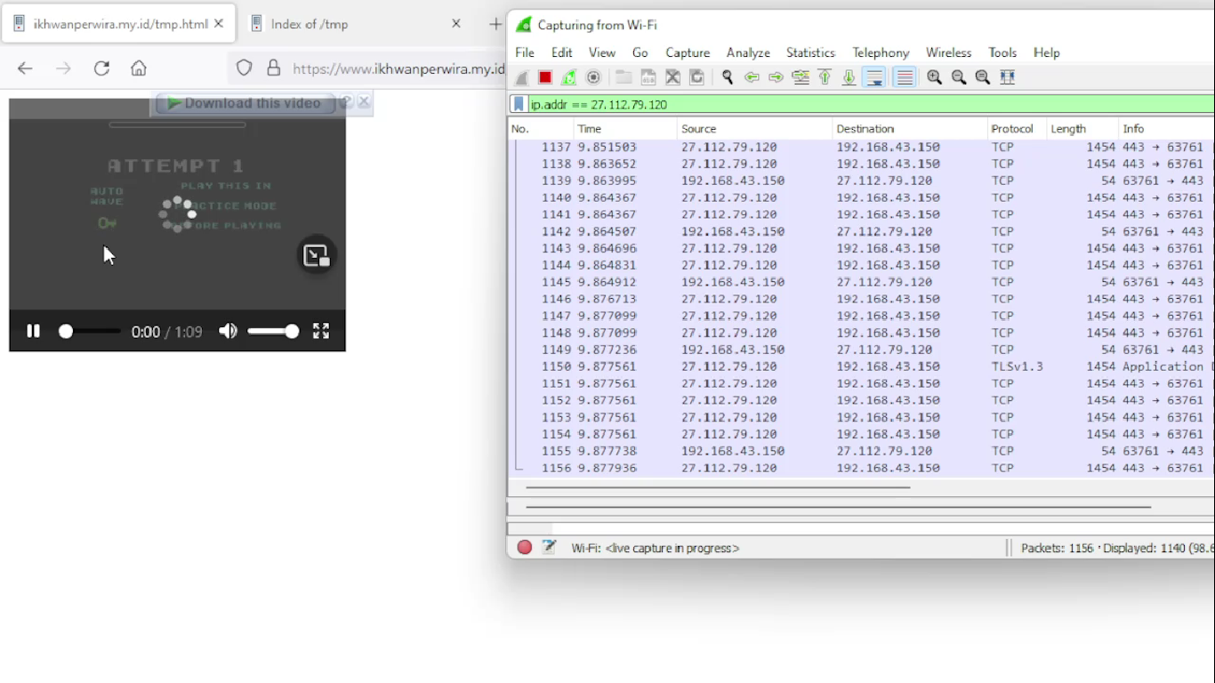
Menganalisa Trafik Jaringan Streaming Download Video pada server 27.112.79.120

Slide 13
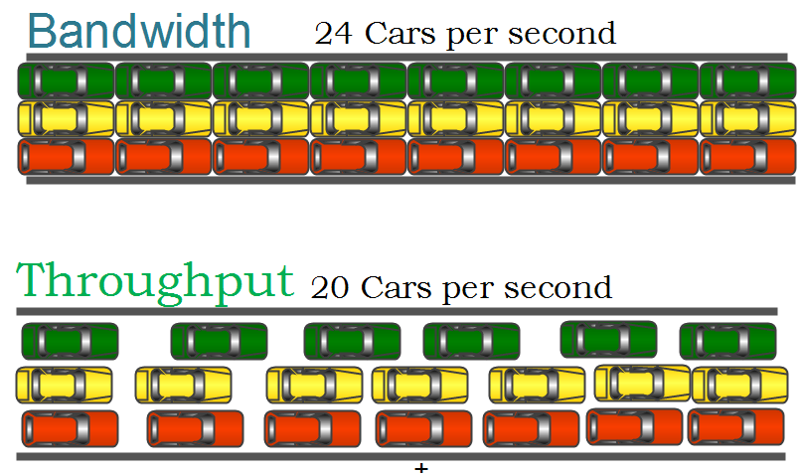
Perbedaan Throughput dengan Bandwidth
Bandwidth adalah kecepatan maksimal bit yang dapat dipancarkan oleh suatu perangkat (memiliki satuan bit/s).
Throughput adalah nilai rata-rata dari bit-bit yang terkirim tiap waktu (memiliki satuan bit/s)

Slide 14
Perbedaan PING, Delay dan Latency
Ping adalah sinyal atau paket yang ditransfer melalui protocol ICMP (memiliki satuan paket).
Delay adalah waktu tunda antara dua paket (memiliki satuan detik).
Latency adalah nilai rata-rata dari keseluruhan delay (memiliki satuan detik).

Slide 15
Perbedaan Delay dan Jitter
Delay adalah waktu tunda antara dua paket (memiliki satuan detik).
Jitter adalah selisih antara dua Delay (memiliki satuan detik).

Slide 17
Daftar Pustaka
https://packetlife.net/blog/2010/jun/7/understanding-tcp-sequence-acknowledgment-numbers/

