Slide 1
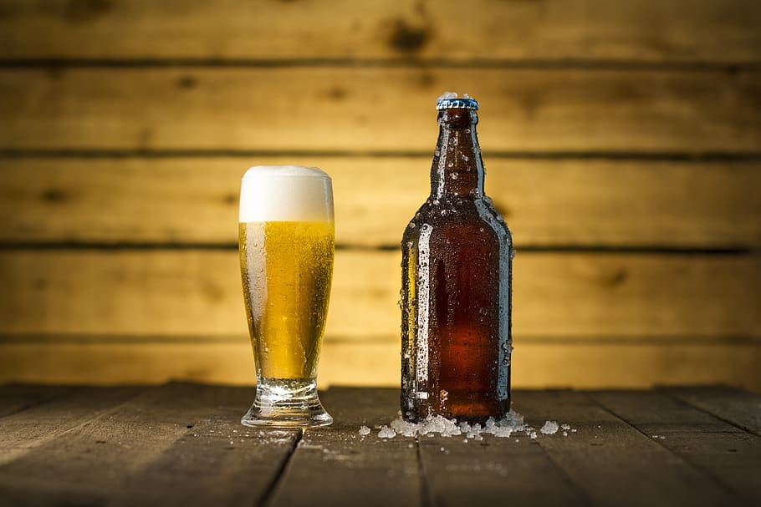
Craft Beer Trends within the United States
Derek Mast, Walter Wilson, Anthony Davey, Rolly Costillas

Slide 2
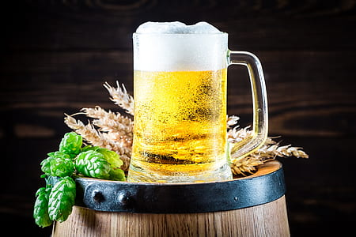
Introduction
Visualizations
Bar Chart showing the top 20 states with the most breweries
Plot showing the average beer reviews for the top ten beer styles in each state, selected by a Drop Down menu
Bubble chart showing the distribution of beer ratings by region
Datasets
Kaggle-Beer Reviews
BeerAdvocate Web Scrape
Pandas, PostgreSQL,Web Scraping/Flask/HTML/CSS/Javascript

Slide 3
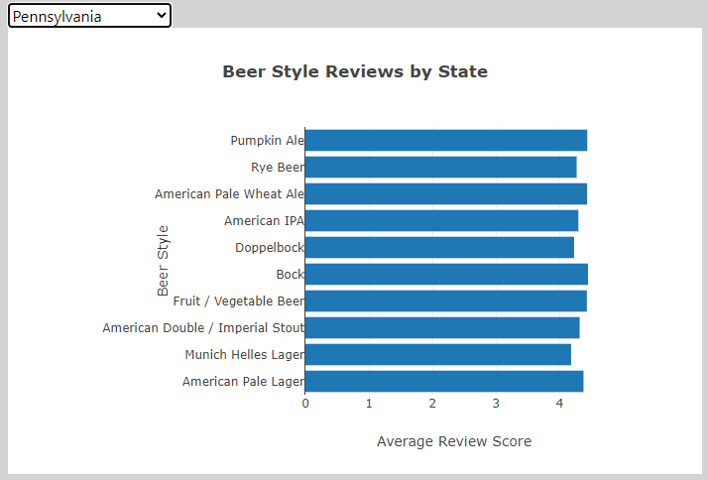
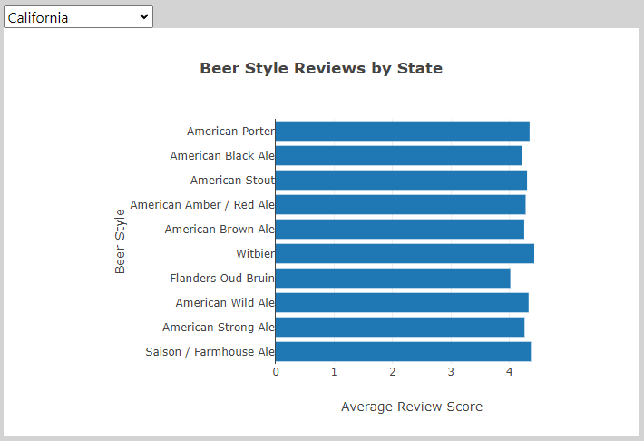
Top Rated Styles of Beer by State

Slide 4
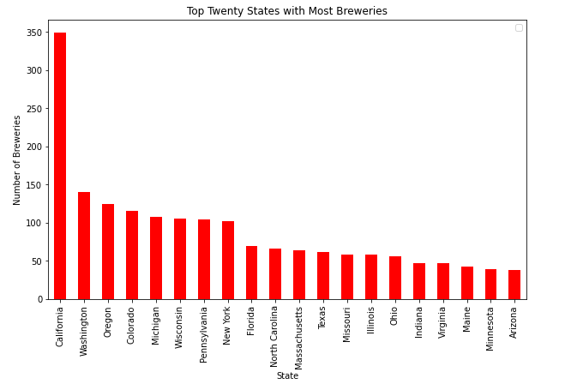
States with the Most Breweries

Slide 5
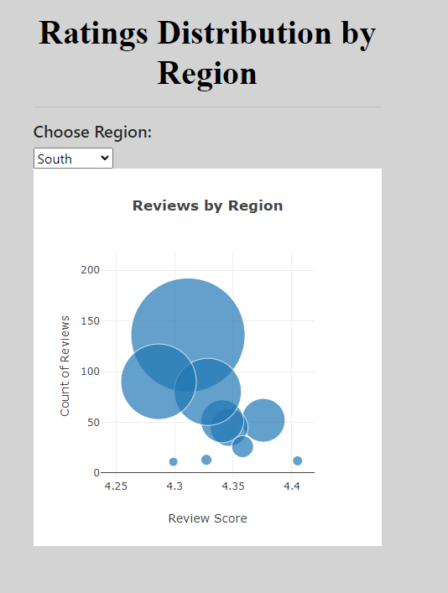

Slide 6
Any Questions?

