Slide 1
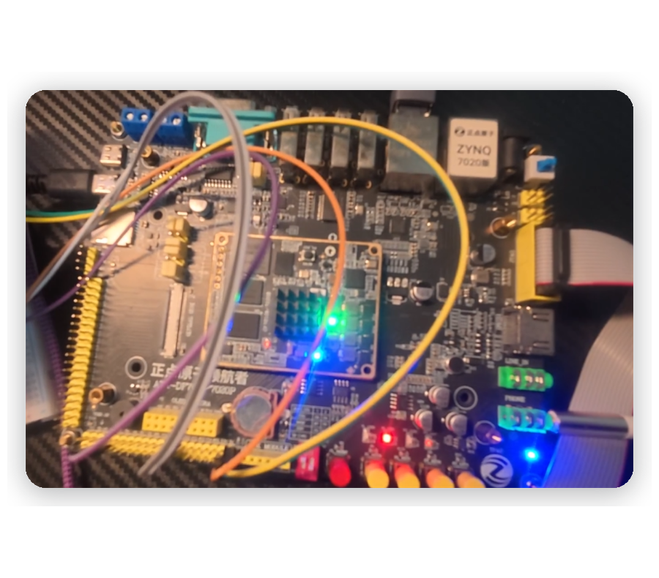

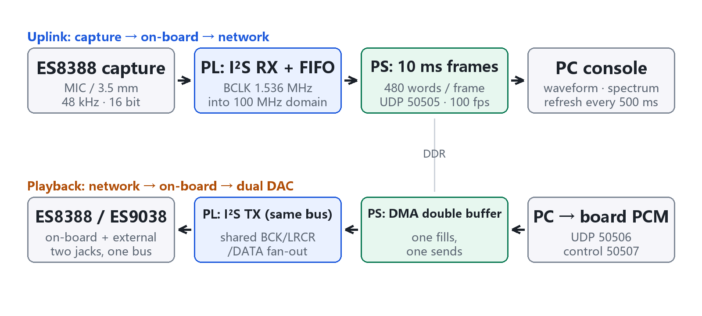

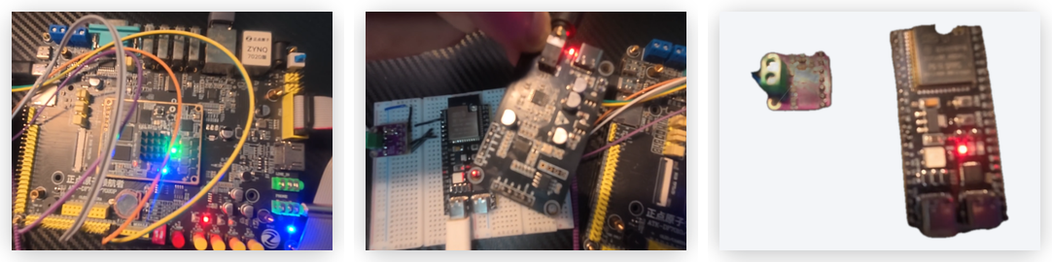



INTRODUCTION
Team members: Junhao Wen, Ziyuan Lin, Yuan Jiang
Real-Time Audio Capture, Denoising and Dual-DAC Playback on ZYNQ-7020
Hardware: ZYNQ-7020 board, external DAC and ESP32-S3
Measured on AMD ZYNQ-7020
One ZYNQ-7020 carries the whole chain: an ES8388 captures audio, an I²S state machine and an asynchronous FIFO move it inside the PL, AXIS and DMA write DDR, and the ARM core sends fixed 10 ms frames over UDP to the PC.
Playback returns the same way, fanned out from one I²S bus to the on-board ES8388 and an external ES9038Q2M. The software only handles protocol and scheduling.
Platform: Windows 11 / Python 3.12 / console :8770
C
R
R
E
E
S
System Architecture
A
T
U
I
L
Typical application case
PL hardware capture path:
1. I²S master timing: BCLK 1.536 MHz, LRCLK 48 kHz, 32 BCLK per frame;
2. 16-bit shift and L/R framing in the BCLK domain;
3. Gray-code pointer asynchronous FIFO into the 100 MHz domain;
4. AXIS and clock converter, then DMA S2MM into DDR.
V
T
Teaching and competitions: analog front end, clocks, clock-domain crossing, DMA and networking - each layer can be verified with a scope and with counters.
Early validation of embedded audio products: microphone arrays, conference terminals and recorders all need a capture path that can be modified, measured and replayed.
Acoustic monitoring in industry and security: long, stable uplinks plus local observability, which is what fixed frames and visible packet loss provide.
Key technical issues addressed:
1. Capture and clock-domain crossing without CPU - an I²S state machine plus a gray-code pointer asynchronous FIFO inside the PL.
2. Lossless 100 fps uplink - 480-word frames split into two 968 B UDP payloads, double-buffered DMA.
3. Audio comparison without software variables - both DACs share the same BCK/LRCR/DATA bus.
4. Can denoising stay on the ARM? - measured: a noise gate costs 0.127 ms per frame, RNNoise 20.07 ms.
E
D
Measured on hardware:
100.0 fps, 1.549 Mbit/s, 0 packet loss, 2 underruns, -31.2 dBFS input; the console refreshes waveform, spectrum and telemetry every 500 ms. LUT 19 656 (36.95%), FF 48 299 (45.39%), BRAM 8, DSP 0, WNS +0.357 ns, power 2.189 W.
Two points worth stating:
The dual-DAC fan-out gives a bench with no software variable; slice utilisation is already 99.40% because the asynchronous FIFO arrays are inferred as registers (16 384 x 2). Moving them to block RAM frees about 32 800 flip-flops, and the spectral-subtraction core is ready for the PL.
E
S
PS frame scheduling and networking:
1. 10 ms frame loop, 480 words (1 920 bytes) per frame;
2. Two UDP packets per frame: 8 B header + 960 B, 100 fps;
3. Double-buffered DMA absorbs network jitter;
4. 200 ms microphone watchdog re-initialises the codec.
I
N
G

