Slide 1
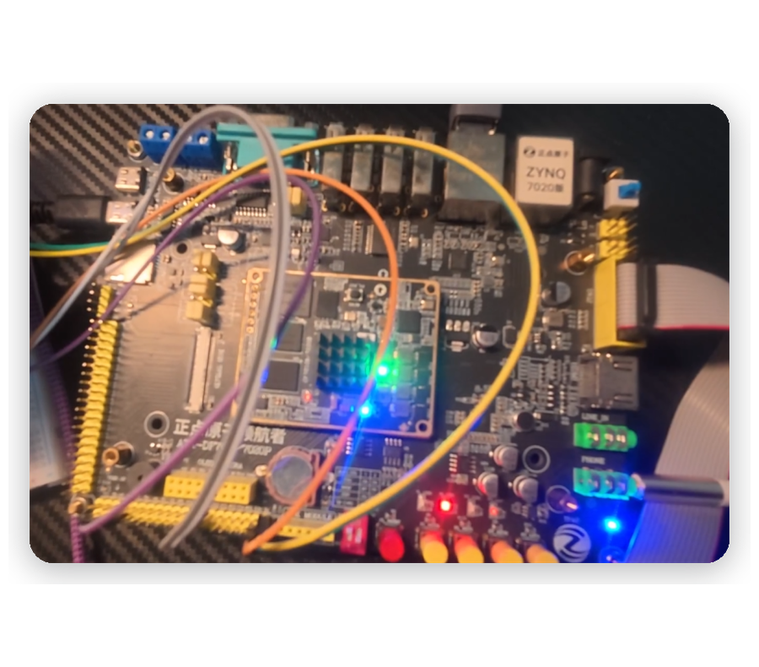

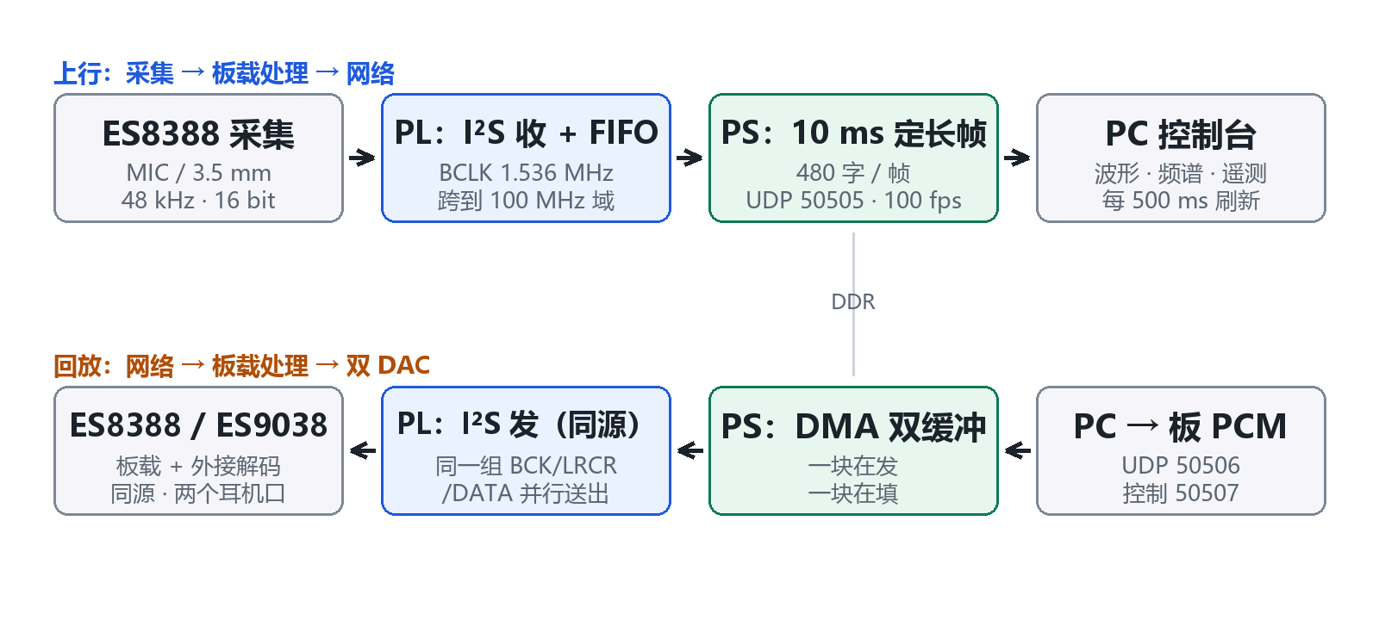

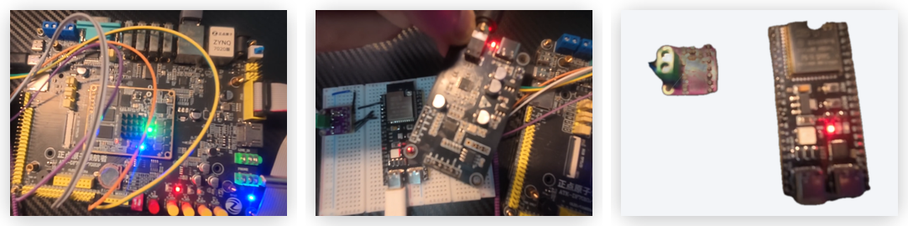
引 言
参赛队员：温俊浩 林子源 姜远
基于 ZYNQ-7020 的实时音频采集、降噪与双路回放系统
系统实物：ZYNQ-7020 板 + 外接解码板 + ESP32-S3
AMD ZYNQ-7020 板上实测
本作品把一条完整的音频链路装进一块 ZYNQ-7020：ES8388 采集的信号经 PL 内 I²S 与异步 FIFO 跨时钟搬运，由 AXIS + DMA 写入 DDR，ARM 端按 10 ms 定长帧以 UDP 上行到 PC；回放原路返回，同一组 I²S 扇出到板载 与外接两片 DAC。
硬实时留给硬件：BCLK/LRCLK 由 PL 产生，采样与合帧全是纯状态机，软件只管协议与调度。
平台：Windows 11 / Python 3.12 / 控制台 :8770
C
R
R
E
E
S
系统架构
A
T
U
I
L
典型应用场景
PL 硬件采集通路：
1. I²S 主机时序：BCLK 1.536 MHz、LRCLK 48 kHz、每帧 32 BCLK；
2. BCLK 域 16 bit 移位、左右声道合帧；
3. 格雷码指针异步 FIFO 跨到 100 MHz 域；
4. AXIS → 时钟转换 → DMA S2MM 入 DDR。
V
T
教学与竞赛：模拟前端、时钟、跨时钟域、DMA、网络协议，每一层都能用示波器与读数验证。
嵌入式音频产品前期验证：麦克风阵列、会议终端、录音笔都需要一条可改、可测、可回放的采集链路。
工业与安防声学监测：设备异响、管道泄漏要的是长期稳定上行与本地可判，定长帧与可观测丢包正好对应。
关键问题与做法：
① 采集与跨时钟域不能有 CPU 参与 → PL 内 I²S 状态机 + 格雷码指针异步 FIFO。
② 100 帧/秒无损上行 → 480 字定长帧、每帧拆两个 968 B 的 UDP 载荷、DMA 双缓冲。
③ 排除软件变量的音质对比 → 两片 DAC 共享同一组 BCK/LRCR/DATA。
④ 降噪能否留在 ARM → 用实测时延回答：噪声门 0.127 ms/帧，RNNoise 20.07 ms/帧，后者已越线。
E
D
实测（真实硬件）：
100.0 帧/秒、1.549 Mbit/s、丢包 0、欠载 2、输入 −31.2 dBFS；控制台每 500 ms 刷新波形、频谱与遥测。资源：LUT 19 656（36.95%）、FF 48 299（45.39%）、BRAM 8、DSP 0，WNS +0.357 ns，功耗 2.189 W。
两点要说清楚：
双 DAC 并联是"零软件变量"的实验台；但布局密度已达 99.40%，因为异步 FIFO 的存储阵列被综合成触发器（16 384×2）。改为块 RAM 可释放约 32 800 个触发器，谱减也已具备搬进 PL 的条件。
E
S
PS 帧调度与网络：
1. 10 ms 帧循环，480 字（1 920 字节）/帧；
2. 每帧拆两包：8 B 头 + 960 B，100 帧/秒；
3. DMA 双缓冲吸收网络抖动；
4. MIC 看门狗 200 ms，采集停摆自动重配 codec。
I
N
G

Slide 2
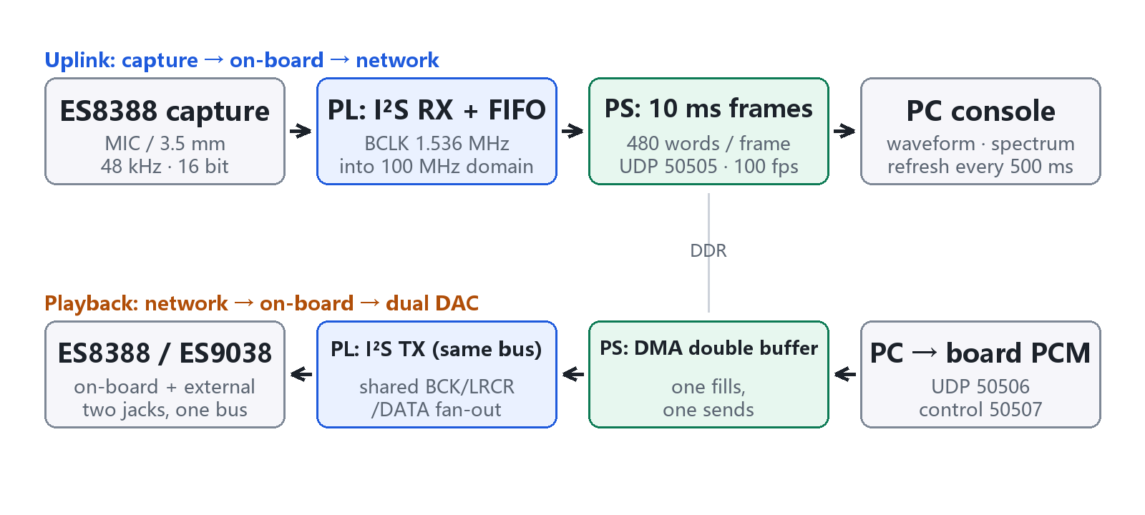
INTRODUCTION
Team members: Junhao Wen, Ziyuan Lin, Yuan Jiang
Real-Time Audio Capture, Denoising and Dual-DAC Playback on ZYNQ-7020
Hardware: ZYNQ-7020 board, external DAC and ESP32-S3
Measured on AMD ZYNQ-7020
One ZYNQ-7020 carries the whole chain: an ES8388 captures audio, an I²S state machine and an asynchronous FIFO move it inside the PL, AXIS and DMA write DDR, and the ARM core sends fixed 10 ms frames over UDP to the PC.
Playback returns the same way, fanned out from one I²S bus to the on-board ES8388 and an external ES9038Q2M. The software only handles protocol and scheduling.
Platform: Windows 11 / Python 3.12 / console :8770
C
R
R
E
E
S
System Architecture
A
T
U
I
L
Typical application case
PL hardware capture path:
1. I²S master timing: BCLK 1.536 MHz, LRCLK 48 kHz, 32 BCLK per frame;
2. 16-bit shift and L/R framing in the BCLK domain;
3. Gray-code pointer asynchronous FIFO into the 100 MHz domain;
4. AXIS and clock converter, then DMA S2MM into DDR.
V
T
Teaching and competitions: analog front end, clocks, clock-domain crossing, DMA and networking - each layer can be verified with a scope and with counters.
Early validation of embedded audio products: microphone arrays, conference terminals and recorders all need a capture path that can be modified, measured and replayed.
Acoustic monitoring in industry and security: long, stable uplinks plus local observability, which is what fixed frames and visible packet loss provide.
Key technical issues addressed:
1. Capture and clock-domain crossing without CPU - an I²S state machine plus a gray-code pointer asynchronous FIFO inside the PL.
2. Lossless 100 fps uplink - 480-word frames split into two 968 B UDP payloads, double-buffered DMA.
3. Audio comparison without software variables - both DACs share the same BCK/LRCR/DATA bus.
4. Can denoising stay on the ARM? - measured: a noise gate costs 0.127 ms per frame, RNNoise 20.07 ms.
E
D
Measured on hardware:
100.0 fps, 1.549 Mbit/s, 0 packet loss, 2 underruns, -31.2 dBFS input; the console refreshes waveform, spectrum and telemetry every 500 ms. LUT 19 656 (36.95%), FF 48 299 (45.39%), BRAM 8, DSP 0, WNS +0.357 ns, power 2.189 W.
Two points worth stating:
The dual-DAC fan-out gives a bench with no software variable; slice utilisation is already 99.40% because the asynchronous FIFO arrays are inferred as registers (16 384 x 2). Moving them to block RAM frees about 32 800 flip-flops, and the spectral-subtraction core is ready for the PL.
E
S
PS frame scheduling and networking:
1. 10 ms frame loop, 480 words (1 920 bytes) per frame;
2. Two UDP packets per frame: 8 B header + 960 B, 100 fps;
3. Double-buffered DMA absorbs network jitter;
4. 200 ms microphone watchdog re-initialises the codec.
I
N
G

