Slide 1
Simulated Images for Heterogeneity Project
Arrays were created and visualized with a Python code

Slide 2
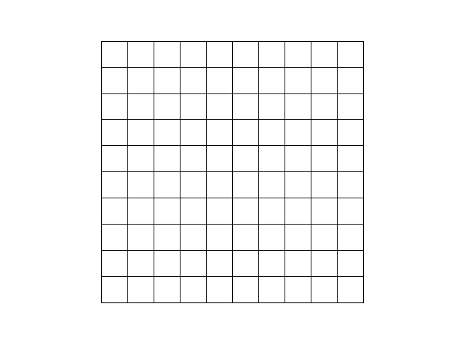
Homogenous – array filled with zeros

Slide 3
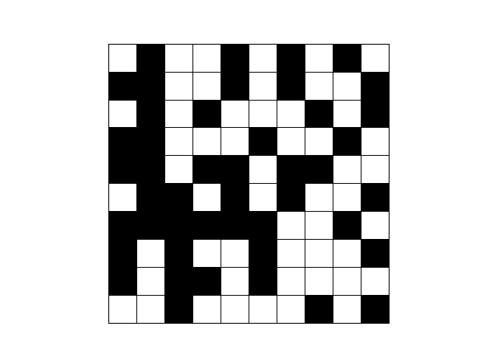
Randomized array

Slide 4
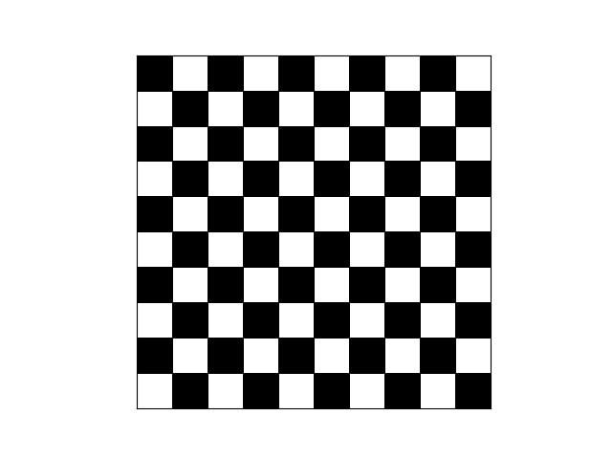
Patterned Array – checkboard

Slide 5
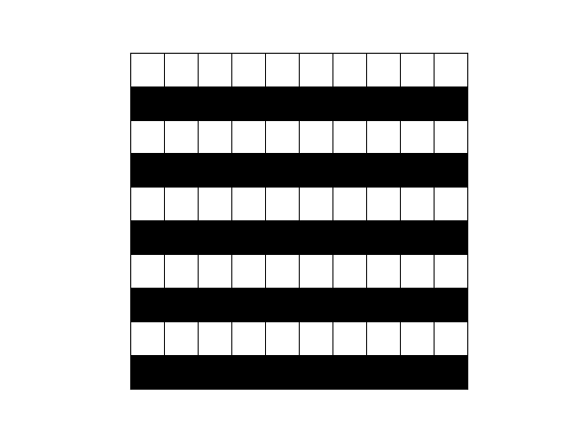
Patterned Array – horizontal lines

Slide 6
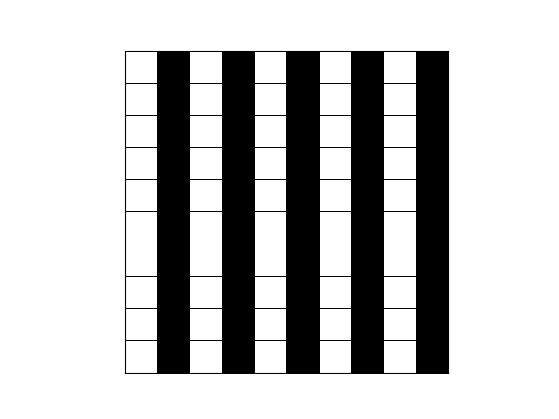
Patterned Array – vertical lines

Slide 7
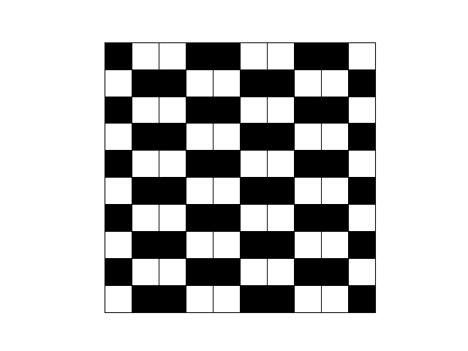
Manually Defined Array

