Slide 1


Data Governance @ SneakerPark
Prepared by: Xabier Laibarra
Submitted on: 16/07/2023

Slide 2
Background
SneakerPark is an online shoe reseller that allows people to buy and sell used and new shoes. Buyers can bid for shoes or buy them outright, and sellers can set a price or sell to the highest bidder.
Each buyer and seller must have an active account in order to sell, bid, or purchase sneakers using SneakerPark’s website.
SneakerPark authenticates the shoes before shipping them to the buyer, so before listing an item, the seller must ship it to SneakerPark’s warehouse. Upon receipt, SneakerPark assigns an item number to each pair of sneakers and notifies the seller that they are now free to list their item. If the item is not listed within 45 days, SneakerPark returns it to the seller and sends an invoice to the seller for the shipping cost.
If the item is found to be inauthentic or in an unacceptable condition, it is also returned back to the seller in a similar fashion.
When the item sells, the buyer’s account is credited with the purchase price minus the SneakerPark service fee and shipping fees to deliver the item to the buyer.
Currently, SneakerPark only supports sales within the United States.

Slide 3
Step 1
Enterprise Data Catalog
Part 1: Enterprise Data Model

Slide 4
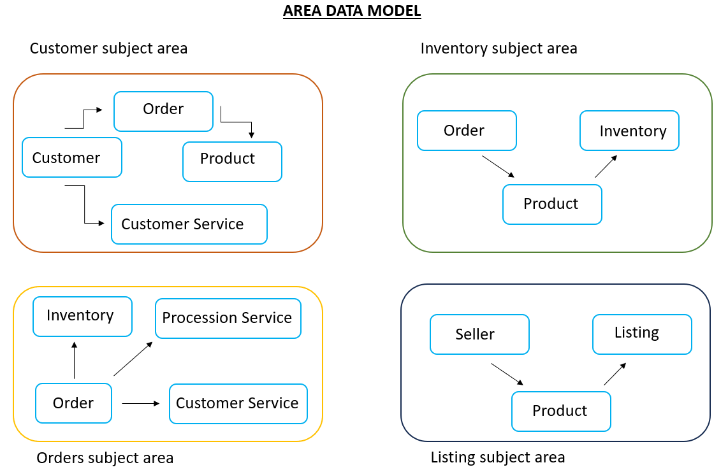
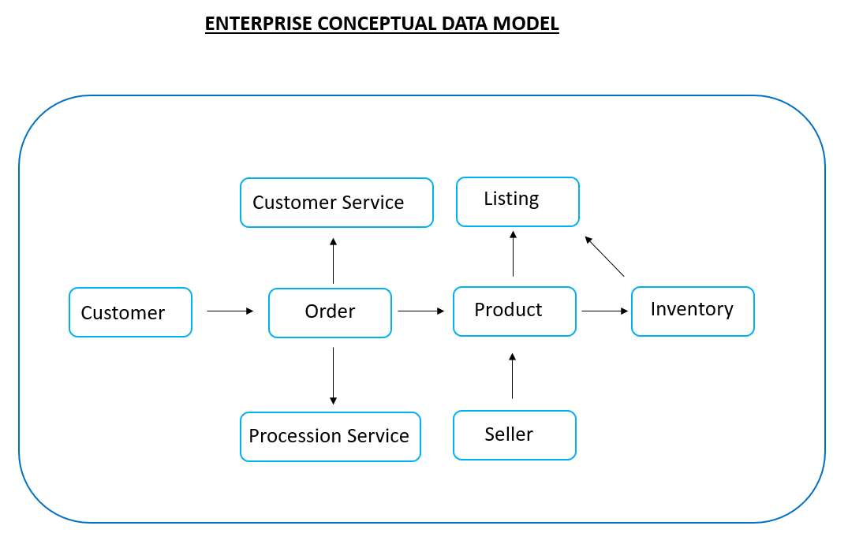

Slide 5
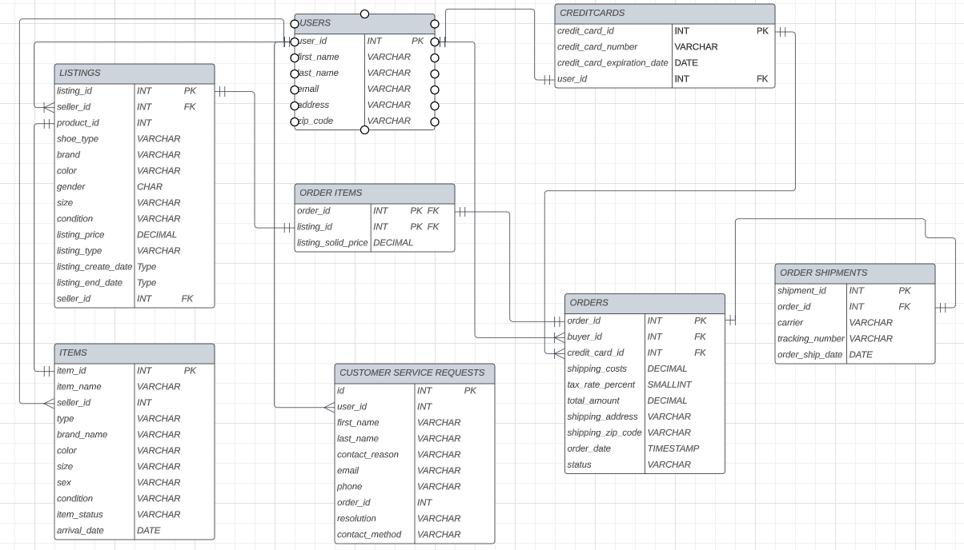

Slide 6
Step 2
Enterprise Data Catalog
Part 2: Metadata

Slide 7
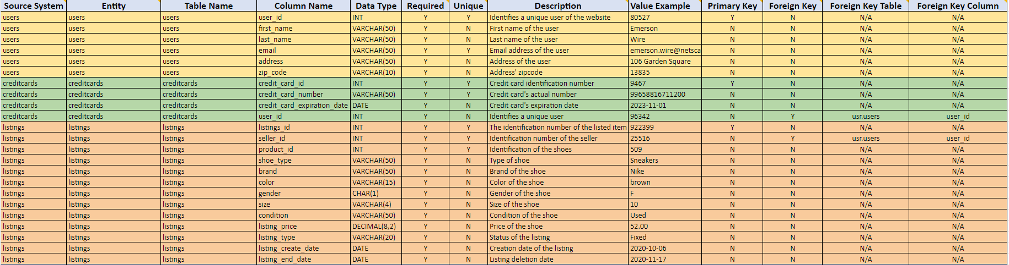
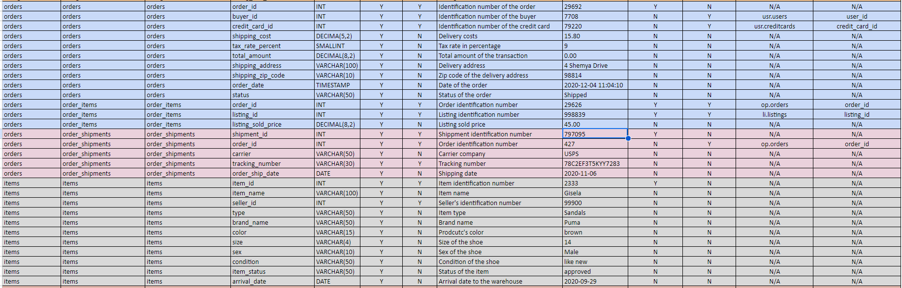
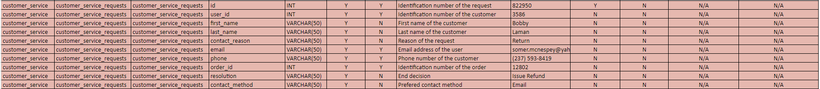
Data Catalog and Business Metadata

Slide 8
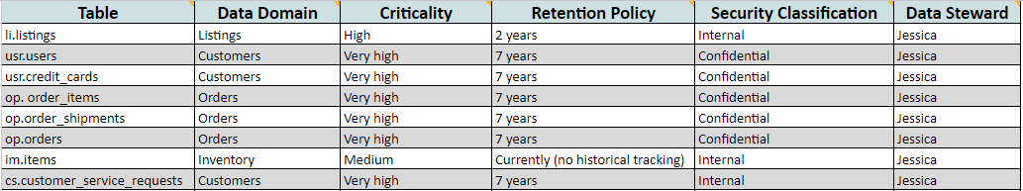
Business metadata

Slide 9
Step 3
Data Quality
Part 1: Profiling and Cleansing

Slide 10
Not possible that in the op.ordershipments table there are just 14 records and in the op.orders and in the op.ordersitems tables there 98 distinct order_id. Data regarding the shipments is missing and it should be synchornized to be complete.
Quality rule → 75% or more of the order_id should be included as shipped in the op.ordershipment table.
Four observations (three distinct order_id) that do not have nor the phone information neither the email information in the cs.customerservicerequests table.
Quality rule → every person that has an account in SnearkerPark must include at least a phone or an email in their profile.
There are 7 shipping addresses missing in the op.orders table, which means that the order cannot be shipped.
Quality rule → no order will be processed with the shipping address field empty.
Not observed but possible to happen in the future: negative or string values in the size column of the im.items table, as it is defined as VARCHAR.
Quality rule → a dropdown menu will be provided in order to avoid negative, too high or string values. Data type will also be set as integer instead of string.

Slide 11
Step 4
Data Quality
Part 2: Monitoring

Slide 12
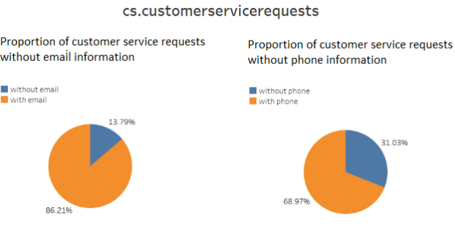
Data quality dashboard
In the table cs.customerservicerequests values for “phone” and “email” are missing, as shown below. As a metric, we will fix, that we should have always a value by observation in “email” (100%) and a 80% in “phone” column (currently we have 4 observations without any contact information, hence, 13,79%).

Slide 13
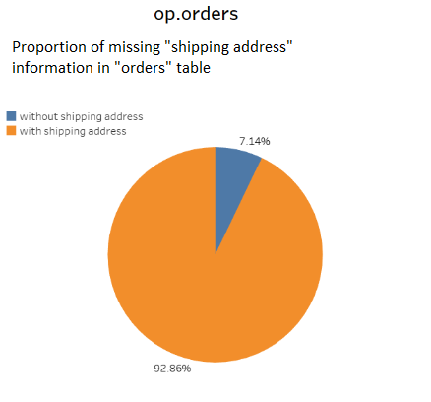
Regarding the “shipping address” in the op.orders table, there are 7 values missing out of 98. This means, that the order will not be able to be delivered, which is not admissible. We will have to make sure, that every time an order is place, the shipping address is available.

Slide 14
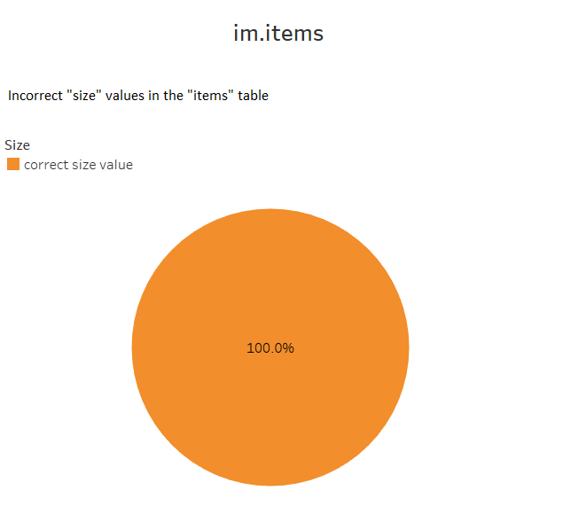
Even this issue has not happened yet, we will follow the metric of it. As we can see in the chart below, there is no incorrect value (string, negative or extremely high) in the “size” column in the “items” table.

Slide 15
Step 5
Master Data Management
Part 1: MDM Architecture

Slide 16
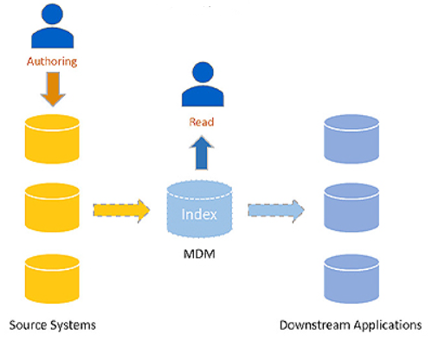
I would suggest to implement a Registry type Master Data Management (MDM) Architecture. As the current and most urgent pain point are the discrepancies between systems. Additionally, the CEO informed that the budget for the MDM is low, even though it possible that in the future an Enterprise Data Warehouse could be an option.
With the Registry MDM we will establish a central database with a list of primary keys for the master records, attributes, source systems and identifiers. The master data will stay in the source systems and it will have to be joined manually by the user.
This solution is low cost, is not intrusive to existing systems, it is simple to implement and allows a distributed governance.

Slide 17
Step 6
Master Data Management
Part 2: Master Record

Slide 18
- Rule 1 : user_id from the table usr.users should match uniquely with the or.orders table’s buyer_id.
SELECT *
FROM or.orders
INNER JOIN usr.users ON usr.users.user_id=or.orders.buyer_id
- Rule 2 : user_id from the table usr.users should match uniquely with the li.listings table’s seller_id.
SELECT *
FROM li.listings
INNER JOIN usr.users ON usr.users.user_id=or.orders.seller_id

Slide 19
- Rule 3 : order_id from the table or.order_items should match uniquely with the or.orders table’s order_id.
SELECT *
FROM or.orders
INNER JOIN or.order_items USING (order_id)
- Rule 4 : listing_id from the table or.order_items should match uniquely with the li.listings table’s listing_id.
SELECT *
FROM li.listings
INNER JOIN or.order_items USING (listing_id)

Slide 20
Step 7
Data Governance:
Roles and Responsibilities

Slide 21
For this Registry Master Data Management it would not be required to hire additional people. Jake and Jessica know the data and they have been executing similar tasks in an environment lacking a MDM. From now on, they are going be in charge of the quality and monitoring of the data. Thus, the following roles will be required:
MDM Data Steward (Jessica): will be responsible for the accuracy, completeness and consistency of the data across the organization.
MDM Data Quality Analyst (Jake): responsible for monitoring, measuring and improving the quality of master data.
MDM Data Governance Analyst (Xabier): in charge of defining and enforcing policies and procedures for managing data, including data quality and data security.

Slide 22
Standout Suggestions

Slide 23
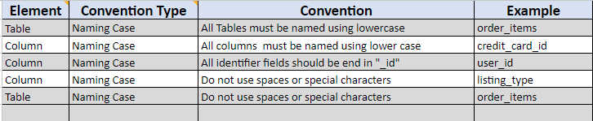
The following will be the SneakerPark’s naming conventions:

