Slide 1

BOOTCAMP FINAL PROJECT Next month payment default prediction
Xabier Laibarra
01/10/2022

Slide 2
Next month payment prediction
1. Goal
2. Data Cleaning
3. EDA
4. Imbalanced data
5. Classification model
6. Calculations
7. Mode selection
8. Conclusions and next steps

Slide 3

Next month payment prediction
1. Goal:
Predict correctly the persons that are elegible for a credit in order
to maximize the profit.
Predict correctly people who are paying back the next month (dpnm).
Predicting correctly people who are not paying back the next month.

Slide 4
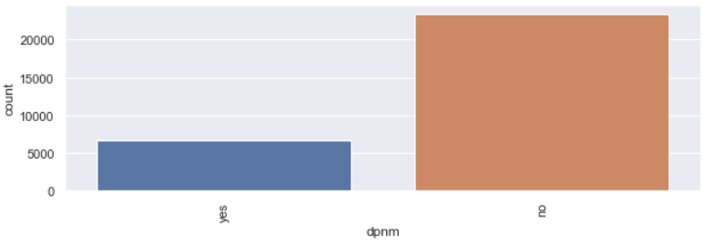
Next month payment prediction
2. Data cleaning
Duplicates
Column names
Null values
Bucket features
3. EDA
Distributions
Features´ data distribution
Feature types
Relationship between features
Relationship between features and target variable

Slide 5
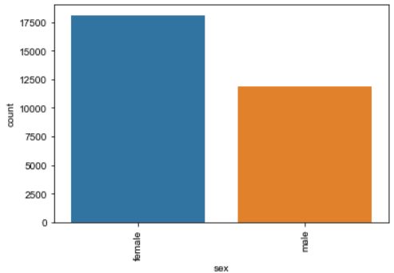
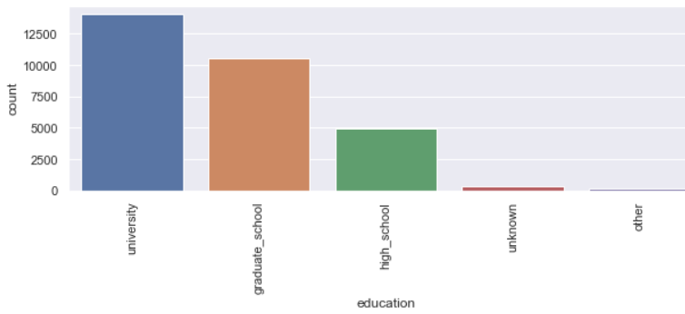
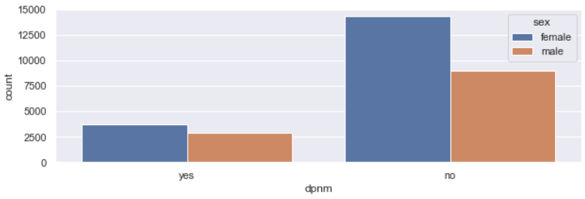
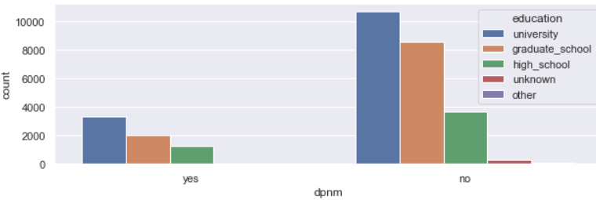
Next month payment prediction
3. EDA

Slide 6
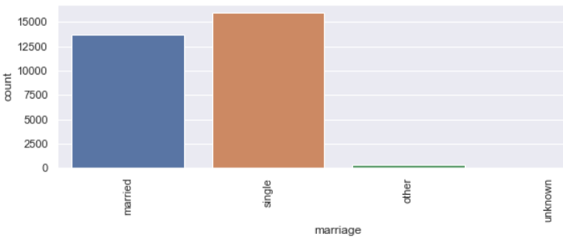
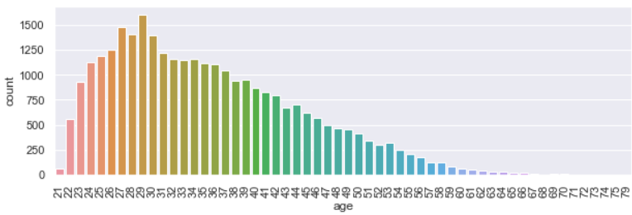
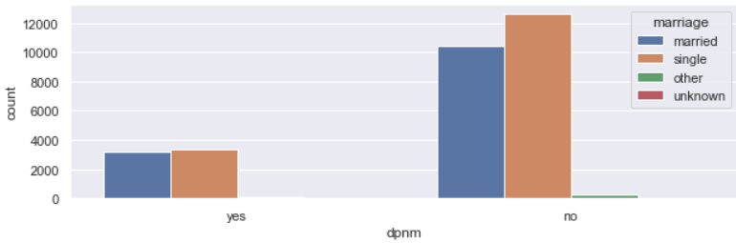
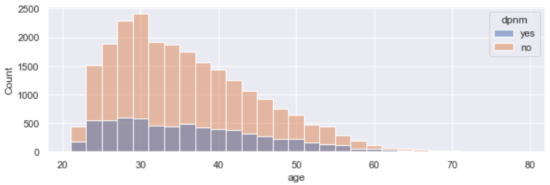
Next month payment prediction
3. EDA

Slide 7
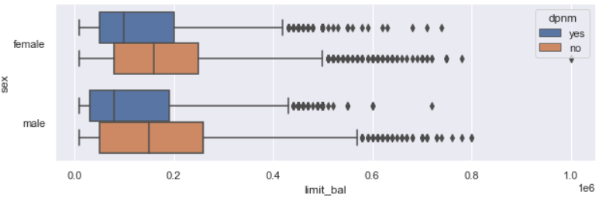
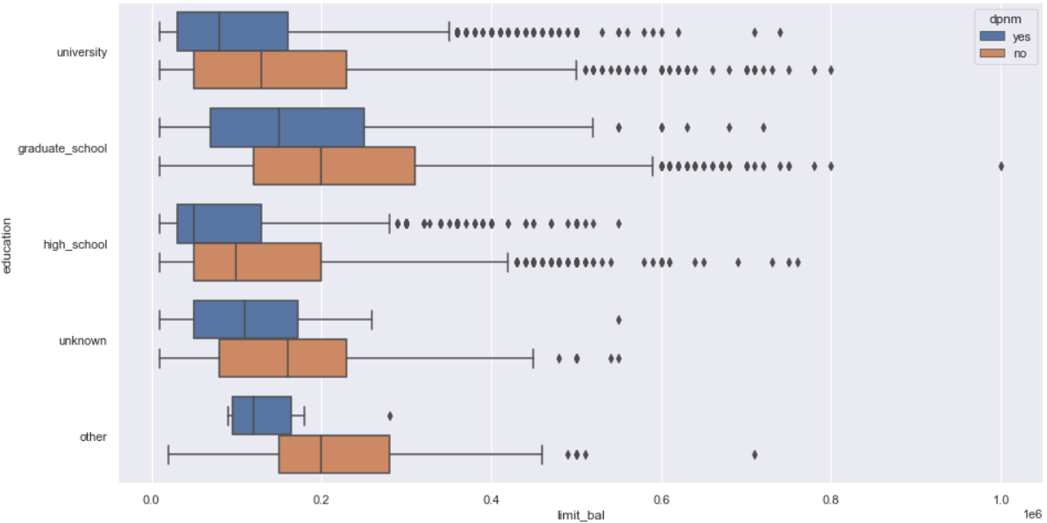
Next month payment prediction
3. EDA

Slide 8
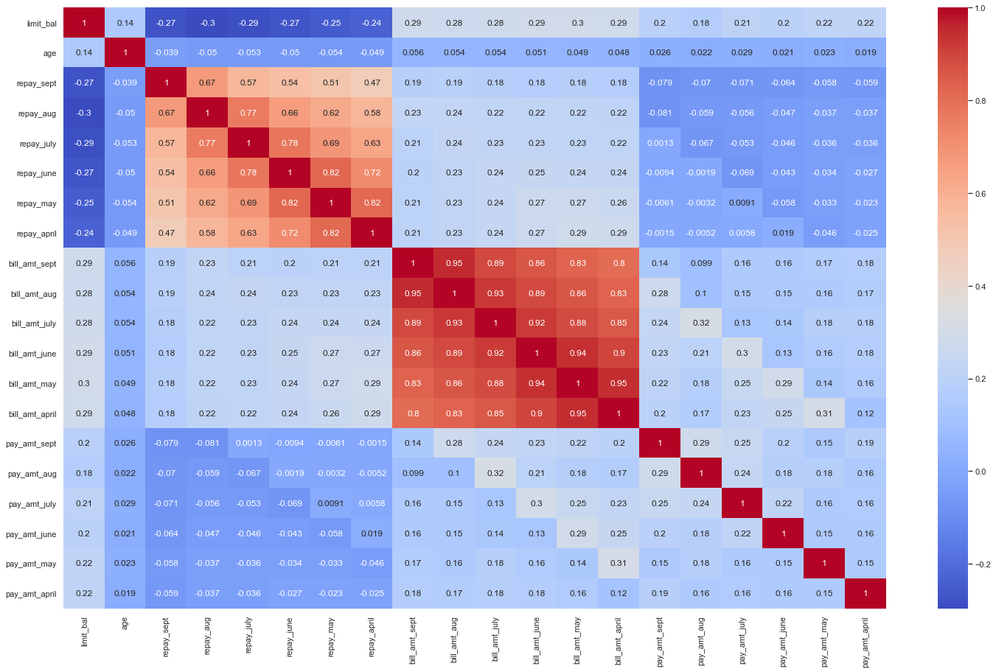
Next month payment prediction
3. EDA
Kept features that are not highly correlated
Given credit (limit_bal)
Billing amount (bill_amt)
Paid amount (pay_amt)
History of payments (repay)

Slide 9
Next month payment prediction
4. Imbalanced data( “yes” 22% vs 78% “no”)
SMOTE
Tomek Links
5. Classification model:
Scale the numeric data (payments, billing, etc.) → Standard Scaler
Encode the categorical data (sex, marriage, education) → One Hot Encoding
Used ML modeling techniques:
Logistic Regression
Decision Trees
Random Forests

Slide 10
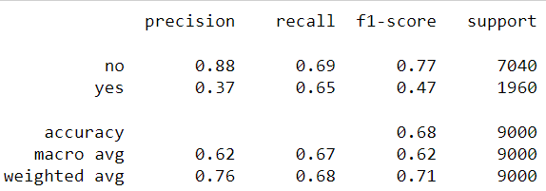
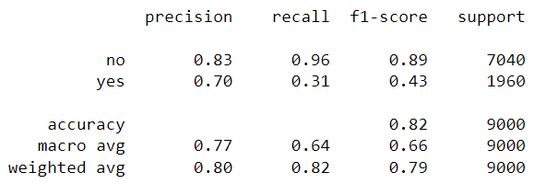
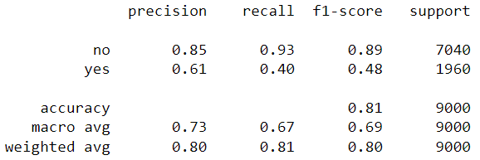
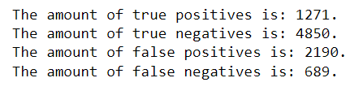
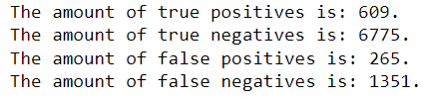
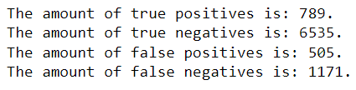
Next month payment prediction
6. Calculations
Metrics
Log. Regression – Smote Dec. Trees – Tomek Links Random Forests – Tomek Links
Confussion Matrix (True Positives, True Negatives, False Positives, False Negatives).
Log. Regression – Smote Dec. Trees – Tomek Links Random Forests – Tomek Links

Slide 11
Next month payment prediction
6. Calculations
Allocation of weights to the correct and incorrect predictions.
Well predicted “yes” → correct identification of clients that will not pay.
Coef. = 1 → calculated as profit.
Well predicted “no” → correct identification of clients that will pay.
Coef. = 0.3 → calculated as the profit provided by the loan´s interests.
Wrong predicted “yes” → incorrect labelling of clients that will not pay.
Coef. = -0.3 → calculated as profit.
Wrong predicted “no” → incorrect identification of clients that will pay.
Coef. = -1 → calculated as the profit provided by the loan´s interests.

Slide 12
Next month payment prediction
7. Model selection.
Select the model that will maximize the profits for the bank.
Σ(bill_pay_diff*coef.)/n = mean profit by client
Mean profit by customer and model:
Logistic Regression + SMOTE: 1414,48$
Logistic Regression + Tomek Links: 4604,35$
Decision Trees + SMOTE: 1606,04$
Decision Trees + Tome Links: 5398,33$
Random Forests + SMOTE: 4360,81$
Random Forests + Tomek Links: 4381,03$

Slide 13
Next month payment prediction
8. Conclusions and next steps:
Good model to predict the clients that will not default the payment.
More data from clients that defaulted the payment would help to build a better model.
Improve the current model so we can improve the predictions of the clients that will default the payment.

