Slide 1
Case Study: Regression data of a real estate company
Ironhack-Mid Bootcamp Project
Aravind Endluri
Xabi Laibarra
Nikos Karras
Teacher: Felipe Rocha
Teacher Assistant: Cristian Castro Blua

Slide 2
Targets of the Mid Bootcamp Project
Data analysis of the real estate company’s data
Explore the data
Build a machine learning model to predict the selling prices of houses based on features provided in the dataset
Compare the accuracies of different models and find the model that best fits our data Explore the characteristics of the houses using some business intelligence tools
Understanding which factors are responsible for higher property value - $650K and above
Visualize the explored data

Slide 3
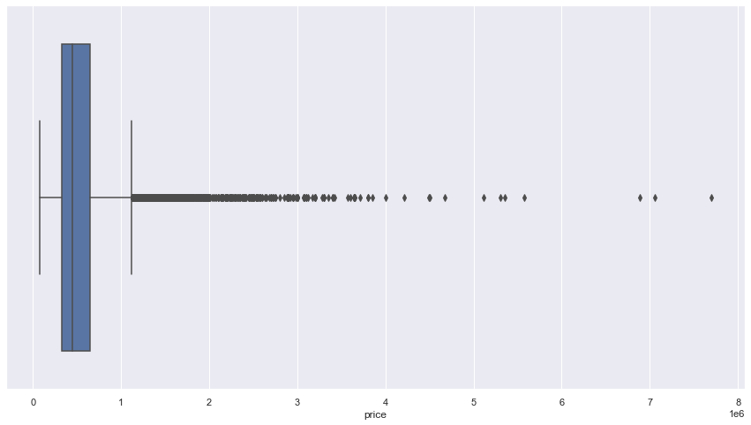
Different models
1st model) Using the whole data (including outliers).
Price range: whole price range.
2nd model) Using the data of the houses that are most expensive than 650K$
Price range: 650K $ < house price < 2M$
3rd model) Using the whole data (without extreme outliers).
Price range: houses cheaper than 2M$
boxplot of the target variable

Slide 4
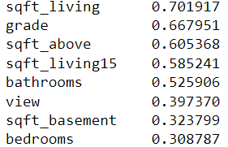
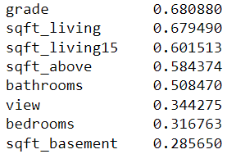
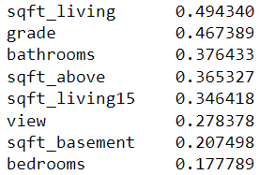
Correlations- high correlated features with the target
A) Using the whole data (including outliers).
B) Using the whole data (excluding the outliers)
C) Using the data of the houses that are most expensive than 650K$ (after removing the outliers).

Slide 5
Metrics
A) Using the whole data (including outliers)
Metrics:
r2 score: 0.794383880459157
RMSE: 404.5112559905159
MAE: 97221.71451695258
B) Using the whole data (without outliers)
Metrics:
r2 score: 0.8304071484887322
RMSE: 346.2591720598296
MAE: 81271.44480789847
C) Using the data of the houses that are most expensive than 650K$ (after removing the outliers)
Metrics
r2 score: 0.6855373470162327
RMSE: 397.25329338968805
MAE: 117200.195

Slide 6
Conclusions-Limitations of the model
Difficult to predict the prices of the houses, which are more expensive than 650K$
A) Very wide price range (approximately from 650 K-8 M) – there are extreme outliers
B) Very few houses in that price range-no representative sample
Reasons:
A) Better results after dropping outliers (smaller price range)
B) Better results using all the houses cheaper than 2M$ (large amount of houses)

Slide 7
Thank you for watching our presentation Gracias - Ευχαριστούμε(Efcharistoúme) -धन्यवाद(dhanyavaad)

