Slide 1
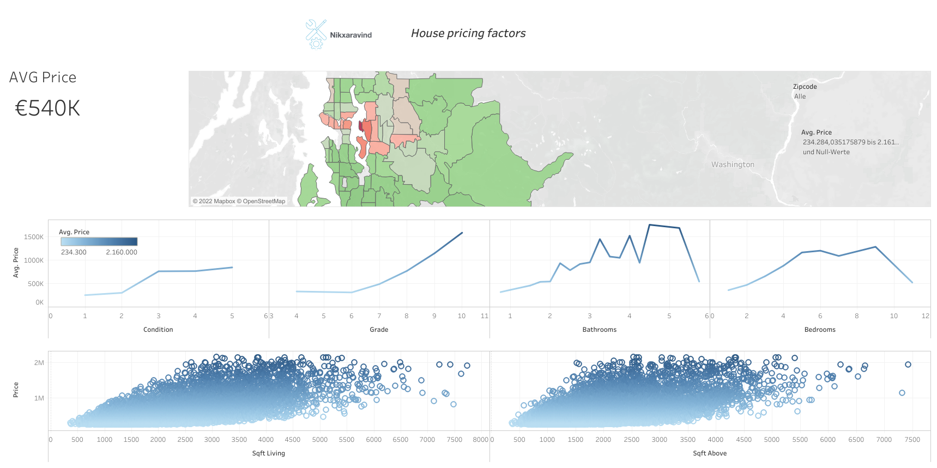

Slide 2
https://public.tableau.com/views/regression_dashboard/Housepricingfactors?:language=de-DE&publish=yes&:display_count=n&:origin=viz_share_link
Dashboard under this link

