Slide 1
Pain Points
Subject matter expertise professionals want to spread their knowledge to online learners, but don’t know the proper way to setup a curriculum or facilitate course production (video editing)

Slide 2
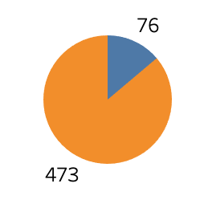

User Research Insights
Rate of professionals that don’t have software, or the skills to use software, to edit course videos
Notes:
We surveyed a random sample of professionals that are interested creating an online course, but haven’t done so yet due a handful of limitations. 85%

Slide 3
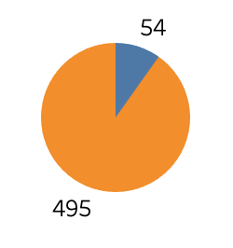
User Research Insights
Rate of professionals that don’t have hardware to film course videos
Notes:
90%

Slide 4
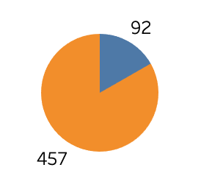
User Research Insights
Rate of professionals that have a content management system to create quizzes & exercises
Notes:
80%. Dynamic student interactions

Slide 5
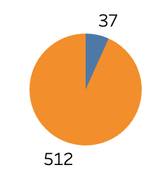
User Research Insights
Rate of professionals that feel like they have a lack of knowledge on academic course design (grading rubric, curriculum, learning objectives, etc..)
Notes:
80%. Dynamic student interactions

Slide 6
Target Users
Professionals that are experts and passionate about their field, who want to share knowledge with others, but don’t have a background in academia and/or digital content creation

