Slide 1
Apps – Environment
Omero Server + Omero Web + Django
App
e.g. figure, iviewer, …
Java Script Code
HTML, CSS and Images
Frontend Framework(s)
Build/Deployment
figure/imgData
iviewer/image_data
Django views.py/urls.py
Django templates
api/v0/m/rois
Web Api
get_rois_json
openwith.js
Webclient
Webgateway
openwith.js
Blitz Gateway
raw_pixel_store.getTile
update.saveAndReturnObject

Slide 2
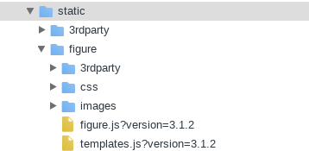
'Minimal' App Setup – django directories
app/static/app/app.js
app/templates/app/index.html

Slide 3
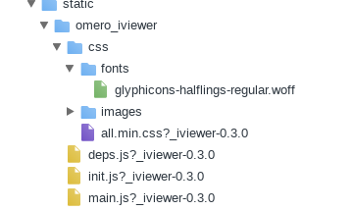
static/app – what would it contain?
Java Script
Third Party Resources
Css
Images

Slide 4
app/templates/app/index.html
<html>
<head>
<link rel="stylesheet" type="text/css"
href=" {% static 'app_directoryr/css/app.css?version=1.1' %}" />
<script type="text/javascript"
src="{% static 'app_directory/app.js?version=1.1' %}">
</script>
<script type="text/javascript">
// optionally set parameters for app
window.SOME_APP_PARAM = ….;
</script>
<title>Some App</title>
</head>
….
</html>

Slide 5
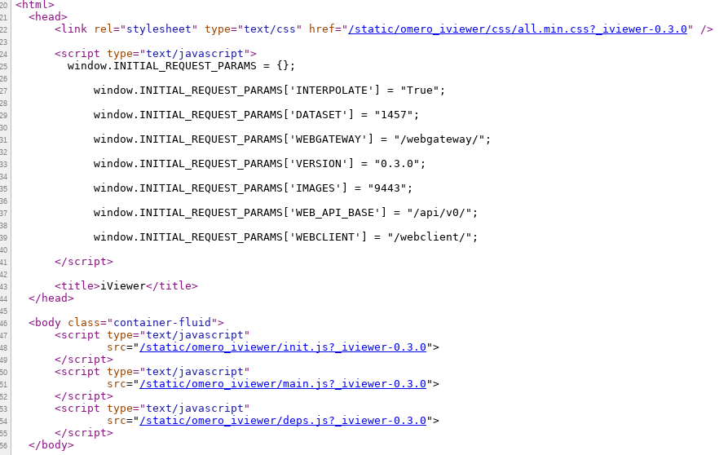
e.g. index.html

Slide 6
Remarks / 'Best Practices'
Build in separate directory then copy over, either for development or distribution bundling
Files that are not affected by builds could as well be in the appropriate directories, e.g. index.html in the templates directory
Depending on your setup and building tools and dependency requirements/order roughly speaking 4 ways of js deployment are possible:
Bundled, either with the app.js or independently (incl. via script in index.html)
Included in the static directory (and loaded via script in index.hml)
Use of remote library servers (again via script tag in index.html)
Loaded fully dynamically on demand given used frameworks and loader support it or one uses a third party library or injects/loads js manually

Slide 7
Remarks / 'Best Practices' – cont'd
Add suffix to resources to indicate app version and avoid caching of older version
Split up both css and java script dependencies if the project setup and dependency order allows for delayed loading. That said if it doesn't don't split them up since the many initial requests will hurt performance.
Set up a dev/debug and a production build. Choose tools that allow incremental builds.

Slide 8
App - Design Considerations
Server/Web resources (web api/web gateway) vs.
Plugin resources (View.py) vs.
Server-Side extentions (Blitz Gateway)
Code Reuse
Stability/Breaking Potential across Versions
Missing Functionality
Release/Bugfix Cycles
Cross origin implications (jsonp and cors)

Slide 9
App - Design Considerations
Server/Web resources (web api/web gateway) vs.
Plugin resources (View.py) vs.
Server-Side extentions (Blitz Gateway)
Code Reuse
Stability/Breaking Potential across Versions
Missing Functionality
Release/Bugfix Cycles
Cross origin implications (jsonp and cors)

Slide 10
App - Open With
TODO: add example

Slide 11
Apps – figure and iviewer
TODO: commonalities and differences and implications

Slide 12
Apps – iviewer
TODO: diagram components
MVC and aurelia
Openlayers

Slide 13
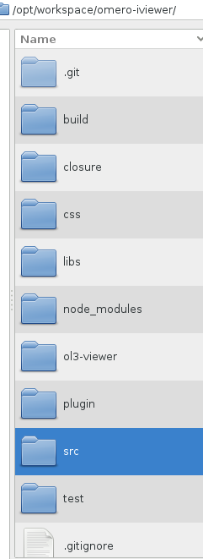
Build directory for all components
Closure Compiler and dependency calculation script
Css as well as images
Contains the built ol3-viewer – not in git. Triggered on build
Download directory for dependencies (on npm install)
Contains ol3-sources
Django Plugin Directories – needs to be added to PYTHONPATH for local setup
All sources other than ol3 viewer, i.e. aurelia bit
Js unit tests

Slide 14
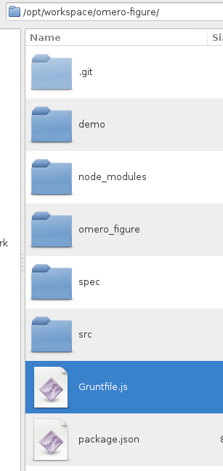
Demo App
Dependencies Download Folder
The Plugin/Deployment Directory
All sources except demo
The build configuration
Dependencies Definition – used for npm install

