Slide 1
3D Modeling and Printing with Autodesk Maya and Dremel
By: Andrew Green

Slide 2
My iDea
Demoman's Grenade Launcher

Slide 3
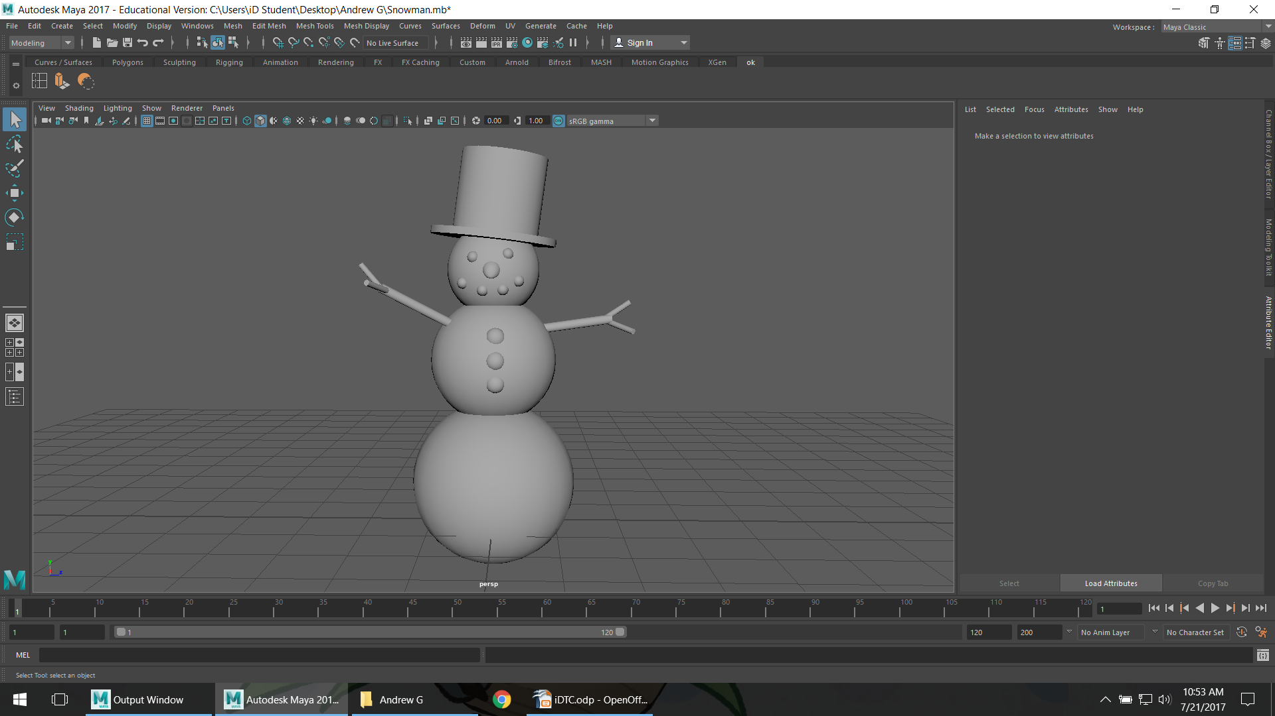
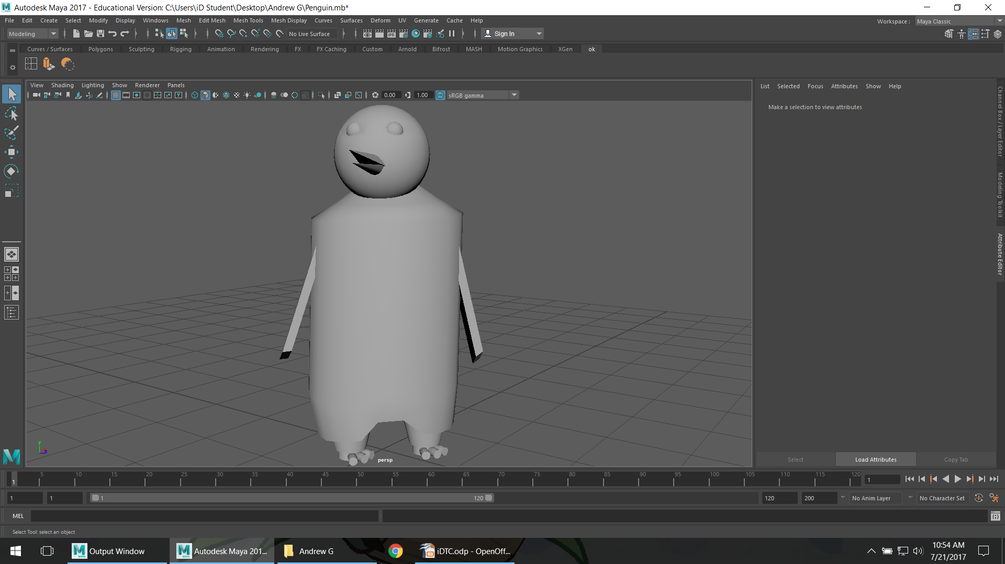
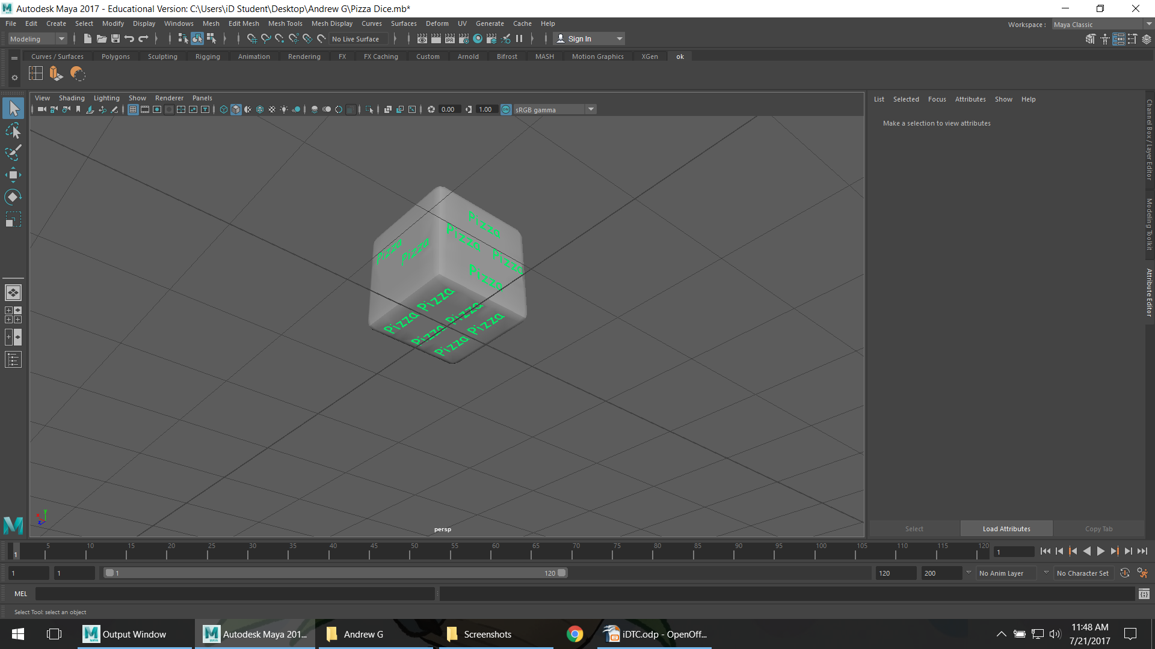
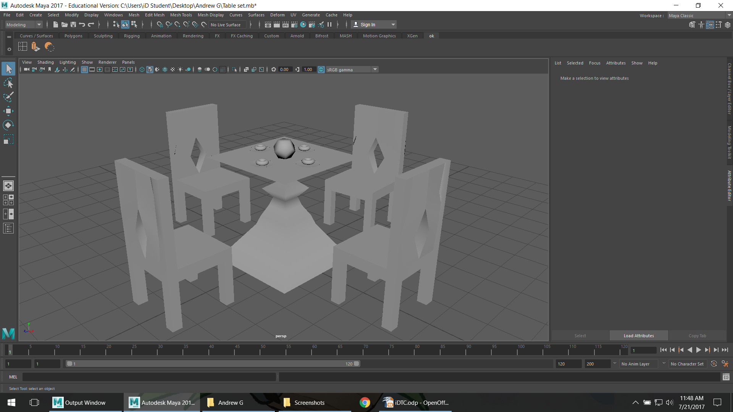
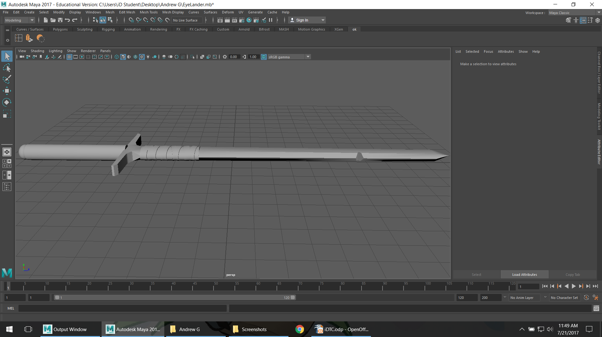
3D Modeling and Printing
In the beginning...
On day one and two we made Snowmen, Animals, Dice, a Table Set, and Swords.
I learned the basics of Autodesk Maya

Slide 4
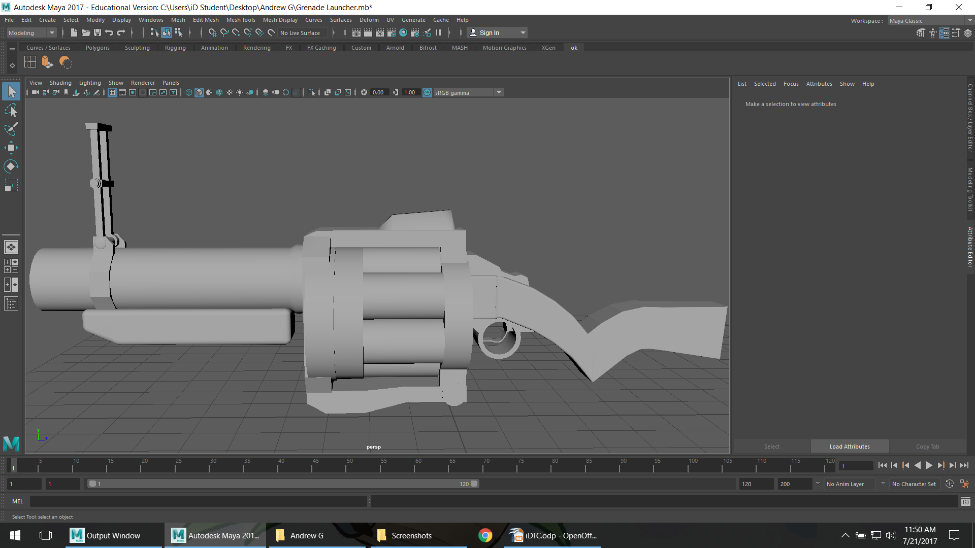
3D Modeling and Printing
Along the way...
On the End of Tuesday and all Wednesday,
we worked on our final projects, mine was the Demoman's Grenade Launcher.

Slide 5
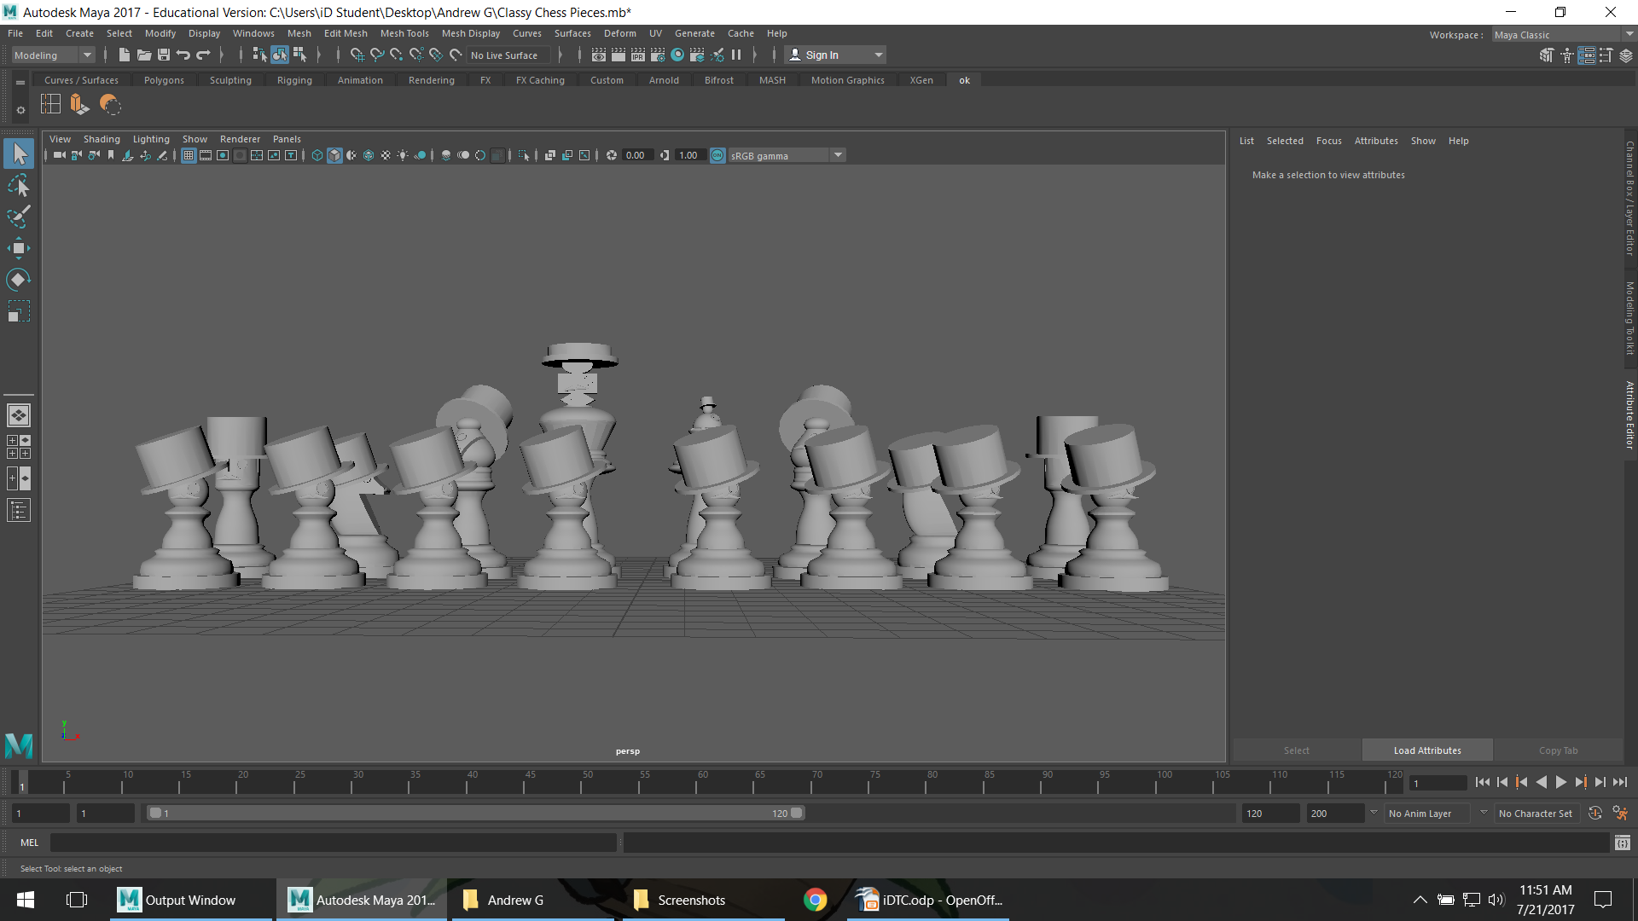
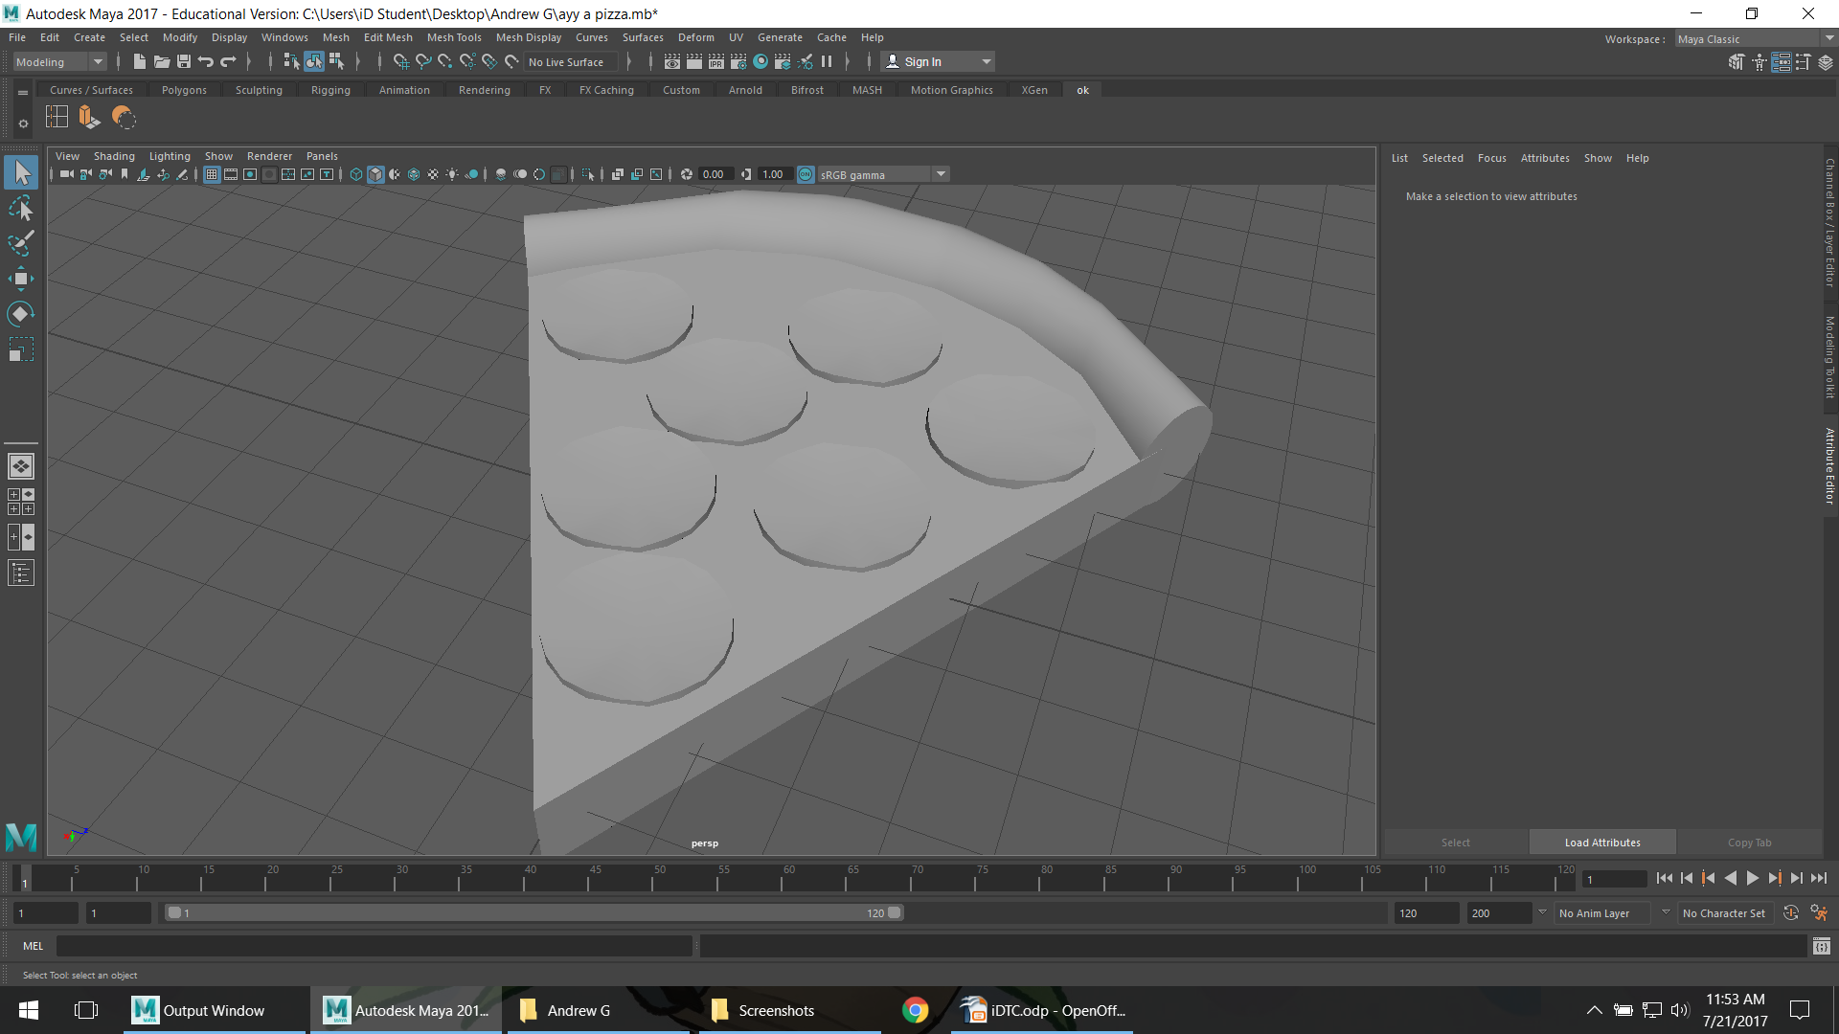
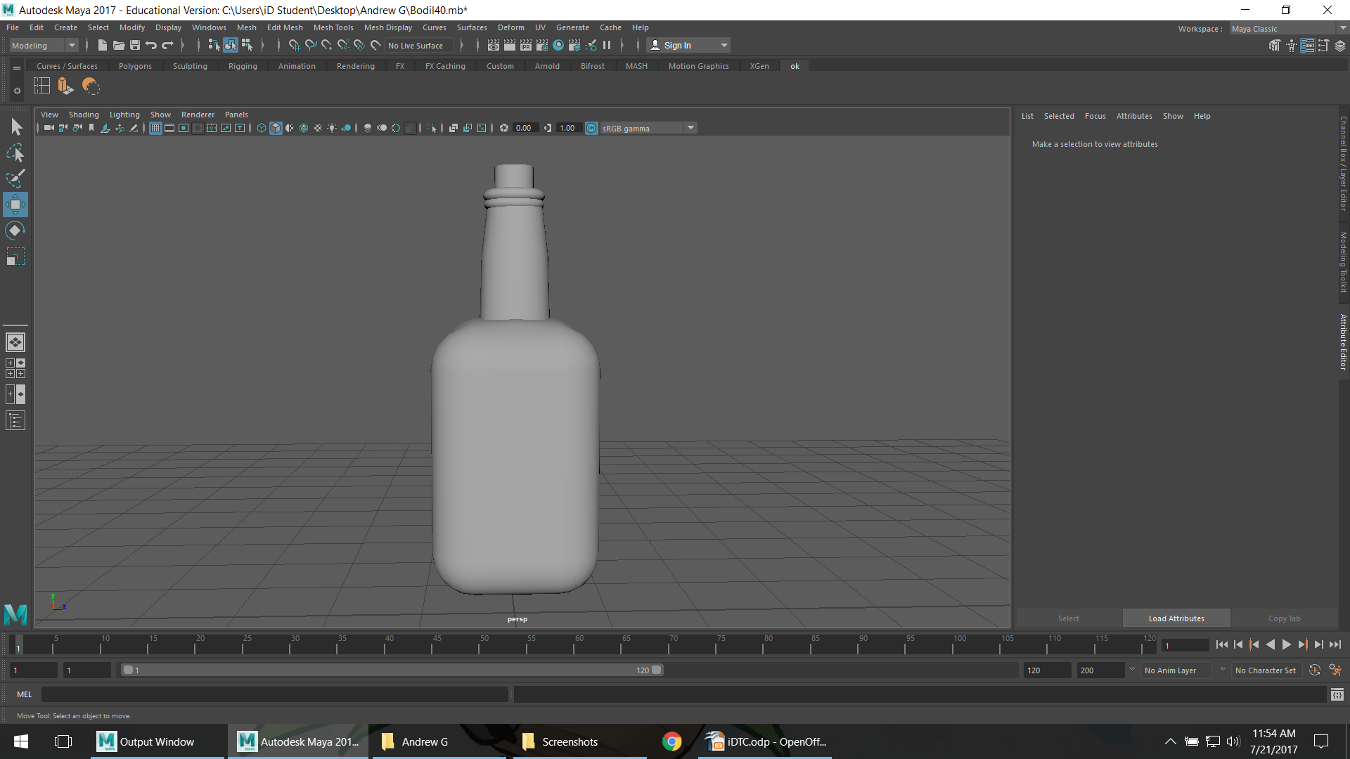
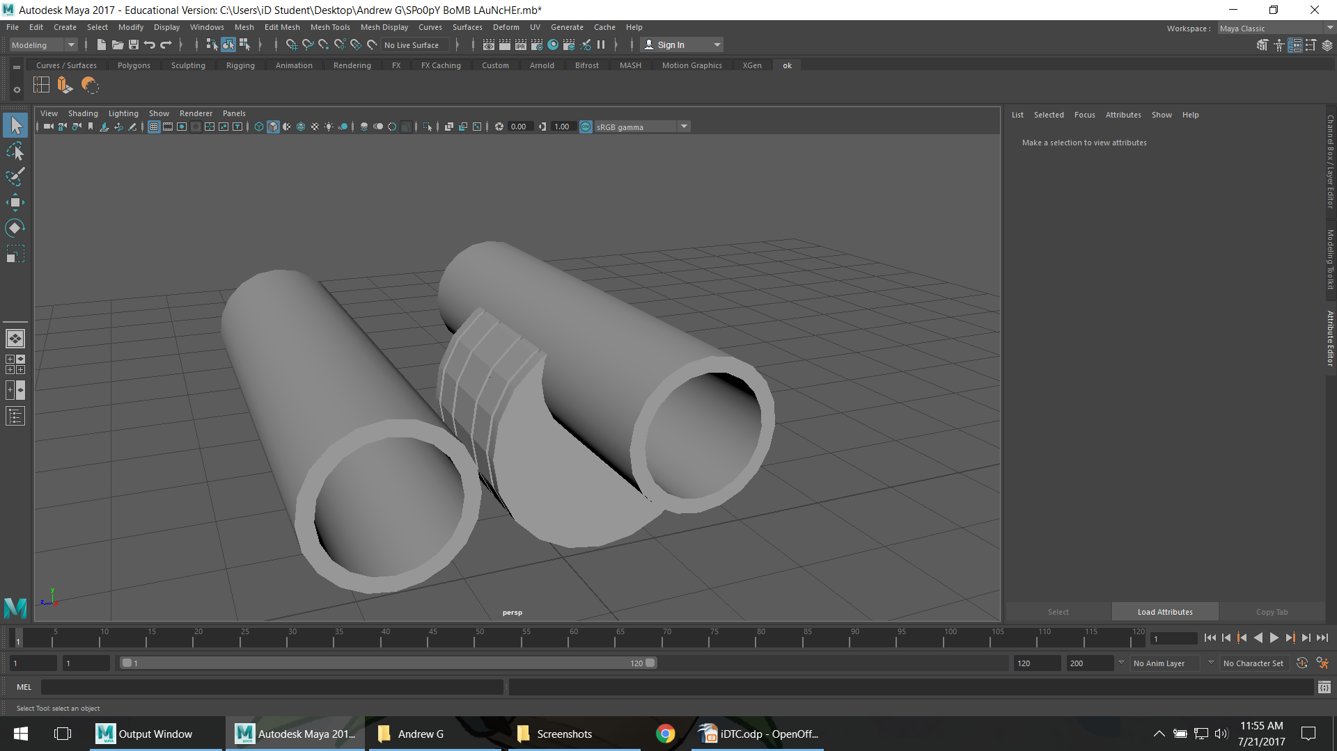
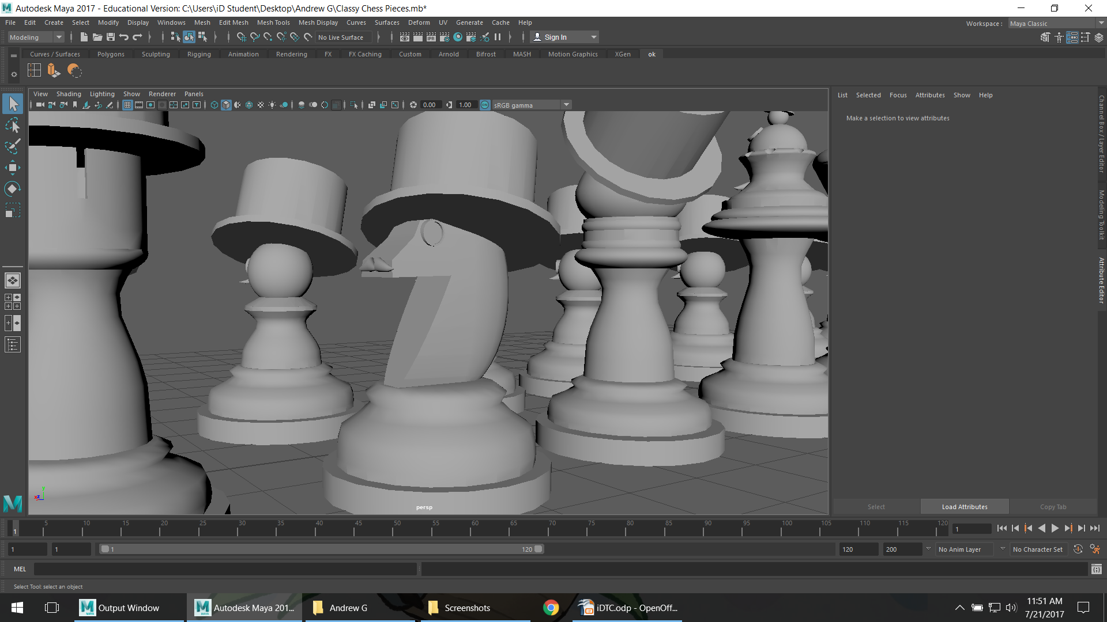
My Project
In the end...
On Thursday we worked on Chess Pieces as a collaborative project.
And on Friday I had nothing to do so I speed-modeled pizza, a Bottle o' Scrumpy, and I started working on a Sticky Bomb Launcher

Slide 6
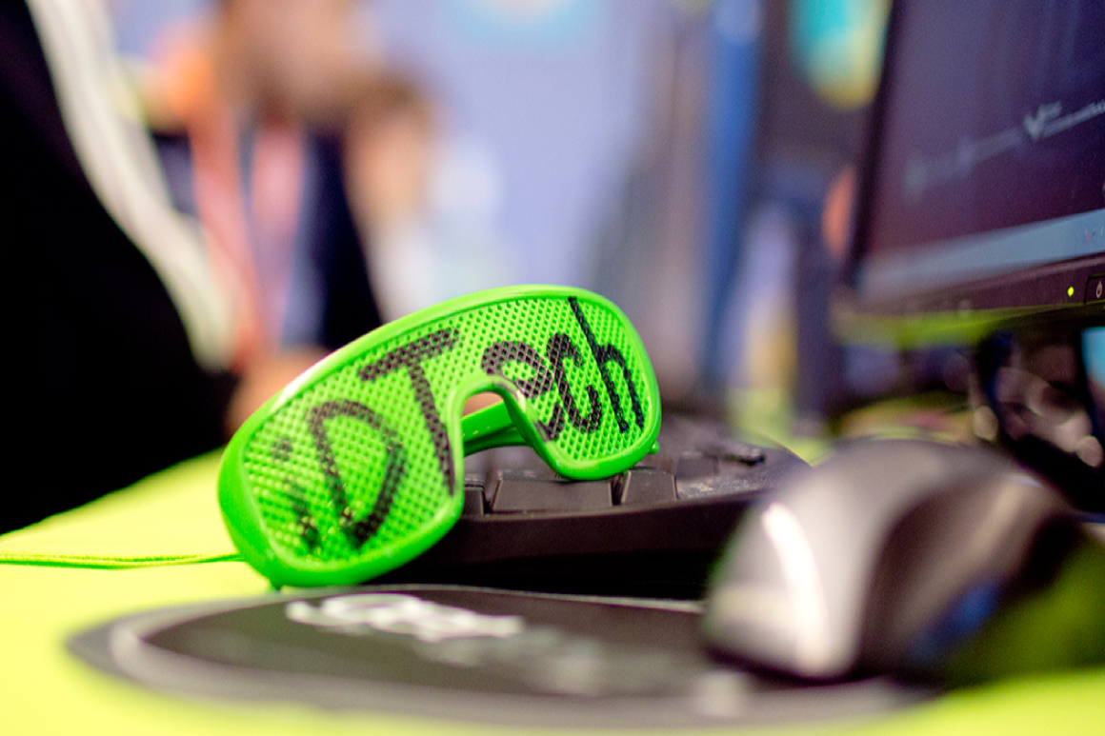
Favorite Camp Memory
I broke a chair

