Slide 1
Dept. of ECE, TKU Spring, 2018
計算機韌體實驗（P00） 範本/Template
饒建奇（Jiann-Chyi Rau） 淡江大學電機工程學系，E627 E-mail: jcrau@ee.tku.edu.tw

Slide 2
Dept. of ECE, TKU Spring, 2018
解題要訣
‧重新導向(Redirection)
‧執行時間的量測

Slide 3
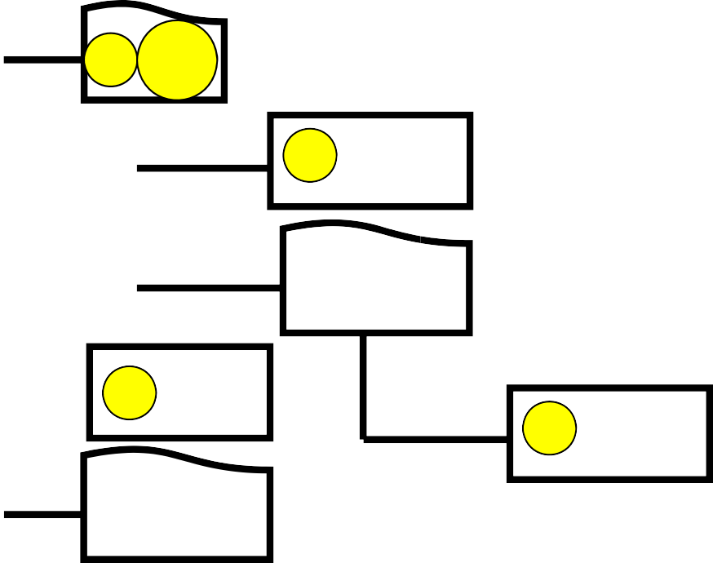
Dept. of ECE, TKU Spring, 2018
VC++ 2010
4
5
• 將測試輸入檔(IN.txt)與 結果輸出檔(OUT.txt)放 在資料夾③中
3 10
9 .cpp
Debug
5 .sln
9 .obj
Debug
5 .exe

Slide 4

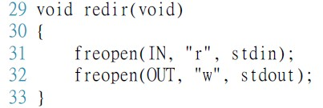
Dept. of ECE, TKU Spring, 2018
重新導向(Redirection)
‧設定
Lib.
‧取消

Slide 5
Dept. of ECE, TKU Spring, 2018
執行時間的量測
Lib.

Slide 6
Dept. of ECE, TKU Spring, 2018
Lib. Functions
freopen();
clock(void);
Defined in <ctime>
–程式已執行時間 = (double)clock()/CLK_TCK
Also CLOCKS_PER_SEC for CLK_TCK
printf();

Slide 7
Dept. of ECE, TKU Spring, 2018
C/C++ Reference
http://www.cplusplus.com

