Slide 1
Dept. of ECE, TKU Spring, 2018
計算機韌體實驗（P01）
3n+1問題/The 3n+1 Problem
饒建奇（Jiann-Chyi Rau） 淡江大學電機工程學系，E627 E-mail: jcrau@ee.tku.edu.tw

Slide 2
Dept. of ECE, TKU Spring, 2018
解題要訣
‧整數(int)的上限（最大值）
‧奇偶數的判定
–是否為2的倍數

Slide 3
Dept. of ECE, TKU Spring, 2018
int vs. long long
int: 4 bytes
– Max. 2³¹-1 (2147483647)
(after VC++ 2010) long long: 8bytes
– Max. 2⁶³-1
– Formatted character: %lld for printf() and scanf()

Slide 4
Dept. of ECE, TKU Spring, 2018
Lib. Function: scanf();
‧傳回成功讀取資料的個數
–遇檔尾(EOF, end of file, -1)結束，傳回-1
• E.g. while(scanf(“%d”, &n) == 1){…}
E.g. while(scanf(“%d”, &n) != EOF) {…}
➢讀取數值，字串(%s)時會跳過空白
➢讀取字元(%c)時不會跳過空白

Slide 5
Dept. of ECE, TKU Spring, 2018
Promotion Rule
Specify how types can be converted to other types without losing data
Covert a lower data type into a higher one (upgrade) without losing data; otherwise, a warning message is issued for degradation
E.g. int into long long

Slide 6
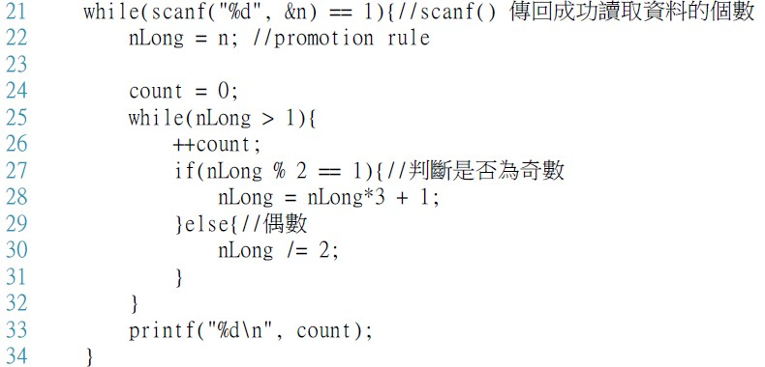
Dept. of ECE, TKU Spring, 2018
奇偶數的判定

