Slide 1
Dept. of ECE, TKU Spring, 2018
計算機韌體實驗（P04） 迴文詞/Palindromes
饒建奇（Jiann-Chyi Rau） 淡江大學電機工程學系，E627 E-mail: jcrau@ee.tku.edu.tw

Slide 2
Dept. of ECE, TKU Spring, 2018
解題要訣
‧使用字串常數記錄對應的鏡像字元
– ASCII碼的應用
‧字串常數陣列

Slide 3
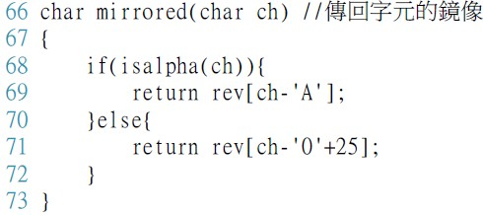
Dept. of ECE, TKU Spring, 2018
字串常數
‧字元常數陣列，但最後一個須為終止字元‘\0’
–使用字元指標(pointer)指向字串常數的第一個字元
–例：
Lib.

Slide 4
Dept. of ECE, TKU Spring, 2018
指標陣列 (1/2)
Arrays can contain pointers
Commonly used to store an array of strings
E.g. char *suit[4] = {"Hearts",
"Diamonds", "Clubs",
"Spades" };
Each element of suit is a pointer to a string (char *)
The strings are not in the array, only pointers to the strings are in the array

Slide 5
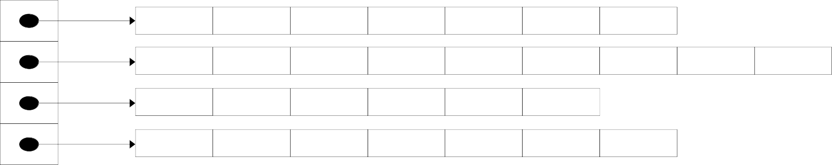
Dept. of ECE, TKU Spring, 2018
指標陣列 (2/2)
array suit of type char * ⇒ suit is of type char **
suit[0] | ’H’ | ’e’ | ’a’ | ’r’ | ’t’ | ’s’ | ’\0’
suit[1] | ’D’ | ’i’ | ’a’ | ’m’ | ’o’ | ’n’ | ’d’ | ’s’ | ’\0’
suit[2] | ’C’ | ’l’ | ’u’ | ’b’ | ’s’ | ’\0’
suit[3] | ’S’ | ’p’ | ’a’ | ’d’ | ’e’ | ’s’ | ’\0’
array suit has a fixed size; but strings can be of any size (length)

Slide 6
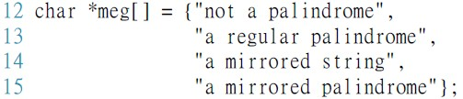
Dept. of ECE, TKU Spring, 2018
字串常數陣列
–例：

Slide 7
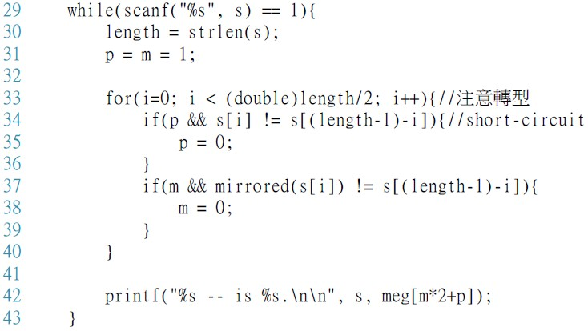
Dept. of ECE, TKU Spring, 2018
短路運算(Short-Circuit)
Lib.

Slide 8
Dept. of ECE, TKU Spring, 2018
Lib. Functions
int isalpha(int c);
Return true if c is a letter; otherwise, false
size_t strlen(char *s);
Return the length of string s
size_t is an alias of unsinged int

