Slide 1
Dept. of ECE, TKU Spring, 2018
計算機韌體實驗（P09） 劊子手遊戲/Hangman Judge
饒建奇（Jiann-Chyi Rau） 淡江大學電機工程學系，E627 E-mail: jcrau@ee.tku.edu.tw

Slide 2
Dept. of ECE, TKU Spring, 2018
解題要訣
Type string (define in <string>)的變數可以儲 存任意長度的字串
–透過cin讀取資料
–讀取單一字元
計算機韌體實驗 P09-2

Slide 3
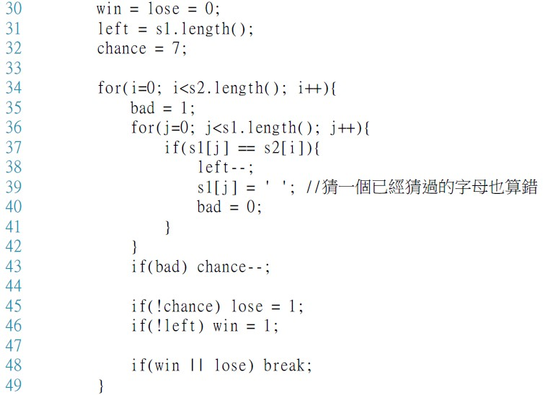
Dept. of ECE, TKU Spring, 2018
判斷輸贏
n-Chyi Rau 計算機
Member Function
將已猜到的字母標記為特殊字元 例如:空白字元
© 2018 by Jian
韌體實驗 P09-3

Slide 4
Dept. of ECE, TKU Spring, 2018
Member Functions
size_t string::length();
Return the length of the string, in terms of bytes
E.g.
計算機韌體實驗 P09-4

