Slide 1


Branching and Merging Database Code DevConnections 2015
Steve Jones
SQLServerCentral
Red Gate Software

Slide 2
Agenda
Who Am I?
What is Branching?
Branching strategies in a VCS
Managing databases for branches
Merging stored procedure code
Merging table schema changes

Slide 3
Goals
Learn types of branching database code in Version Control Systems
Merges for table schema changes
Merges for stored procedure code

Slide 4


Get in Touch
Steve Jones
www.voiceofthedba.com
sjones@sqlservercentral.com
@way0utwest
/in/way0utwest
Editor and founder, SQLServerCentral
Evangelist, Red Gate Software
Working with SQL Server since 1991 (v4.2)

Slide 5

What is Branching?
Branching, in revision control and software configuration management, is the duplication of an object under revision control (such as a source code file or a directory tree) so that modifications can happen in parallel along both branches.
Branches are also known as trees, streams or codelines. The originating branch is sometimes called the parent branch, the upstream branch (or simply upstream, especially if the branches are maintained by different organizations or individuals), or the backing stream. Child branches are branches that have a parent; a branch without a parent is referred to as the trunk or the mainline.^{[1]}

Slide 6
The Purpose of Branching
Branching is for isolation
One person’s code doesn’t affect others
For the database, this breaks the traditional “dev database” model

Slide 7
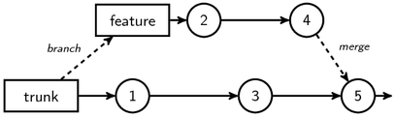
Branching
Notes:
http://gregheartsfield.com/2009/05/26/version-control-diagrams-with-tikz.html

Slide 8
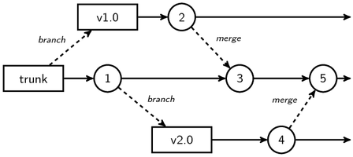
Branching
Notes:
http://gregheartsfield.com/2009/05/26/version-control-diagrams-with-tikz.html

Slide 9
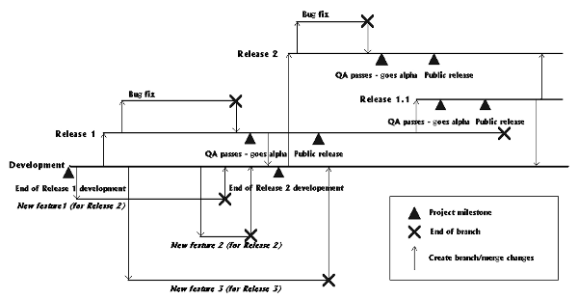
Branching
Notes:
http://accu.org/index.php/journals/439

Slide 10
Branching Types
Feature Branches
Release Branches
Any of these can work with databases, however…
Notes:
There are lots of names, but really all branches of for one of these reasons.

Slide 11

We have data
Notes:
Image: https://civil3d.wordpress.com/

Slide 12
What about the data?
We can’t drop and recreate our table objects to match a branch of code.
Copying data makes branching more complex
Our schema isn’t just “code”

Slide 13
Why is this hard?
The table is a container
Some parts of schema alteration mean we have extra or no buckets.

Slide 14
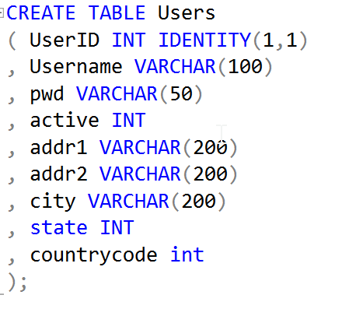
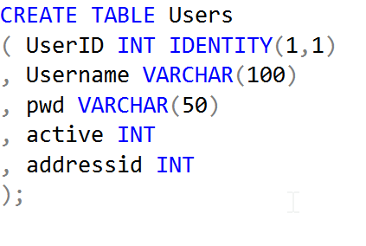
Branch Problems
Trunk
Feature Branch
Notes:
What happens if I normalize the trunk table in my feature branch? Where does this data go? For the branch, I can write a script to change this, but the merge back into trunk needs the same data movement.

Slide 15
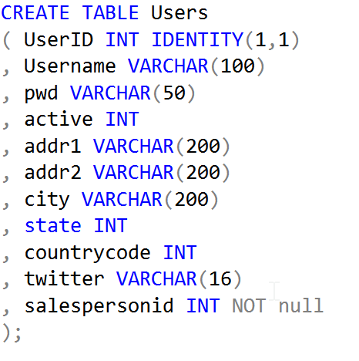
Branch Problems
Trunk
Feature Branch
?
Notes:
The reverse case is also an issue. How do I get this data? Especially true for not null columns, though defaults will usually be enforced here.

Slide 16
What do we do?
Various Options
Dedicated database per branch
recommended
Very short-lived branches (fast merges)
Good communication
Mostly table changes
Maybe views
Sample data scripts stored in VCS
Notes:
What can we do about the issues? First, you can use a shared database. This isn’t recommended because it defeats the purpose of branching. You will need a shared database somewhere, at some point, to get your code together, but for development branching, you need a separate db per branch, if not per developer.
Branches shouldn’t exist a long time without merging. Certainly you might have a period of time to complete a feature or idea, but merge this back quickly so that others can get the change. Otherwise, merges and the scripts that might be needed for upgrades become complex.
Communication between people is key. Whether you have a DBA doing development changes, or individual front end developers, communicate schema changes.
You will need sample data scripts that can be shared, otherwise this becomes a hassle.

Slide 17
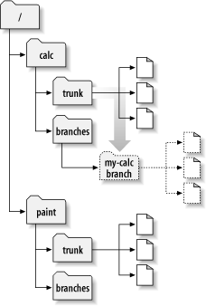
In Version Control
Notes:
What does this normally look like in a VCS. Here’s how multiple apps look.
Image: http://svnbook.red-bean.com/en/1.6/images/ch04dia3.png

Slide 18
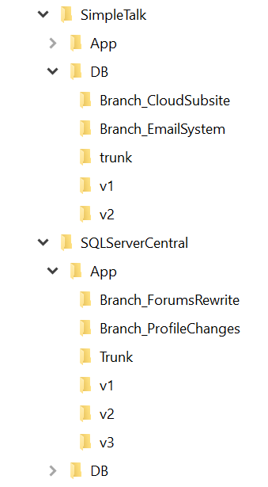
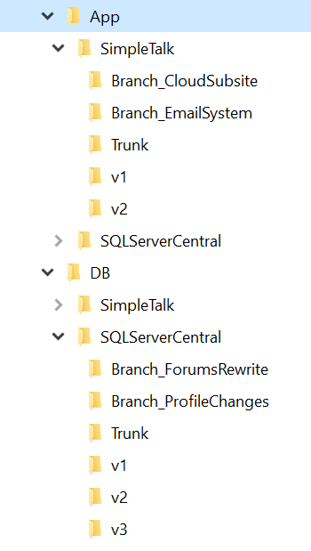
Application and Database
Notes:
Two views, DB stuff together, or all applications stuff together.

Slide 19
Application and Database
Notes:
I prefer the right side. Keep the db separate, as it’s only likely your application count will grow.

Slide 20
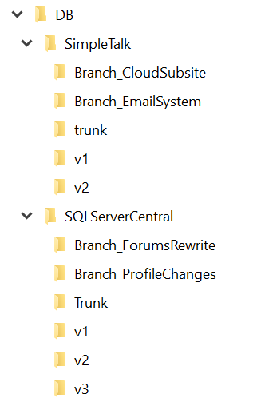
Database Branching
Keep the database separate from app code
Keep branches and trunk under the database name
Notes:
Keep the branches separate from trunk. Whether they’re at the root or below a folder, that’s fine. One thing I’d be sure to do is version data movement scripts as well.

Slide 21
Demo
Branch Setup
Notes:
Demo – show how to make a branch in SVN, copy code. Make changes in two places. Note separation.
Use two databases.
Change two tables
One has no conflicts (add)
One has multiple changes that conflict

Slide 22
VCS Branch
Branch DB
Developer
Merge
VCS Trunk
Trunk DB

Slide 23
Merging
Merges are a way to combine code from two developers
Two cases for databases
Table code
All other schema objects

Slide 24
Merging Table Schemas
Complex because the data must be preserved
May require data movement scripts
Often needs some manual intervention
Made easier if the application logic doesn’t depend on column order

Slide 25
Demo
Merging Table Schema Changes
Notes:
Merge the previous table changes.

Slide 26
Merging Stored Procedures
Stored procedures are more like application code for branching/merging
Views/functions are the same as stored procedures
Various options for help
We will use KDiff3

Slide 27
Demo
Merging Stored Procedures
Notes:
Merge demo for stored procedures. Show changes in two procs. Make multiple changes. One is non conflicting. One conflicts.

Slide 28
Goals
Learn types of branching database code in Version Control Systems
Merges for table schema changes
Merges for stored procedure code

Slide 29
Rate This Session Now!
Rate with Mobile App:
Tell Us What You Thought of This Session
Select the session from the Agenda or Speakers menus
Select the Actions tab
Click Rate Session
Be Entered to
WIN
Prizes!
Rate with Website:
Register at www.devconnections.com/logintoratesession
Go to www.devconnections.com/ratesession
Select this session from the list and rate it
#ITDEVCON

Slide 30
The End
Thanks for coming
Please fill out evaluations
Questions?
www.sqlservercentral.com/Forums
www.sqlservercentral.com/Window Functions
www.voiceofthedba.com
@way0utwest
sjones@sqlservercentral.com
/in/way0utwest

Slide 31
References
Articles
The Performance of the T-SQL Window Functions - https://www.simple-talk.com/sql/t-sql-programming/the-performance-of-the-t-sql-window-functions/
Window Functions in SQL - https://www.simple-talk.com/sql/t-sql-programming/window-functions-in-sql/
SQL Server 2012 Window Function Basics - https://www.simple-talk.com/sql/t-sql-programming/sql-server-2012-window-function-basics/
Working with Window Functions in SQL Server - https://www.simple-talk.com/sql/learn-sql-server/working-with-window-functions-in-sql-server/
Videos
T-SQL Power! SQL Server Windows That Open Doors - https://www.youtube.com/watch?v=YK-ufNpMeLU
Building Your T-SQL Toolkit: Window function Fundamentals - http://www.sqlbits.com/Sessions/Event12/Building_Your_T-SQL_Tool_Kit_Window_Function_Fundamentals
Using Window Functions to Solve Common T-SQL Challenges - http://channel9.msdn.com/Events/TechEd/NewZealand/TechEd-New-Zealand-2012/DBI309

