Slide 1


Branching and Merging Database Code DevConnections 2015
Steve Jones
SQLServerCentral
Red Gate Software

Slide 2
Agenda
Who Am I?
What is Branching?
Branching strategies in a VCS
Managing databases for branches
Merging stored procedure code
Merging table schema changes

Slide 3
Goals
Learn different ways of branching database code in Version Control Systems
Techniques for branching database code
Merges for table schema changes

Slide 4


Get in Touch
Steve Jones
www.voiceofthedba.com
sjones@sqlservercentral.com
@way0utwest
/in/way0utwest
Editor and founder, SQLServerCentral
Evangelist, Red Gate Software
Working with SQL Server since 1991 (v4.2)

Slide 5
Agenda
Who Am I?
What is Branching?
Branching strategies in a VCS
Managing databases for branches
Merging stored procedure code
Merging table schema changes

Slide 6

What is Branching?
Branching, in revision control and software configuration management, is the duplication of an object under revision control (such as a source code file or a directory tree) so that modifications can happen in parallel along both branches.
Branches are also known as trees, streams or codelines. The originating branch is sometimes called the parent branch, the upstream branch (or simply upstream, especially if the branches are maintained by different organizations or individuals), or the backing stream. Child branches are branches that have a parent; a branch without a parent is referred to as the trunk or the mainline.^{[1]}

Slide 7
The Purpose of Branching
Branching is for isolation
One person’s code doesn’t affect others
For the database, this breaks the traditional “dev database” model

Slide 8
Agenda
Who Am I?
What is Branching?
Branching strategies in a VCS
Managing databases for branches
Merging stored procedure code
Merging table schema changes

Slide 9
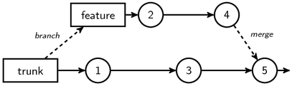
Branching
Notes:
http://gregheartsfield.com/2009/05/26/version-control-diagrams-with-tikz.html

Slide 10
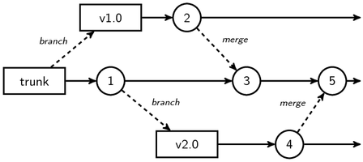
Branching
Notes:
http://gregheartsfield.com/2009/05/26/version-control-diagrams-with-tikz.html

Slide 11
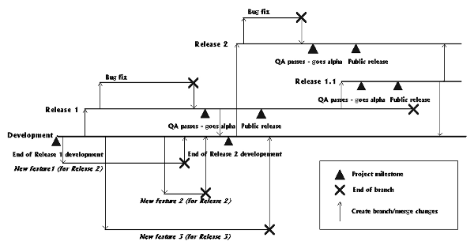
Branching
Notes:
http://accu.org/index.php/journals/439

Slide 12
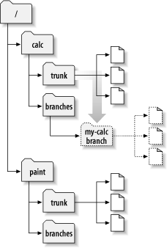
In Version Control
Notes:
http://svnbook.red-bean.com/en/1.6/images/ch04dia3.png

Slide 13
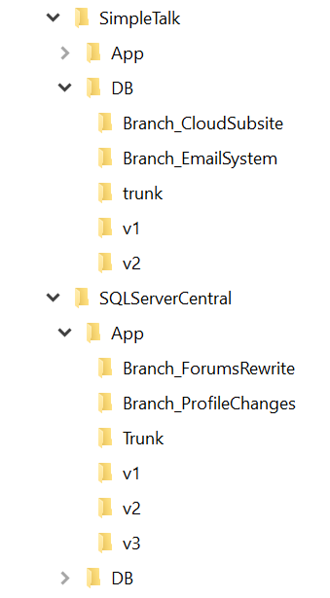
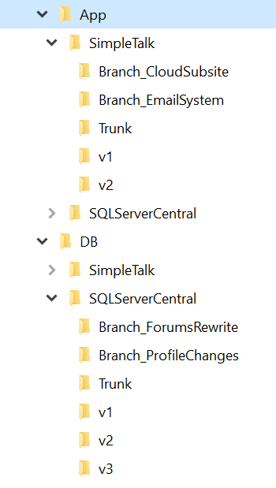
Application and Database
Notes:
Two views, DB stuff together, or all applications stuff together.

Slide 14
Branching Types
Feature Branches
Release Branches
Any of these can work with databases, however…
Notes:
There are lots of names, but really all branches of for one of these reasons.

Slide 15

We have data
Notes:
Image: https://civil3d.wordpress.com/

Slide 16
What about the data?
We can’t drop and recreate our table objects to match a branch of code.
Copying data makes branching more complex
Our schema isn’t just “code”

Slide 17
Why does data make this hard?
The table is a container
Some parts of schema alteration mean we have extra or no buckets.

Slide 18
Demo
Branch Issues with Code
Notes:
Database problems with having table alters in two places.

Slide 19
Demo
Branch strategies

Slide 20
Merging

Slide 21
Demo
Merging Stored Procedures

Slide 22
The End
Thanks for coming
Please fill out evaluations
Questions?
More information
www.sqlservercentral.com/Forums
www.sqlservercentral.com/Window Functions
www.voiceofthedba.com
@way0utwest
sjones@sqlservercentral.com
/in/way0utwest

Slide 23
References
Articles
The Performance of the T-SQL Window Functions - https://www.simple-talk.com/sql/t-sql-programming/the-performance-of-the-t-sql-window-functions/
Window Functions in SQL - https://www.simple-talk.com/sql/t-sql-programming/window-functions-in-sql/
SQL Server 2012 Window Function Basics - https://www.simple-talk.com/sql/t-sql-programming/sql-server-2012-window-function-basics/
Working with Window Functions in SQL Server - https://www.simple-talk.com/sql/learn-sql-server/working-with-window-functions-in-sql-server/
Videos
T-SQL Power! SQL Server Windows That Open Doors - https://www.youtube.com/watch?v=YK-ufNpMeLU
Building Your T-SQL Toolkit: Window function Fundamentals - http://www.sqlbits.com/Sessions/Event12/Building_Your_T-SQL_Tool_Kit_Window_Function_Fundamentals
Using Window Functions to Solve Common T-SQL Challenges - http://channel9.msdn.com/Events/TechEd/NewZealand/TechEd-New-Zealand-2012/DBI309

