Slide 1
Using Data API Builder to Speed Up Application Development
Day of Data Baton Rouge 2026
Steve Jones (he/him)
Editor, SQLServerCentral
Advocate, Redgate Software
President, SQL Saturday 501.c.3 charity
@way0utwest
NO FOOD OR DRINKS IN THE CLASSROOMS
Notes:
Remove .json il\]f

Slide 2
Using Data API Builder to Speed Up Application Development
Steve Jones (he/him)
Editor, SQLServerCentral
Advocate, Redgate Software
President, SQL Saturday 501.c.3 charity
@way0utwest
Notes:
The Data API Builder from Microsoft, you can quickly and easily expose your database objects for developers to use without writing a lot of data access layer code.
In this session, we will see how to setup, configure, and use the Data API Builder and GraphQL to expose and query data in SQL Server and PostgreSQL.
Learn how easy it is to run this service alongside your application and let developers filter, sort, and change data using standard GraphQL queries.

Slide 3
Agenda
Introduction
Data API Builder Introduction
Getting Your Database Into the API
Updating the API
Using the REST API
Using the GraphQL API
The DAB MCP Server

Slide 4


35 years database experience
DBA, developer, manager, writer, speaker in a variety of companies and industries using SQL Server, Oracle, and other database platforms.
Founder, SQL Server Central
Currently the editor in chief, with the goal of helping you learn to be a better data professional every day
Steve Jones
Advocate, Redgate Software
Editor, SQL Server Central
President, SQL Saturday 501.c.3 charity
he/him
20-year Microsoft Data Platform MVP
I have been honored to be recognized by Microsoft for the as a Data Platform MVP working with SQL Server
/in/way0utwest
@way0utwest
sjones@sqlservercentral.com
www.voiceofthedba.com
Notes:
Steve Bio

Slide 5






















Day of Data Baton Rouge 2026
Thank You, Sponsors!

Slide 6
Data API Builder Overview
What is this thing?

Slide 7
The Data API Builder (DAB)
A service that presents and API over your database
This is designed to replace CRUD operations by developers
Removes the need for a data access layer
Builds endpoints
Swagger for REST
Banana Cake Pop for GraphQL
MCP for agents
Works on Windows/Linux/MacOS
Authentication with Entra, OAuth2, JWT, EasyAuth
Open source: repo

Slide 8
Platform Support
RDBMS and NoSQL
SQL Server
Azure SQL
Azure Cosmos DB for NoSQL
PostgreSQL
Azure Database for PostgreSQL
Azure Cosmos DB for PostgreSQL
MySQL
Azure Database for MySQL
Azure SQL Data Warehouse

Slide 9
Platform support
Varies by platform
Not all features on all platforms on all versions
Not all data types supported
Make sure you check docs
https://learn.microsoft.com/en-us/azure/data-api-builder/feature-availability

Slide 10
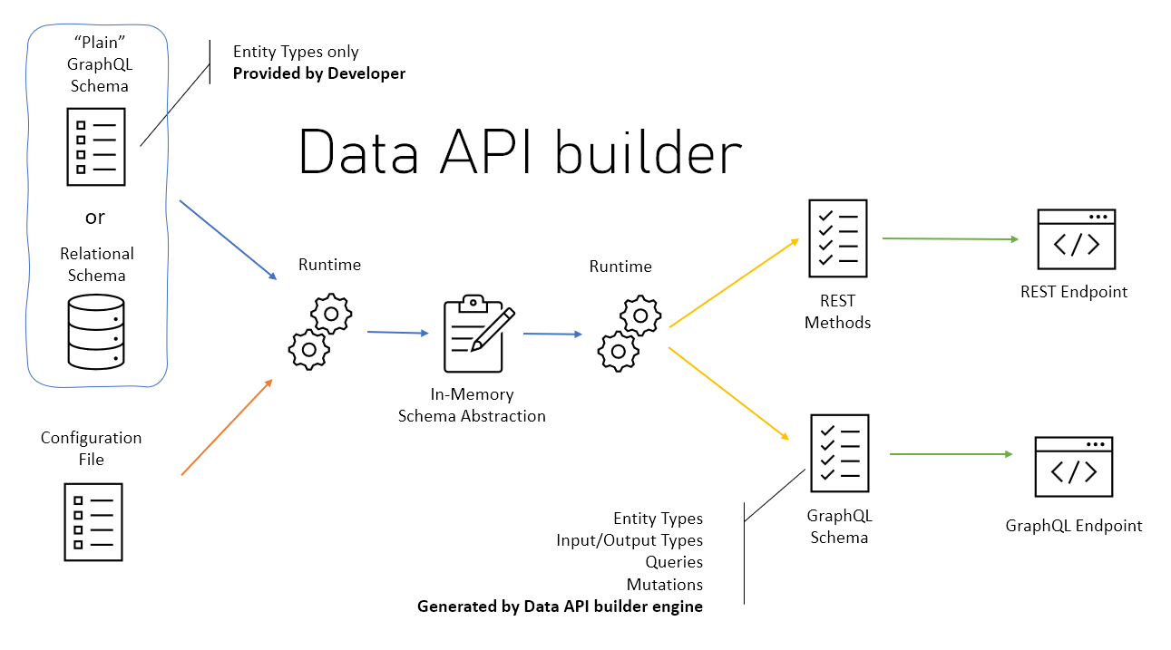
Architecture
From: https://learn.microsoft.com/en-us/azure/data-api-builder/overview#architecture

Slide 11
Deployment Options
The engine can be run as a CLI process
The engine can run as a docker container
Azure support
Azure Container Apps
Azure Container Instances
Azure App Service
Azure Kubernetes Service
Azure Static Web Apps (preview as of May 2025)

Slide 12
Installing DAB
Installation and Upgrade

Slide 13

Install
dotNet 8 required
DAB installs from dotnet CLI
dotnet tool install --global Microsoft.DataApiBuilder
dab.exe is the CLI
Check installs with dab --version

Slide 14
Container
Image is: mcr.microsoft.com/azure-databases/data-api-builder
Run with a docker command:
docker run \
--name dab \
--publish 5000:5000 \
--detach \
--mount type=bind,source=$(pwd)/dab-config.json,target=/App/dab-config.json,readonly \
mcr.microsoft.com/azure-databases/data-api-builder

Slide 15
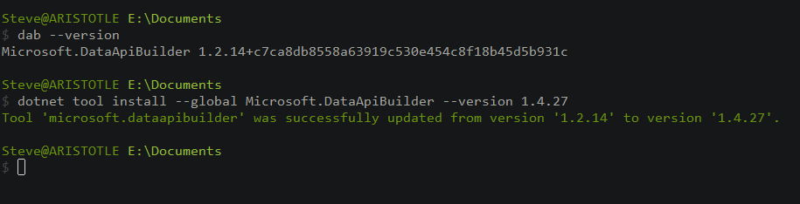
Upgrade
dotnet tool install --global Microsoft.DataApiBuilder --version 1.4.27

Slide 16
Getting Started with DAB
Configuration and Running and API interface

Slide 17
The Basic Steps
Create a database (Northwind)
Create a configuration file (init)
Add API items (add)
Stand up the API (start)
Add/modify API items

Slide 18
Init
Creates a configuration file
Default is dab.config.json
Can be overridden with --config
Requires a type of database
Can include a connection to the database
Values can be read from an environment file
dab configure changes settings

Slide 19
Start
Starts the API process
Exposes the APIs configured
Can include the specific config file you want

Slide 20
Demo
Init an API – Demo 1-3

Slide 21
Updating the API
DAB CLI makes config easy
dab add - Adds items to the API
We can add
Tables
Views
Stored procedures
Lots of limitations
dab update – changes existing items
dab validate – checks the config file

Slide 22
Demo
Demo 4-5
Query the API from a browser - http://localhost:5000
Notes:
Go to the URL

Slide 23
Using the DAB API
How would developers access data

Slide 24
Accessing the API
The API will be available as an http request
Rest uses SWAGGER style API
GraphQL uses Banana Cake Pop
For REST developers
System.Net.Http.HttpClient
Spring has RestClient
For GraphQL developers
Use Strawberry Shortcake
Bruno is a great way to query - https://www.usebruno.com/
MCP – I’ll use VSCode

Slide 25
Using the REST API
How this works when querying a database

Slide 26
Rest API
REpresentative State Transfer
Well-known by most developers
Typically, this is accessed with an http/https access point.
http://myserver/api/customer
http://myserver/api/order
Typically, each separate “thing” is a separate URL
Often, these return JSON values, which developers can easily use in code
This doesn’t matter for db people

Slide 27
The DAB Rest API
Everything is /api (from config)
Simple GET/PUT/PATCH/POST/DELETE queries
Limited by entity (table/view/proc)
Query Parameters
$select
$filter
$orderby
$first / $after
Supports actions to change data
Docs for REST API

Slide 28
Changing Data
POST creates a new item
queries require all fields that are not nullable
Fields not included are NULL
PUT queries can change or update
All fields required or they are NULL
PATCH queries allow updating specific fields
DELETE deletes items

Slide 29
Demo
Query the REST API from Bruno
Demo 6-8

Slide 30
Using the GraphQL API
Another way to retrieve data

Slide 31
What is GraphQL
A Richer API for data access
Allows more complex queries from one path
An open standard: https://graphql.org/
Used by many Microsoft products (Azure, LinkedIn, Fabric, etc.)

Slide 32
The DAB GraphQL API
A single path for queries (/graphql)
Default query actions
Pagination
Query by PK
Generic Query
filter parameter for limiting rows
orderBy for ordering
Supports Mutations to alter data
DAB docs for GraphQL API

Slide 33
Relationships
The power of GraphQL comes into play with relationships
We can query across entities that are related
We can define relationships in DAB
We can set up different types of relationship
One -> many
Many -> one
Many -> many

Slide 34
Views and Procedures
We can query views just like tables.
Stored procedures are their own type
Need to add parameters in the definition
The call contains the output.
Needs a POST type (GraphQL and REST)
Parameters needs to be variable (NVARCHAR v NCHAR)

Slide 35
Demo
Query the GraphQL API
Demo 9-11

Slide 36
The DAB MCP Server
A Modern API for AI

Slide 37
MCP Servers
MCP = Model Context Protocol
A way for AI agents to interact with other systems
MCP servers expose tools for AI agents to use
More info – Understanding MCP Servers

Slide 38
The DAB MCP Server
Exposes an MCP endpoint for agents
/mcp by default (mine is http://localhost:5000/mcp
Limited tools
Allows an agent to perform actions on your database
The dab add/update commands can add semantic descriptions and more information about entities for the LLM to use
Can be at the object (table/view/proc) level
Can be at the field (column) level

Slide 39
Demo
Query the MCP Server
Demo 12-13

Slide 40
Other Topics
Mode
Development – used in demos today
Production (default) – keeps sensitive info out of config file
GraphQL
Depth Limit - configures depth of queries
Multiple mutations – make many changes in one query

Slide 41
Security
Authentication
Unauthenticated (not recommended)
Entra/AzureAD
Custom – 3rd party OpenID Connect or JWT
AppService with Azure
Simulator - simulate Entra with local auth
On-Behalf-Of – local dev and roles
Authorization
DB login roles map to authorized users
Normal limits for objects (read, create, update, delete, execute)

Slide 42
Summary
Data API Builder gives a quick API over a database that is familiar to developers
Reduces the load for developers to start querying the database
The APIs available are well understood by developers
REST is familiar, but requires different URLs for each entity
GraphQL is newer, but very flexible
MCP gives a model access to your database (be careful)
This is worth experimenting with for simple CRUD apps

Slide 43


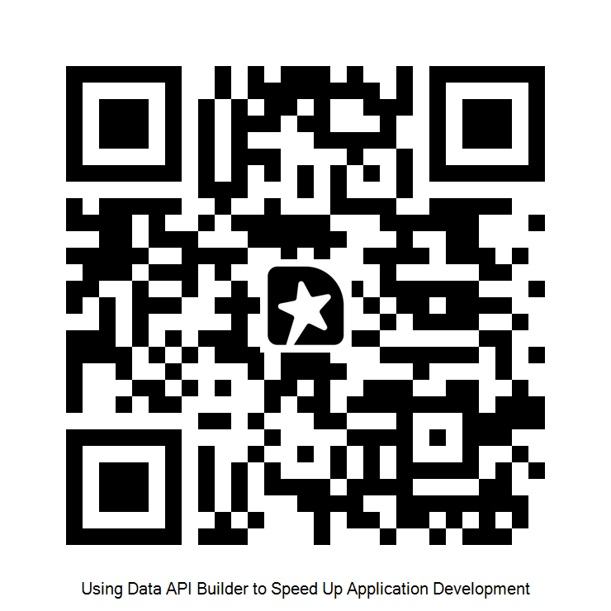


Thank you for coming
www.voiceofthedba.com
sjones@sqlservercentral.com
@way0utwest
/in/way0utwest
@way0utwest

Slide 44
References
DAB API builder Documentation
https://graphql.org/
What is a REST API?
What is a RESTful API?
Intro to GraphQL
GraphSQL vs. REST
Getting Started with the Data API Builder
The SQL MCP Server

Slide 45
Images

