Slide 1


Unstructured Data in SQL Server
Steve Jones
SQLServerCentral
Red Gate Software

Slide 2
Agenda
Unstructured data in SQL Server
Filestream
Filetable

Slide 3




Get in touch
  Editor and founder, SQLServerCentral
  Evangelist, Red Gate Software
  Working with SQL Server since 1991 (v4.2)
  Author and speaker on many different aspects of SQL Server
Steve Jones
http://voiceofthedba.wordpress.com/
sjones@sqlservercentral.com
@way0utwest

Slide 4
Agenda
Unstructured data in SQL Server
Filestream
Filetable

Slide 5
Data
From Gutenburg inventing the printing press we created 1 exabyte of data in the world across 500 years.
Today we create 2 exabytes a day.

Slide 6
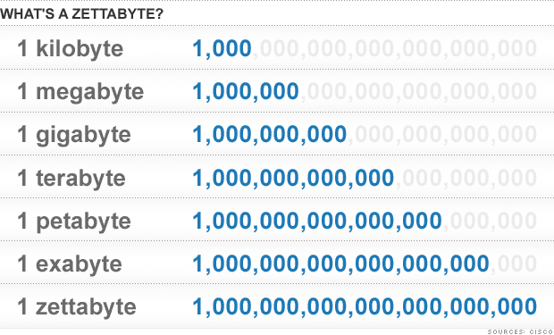
Data

Slide 7
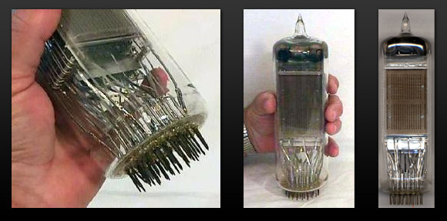
4,096 bits
Notes:
The old Selectron tube. 4096 bits, 512 bytes. A page of text averages around 1200 characters.

Slide 8


Slide 9
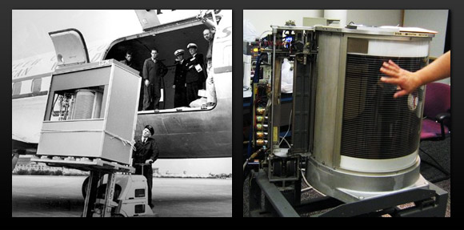
Notes:
IBM, 5MB disk drive in the RAMAC 305 computer

Slide 10

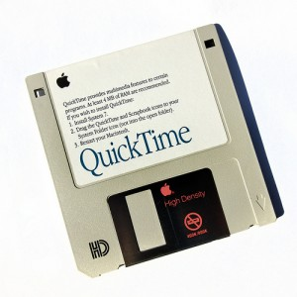


Slide 11






Slide 12




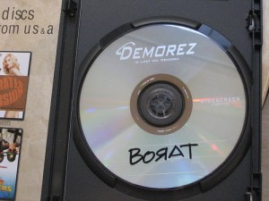


Slide 13
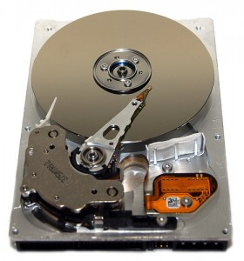

Slide 14
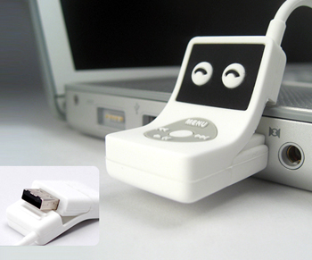
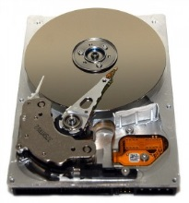

Slide 15
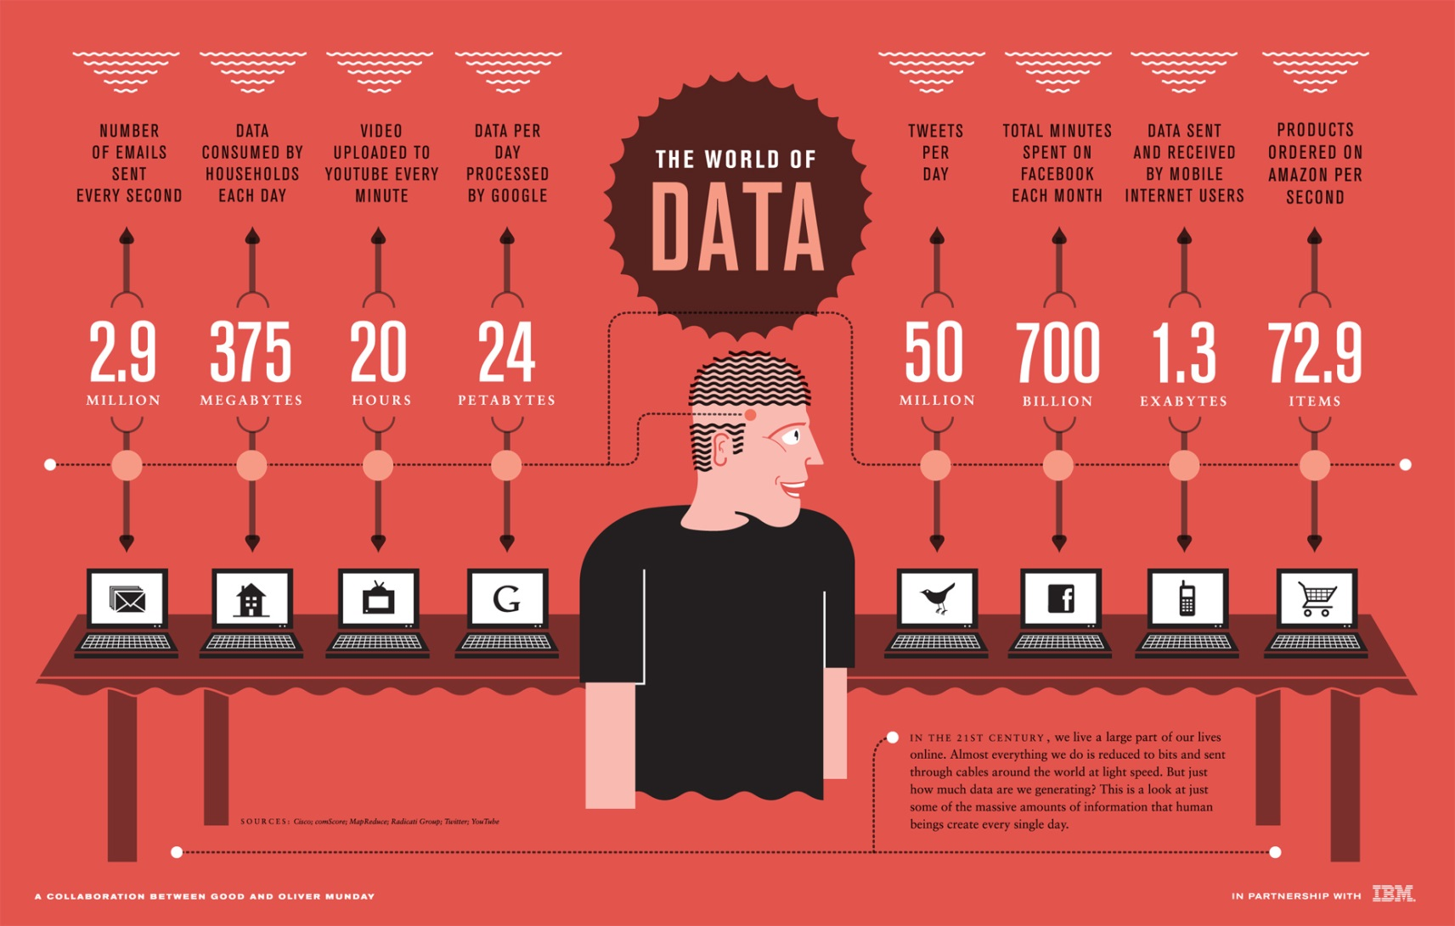
Binary Data
From 2010
Notes:
Lots of binary data is coming, and while it’s spread out, it’s growing like crazy.

Slide 16
From 2010
Notes:
One statistic, from 2011. Today Google gets 24 hours + per second.

Slide 17
100 hours today
From 2010
Notes:
One statistic, from 2011. http://www.youtube.com/yt/press/statistics.html

Slide 18
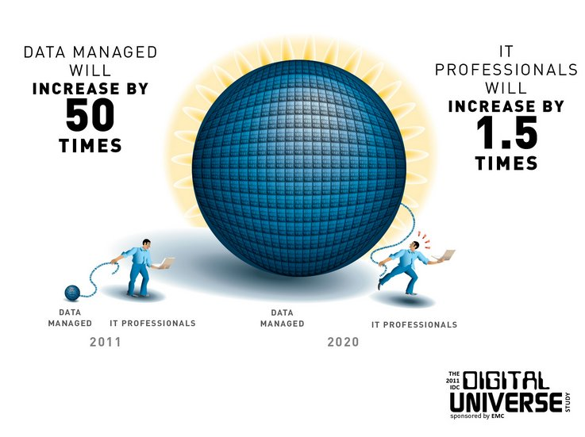
Notes:
As data professionals, we need to be aware and concerned.

Slide 19
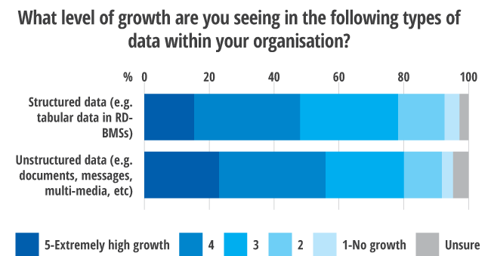
Binary Data
Notes:
Most people see growth occurring. Not just in RDBMSes, but also in unstructured data.

Slide 20
Unstructured Data in SQL Server
Stored as varbinary (text/image)
Type of (mostly) unstructured data
  Audio files
  Word (or Office) Documents
  PDF
  Video
Structure is merely encoding.
Meta data may be in the structure

Slide 21
Demo
Structured and Unstructured Data

Slide 22
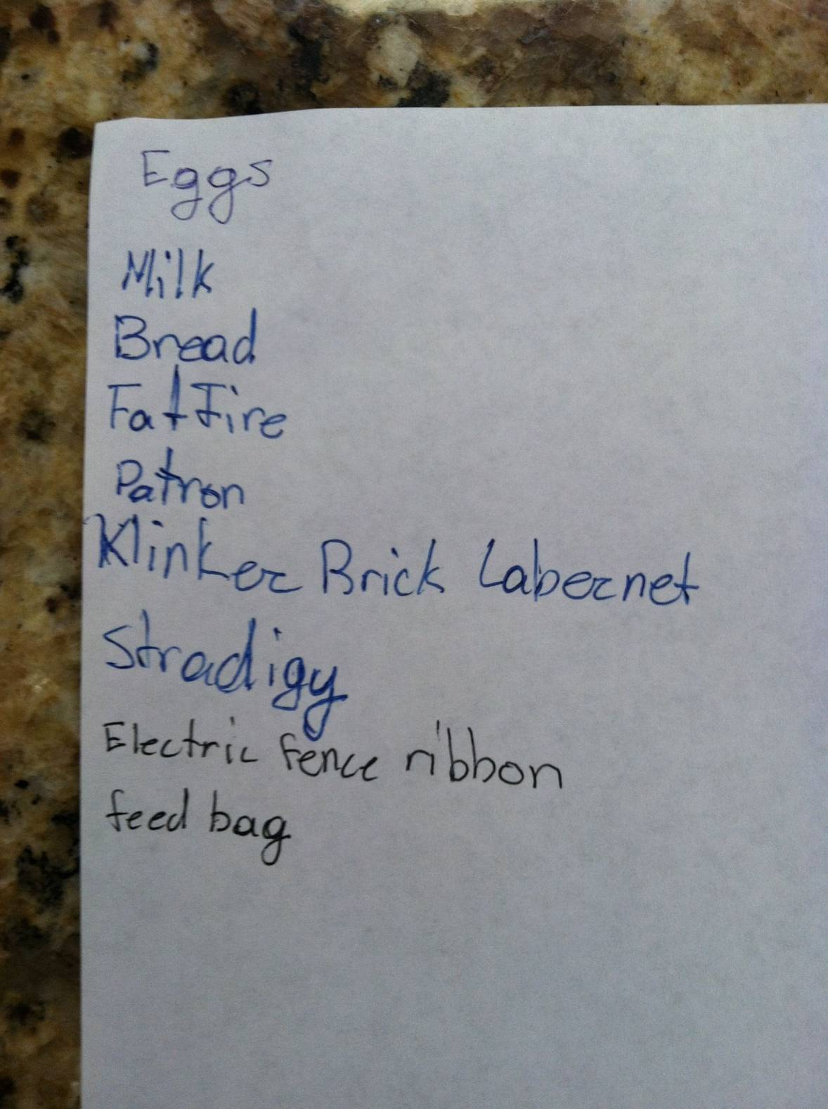
Unstructured Example

Slide 23
Unstructured Data - Pre 2008
In SQL Server large binary files handling had two solutions:
store in the file system, but a reference in the database
  administrative issues (backup, security)
  synchronization issues
store the binary file in the database
  Larger backups
  complex storage, manipulation, and retrieval.

Slide 24
Agenda
Binary data in SQL Server
Filestream
Filetable

Slide 25
Filestream
Added in SQL Server 2008
Allows storage in the filesystem, but appears to be in the database.
Uses varbinary(max) with FILESTREAM attribute
Does not use the buffer cache
No 2GB limit
Can be on compressed volumes

Slide 26
SQL Server Database
Filegroup_1
File 1 - c:\Program Files\...\Data\MyDB.mdf
File 2 - c:\Program Files\...\Data\MyDB2.ndf
File 3 - c:\Program Files\...\Data\MyDB3.ndf
Table: MyMP3s
-----------------
Name varchar(200)
MP3 varbinary(max)

Slide 27
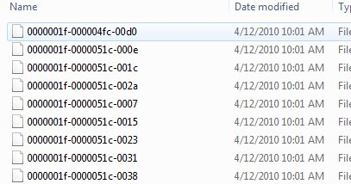
SQL Server Instance
Filegroup_1
File 1 - c:\Program Files\...\Data\MyDB.mdf
File 2 - c:\Program Files\...\Data\MyDB2.ndf
File 3 - c:\Program Files\...\Data\MyDB3.ndf
Table: MyMP3s
-----------------
Name varchar(200)
MyMP3 VARBINARY(MAX) FILESTREAM
Filegroup_2 - Filestream
File 1 - c:\Program Files\...\Data\FileStreamData

Slide 28
Comparison point | Storage solution
 | File server / file system | SQL Server (using varbinary(max)) | FILESTREAM
Maximum BLOB size | NTFS volume size | 2 GB – 1 bytes | NTFS volume size
Streaming performance of large BLOBs | Excellent | Poor | Excellent
Security | Manual ACLs | Integrated | Integrated + automatic ACLs
Cost per GB | Low | High | Low
Manageability | Difficult | Integrated | Integrated
Integration with structured data | Difficult | Data-level consistency | Data-level consistency
Application development and deployment | More complex | More simple | More simple
Recovery from data fragmentation | Excellent | Poor | Excellent
Performance of frequent small updates | Excellent | Moderate | Poor
From Filestream Storage in SQL Server 2008

Slide 29
Demo
Filestream

Slide 30
Filestream - Caveats
TDE does not encrypt Filestream data
Encryption is not supported on Filestream data
No database snapshots
No database mirroring (AlwaysOn is supported)
In a cluster – filestream container must be on shared resources.
8.3 naming causes performance issues (disable this).
Others

Slide 31
Agenda
Binary data in SQL Server
Filestream
Filetable

Slide 32
FileTable
new in SQL Server 2012, unchanged in SQL Server 2014
builds on the Filestream, but eliminates some of the complexity
allows Windows Explorer style access
folder is a subdirectory of your Filestream share.
access is non-transactional

Slide 33
FileTable
Has a set schema
An existing table cannot be altered to “add” filetable support (think vertical partitions here)
No filetables in tempdb
If you drop the filetable, all files and the folder are gone

Slide 34
Demo
Filetable

Slide 35
Filetable
Caveats/Limits
  No partitioning
  No replication
  Memory mapped file applications (notepad/paint) do not work locally
  No transaction rollbacks with Windows update operations
  No query notifications
  Trigger limitations
  RCSI limitations
  Cannot be fully contained

Slide 36
The Future
Unknown
  Filestream not really enhanced in 2012.
  Filetable not really enhanced in 2014
Microsoft Azure

Slide 37
The End
Questions?
Resources at the end of the PPT
www.sqlservercentral.com/forums
www.voiceofthedba.com/talks
Fill out your evaluations

Slide 38
References
FILESTREAM Overview - http://msdn.microsoft.com/en-us/library/bb933993.aspx
FILESTREAM Best Practices –http://msdn.microsoft.com/en-us/library/dd206979.aspx
FILESTREAM Storage in SQL Server 2008 - http://msdn.microsoft.com/en-us/library/cc949109.aspx
Remote BLOB store - http://technet.microsoft.com/en-us/library/gg638709.aspx
Enable the Prerequisites for FileTable - http://msdn.microsoft.com/en-us/library/gg509097(v=sql.110).aspx
Create, Alter, and Drop FileTables - http://msdn.microsoft.com/en-us/library/gg509088%28v=sql.110%29.aspx

Slide 39
References
Computer storage in pictures - http://royal.pingdom.com/2008/04/08/the-history-of-computer-data-storage-in-pictures/
Data Storage History - http://www.datarecoverygroup.com/articles/data-storage-history-and-future.
Data Storage Breaking Moore’s Law - http://enterprise.media.seagate.com/2011/06/inside-it-storage/idc-says-worlds-storage-is-breaking-moores-law-more-than-doubling-every-two-years

Slide 40
Images
http://blog.mozilla.org/it/files/2011/11/dc-growth.002.png
http://regmedia.co.uk/2012/10/05/big-data-1.png
http://editorial.designtaxi.com/news-data1210/2.jpg
http://infothread.org/Electronics%20and%20Computers/1%20Terabyte.png
http://cdn1.nwlinux.com/8-chart-zettabyte.gif
https://s3.amazonaws.com/luuux-original-files/bookmarklet_uploaded/cute-usb-flash-drive-ipod_0.jpg
http://www.bgitechsolutions.cn/wp-content/uploads/2011/08/Cloud-computing.png

