Slide 1
Steve Jones

Slide 2
Agenda
Goals
Who am I?
Summary

Slide 3
Goals
A
B
C

Slide 4
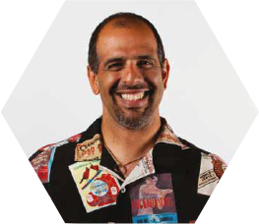



Get in touch
Editor and founder, SQLServerCentral
Evangelist, Red Gate Software
Working with SQL Server since 1991 (v4.2)
Author of many articles and books on different aspects of SQL Server
Steve Jones
http://voiceofthedba.wordpress.com/
sjones@sqlservercentral.com
@way0utwest

Slide 5
The End
Questions?

Slide 6
References

