Slide 1
Database Maintenance Essentials
Steve Jones
Editor, SQLServerCentral
Red Gate Software
Notes:
Start up SSMS, load trace def
Start SQL Storage Compress
Start SQL Monitor (tabs for overview, config, custom alerts)
Start SQL Index Manager
Start Windows Manager and go to: D:\Program Files\Microsoft SQL Server\MSSQL11.MSSQLSERVER\MSSQL\DATA
Start Profiler, stopped Tuning trace
Start DTA

Slide 2
What We Are Going to Learn Today
The essentials of SQL Server Maintenance
Managing MDF and LDF Files
Managing Indexes
Maintaining Statistics
Checking for Corruption
Creating Backups That Will Restore
Managing Maintenance Jobs
Not every recommendation may be appropriate for your environment. Be sure to test in a non-production environment before trying these recommendations out.
Notes:
Mention that I will be discussing, in addition to these best practices, some of the tools available from Red Gate that can help you out.

Slide 3
What We Are Going to Learn Today
Managing MDF and LDF Files
Managing Indexes
Maintaining Statistics
Checking for Corruption
Creating Backups That Will Restore
Managing Maintenance Jobs
Not every recommendation may be appropriate for your environment. Be sure to test in a non-production environment before trying these recommendations out.
Notes:
Mention that I will be discussing, in addition to these best practices, some of the tools available from Red Gate that can help you out.

Slide 4

Managing MDF & LDF Files
There is a myth that MDF and LDF files “manage” themselves.

Slide 5
Create a database
Sales.mdf – 2MB
Sales.ldf – 1MB

Slide 6
Autogrow
Sales.mdf – 2MB
Sales.ldf – 100MB

Slide 7
Autogrow
Sales.mdf – 50MB
Sales.ldf – 100MB

Slide 8
Autogrow
Sales.mdf – 50MB
Sales.ldf – 200MB

Slide 9
Autogrow
Sales.mdf – 50MB
Sales.ldf – 300MB

Slide 10
Autogrow
Sales.mdf – 100MB
Sales.ldf – 300MB

Slide 11
Autogrow
Sales.mdf – 100MB
Sales.ldf – 400MB

Slide 12
Autogrow
Sales.mdf – 100MB
Sales.ldf – 600MB

Slide 13
Autogrow
Sales.mdf – 100MB
Sales.ldf – 800MB

Slide 14
Autogrow
Sales.mdf – 200MB
Sales.ldf – 800MB

Slide 15
Autogrow
Sales.mdf – 200MB
Sales.ldf – 1GB

Slide 16
Autogrow
Sales.mdf – 20GB
Sales.ldf – 1GB

Slide 17
Autogrow
Sales.mdf – 100GB
Sales.ldf – 4GB

Slide 18
Autogrow - Fragmented
Sales.mdf – 200GB
Sales.ldf – 120GB

Slide 19
Autogrow - Fragmented
Sales.mdf – 200GB
Sales.ldf – 120GB

Slide 20
The Disk

Slide 21
The Disk

Slide 22
The Disk

Slide 23
The Disk

Slide 24
The Disk

Slide 25
The Disk

Slide 26
The Disk

Slide 27
The Disk

Slide 28
The Disk

Slide 29
The Disk - Fragmented

Slide 30
Managing MDF Files
Pre-size for xx months (I recommend 4-6 months)
Free space inside the mdf/ndf is not bad.
Monitor file sizes and data growth
When you need space, manually grow the files
If you overestimated the database’s size, that’s not a problem either. Don’t shrink the database*.
Don’t depend on Autogrow
* If you are wildly oversized, shrink once to meet the needs for the next quarter
Notes:
Benefits are explained on next slide.

Slide 31
Manually Grown
Sales.mdf – 200GB
Sales.ldf – 120GB

Slide 32
Managing LDF Files
Pre-size - The size should be the peak amount of log data between log backups + a pad
Monitor and adjust the size as needed over time. Grow the file by 8000MB *
A guesstimate is better than letting autogrowth grow the LDF file for you. If you have no idea, try 15% of data.
Multiple files do not help performance
* http://sqlskills.com/BLOGS/KIMBERLY/post/Transaction-Log-VLFs-too-many-or-too-few.aspx

Slide 33
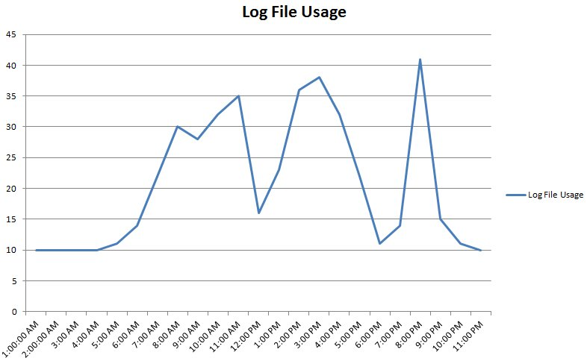
Managing LDF Files

Slide 34
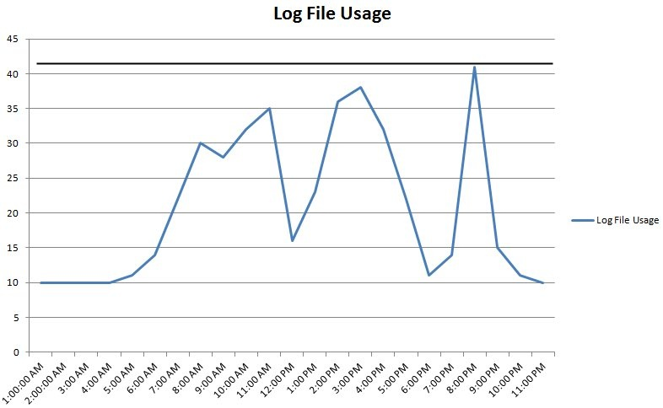
Managing LDF Files

Slide 35
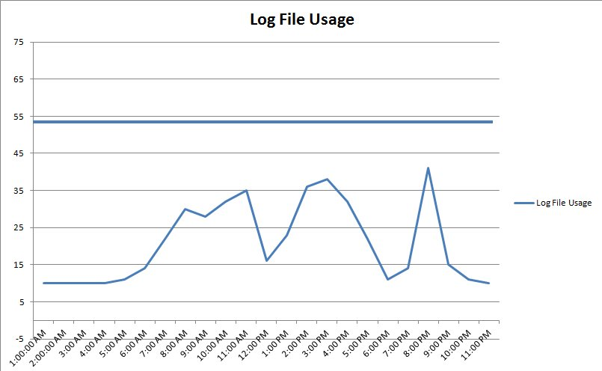
Managing LDF Files

Slide 36
Database Files – Data and Log
DO NOT depend on Autogrow (for emergencies only)
Monitor, monitor, monitor
Assess space monthly
Use alerting for low space
Keep free space in the files

Slide 37
Database Files
Demo
Checking space
Manually growing a file

Slide 38
What We Are Going to Learn Today
Managing MDF and LDF Files
Managing Indexes
Maintaining Statistics
Checking for Corruption
Creating Backups That Will Restore
Managing Maintenance Jobs
Not every recommendation may be appropriate for your environment. Be sure to test in a non-production environment before trying these recommendations out.
Notes:
Mention that I will be discussing, in addition to these best practices, some of the tools available from Red Gate that can help you out.

Slide 39
Regularly Review Indexing Needs
Indexing needs change over time, depending on
Data volume
The queries
Your indexing scheme needs to change to keep up
Proactively monitor your servers to see if their indexing needs are properly met. SQL Server will not do this for you.
Set aside time regularly (monthly, quarterly)
Notes:
Now let’s drill down into more detail about maintaining indexes.

Slide 40
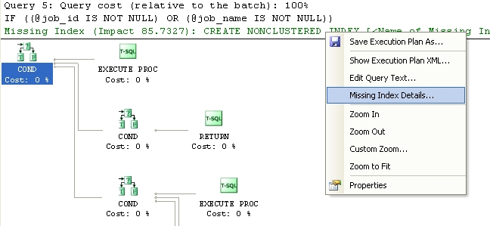
Missing Indexes

Slide 41
Identify Missing Indexes
Identify lots of missing indexes using a SQL Trace and the Database Engine Tuning Advisor (DTA)
When capturing a SQL Trace, use the Tuning template and capture data over a representative time frame
Run the DTA against the trace data, review recommendations, and then add appropriate indexes. Do so regularly (monthly, quarterly).
Note: you can use sys.dm_db_missing_index_details, but it has many limitations. This is not recommend unless you really understand the limitations.

Slide 42
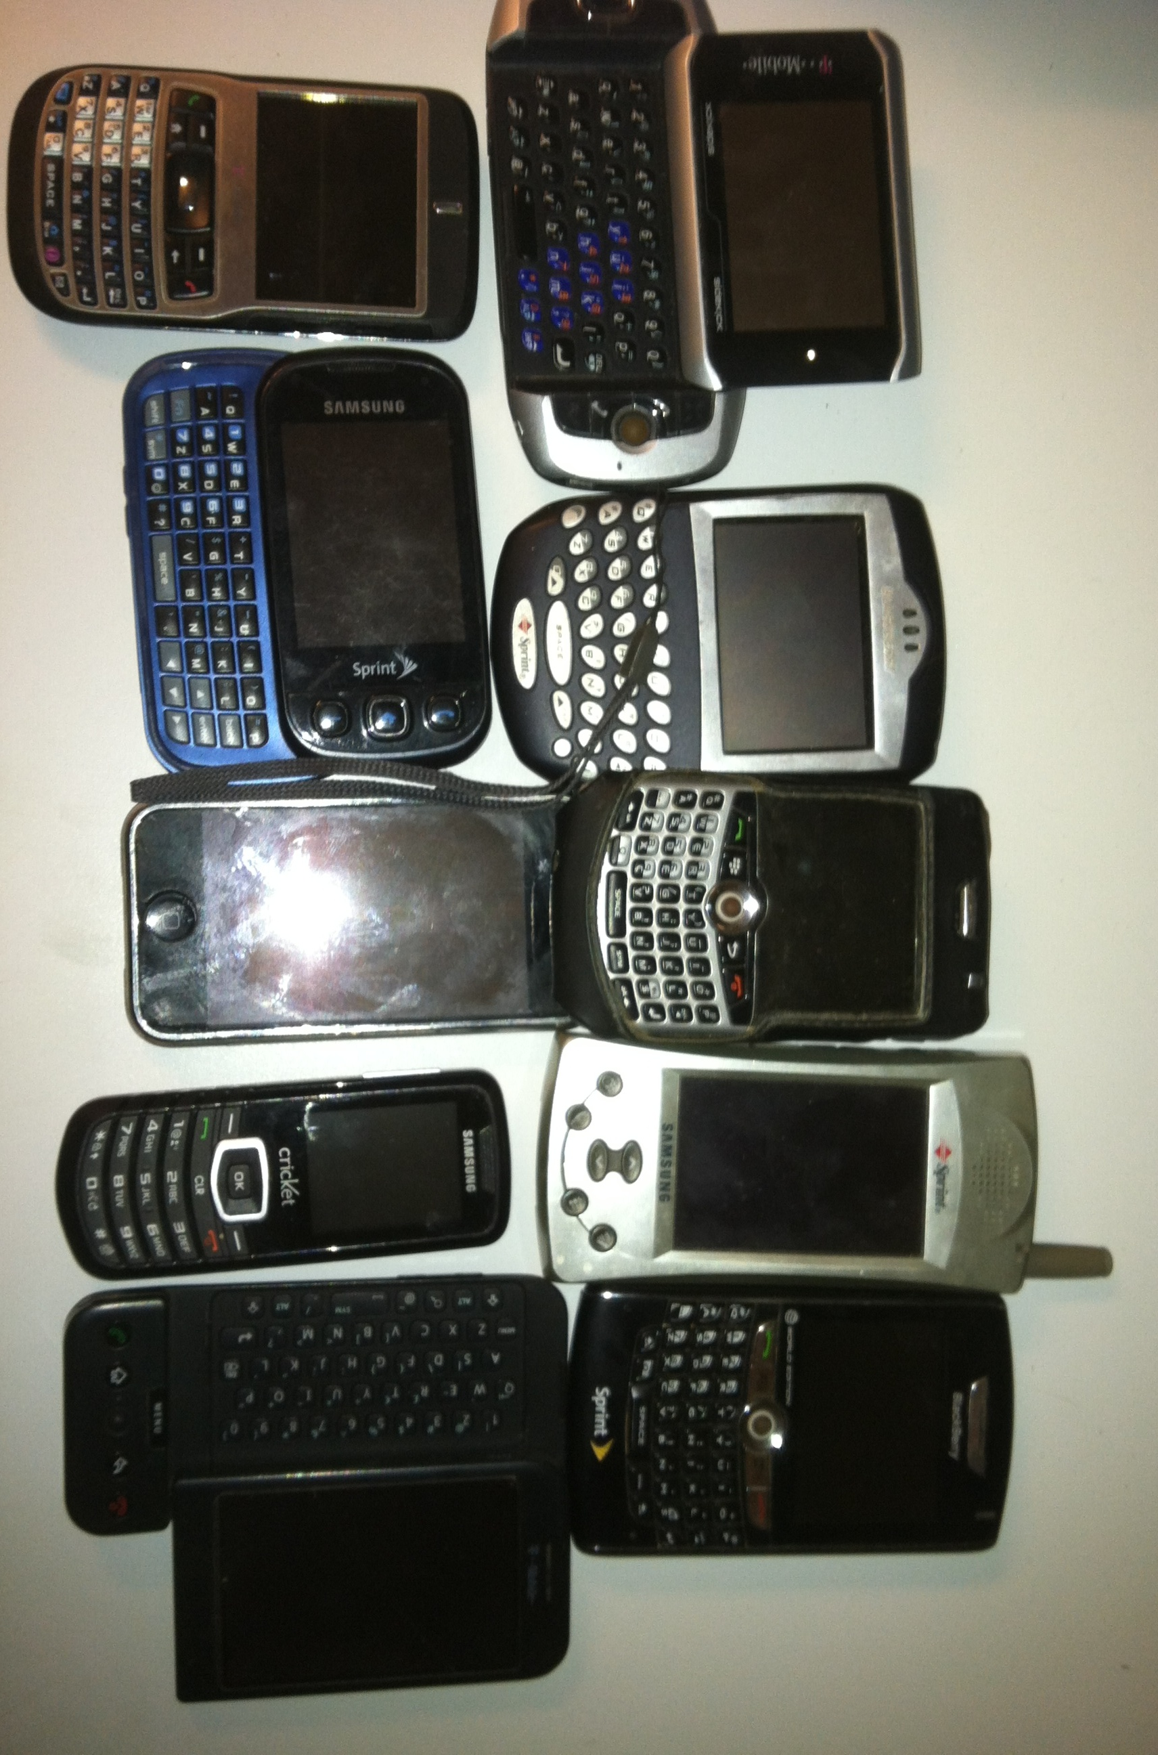
Unused Indexes

Slide 43
Identify Unused Indexes
Most databases have indexes that were created because they seemed that they might be useful, but they have ended up not being used.
Because indexes need to be maintained, unused indexes are a waste of resources.
Periodically, identify unused indexes and remove them¹.
Use the sys.dm_db_index_usage_stats DMV to help you identify unused indexes².
1 – Immediate Removal is a bad idea. Disable for a business cycle and then remove
2 - The data in this DMV is cleared out each time SQL Server is restarted

Slide 44
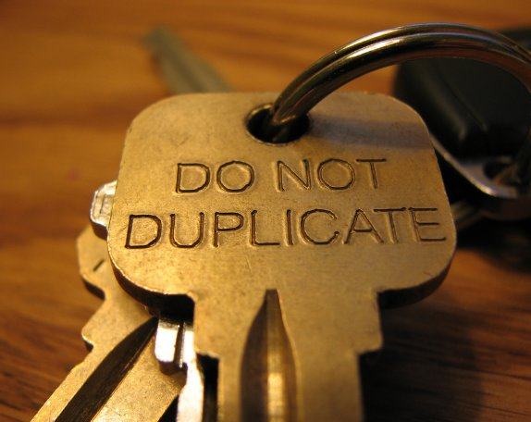
Duplicate Indexes

Slide 45
Identify Duplicate Indexes
For many different reasons, it is possible for the duplicate indexes to be created using different names.
This wastes resources and duplicate indexes should almost always be removed.
See the following URLs for sample scripts:
www.sqlblog.com/blogs/paul_nielsen/archive/2008/06/25/find-duplicate-indexes.aspx
http://blogs.msdn.com/b/mssqlisv/archive/2007/06/29/detecting-overlapping-indexes-in-sql-server-2005.aspx
http://www.sqlskills.com/BLOGS/KIMBERLY/post/RemovingDuplicateIndexes.aspx

Slide 46

Index Maintenance

Slide 47
Index Maintenance: Fragmentation
Index Fragmentation Hurts Performance
Over time, as indexes are subjected to data modifications, gaps in data on pages develop (internal fragmentation), and the logical ordering of the data no longer matches the physical ordering of the data (external fragmentation). Together, this is referred to as index fragmentation. This is a normal behavior, but must be regularly addressed.
Heavily fragmented indexes can lead to poor query performance, especially if scans occur regularly. This is because less data can fit into the data cache and because more disk I/O is required.
Because of this, it is important that DBAs regularly detect and remove index fragmentation from their databases on a regular basis.

Slide 48
Index Fragmentation Maintenance
There are three ways to remove fragmentation from an index:
Reorganize: online (Standard and Enterprise Edition)
Rebuild: offline (Standard and Enterprise Edition)
Rebuild: online (Enterprise Edition Only)
Each option has its pros and cons. You must select the option(s) which work best for your environment. I can’t tell you what will work best for your environment.

Slide 49
Rebuild Indexes
A
H
E
B
G
C
D
F
J
I

Slide 50
Rebuild Indexes
A
H
E
B
G
C
D
F
J
I

Slide 51
Rebuild Indexes
A
H
X
E
B
Z
G
Y
C
W
D
X
F
V
J
I

Slide 52
Rebuild Indexes
A
H
X
E
B
Z
G
Y
C
W
D
X
F
V
J
I
A
B
C
D
E
F
G
H
I
J
Need twice the disk space (+ pad)

Slide 53
Rebuild Indexes
X
Z
Y
X
A
B
C
D
E
F
G
H
I
J

Slide 54
Reorganize Indexes
A
H
E
B
G
C
D
F
J
I

Slide 55
Reorganize Indexes - Compact
A
H
E
B
G
C
D
F
J
I

Slide 56
Reorganize Indexes - Compact
A
H
E
B
G
C
D
F
J
I

Slide 57
Reorganize Indexes - Compact
A
H
E
B
G
C
D
F
I

Slide 58
Reorganize Indexes - Reorder
A
H
E
B
G
C
D
F
I

Slide 59
Reorganize Indexes - Reorder
A
E
B
G
C
D
F
I
H

Slide 60
Reorganize Indexes - Reorder
A
B
E
G
C
D
F
I
H

Slide 61
Reorganize Indexes - Reorder
A
B
E
G
C
D
F
I
H

Slide 62
Reorganize Indexes - Reorder
A
B
C
E
G
D
F
I
H
Only a single extra page is used

Slide 63
When to Defragment Indexes?
There is no easy answer, or one answer fits all.
BOL makes these recommendations:
pages < 1000, do nothing
avg_fragmentation_in_percent < 5%, do nothing
5% < avg_fragmentation_in_percent < 30%, consider REORGANIZE
avg_fragmentation_in_percent > 30%, consider REBUILD or REBUILD ONLINE.
These recommendations were made up by Paul Randal as a general recommendation, but it is often not always the best solution.

Slide 64
Recommendations
Prefer REBUILD over REORGANIZE. If you have a maintenance window, or have Enterprise Edition (online REBUILD), then use REBUILD to defragment indexes.
If you don’t have a maintenance window and don’t have EE, consider using a combination of REBUILD and REORGANIZE. Experiment with the thresholds, and reduce them if the time required to run them doesn’t increase. I use 100 pages & 20% for my tradeoffs instead of 1000 pages & 30%.
Don’t defrag indexes that don’t need it, or have less than 5% external fragmentation.
Run REBUILD or REORGANIZE as often as possible, daily if possible. If you have huge databases, maybe use REORGANIZE and run a pre-defined amount of time each day.
If you cannot REBUILD or REORGANIZE often, use a lower fill factor
Use pre-written scripts, as they will save you a lot of time.
ola.hallengren.com
http://sqlfool.com/
Notes:
Rebuild Daily - This spreads out the resources needed for defragging over time and keeps indexes healthier for longer.

Slide 65
What We Are Going to Learn Today
Managing MDF and LDF Files
Managing Indexes
Maintaining Statistics
Checking for Corruption
Creating Backups That Will Restore
Managing Maintenance Jobs
Not every recommendation may be appropriate for your environment. Be sure to test in a non-production environment before trying these recommendations out.
Notes:
Mention that I will be discussing, in addition to these best practices, some of the tools available from Red Gate that can help you out.

Slide 66
Maintaining Statistics
Defragging index fragmentation and updating statistics are closely related and must be considered together. Keep the following in mind when creating statistics updating jobs:
If you use REORGANIZE, then you must separately update index and column statistics.
UPDATE STATISTICS table_name WITH FULLSCAN, ALL
If you use REBUILD, index statistics are automatically updated using FULLSCAN, but you must separately update column statistics.
UPDATE STATISTICS table_name WITH FULLSCAN, COLUMNS

Slide 67
What We Are Going to Learn Today
Managing MDF and LDF Files
Managing Indexes
Maintaining Statistics
Checking for Corruption
Creating Backups That Will Restore
Managing Maintenance Jobs
Not every recommendation may be appropriate for your environment. Be sure to test in a non-production environment before trying these recommendations out.
Notes:
Mention that I will be discussing, in addition to these best practices, some of the tools available from Red Gate that can help you out.

Slide 68

Corruption

Slide 69
Database Corruption
Appears with error 823, 824 (watch 825 as well) in the error log
Physical problem with the interpretation of the data on disk or in memory
Almost always a physical hardware problem.

Slide 70

You Cannot Stop Corruption

Slide 71
Checking for Corruption
You cannot prevent corruption, so detect it ASAP.
Use DBCC CHECKDB – This checks the logical and physical integrity of a database.
Ideally, run this before a full database backup is made.
Ideally , run this on every database, every day
Running DBCC CHECKDB is resource-intensive and potentially time-consuming, and should be run during slow times.
If you can’t run DBCC CHECKDB before backing up, restore the backup to another server and run DBCC CHECKDB there.

Slide 72
Fixing Corruption
DBCC CHECKDB has some very limited “fixing” ability, but it should not be counted upon, and only used by experts, as bad data is dropped.
In nonclustered indexes, you can drop and rebuild them.
If in doubt, call CSS (Customer Support Services).
Be prepared to restore from backup.

Slide 73
What We Are Going to Learn Today
Managing MDF and LDF Files
Managing Indexes
Maintaining Statistics
Checking for Corruption
Creating Backups That Will Restore
Managing Maintenance Jobs
Not every recommendation may be appropriate for your environment. Be sure to test in a non-production environment before trying these recommendations out.
Notes:
Mention that I will be discussing, in addition to these best practices, some of the tools available from Red Gate that can help you out.

Slide 74
Good Resume, Good Backup
You only need one.

Slide 75
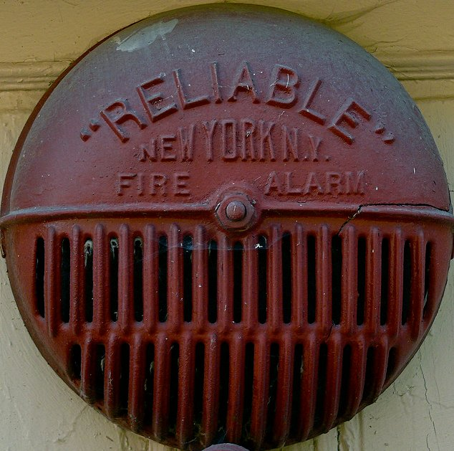

Slide 76
Creating Backups That Will Restore
Production databases should use the Full Recovery model (mostly).
Perform full backups daily, plus log backups regularly (to meet your HA needs).
Perform online backups
Always back up WITH CHECKSUM
Always back up to separate files

Slide 77
Creating Backups That Will Restore
Check backups using RESTORE WITH VERIFYONLY to verify integrity. THIS IS NOT a guarantee the backup will restore.
Restore backups to verify that you can restore your databases.
Store backups securely (physically & encrypted), and off-site.
If you have a limited backup window, or have limited disk space, use backup compression.

Slide 78
Creating Backups That Will Restore
Demo
Backups and options
DBCC

Slide 79
What We Are Going to Learn Today
Managing MDF and LDF Files
Managing Indexes
Maintaining Statistics
Checking for Corruption
Creating Backups That Will Restore
Managing Maintenance Jobs
Not every recommendation may be appropriate for your environment. Be sure to test in a non-production environment before trying these recommendations out.
Notes:
Mention that I will be discussing, in addition to these best practices, some of the tools available from Red Gate that can help you out.

Slide 80
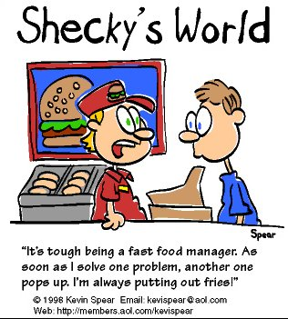

Slide 81
SQL Server Maintenance Jobs
Backups
DBCC checks
Index Rebuilds
Statistics
Automated Restores
Business Processes

Slide 82
Managing Maintenance Jobs
KISS - As much as practical, keep maintenance plans the same
Don’t duplicate maintenance tasks (e.g. Rebuild indexes, then update index statistics immediately thereafter).
DO NOT SHRINK
Don’t overlap scheduled jobs
Schedule tasks during the least busy time(s)
Monitor jobs
Don’t over-maintain.
Clean Up

Slide 83
Managing Maintenance Jobs
Demo
Maintenance Jobs
Cleanup Tasks

Slide 84
Take Aways From This Session
Implementing optimal maintenance can greatly affect a SQL Server instance’s:
Availability
Performance
Database maintenance is on-going
Automate as much as possible
A Challenge: when you get back to work, evaluate all of your instances to ensure that all appropriate maintenance tasks are being performed optimally.

Slide 85
Checklist
Backups scheduled on all databases (full and log)
DBCC CHECKDB running regularly
Test restores scheduled
Manage mdf/ndf/ldf file sizes
Proactively monitor and maintain indexes and statistics (use your calendar)
Monitor jobs and set up alerts
Regular Maintenance of indexes, stats, history

Slide 86
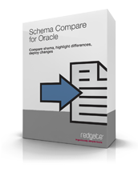
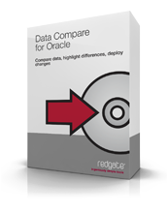

Oracle Tools
Source Control - www.red-gate.com/source-control-for-oracle
Schema Compare - http://www.red-gate.com/products/oracle-development/schema-compare-for-oracle/
Data Compare - http://www.red-gate.com/products/oracle-development/data-compare-for-oracle/

Slide 87
The End
Questions?
www.sqlservercentral.com/forums
www.voiceofthedba.com/talks
Learn more
www.red-gate.com/sqlstoragecompress
www.red-gate.com/sqlbackup
www.red-gate.com/sqlmonitor
http://www.red-gate.com/products/dba/sql-index-manager/

Slide 88
References
How to Monitor Your SQL Server for Performance and High Availability
How to Defragment Indexes for Peak Performance
Inside the SQL Server Transaction Log
2012 Diagnostic Queries (Glenn Berry) - http://sqlserverperformance.wordpress.com/category/sql-server-2012/
SQLFool Missing Indexes - http://sqlfool.com/2009/04/a-look-at-missing-indexes/
http://sqlblog.com/blogs/elisabeth_redei/archive/2009/03/01/lies-damned-lies-and-statistics-part-i.aspx (part II, part III)
Multiple log files and why they're bad – SQLskills, Paul Randal

Slide 89
References
Reorganizing and Rebuilding Indexes - http://msdn.microsoft.com/en-US/library/ms189858%28v=SQL.90%29.aspx
Restore with Verify Only - http://msdn.microsoft.com/en-us/library/ms188902.aspx
Database Tuning Advisor Overview - http://msdn.microsoft.com/en-us/library/ms173494%28v=sql.105%29.aspx
Transaction Log File VLFs - http://sqlskills.com/BLOGS/KIMBERLY/post/Transaction-Log-VLFs-too-many-or-too-few.aspx
Duplicate Indexes - http://www.sqlskills.com/BLOGS/KIMBERLY/post/UnderstandingDuplicateIndexes.aspx

Slide 90
Images
Office Space - http://www.imdb.com/title/tt0151804/
Missing index - http://sqlfool.com/2009/04/a-look-at-missing-indexes/
Duplicate key - http://www.flickr.com/photos/popilop/331357312/
Maintenance - http://www.flickr.com/photos/metrolibraryarchive/3897646507/
Corruption - http://www.flickr.com/photos/87913776@N00/4363265760/
Reliable Fire Alarm - http://www.flickr.com/photos/goosedancer/3733356197/
Fast food manager cartoon – http://kevinspear.com

