Slide 1


Common Backup Problems will get started soon
#sqlinthecity

Slide 2


While you’re waiting, check out SQL Prompt
#sqlinthecity

Slide 3
While you’re waiting, go on Twitter
#sqlinthecity
Tweet us at @redgate #sqlinthecity and let us know how you’re enjoying the event, speakers, sessions,
food, demos and more
@redgate | #sqlinthecity

Slide 4

Enjoy the session
Be sure to note down/tweet your questions to ask the speaker during the Q&A at the end of the session
#sqlinthecity

Slide 5
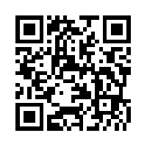
Once you’ve viewed today’s sessions, please complete the online feedback form
#sqlinthecity
www.red-gate.com/sitc13-feedback
In return you can:
Collect a Red Gate book of your choice from 5PM
Have a chance to win a Conference pass to SQL Server LIVE! 2013, which will be drawn at 5.15PM

