Slide 1
How to Manage Unstructured SQL Server Data
Steve Jones
SQLServerCentral
Red Gate Software

Slide 2
Agenda
Structured and unstructured data
Filestream
Filetable

Slide 3
Types of Data
Structured
Semi-structured
Unstructured

Slide 4
Structured Data
“normal” RDBMS data
Format is known and defined
Example: Sales Order

Slide 5
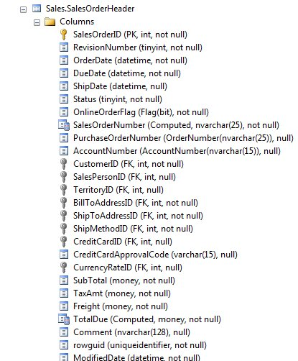

Slide 6
Semi-structured Data
some structure, but it is fluid
changes in structure should not break code
example: XML

Slide 7
Semi Structured Data
<SalesOrder DueDate=”20120201”>
<OrderID>12</OrderID>
<Customer>John Doe</Customer>
<OrderDate>2012/01/15</OrderDate>
<Items>
<Item>
<Product>Widget</Product>
<Quantity>12</Quantity>
</Item>
<Item>
<Product>Whatchamacallit</Product>
<Quantity>2</Quantity>
</Item>
</Items>
</SalesOrder>

Slide 8
Semi Structured Data
<SalesOrder DueDate=”20120201”>
<OrderID>12</OrderID>
<Customer>John Doe</Customer>
<OrderDate>2012/01/15</OrderDate>
<Items>
<Item>
<Product>Widget</Product>
<Quantity>12</Quantity>
</Item>
<Item>
<Product>Whatchamacallit</Product>
<Quantity>2</Quantity>
</Item>
</Items>
</SalesOrder>

Slide 9
Semi Structured Data
<SalesOrder DueDate=”20120201”>
<OrderID>12</OrderID>
<Customer>John Doe</Customer>
<OrderDate>2012/01/15</OrderDate>
<Items>
<Item>
<Product>Widget</Product>
<Quantity>12</Quantity>
</Item>
<Item>
<Product>Whatchamacallit</Product>
<Quantity>2</Quantity>
</Item>
</Items>
</SalesOrder>

Slide 10
Unstructured Data
structure is merely encoding.
meta data may be in the structure
examples:
  Audio files
  Word Documents
  PDF
  Movies

Slide 11
Example
Lists Demo

Slide 12
Unstructured Data - Pre 2008
In SQL Server large binary files handling had two solutions:
  store in the file system, but a reference in the database
    administrative issues (backup, security)
    synchronization issues
  store the binary file in the database
    Text/image/varbinary data type
    complex storage, manipulation, and retrieval.

Slide 13
Filestream
Added in SQL Server 2008
Allows storage in the filesystem, but appears to be in the database.

Slide 14
SQL Server Instance
Filegroup_1
File 1 - c:\Program Files\...\Data\MyDB.mdf
File 2 - c:\Program Files\...\Data\MyDB2.ndf
File 3 - c:\Program Files\...\Data\MyDB3.ndf
Table: MyMP3s
-----------------
Name varchar(200)
MP3 varbinary(max)

Slide 15
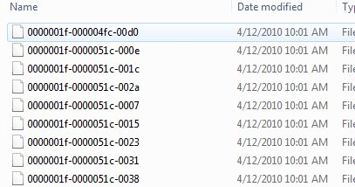
SQL Server Instance
Filegroup_1
File 1 - c:\Program Files\...\Data\MyDB.mdf
File 2 - c:\Program Files\...\Data\MyDB2.ndf
File 3 - c:\Program Files\...\Data\MyDB3.ndf
Table: MyMP3s
-----------------
Name varchar(200)
MyMP3 VARBINARY(MAX) FILESTREAM
Filegroup_2 - Filestream
File 1 - c:\Program Files\...\Data\FileStreamData

Slide 16
Filestream
Comparison point | Storage solution
 | File server / file system | SQL Server (using varbinary(max))
Maximum BLOB size | NTFS volume size | 2 GB – 1 bytes
Streaming performance of large BLOBs | Excellent | Poor
Security | Manual ACLs | Integrated
Cost per GB | Low | High
Manageability | Difficult | Integrated
Integration with structured data | Difficult | Data-level consistency
Application development and deployment | More complex | More simple
Recovery from data fragmentation | Excellent | Poor
Performance of frequent small updates | Excellent | Moderate
From Filestream Storage in SQL Server 2008

Slide 17
Filestream
Comparison point | Storage solution
 | File server / file system | SQL Server (using varbinary(max)) | FILESTREAM
Maximum BLOB size | NTFS volume size | 2 GB – 1 bytes | NTFS volume size
Streaming performance of large BLOBs | Excellent | Poor | Excellent
Security | Manual ACLs | Integrated | Integrated + automatic ACLs
Cost per GB | Low | High | Low
Manageability | Difficult | Integrated | Integrated
Integration with structured data | Difficult | Data-level consistency | Data-level consistency
Application development and deployment | More complex | More simple | More simple
Recovery from data fragmentation | Excellent | Poor | Excellent
Performance of frequent small updates | Excellent | Moderate | Poor
From Filestream Storage in SQL Server 2008

Slide 18
Filestream - Caveats
TDE does not encrypt filestream data
Encryption is not supported on Filestream data
Containers cannot be nested
In a cluster – filestream container must be on shared resources.

Slide 19
Filestream
Demo

Slide 20
FileTable
new in SQL Server 2012
builds on the Filestream, but eliminates some of the complexity
allows Windows Explorer style access
folder is a subdirectory of your Filestream share.
Access is non-transactional

Slide 21
FileTable
Demo

Slide 22
FileTable
Has a set schema
An existing table cannot be altered to “add” filetable support (think vertical partitions here)
Table names must be unique within the database
No filetables in tempdb
If you drop the filetable, all files and the folder are gone

Slide 23
The End
Questions?
Resources at the end of the PPT
www.sqlservercentral.com/forums
www.voiceofthedba.com/talks
Fill out your evaluations

Slide 24
References
FILESTREAM Overview - http://msdn.microsoft.com/en-us/library/bb933993.aspx
FILESTREAM Best Practices –http://msdn.microsoft.com/en-us/library/dd206979.aspx
FILESTREAM Storage in SQL Server 2008 - http://msdn.microsoft.com/en-us/library/cc949109.aspx
Remote BLOB store - http://technet.microsoft.com/en-us/library/gg638709.aspx
Enable the Prerequisites for FileTable - http://msdn.microsoft.com/en-us/library/gg509097(v=sql.110).aspx
Create, Alter, and Drop FileTables - http://msdn.microsoft.com/en-us/library/gg509088%28v=sql.110%29.aspx

