Slide 1

Adopting a Compliant Database DevOps Process
Steve Jones, Advocate/Editor
Redgate Software/SQL Server Central / SQL Saturday

Slide 2
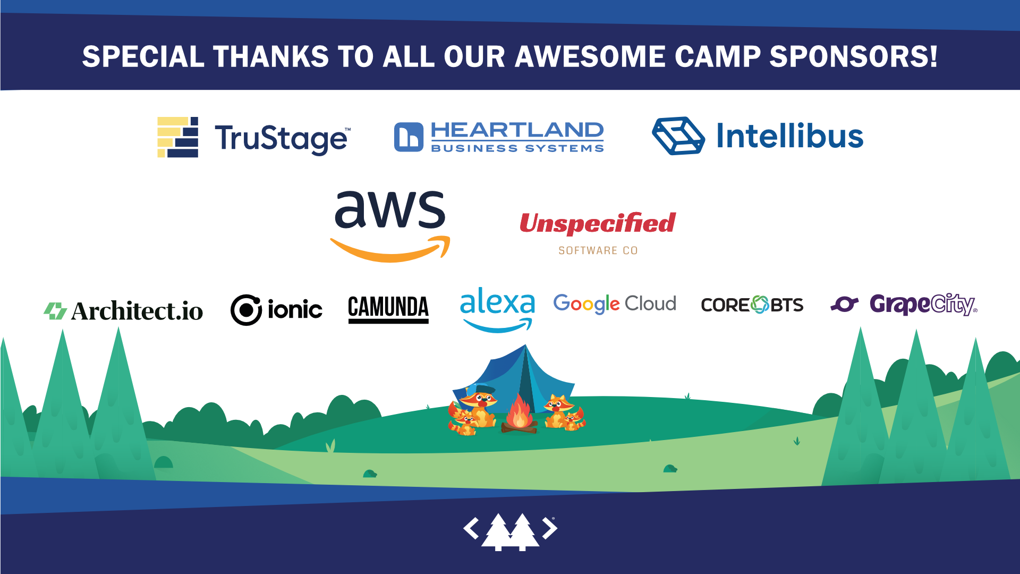
PULF-5TP473-T4AQ

Slide 3
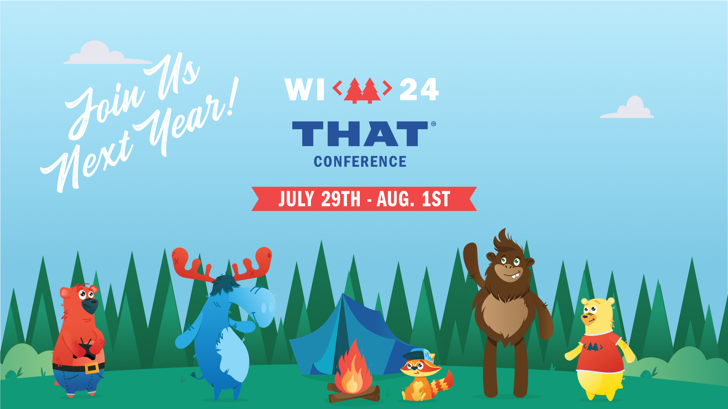
PULF-5TP473-T4AQ

Slide 4
Three Takeaways
The database can be built*
The database can be tested*
The database can be released*
* like other software
Notes:
This should be at the beginning and end of your presentation: What are the three talking points your audience should be able to answer after this presentation?

Slide 5
Agenda
Who am I?
Principles of DevOps
The DevOps Software Development Pipeline
Evolving Database Development

Slide 6
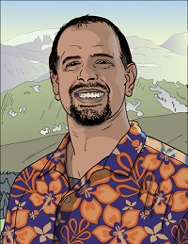

32 years SQL Server data experience
DBA, developer, manager, writer, speaker in a variety of companies and industries
Founder, SQLServerCentral
And current editor, with the goal of helping you learn to be a better data professional every day
Steve Jones
Advocate, Redgate Software
Editor, SQLServerCentral
15-year Microsoft Data Platform MVP
I am honored to be recognized by Microsoft for the last decade as an MVP
/in/way0utwest
@way0utwest
www.voiceofthedba.com
Notes:
steve

Slide 7
What is DevOps?
Grew out of the Agile movement
Velocity ‘09 – 10+ Deploys Per Day: Dev and Ops Cooperation at Flickr
Is not Agile (or Scrum or Lean or Kanban)
Is an amalgamation of various ideas and principles that describe how to better build software.

Slide 8

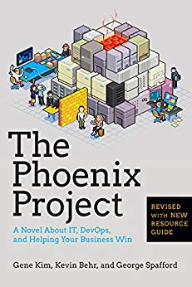
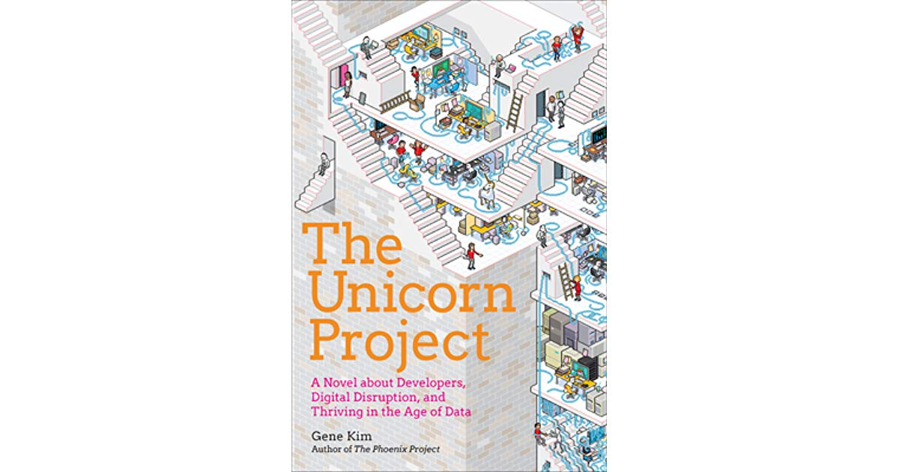
The Three Ways
Principles underlying DevOps from Gene Kim
Systems Thinking (Flow)
Amplify Feedback Loops (Feedback)
Culture of Experimentation and Learning (Experiments)

Slide 9
What is DevOps?
“DevOps is the union of people, process, and products to enable continuous delivery of value to our end users.”
- Donovan Brown

Slide 10
What is DevOps?
“DevOps is the union of people, process, and products to enable continuous delivery of value to our end users.”
- Donovan Brown

Slide 11
DevOps in Practice
Culture
DBAs and developers and others working together
Automation
Introduce tools to the database
Lean
make db changes simpler, evolve the db
Measurement
consider impact of db change
Sharing
understand how a db change impacts development and operations
Culture - DBAs and developers (and others) working together
Automation - Introduce tools to the database
Lean - make db changes simpler, evolve the db
Measurement - consider impact of db change
Sharing - understand how a db change impacts development and operations

Slide 12

The Application Development Pipeline
Development
Operations
Continuous integration
QA
Build
Production
Trigger
Test
Staging
Report
Sync
Beta
Publish
Artifact repository

Slide 13
The Database Development Pipeline
Development
Operations
Continuous integration
QA
Build
Production
Trigger
Test
Shared
Staging
Report
Sync
UAT
Publish
Artifact repository

Slide 14
Evolving Database Development
We need consistent environments in Development
Easily onboard developers
Compliance
Ensure sensitive data is protected
Classify data in production
Mask/anonymize/pseudomize sensitive information
Have a consistent data set(s)
For all devs, build envs, test envs, etc.
Start testing here by ensuring your use cases are represented
Shift security and compliance left

Slide 15
Evolving Database Development
The foundation is Version Control (VCS)
As much as possible, treat db code like app code
VCS Organization
Can be same repo or separate repo (I prefer separate)
Use a sub folder for the DDL
Use the same VCS as app developers
Distributed
Centralized
Be careful with branching flows (short lived)
The database is a foundation
Rebase/merge often

Slide 16
SQL and Version Control
Capture our DDL (and DML) into a VCS
Use Pull Requests for code review
The code process is
Write code
Get changed DDL/DML to a text file
Commit to the VCS
Comments are why changes were made, not what.
Options for database DDL and DML
Scripting – SMO in SQL Server
Third Party Tools
File | Save

Slide 17
Demo: Store database code in a VCS

Slide 18
Database Continuous Integration
App code uses CI to build, test, package code
Start code evaluation here (tests)
Database Build Process
Pull code from VCS
Order code according to rules of SQL
Execute code on a database
Run tests
Package code for downstream release
Use a Build Server just like application code
TFS Build, Bamboo, Team City, Cruise Control, Jenkins, etc.

Slide 19
Database Testing
Tests must be automated
Known starting state
Transaction support
For SQL Server
tSQLt
Microsoft Unit Testing Projects
DBUnit
Custom scripted tests
For best results, use a curated test data
Additive or subtractive from production
Include some randomness
Ensure no sensitive data is used

Slide 20
Demo: Implement Continuous Integration

Slide 21
Generate the Update Script
For code (stored procedures, functions, views, modules, etc.)
Take latest version from VCS
For tables
Use Comparison or migration scripts to make changes.
Tools
Comparison tools (SQL Compare, etc)
Migration Tools (SQL Change Automation, FlywayDB, EF migrations, etc.)

Slide 22

Model/State/Compare based process
Dev
Prod
Tables
Cust
Views
CustomerSales
Procedures
CheckLogin
GetCustList
Functions
CalcDiscount
Tables
Cust*
Sales
Views
CustomerSales
Monthly Sales
Procedures
CheckLogin*
GetCustList
Functions
CalcDiscount*
Create table Sales
Tables
Cust*
Sales
Views
CustomerSales
Monthly Sales
Procedures
CheckLogin*
GetCustList
Functions
CalcDiscount*
SQL Compare
Tables
Cust
Views
CustomerSales
Procedures
CheckLogin
GetCustList
Functions
CalcDiscount
Alter table Cust
Create View MonthlySales
Create Sales
Alter Cust
Create MonthlySales
Alter CheckLogin
Alter Calcdiscount
Alter proc CheckLogin
Alter function CalcDiscount

Slide 23
Migrations based process
Dev
Prod
Tables
Cust*
Sales
Views
CustomerSales
Monthly Sales
Procedures
CheckLogin*
GetCustList
Functions
CalcDiscount*
Tables
Cust
Views
CustomerSales
Procedures
CheckLogin
GetCustList
Functions
CalcDiscount
Create table Sales
001Create table Sales
Tables
Cust*
Sales
Views
CustomerSales
Monthly Sales
Procedures
CheckLogin*
GetCustList
Functions
CalcDiscount*
Tables
Cust
Views
CustomerSales
Procedures
CheckLogin
GetCustList
Functions
CalcDiscount
Alter table Cust
002Alter table Cust
Create View MonthlySales
003Create View MonthlySales
Alter proc CheckLogin
004Alter proc CheckLogin
Alter function CalcDiscount
005Alter function CalcDiscount

Slide 24
Pros/Cons
State/Model/Compare
Pros
Simpler for developers
Merges are easier
Tooling generates script
Visibility of History
Cons
Domain of problems not solved
Tool ordering of changes can be problematic
Tool choices for changes could be an issue
Migrations
Pros
All changes work since they worked in dev/test
Control over method and order of changes
All domain problems handled
Cons
Harder for developers
History hard to assemble
Merges are hard (chronology matters)
All changes in Dev occur in Prod

Slide 25
Deploy the Code
Use a consistent process
Use automation where you can, use manual steps (documented) where you cannot/fear issues
Slowly and continuously improve the process
Use a Release Management Server
Octopus Deploy
TFS
Bamboo

Slide 26
Demo - Release to Downstream Environments

Slide 27
Release Issues - Rollback
For code – Deploy the previous version
Views
Procs
Functions
For tables
Need custom code
I pre-write and test for risky tables (deploy to QA, run rollback in QA)
I like a separate DBA pipeline for this
In general, I am a fan of dark deploys and roll forward
I DO NOT trust tools for table/data rollback

Slide 28
Release Issues – Environmental Data
Data that varies by environment (queue names, security, etc)
Script and deploy with deploy once scripts (maybe separate pipeline)
Use tokens where possible and store config data in the environment
Best solution
Manually enter changes as code
Use code reviews and PR by two people whose jobs depend on this being correct

Slide 29
Refreshing Development
Use safe data in development environments
Ensure developers can deploy or refresh databases *easily*
Restore from production or maintain a curated data set
Use data masking
Use scripts or tools to de-identify/pseudonymize/anonymize
Inject data to create known values for testing
Add randomness
Include new rows for edge cases
Maintain this a part of the development process

Slide 30
High Level Process Summary
Get database code into a VCS
This is a foundation
Use what app devs use
Create a CI Process
Ensure the codebase is clean
Start testing here (standards and/or logic)
Create a CD process
Set security to privileged users
Automate your manual process using CI artifacts

Slide 31
Summary
Understand and apply the DevOps principles to the db
Systems Thinking
Feedback Loops
Experimentation and Learning
Treat the database like application code
Build the exceptions into your process
Build *your* process for your environment
Account for staff changes and varying skill levels
Adapt to your environment
Do more of what works
Do less of what doesn’t

Slide 32
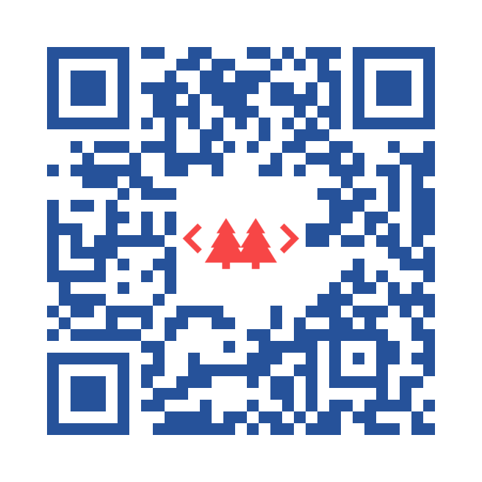

The End
www.voiceofthedba.com
sjones@sqlservercentral.com
@way0utwest
/in/way0utwest
steve.jones@red-gate.com

