Slide 1


Mastering T-SQL: Writing Cleaner Code
Steve Jones
SQLServerCentral
Red Gate Software

Slide 2
Agenda
Who Am I?
CTEs
Error Handling
Tally Tables
Templates and other coding tricks

Slide 3
Goals
Understand CTEs
Learn good error handling techniques
Build a tally table
Write code faster

Slide 4
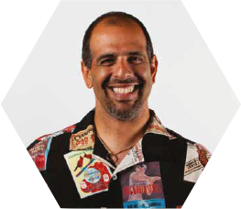




Get in touch
Editor and founder, SQLServerCentral
Evangelist, Red Gate Software
Working with SQL Server since 1991 (v4.2)
Author of many articles and books on different aspects of SQL Server
Steve Jones
http://voiceofthedba.wordpress.com/
sjones@sqlservercentral.com
@way0utwest
http://www.linkedin.com/in/way0utwest

Slide 5
The End
Thanks for coming
Questions?
More information - www.sqlservercentral.com

Slide 6
References

