Slide 1


Testing T-SQL Made Easy
Steve Jones
SQLServerCentral
Redgate Software
Notes:
Connect to .\SQL2014 with SSMS
Run all 0x files
Run SQL Data Generator file

Slide 2
Agenda
Who am I?
Testing Standards with Exceptions
Preventing ALTER TABLE for 1billion rows
Does the join work?
Handling GETDATE()
Isolating Functions and Procedures
Heuristics
Organizing Code

Slide 3
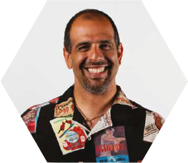



Who am I?
Steve Jones
SQLServerCentral founder
Redgate Software Evangelist
www.voiceofthedba.com
sjones@sqlservercentral.com
@way0utwest
/in/way0utwest

Slide 4
Who are you?
DBAs/sysadmins?
Developers?
Other?
Using tSQLt?
Redgate?
Use Redgate tools?

Slide 5
Testing T-SQL
Tsqlt testing framework
Tsqlt.org
Unit testing similar to nunit/junit/xunit
Format
Assemble
Act
Assert

Slide 6
Testing Standards
SQLCop (sqlcop.lessthandot.com)
Use Extended properties for exceptions
Could use a table instead (Azure)
Limit access to add/change exceptions

Slide 7
Demo
Standards and Exceptions

Slide 8
Large Table Changes
There’s no magic in SQL Server
However, there are methods to limit the impact of changes to large tables
Testing is a way to facilitate a discussion

Slide 9
Demo
Stopping ALTER TABLE

Slide 10
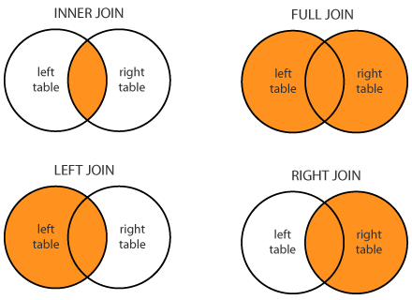

Slide 11
Demo
Checking Joins

Slide 12

Notes:
https://s-media-cache-ak0.pinimg.com/736x/2e/93/1e/2e931ec9f055c57863c89c7d221dd8ad.jpg

Slide 13
Demo
GETDATE()

Slide 14
Isolating Code
We don’t want our tests to depend on more than one module of code.
Dependencies can cause complexities in debugging and testing.

Slide 15
Heuristics
0-1-Some (We’ve seen this in the last demo
Boundaries
Buckets
Various cases

Slide 16
Demo
Heuristics

Slide 17
Summary
Write tests to catch potential issues
Allow for exceptions to rules
Use test failures to learn as a team and discuss issues
Write one test each time you change code

Slide 18
The End
Thank you for coming
Questions?
Tsqlt.org
Ask at www.sqlservercentral.com/forums
www.voiceofthedba.com
sjones@sqlservercentral.com
@way0utwest
/in/way0utwest

