Slide 1


Testing T-SQL Made Easy
Steve Jones
SQLServerCentral
Redgate Software

Slide 2
Agenda
Who am I?
Testing Standards with Exceptions
Preventing ALTER TABLE for 1billion rows
Does the join work?
Handling GETDATE()
Isolating Functions and Procedures
Heuristics
Organizing Code

Slide 3
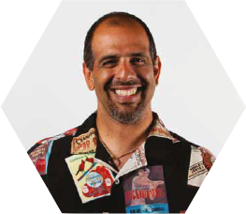



Who am I?
Steve Jones
SQLServerCentral founder
Redgate Software Evangelist
www.voiceofthedba.com
sjones@sqlservercentral.com
@way0utwest
/in/way0utwest

Slide 4
Who are you?
DBAs/sysadmins?
Developers?
Other?
Using tSQLt?
Redgate?
Use Redgate tools?

Slide 5
Testing T-SQL
Tsqlt testing framework
Tsqlt.org
Unit testing similar to nunit/junit/xunit
Format
Assemble
Act
Assert

Slide 6
Testing Standards
SQLCop (sqlcop.lessthandot.com)
Use Extended properties for exceptions
Could use a table instead (Azure)
Limit access to add/change exceptions

Slide 7
Demo
Standards and Exceptions

Slide 8
Demo
Stopping ALTER TABLE

Slide 9
Demo
Checking Joins

Slide 10
Demo
GETDATE()

Slide 11
Demo
Isolating Functions and Procedures

Slide 12
Demo
Heuristics

Slide 13
Summary

Slide 14
The End
Thank you for coming
Questions?
Ask at www.sqlservercentral.com/forums
www.voiceofthedba.com
sjones@sqlservercentral.com
@way0utwest
/in/way0utwest

Slide 15
References

