Slide 1


Testing T-SQL Made Easy
Steve Jones
SQLServerCentral
Redgate Software

Slide 2
Agenda
Who am I?
Testing Standards with Exceptions
Preventing ALTER TABLE for 1billion rows
Does the join work?
Handling GETDATE()
Heuristics
Isolating Functions and Procedures
Organizing Code

Slide 3
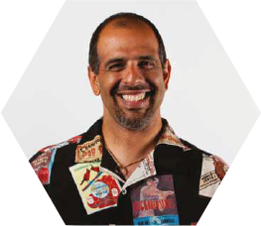



Who am I?
Steve Jones
SQLServerCentral founder
Redgate Software Evangelist
www.voiceofthedba.com
sjones@sqlservercentral.com
@way0utwest
/in/way0utwest

Slide 4
Who are you?
DBAs/sysadmins?
Developers?
Other?
Using tSQLt?
Redgate?
Use Redgate tools?

Slide 5
Summary

Slide 6
The End
Thank you for coming
Questions?
Ask at www.sqlservercentral.com/forums
www.voiceofthedba.com
sjones@sqlservercentral.com
@way0utwest
/in/way0utwest

Slide 7
References

