Slide 1

Get testing with tSQLt
Practical examples and automation
Part III of the Continuous Delivery for Databases series
Steve Jones
Red Gate Software

Slide 2
Agenda
Goals
Who am I?
The Delivery Pipeline
Where do I test?
Why do I test?
tSQLt
Refactoring an application
Testing procedures and functions
Grouping tests
Testing exceptions

Slide 3
Goals
Why testing matters
Introduction to the tSQLt framework
What and how we can test
Testing as part of a deployment pipeline
Notes:
I put these together as a draft based on your email notes and the outline of our new series of talks. What do you think?

Slide 4
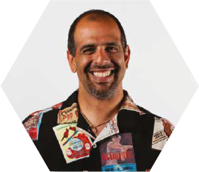



Get in touch
Steve Jones
Editor and founder, SQLServerCentral
Evangelist, Red Gate Software
Working with SQL Server since 1991 (v4.2)
Author of many articles and books on different aspects of SQL Server
http://voiceofthedba.wordpress.com/
sjones@sqlservercentral.com
@way0utwest

Slide 5
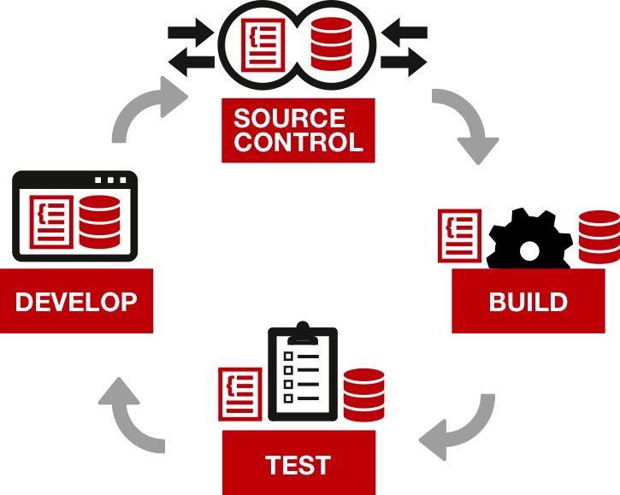
Continuous delivery – an overview

Slide 6
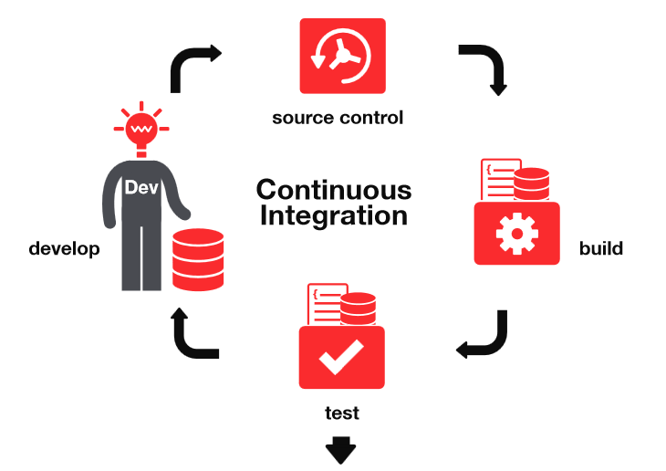
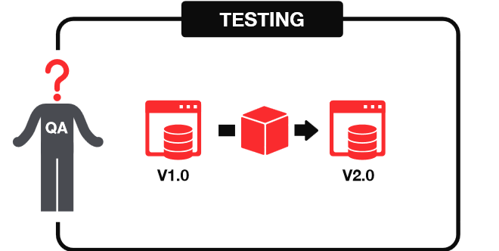


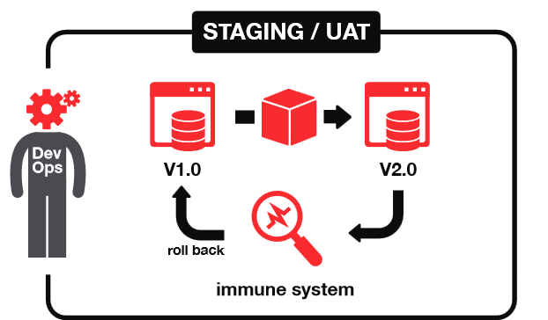
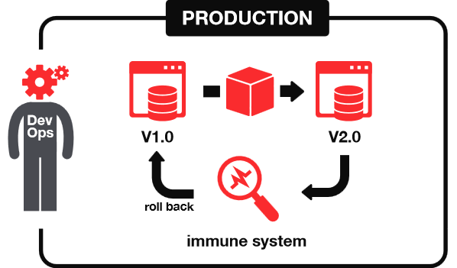

Continuous delivery
1
2
START
3
4
DELIVER

Slide 7

First… the big question:
When do I test?

Slide 8
Different types of tests
Different types of testing for different stages of the pipeline:
Development
Integration Testing
QA
Pre-Production/ Staging
Production
Unit tests
Integration tests
Automated tests
Deployment validation
Behaviour validation
Other validations
Notes:
We use this slide in the Build a Pipeline talk at the very end to touch on the range of tests that you can cover in a pipeline. Perhaps we could reuse here to give further emphasis? I’ve added some animation in case you’d like to build up the pipeline and types of tests step by step on the slide. I see the terms used for the tests and environments here aren’t consistent with the ones you mention in your Testing in the Pipeline slide (hidden for now below). Should we update this slide here to reflect the terms you use in your Testing in the Pipeline slide? I think your pipeline slide with the arrow also works very nicely though – so just let me know which you prefer to use (or both!).

Slide 9
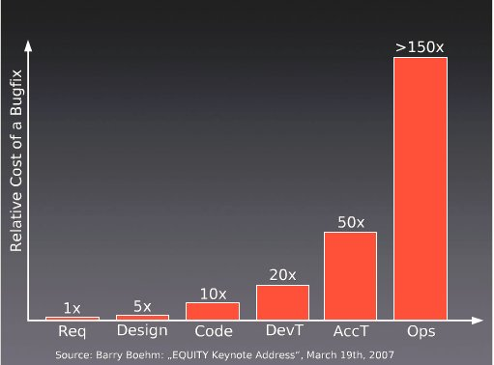
Why test?
Notes:
Note that the cost of bugs rises. We know this. The earlier we find issues, the better. We can see from this survey that the cost of bugs rises dramatically as we get closer to the client.

Slide 10
“Fix bugs as soon as you find them”
Unfixed bugs camouflage other bugs
Unfixed bugs suggest quality isn’t important
Discussing unfixed bugs is a waste of time
Unfixed bugs lead to duplicate effort
Unfixed bugs lead to unreliable metrics
Unfixed bugs distract the entire team
Unfixed bugs hinder short-notice releases
Unfixed bugs lead to inaccurate estimates
Fixing familiar code is easier than unfamiliar code
Fixing a bug today costs less than tomorrow
Source: https://www.ministryoftesting.com/2013/06/ten-reasons-why-you-fix-bugs-as-soon-as-you-find-them/
Notes:
I found this post and thought it might make quite a nice summary slide from a testers’ perspective of why it’s important to fix bugs early – especially with the potential for a snowball effect if unfixed bugs just camouflage other bugs. What do you think?

Slide 11
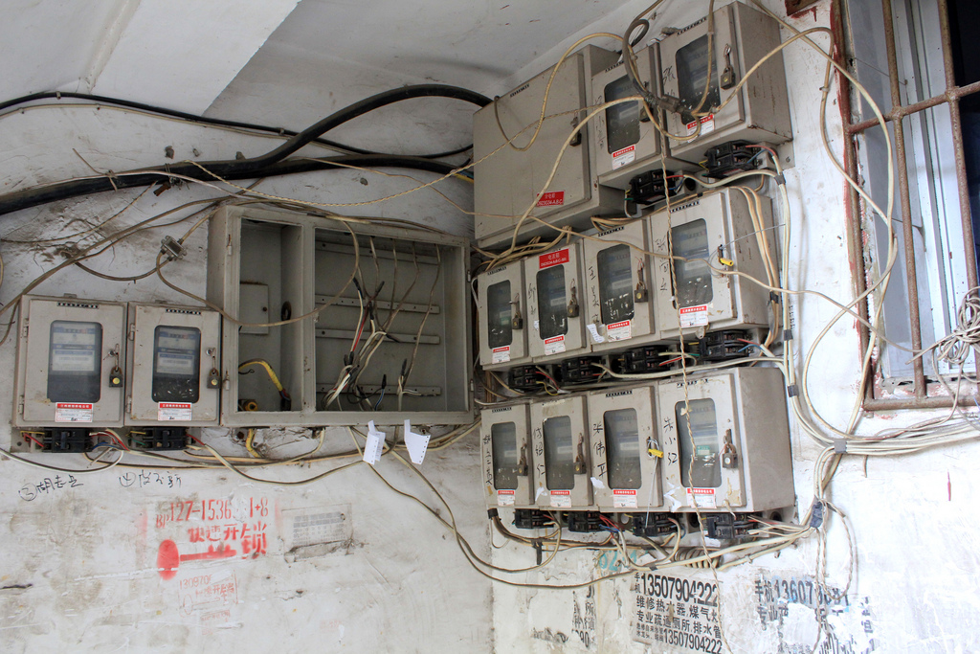
The next question:
What should I test?
Notes:
I thought it might be helpful early on to establish what it’s useful to test as a quick recap. What do you think?

Slide 12
How is data retrieved, stored and maintained in your application?
“[SQL code] includes views, stored procedures, functions, triggers, the creation of tables and the relationships between them, and query statements embedded in other programming languages.”
“…Writing this code often involves decisions about the nature of data being processed, complicated joining and filtering, performance tuning, data cleansing, replication and data maintenance.”
Source: Sebastian Meine and Dennis Lloyd – “SQL Server Unit Testing with tSQLt” – simple-talk.com
Notes:
I wondered if this helps to set the scene on what you should be thinking about when deciding what to test. What do you think?

Slide 13
What do we test?
Calculations in procedures and functions
Constraints
Edge cases of data DML
Expected behavior of data DML
Error Handling
Standards
… straightforward – let’s look at our first demo

Slide 14

Standards
Ensure that the standards you care about are followed.
SQLCop – sqlcop.lessthandot.com
Easy to write your own.
DEMO
Notes:
Ensure that the standards you care about are followed.
SQLCop – sqlcop.lessthandot.com
Easy to write your own.

Slide 15
Why tSQLt?
Free framework, similar to nUnit/jUnit
Tests written in T-SQL
Can use SSMS IDE
Run tests singly, in groups and in any order
Self-contained tests – isolated transaction
Includes common assertions to reduce repetitive coding
Requires the SQLCLR
Find out more:
tSQLt.org
Support via Google Groups
Articles at Simple Talk
Notes:
Introduce the framework. Give URL, support, this is free.
Steve, I’ve added in some extras here – don’t know if that’s useful or if you agree. I found the info in this article: https://www.simple-talk.com/sql/t-sql-programming/test-driven-database-development-%E2%80%93-why-tsqlt/

Slide 16
Structure of tests
Classes
Group by object/area being tested
Layout
Assemble
Act
Assert
Tests fail first

Slide 17
Our story…
We need to refactor and adjust the reading time for articles
Add a column to our table
Notes:
Needs a new name, but this is where we talk about our demo app slightly (or code). Give a first requirement we need to do.

Slide 18
Testing the API
Our first test
tsqlt.AssertResultSetsHaveSameMetaData
DEMO
Notes:
We show our first test. This exists, a test that verifies the results from our table. This is because we have multiple applications that use
Our first test
tsqlt.AssertResultSetsHaveSameMetaData

Slide 19
Our story
We need to refactor and adjust the reading time for articles
Add a column to our table
Create the procedure to update our reading time
Notes:
Second requirement – simple procs.
Create sp_insertArticleImage

Slide 20
Procedures and functions
Test the function
Create a new procedure
Isolate the procedure from the function in a test
DEMO
Notes:
Test the function
Create a new procedure
Isolate the procedure from the function in a test

Slide 21
Exceptions
Our code needs good error handling
We want to test for this by:
Creating errors with edge cases
Testing for specific exceptions when we use bad data

Slide 22
Our story
We need to refactor and adjust the reading time for articles
Add a column to our table
Create the procedure to update our reading time
We haven’t included error handling in our procedure… Let’s test an edge case
Notes:
Second requirement – simple procs.
Create sp_insertArticleImage

Slide 23
Exceptions
Send in bad data in a test
Update our procedure with error handling
Include a new test to catch the exception
DEMO
Notes:
Send in bad data in a test
Update our procedure with error handling
Include a new test to catch the exception

Slide 24
Exceptions
NULL
-x
0
Long strings (esp char)
Nvarchar v varchar
Int/char v datetime
Formatting (mm/dd/yyyy v. dd/mm/yyyy)

Slide 25
Building a Test Suite
By continuing to grow your test suite with each change, developers spread the load
By having a large suite, we have better code coverage
We can easily regression test
However, we need to group tests…

Slide 26
Our story
We need to refactor and adjust the reading time for articles
Add a column to our table
Create the procedure to update our reading time
We haven’t included error handling in our procedure… Let’s test an edge case
Let’s group a series of tests and execute them
Notes:
Second requirement – simple procs.
Create sp_insertArticleImage

Slide 27
Test classes
Grouping Tests by Object
Grouping Tests by Suite
Executing Groups of Tests
DEMO

Slide 28
Building a Test Suite
Write one extra test

Slide 29
Goals
Why testing matters and what it contributes
Introduction to the tSQLt framework
What and how we can test - examples
Testing as part of a deployment pipeline
Notes:
I put these together as a draft based on your email notes and the outline of our new series of talks. What do you think?

Slide 30
The End
Questions?
www.sqlservercental.com
www.simple-talk.com

Slide 31
References
Continuous Integration – http://en.wikipedia.org/wiki/Continuous_integration
Getting Started Testing Databases with tSQLt - https://www.simple-talk.com/sql/t-sql-programming/getting-started-testing-databases-with-tsqlt/

Slide 32
Image sources
Author | Source | Information
Peter Kaminski | Flickr | Safe Area – Flickr. This file is licensed under the Creative Commons Attribution 2.0 Generic license.
Harold Groven | Flickr | Fuse box – Flickr. This file is licensed under the Creative Commons Attribution-ShareAlike 2.0 Generic (CC BY-SA 2.0) license.

