Slide 1
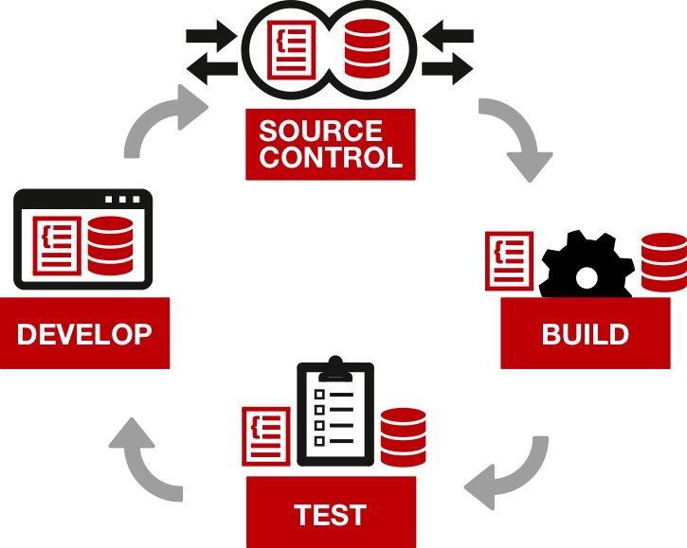
Continuous delivery

Slide 2
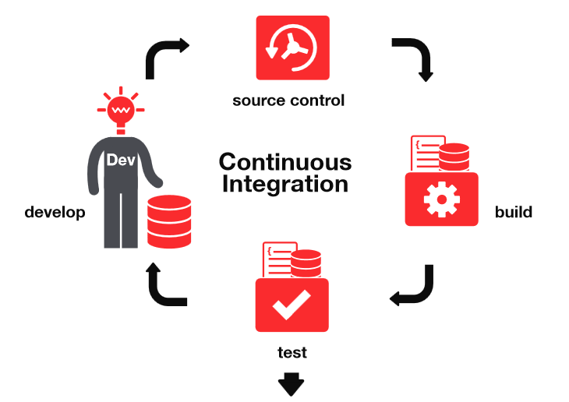
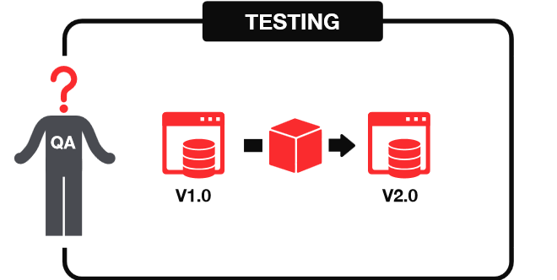


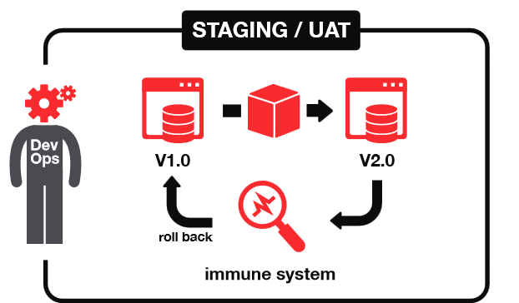
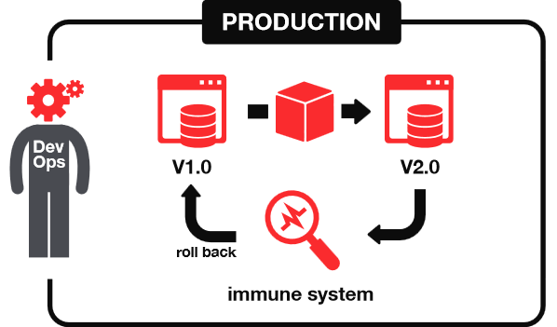

Continuous delivery
1
2
START
3
4
DELIVER

Slide 3
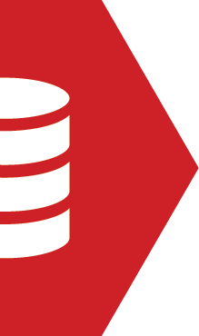
GET TESTING WITH tSQLt
Practical examples and automation
Continuous delivery for databases
Steve Jones
Red Gate Software

Slide 4
Goals
Why testing matters and what it contributes
Introduction to the tSQLt framework
What and how we can test - examples
Testing as part of a deployment pipeline
Notes:
I put these together as a draft based on your email notes and the outline of our new series of talks. What do you think?

Slide 5

First… the big question:
When do I test?

Slide 6
Different types of tests
Different types of testing for different stages of the pipeline:
Development
Integration Testing
QA
Pre-Production/ Staging
Production
Unit tests
Integration tests
Automated tests
Deployment validation
Behaviour validation
Other validations
Notes:
We use this slide in the Build a Pipeline talk at the very end to touch on the range of tests that you can cover in a pipeline. Perhaps we could reuse here to give further emphasis? I’ve added some animation in case you’d like to build up the pipeline and types of tests step by step on the slide. I see the terms used for the tests and environments here aren’t consistent with the ones you mention in your Testing in the Pipeline slide (hidden for now below). Should we update this slide here to reflect the terms you use in your Testing in the Pipeline slide? I think your pipeline slide with the arrow also works very nicely though – so just let me know which you prefer to use (or both!).

Slide 7
Testing in the Pipeline
Continuous Integration
automated unit tests
Development Integration
integration testing of subsystems
functional testing
QA
system testing
performance testing
UAT Environments
Performance/load tests
Notes:
Here are the types of tests in each area.

Slide 8
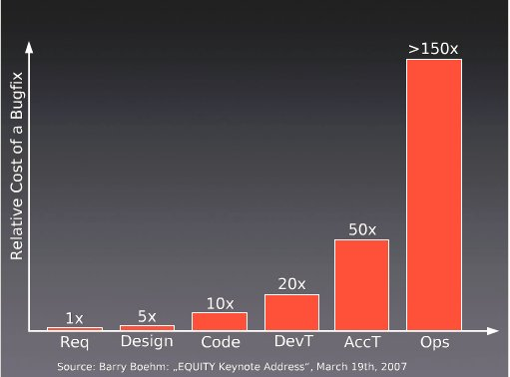
Why test?
Notes:
Note that the cost of bugs rises. We know this. The earlier we find issues, the better. We can see from this survey that the cost of bugs rises dramatically as we get closer to the client.

Slide 9
“Fix bugs as soon as you find them”
Unfixed bugs camouflage other bugs
Unfixed bugs suggest quality isn’t important
Discussing unfixed bugs is a waste of time
Unfixed bugs lead to duplicate effort
Unfixed bugs lead to unreliable metrics
Unfixed bugs distract the entire team
Unfixed bugs hinder short-notice releases
Unfixed bugs lead to inaccurate estimates
Fixing familiar code is easier than unfamiliar code
Fixing a bug today costs less than tomorrow
Source: https://www.ministryoftesting.com/2013/06/ten-reasons-why-you-fix-bugs-as-soon-as-you-find-them/
Notes:
I found this post and thought it might make quite a nice summary slide from a testers’ perspective of why it’s important to fix bugs early – especially with the potential for a snowball effect if unfixed bugs just camouflage other bugs. What do you think?

Slide 10
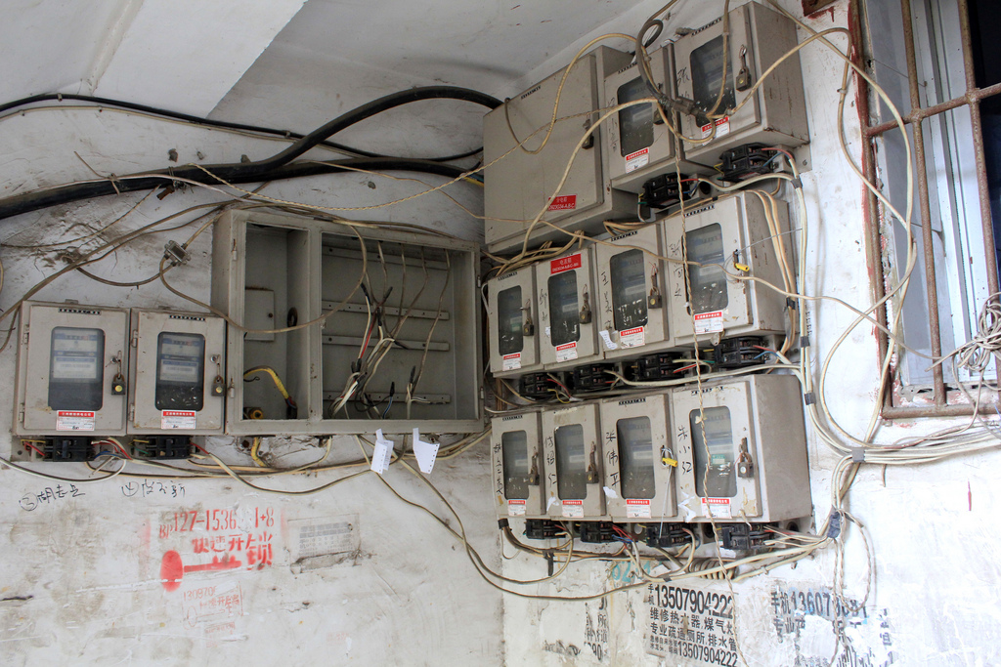
What should I test?
Notes:
I thought it might be helpful early on to establish what it’s useful to test as a quick recap. What do you think?

Slide 11
How is data retrieved, stored and maintained in your application?
“[SQL code] includes views, stored procedures, functions, triggers, the creation of tables and the relationships between them, and query statements embedded in other programming languages.”
“…Writing this code often involves decisions about the nature of data being processed, complicated joining and filtering, performance tuning, data cleansing, replication and data maintenance.”
Source: Sebastian Meine and Dennis Lloyd – “SQL Server Unit Testing with tSQLt” – simple-talk.com
Notes:
I wondered if this helps to set the scene on what you should be thinking about when deciding what to test. What do you think?

Slide 12
Why tSQLt?
Free framework, similar to nUnit/jUnit
Tests written in tSQL
Can use SSMS IDE
Run tests singly, in groups and in any order
Self-contained tests – isolated transaction
Includes common assertions to reduce repetitive coding
Find out more:
tSQLt.org
Support via Google Groups
Articles at Simple Talk
Notes:
Introduce the framework. Give URL, support, this is free.
Steve, I’ve added in some extras here – don’t know if that’s useful or if you agree. I found the info in this article: https://www.simple-talk.com/sql/t-sql-programming/test-driven-database-development-%E2%80%93-why-tsqlt/

Slide 13
tSQLt testing in the pipeline
Development Sandbox
Development Integration
UAT/ 1..n other environments
QA
VCS
Continuous Integration
Production
Notes:
Where does our tsqlt testing take place in the pipeline?

Slide 14
Types of Tests
Standards Tests
Logic Tests
Performance Tests

Slide 15
Structure of Tests
Assemble
Act
Assert

Slide 16
Our Story
We need to refactor and adjust the reading time for articles
Add a column to our table
Add a procedure to calculate the time
Adjust the function
Add tests
Notes:
Needs a new name, but this is where we talk about our demo app slightly (or code). Give a first requirement we need to do.

Slide 17
Demo
Demo that shows how we build a table that doesn’t follow good practices. Use tblProductImages as a table name
SQL Cop catches an error. Actually catches two, name and no PK.
Notes:
Code for snippet:
create table tblArticleImages
(
ImageID Int identity(1, 1)
, ArticleID Int
, ImageFile Varbinary(max)
);

Slide 18
Standards Tests
Ensure that the standards you care about are followed.
SQLCop – sqlcop.lessthandot.com
Easy to write your own.

Slide 19
Our Story
This is our app and we need to enhance it
We need to add a table to hold the images for articles.
Let’s write a procedures to insert and select back images
Notes:
Second requirement – simple procs.
Create sp_insertArticleImage

Slide 20
Demo
Write proc for insert and select of images
Write tests for each
Run tests, get caught naming issues, as well as one procedure works, one fails.
Correct issues in both procedures

Slide 21
Logic Tests
These are unit tests designed to find issues with a particular specific function

Slide 22
Our Story
This is our app and we need to enhance it
We need to add a table to hold the images for articles.
Let’s write a procedures to insert and select back images
More complex logic, refactoring a a procedure that can query for some type of aggregate
Notes:
Second requirement – simple procs.
Create sp_insertArticleImage

Slide 23
Demo
Alter the procedure to meet the new logic
Write test for the proc
Run tests, have new test work, some other, older test that now fails.

Slide 24
Having a Test Suite
By continuing to grow your test suite with each change, developers spread the load
By having a large suite, we have better code coverage.
We can easily regression test.

Slide 25
Summary
Testing will improve the quality of your code
Testing will lower the cost of code
tSQLt is a framework for testing T-SQL code
SQL Cop can help you easily test for standards

Slide 26
The Continuous Delivery Pipeline
Development Sandbox
Development Integration
UAT/ 1..n other environments
QA
VCS
Continuous Integration
Production
Notes:
This is part of a software development philosophy that seeks to build software faster, with a higher level of quality.

Slide 27
The End
Questions?
www.sqlservercental.com
www.simple-talk.com

Slide 28
References
Continuous Integration – http://en.wikipedia.org/wiki/Continuous_integration
Getting Started Testing Databases with tSQLt - https://www.simple-talk.com/sql/t-sql-programming/getting-started-testing-databases-with-tsqlt/

Slide 29
Image sources
Author | Source | Information
Peter Kaminski | Flickr | Safe Area – Flickr. This file is licensed under the Creative Commons Attribution 2.0 Generic license.
Harold Groven | Flickr | Fuse box – Flickr. This file is licensed under the Creative Commons Attribution-ShareAlike 2.0 Generic (CC BY-SA 2.0) license.

Slide 30
Images
Notes:
CD pipeline - http://www.getchef.com/images/chart-continuous-delivery.png
CD process - http://eavonius.github.io/powerdelivery/img/website_pipeline_activities.jpg
Flow - http://www.rampmeupscotty.com/media/images/2012-08-23_changes_moving_through_deployment_pipeline.png
Maturity model - http://www.infoq.com/resource/articles/Continuous-Delivery-Maturity-Model/en/resources/fig1large.jpg

Slide 31
The Continuous Delivery Pipeline
Development Sandbox
Development Integration
UAT/ 1..n other environments
QA
VCS
Continuous Integration
Production
Notes:
This is part of a software development philosophy that seeks to build software faster, with a higher level of quality.

Slide 32
Testing in the Pipeline
Development Sandbox
Development Integration
UAT/ 1..n other environments
QA
VCS
Continuous Integration
Production
Notes:
Where does our tsqlt testing take place in the pipeline?

Slide 33
Scrap
Development Sandbox
Development Integration
UAT/other environments
Check out
Build database
Test Data
Unit Tests
Compare with VCS
QA
Automated Acceptance T
Automated Acceptance Tests
Auto deploy changes
Manual testing
Load Environmental config
Automated backup
VCS
Continuous Integration
Production

