Slide 1

Computer Vision with OpenCV
Embark on a journey into the exciting world of computer vision with OpenCV. This presentation will introduce you to the fundamentals of OpenCV and its diverse applications.
by Aravind K
Notes:
1

Slide 2
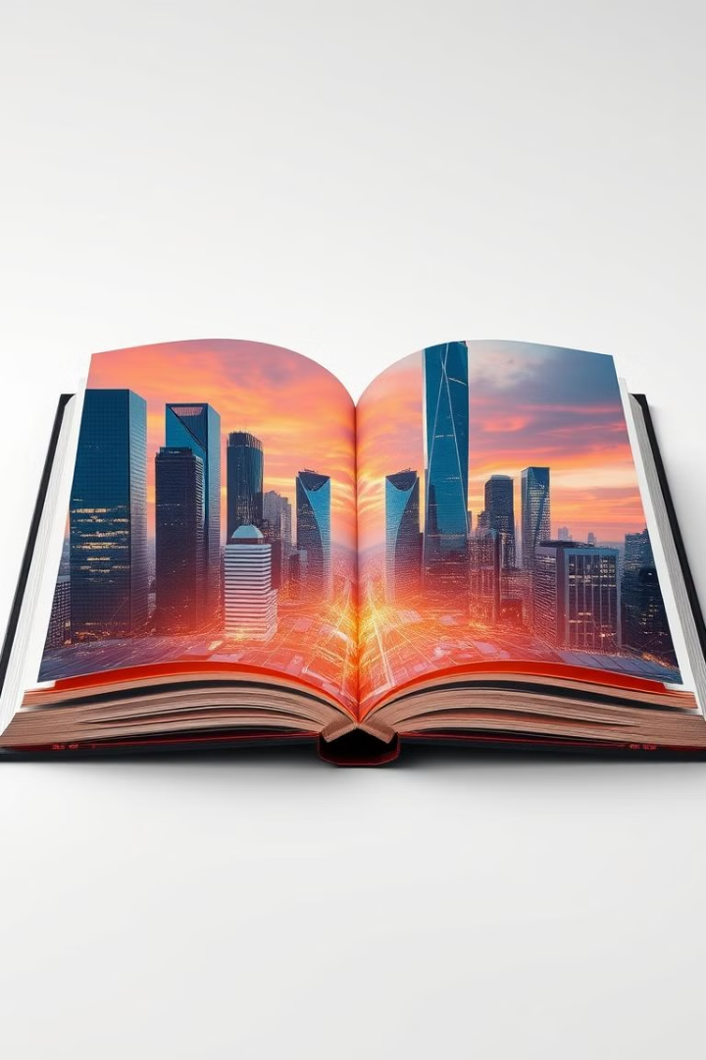
What is OpenCV?
1
Open Source Powerhouse
2
Real-Time Vision
OpenCV excels in handling real-time scenarios, enabling applications that react to visual information instantaneously.
OpenCV is a powerful library that empowers developers to build computer vision applications for a wide range of purposes.
3
Cross-Platform Compatibility
4
Community-Driven
OpenCV boasts a thriving community of developers who contribute to its ongoing development and support.
OpenCV is available across various platforms, making it accessible to a wide range of developers and projects.
Notes:
2

Slide 3
Applications of Computer Vision
Image Processing
Object Detection
Facial Recognition
Enhance, filter, and manipulate images for various applications.
Identify and locate objects within images or videos.
Verify and identify individuals based on their facial features.
Examples: Removing noise, sharpening edges, adjusting colors.
Examples: Detecting cars, pedestrians, faces.
Examples: Security systems, personalized experiences.
Notes:
3

Slide 4
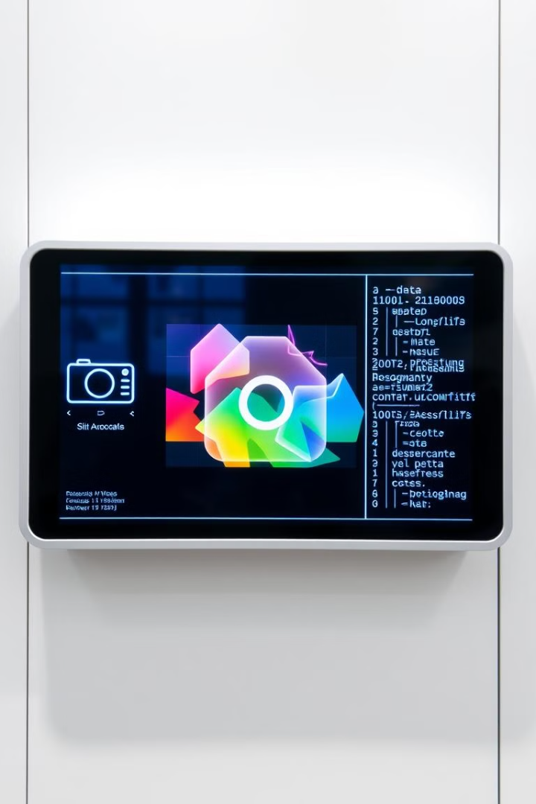



Basic Operations
Image Loading
Read images from various formats using OpenCV functions.
Image Display
Present images on the screen using OpenCV windows or displays.
Image Saving
Store processed images in different formats for later use.
Notes:
4

Slide 5


Image Transformations
Resizing
Rotating
Scale image dimensions up or down to adjust size.
Spin images by a specified angle.
Cropping
Extract regions of interest from images.
Notes:
5

Slide 6

Color Spaces
Color Space
Description
Use Cases
RGB
Represents colors based on red, green, and blue components.
Commonly used for displaying images.
Grayscale
Represents colors based on intensity from black to white.
Useful for simplifying images and highlighting edges.
HSV
Represents colors based on hue, saturation, and value.
Effective for color segmentation and object tracking.
Notes:
6

Slide 7




Edge Detection
Canny Edge Detection
A popular algorithm for finding edges based on gradient changes.
Gradient Analysis
Edges are detected where the image's intensity changes sharply.
Thresholding
Filtering out weak edges and preserving strong edges.
Notes:
7

Slide 8

Contours and Object Detection
Contour Detection
1
Identifying shapes and boundaries in an image.
Object Recognition
2
Analyzing contours to determine object types.
Application in Vision
3
Used in object tracking, motion analysis, and image segmentation.
Notes:
8

