Slide 1

Time Series Analysis with Python
This presentation explores the fundamentals of time series analysis using Python.
by Aravind K
Notes:
1

Slide 2


Introduction
Time series analysis involves understanding and forecasting data indexed over time.
1
Stock Price Prediction
2
Weather Analysis
Analyze historical stock prices to predict future movements.
Forecast weather patterns based on historical data.
3
Demand Forecasting
Predict future demand for products or services.
Notes:
2

Slide 3
Dataset Overview
A synthetic dataset representing monthly data from January 2020 to January 2023 was used.
Trends
Seasonality
Stationarity
The dataset exhibits clear upward and downward trends over time.
Seasonal patterns are evident, indicating recurring fluctuations.
Stationarity checks were performed to assess data stability.
Notes:
3

Slide 4
Key Steps in Analysis
1
Visualizing the Time Series
Plot the data to identify trends, seasonality, and outliers.
2
Decomposing into Trend, Seasonality, and Residuals
Separate the time series into its components for analysis.
3
Checking Stationarity
Assess whether the data has a constant mean and variance over time.
4
Analyzing ACF and PACF Plots
Identify the autocorrelation and partial autocorrelation of the data.
5
Forecasting with ARIMA
Use the ARIMA model to predict future values of the time series.
Notes:
4

Slide 5
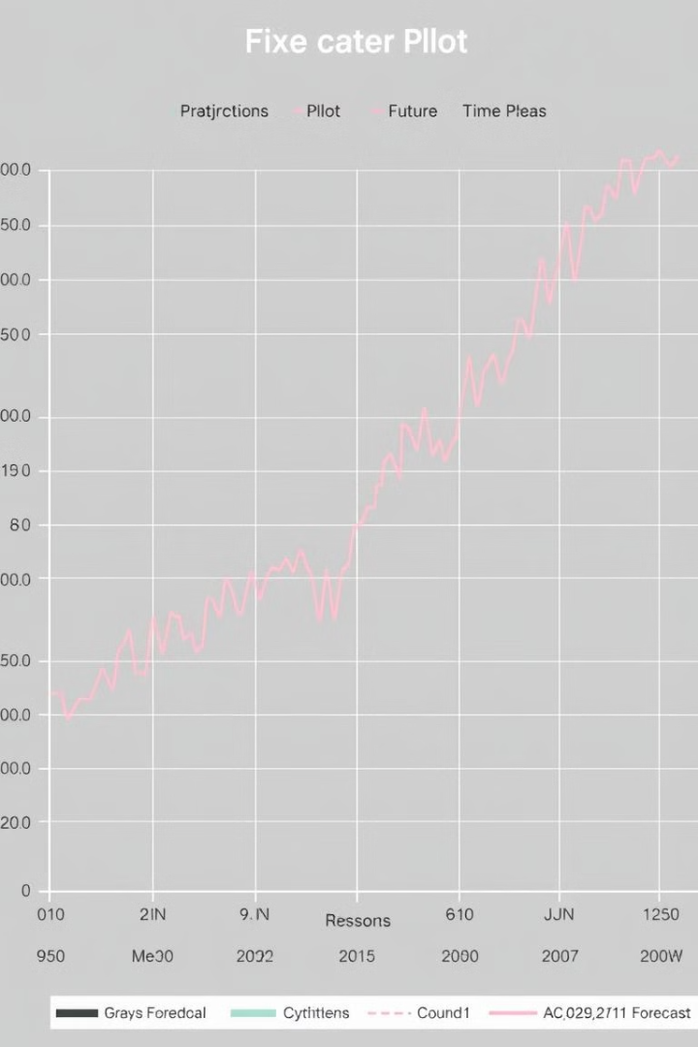
Results and Findings
The analysis revealed key insights about the dataset.
Trends
Seasonality
The data exhibits clear trends over time, indicating growth or decline.
Decomposition effectively separated seasonal effects from the data.
ARIMA Forecasts
The ARIMA model provided accurate forecasts for future values.
Notes:
5

Slide 6
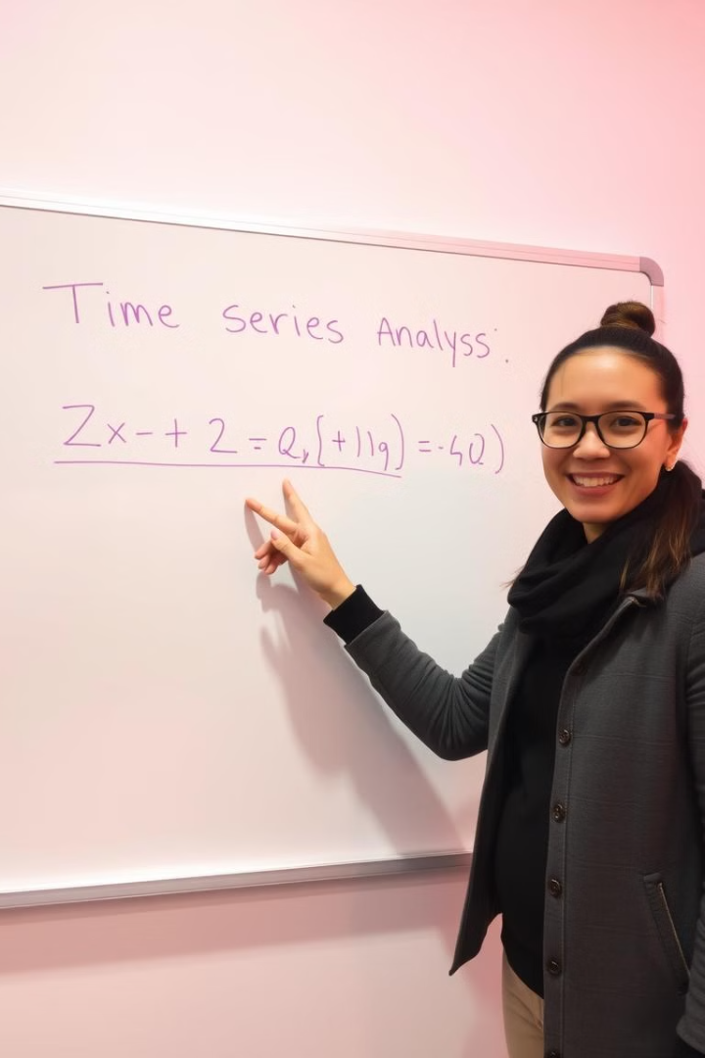
Thank You!
For more details, check out the Jupyter Notebook and stay tuned for Day 19!
Notes:
6

